Slide 1
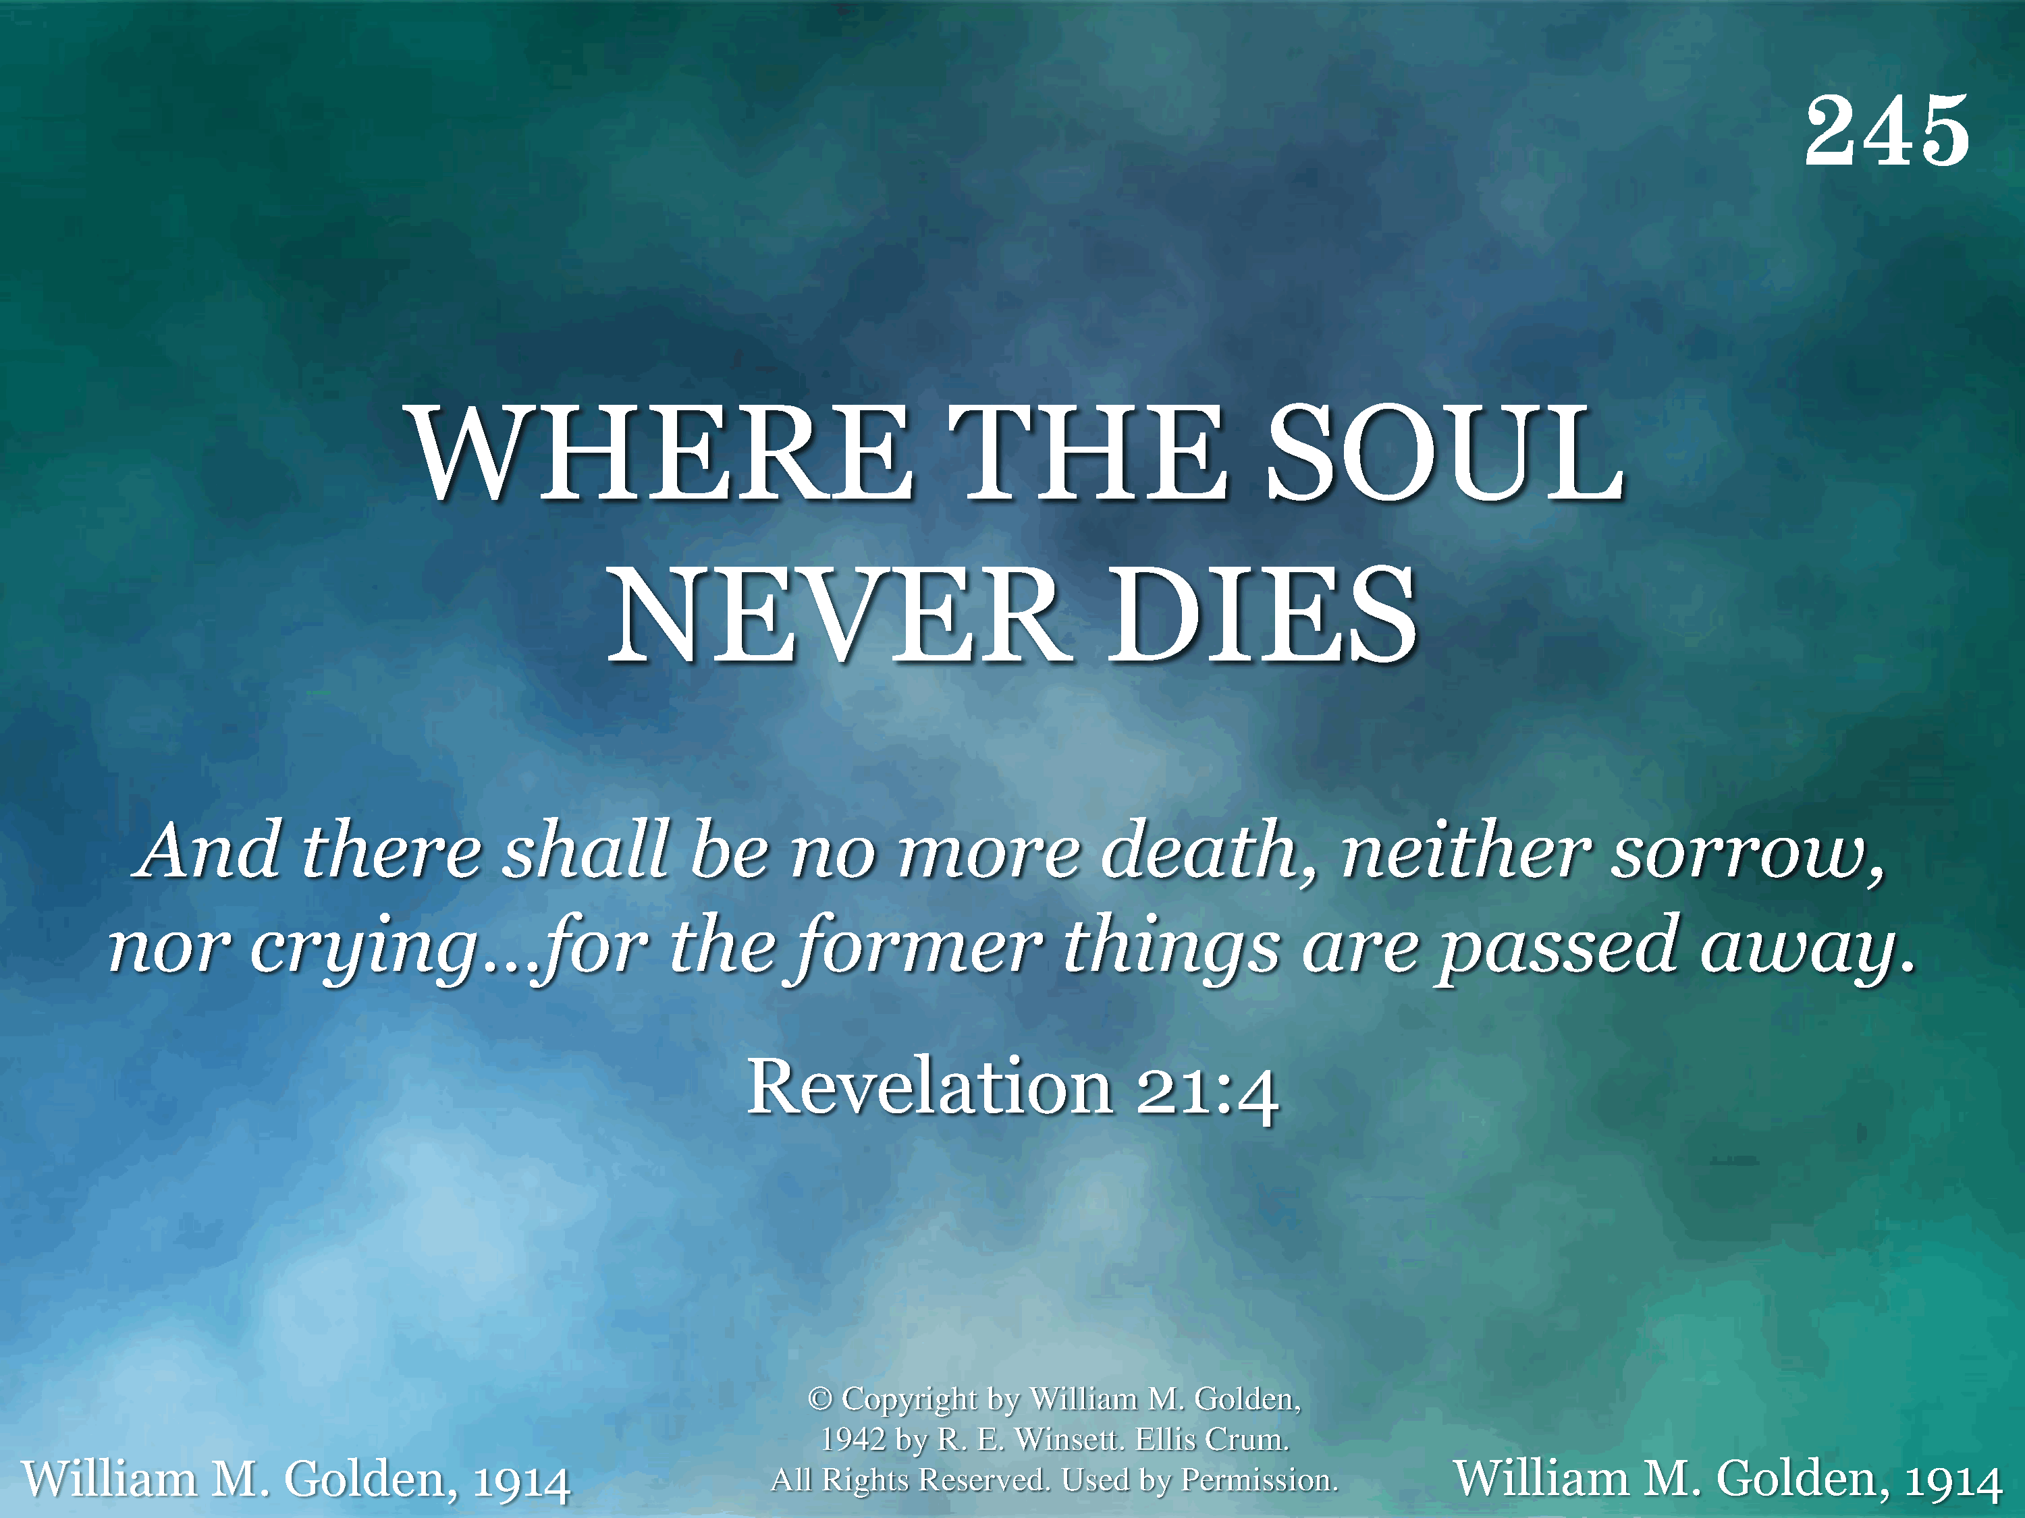
245 - Where The Soul Never Dies - Title

Slide 2
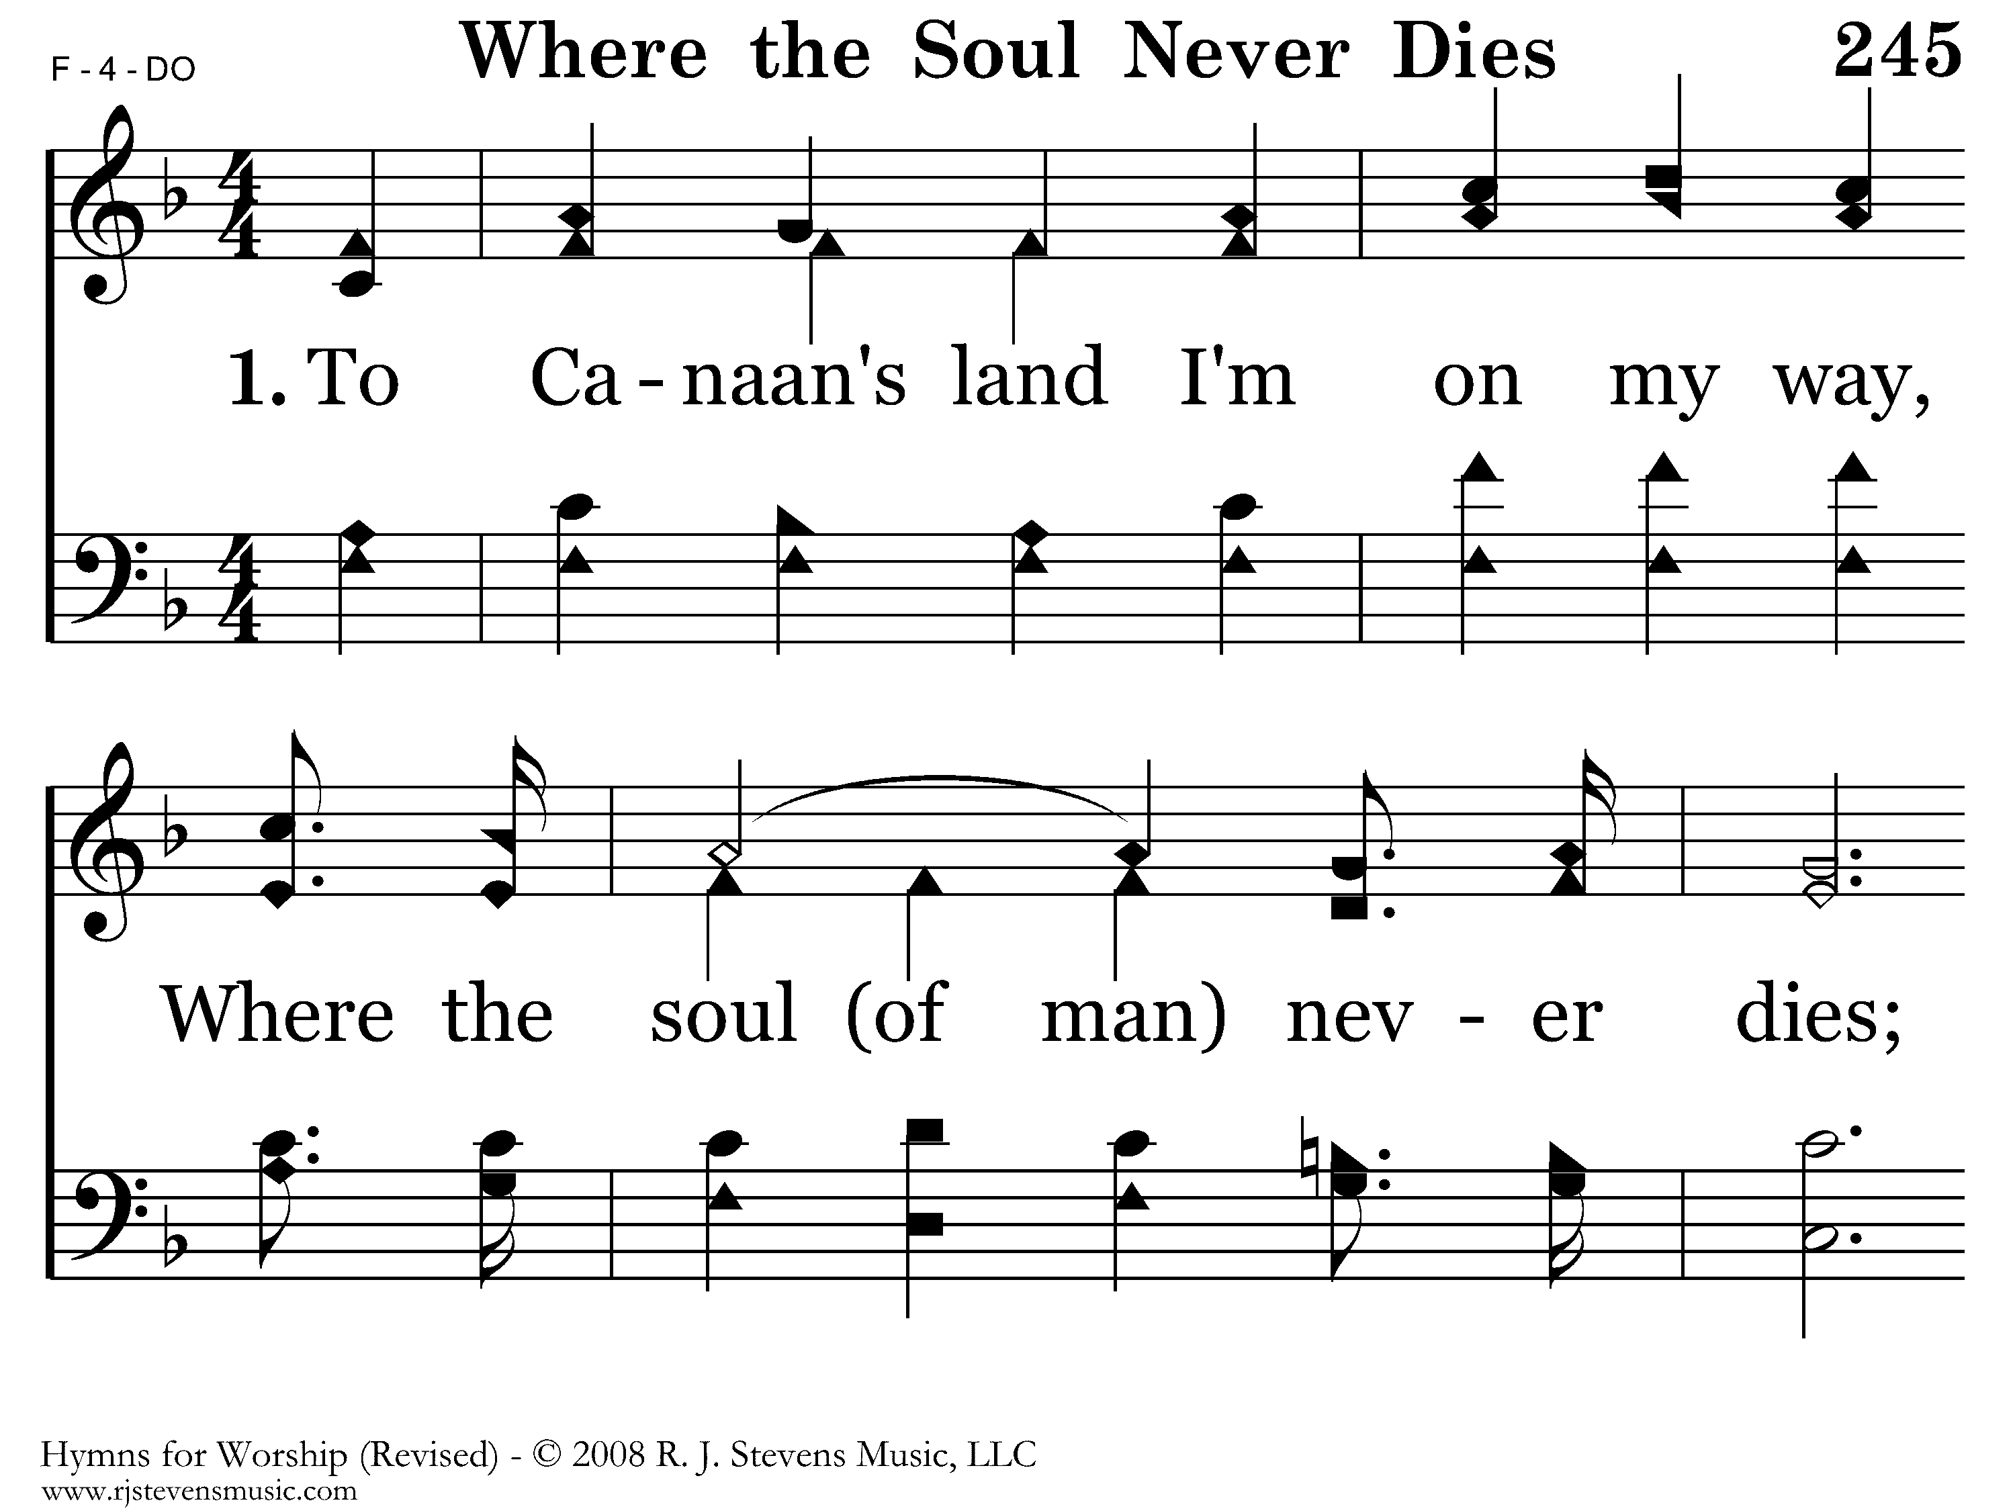
245 - Where The Soul Never Dies - 1.1

Slide 3
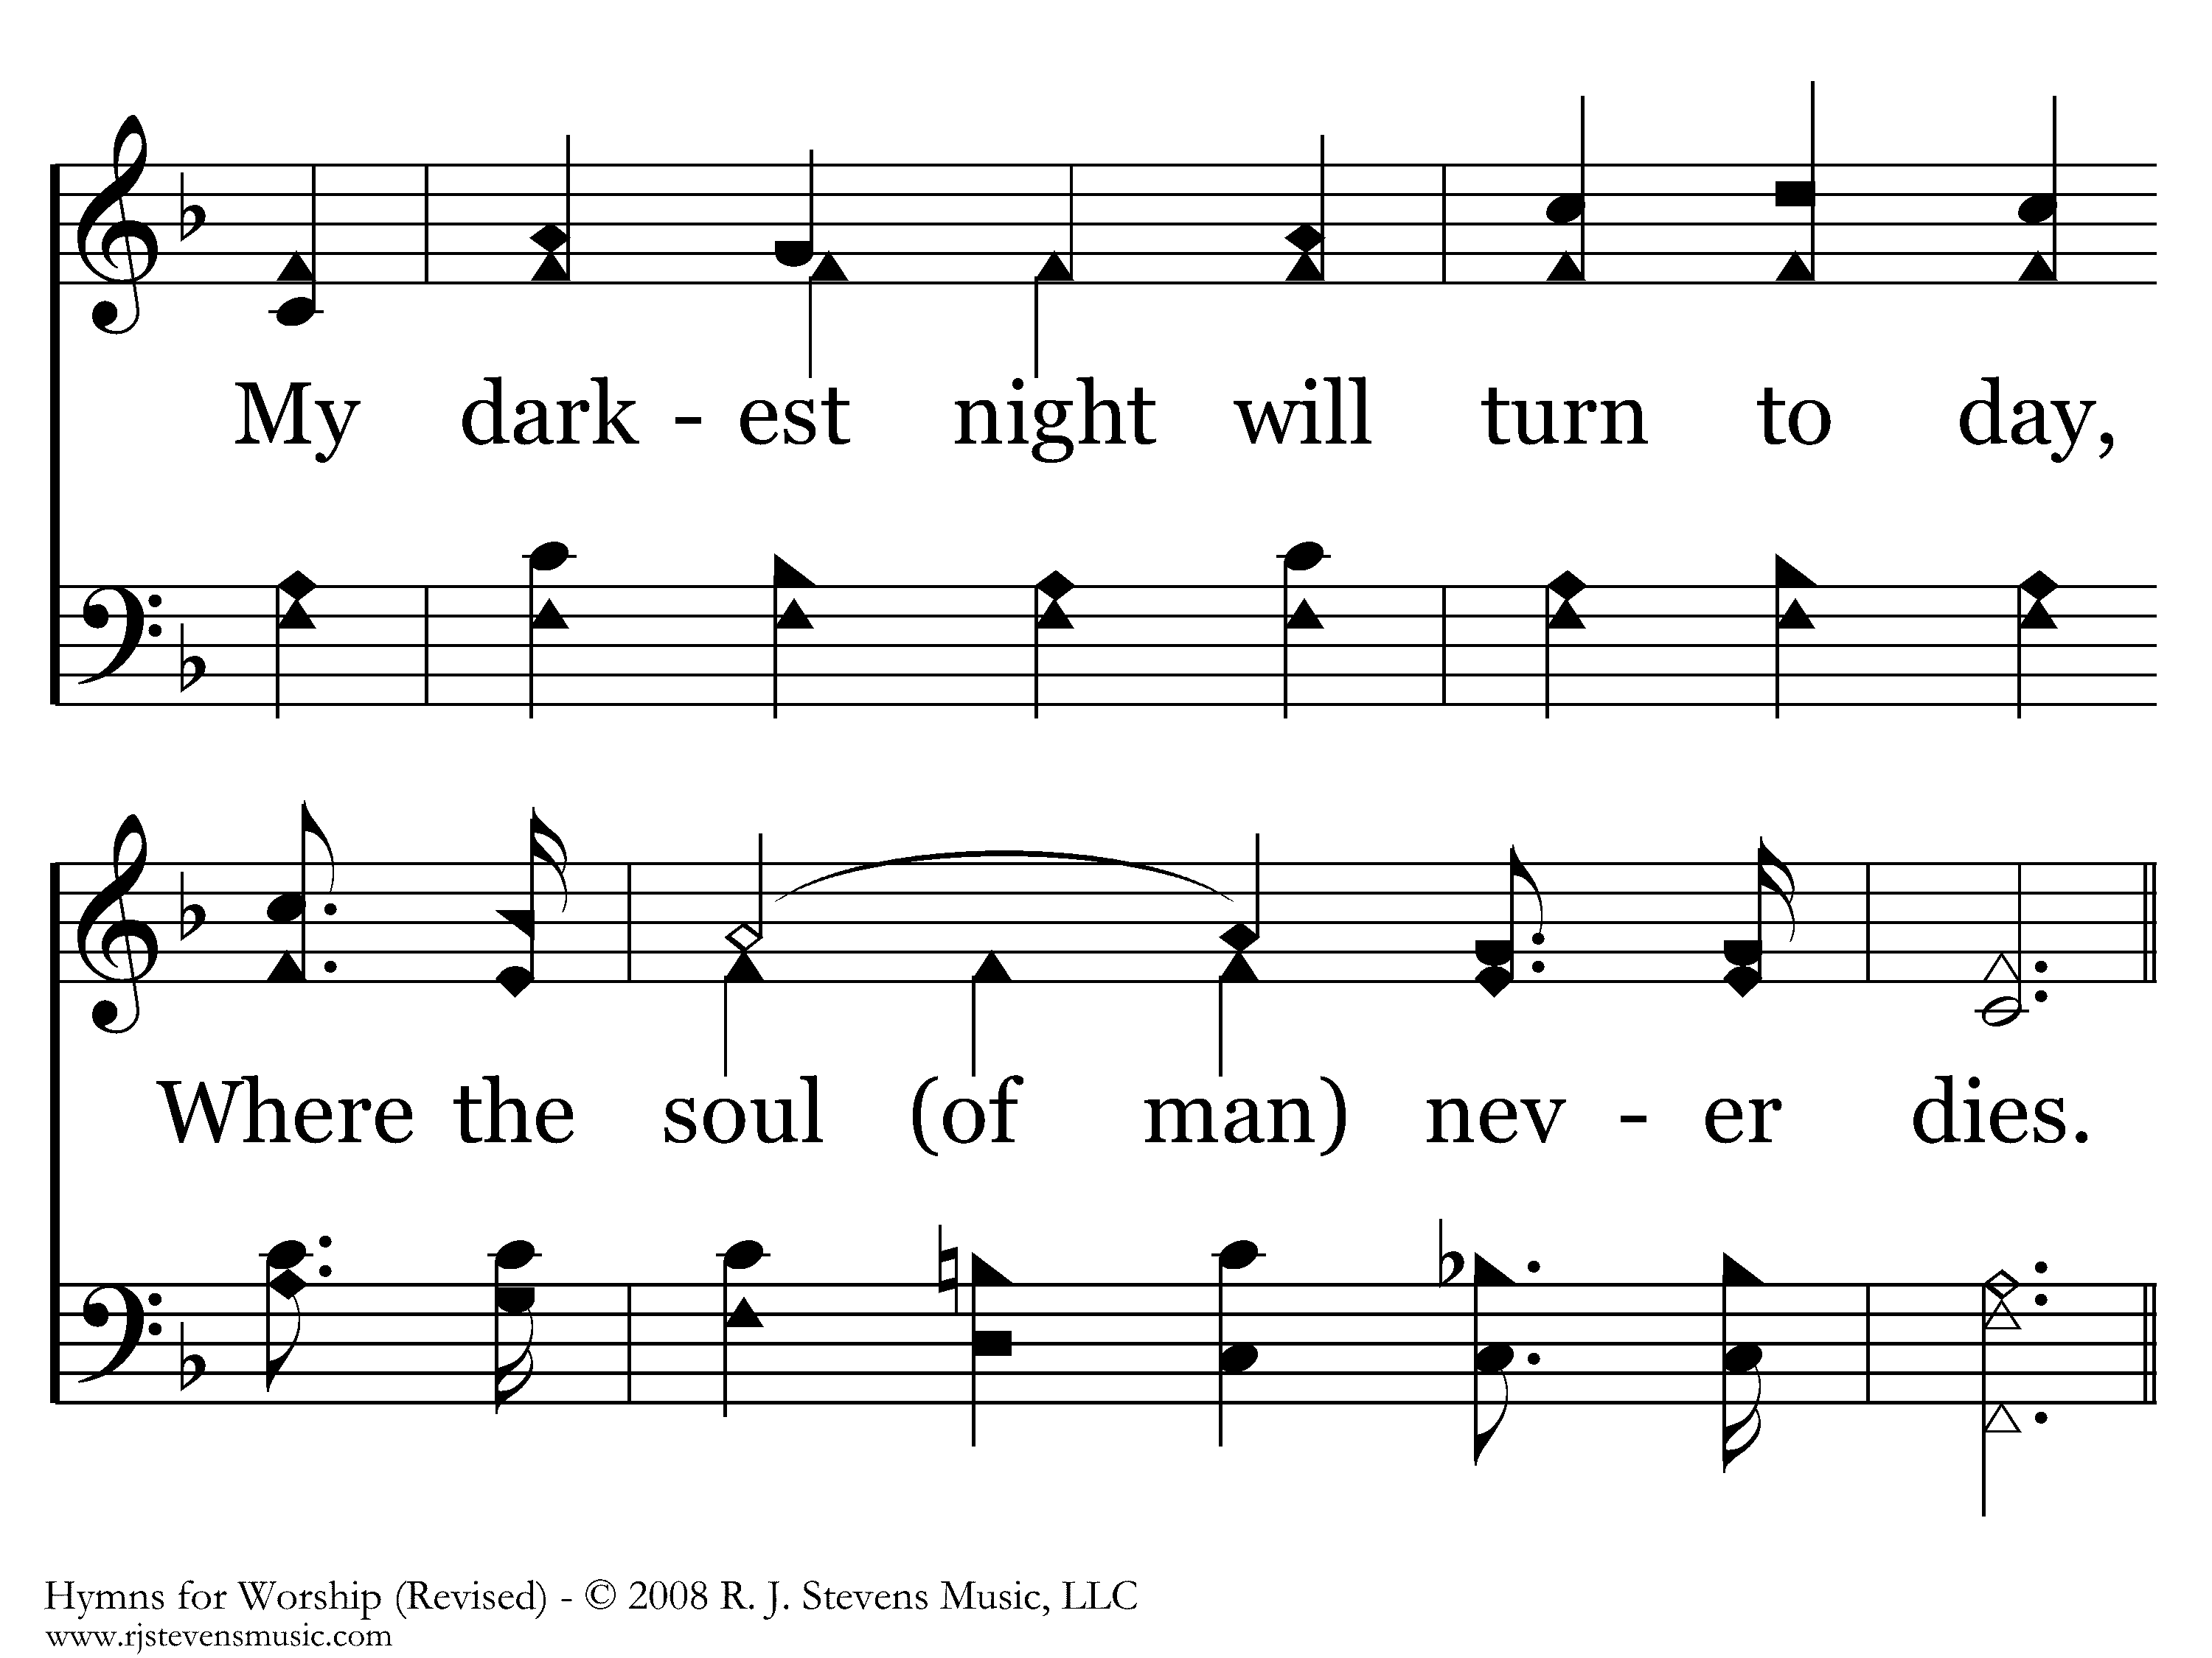
245 - Where The Soul Never Dies - 1.2

Slide 4
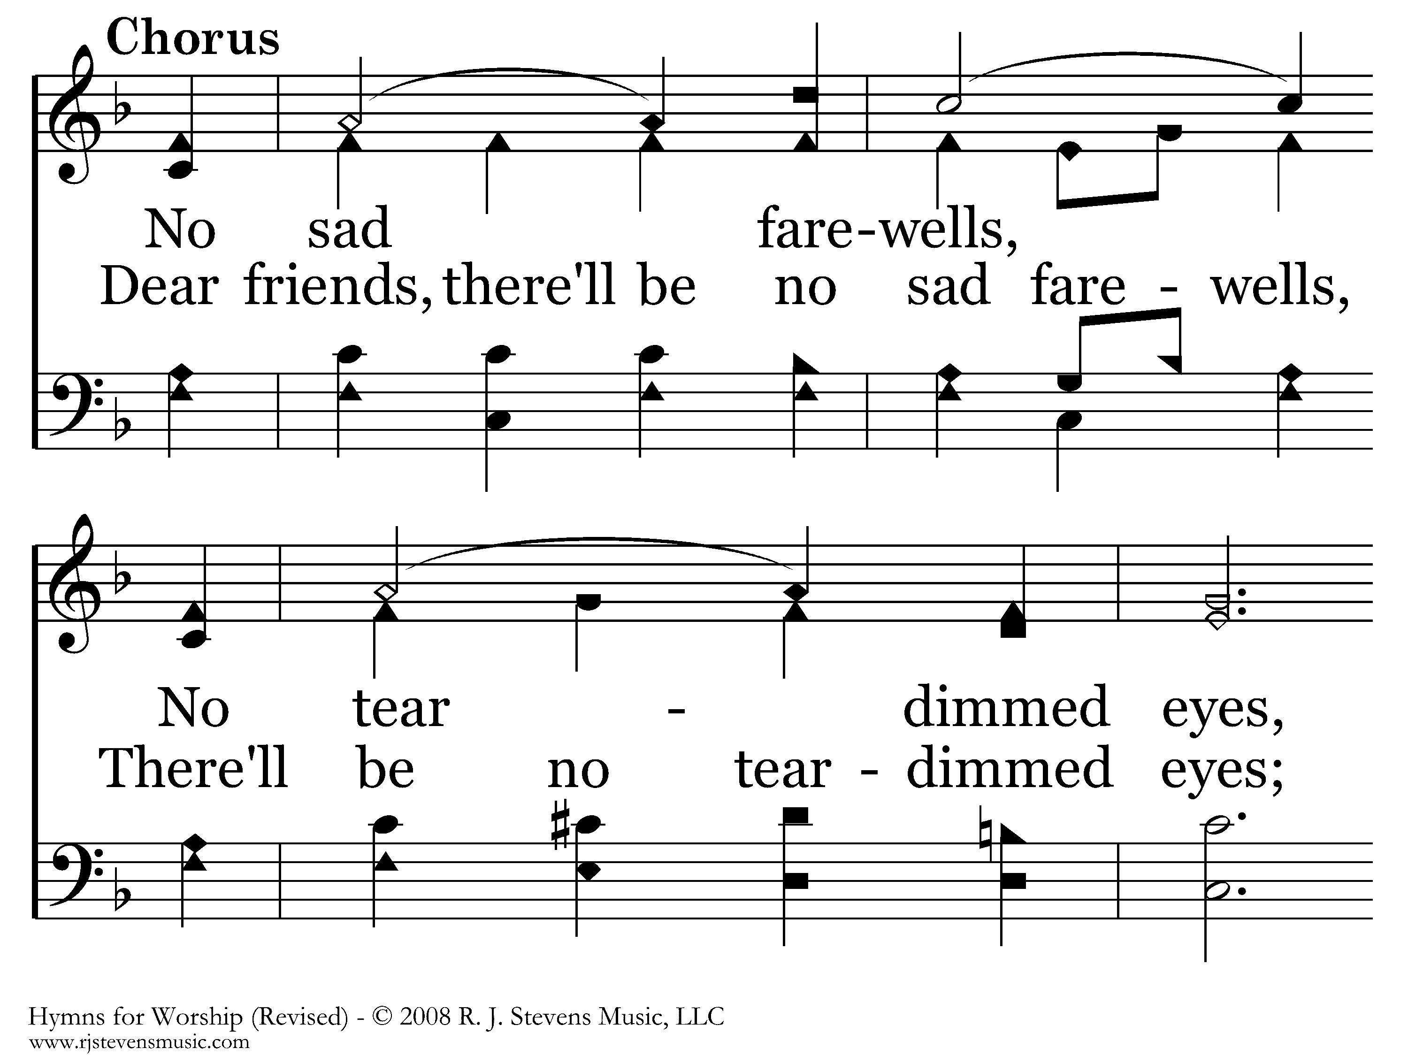
245 - Where The Soul Never Dies - C.1

Slide 5
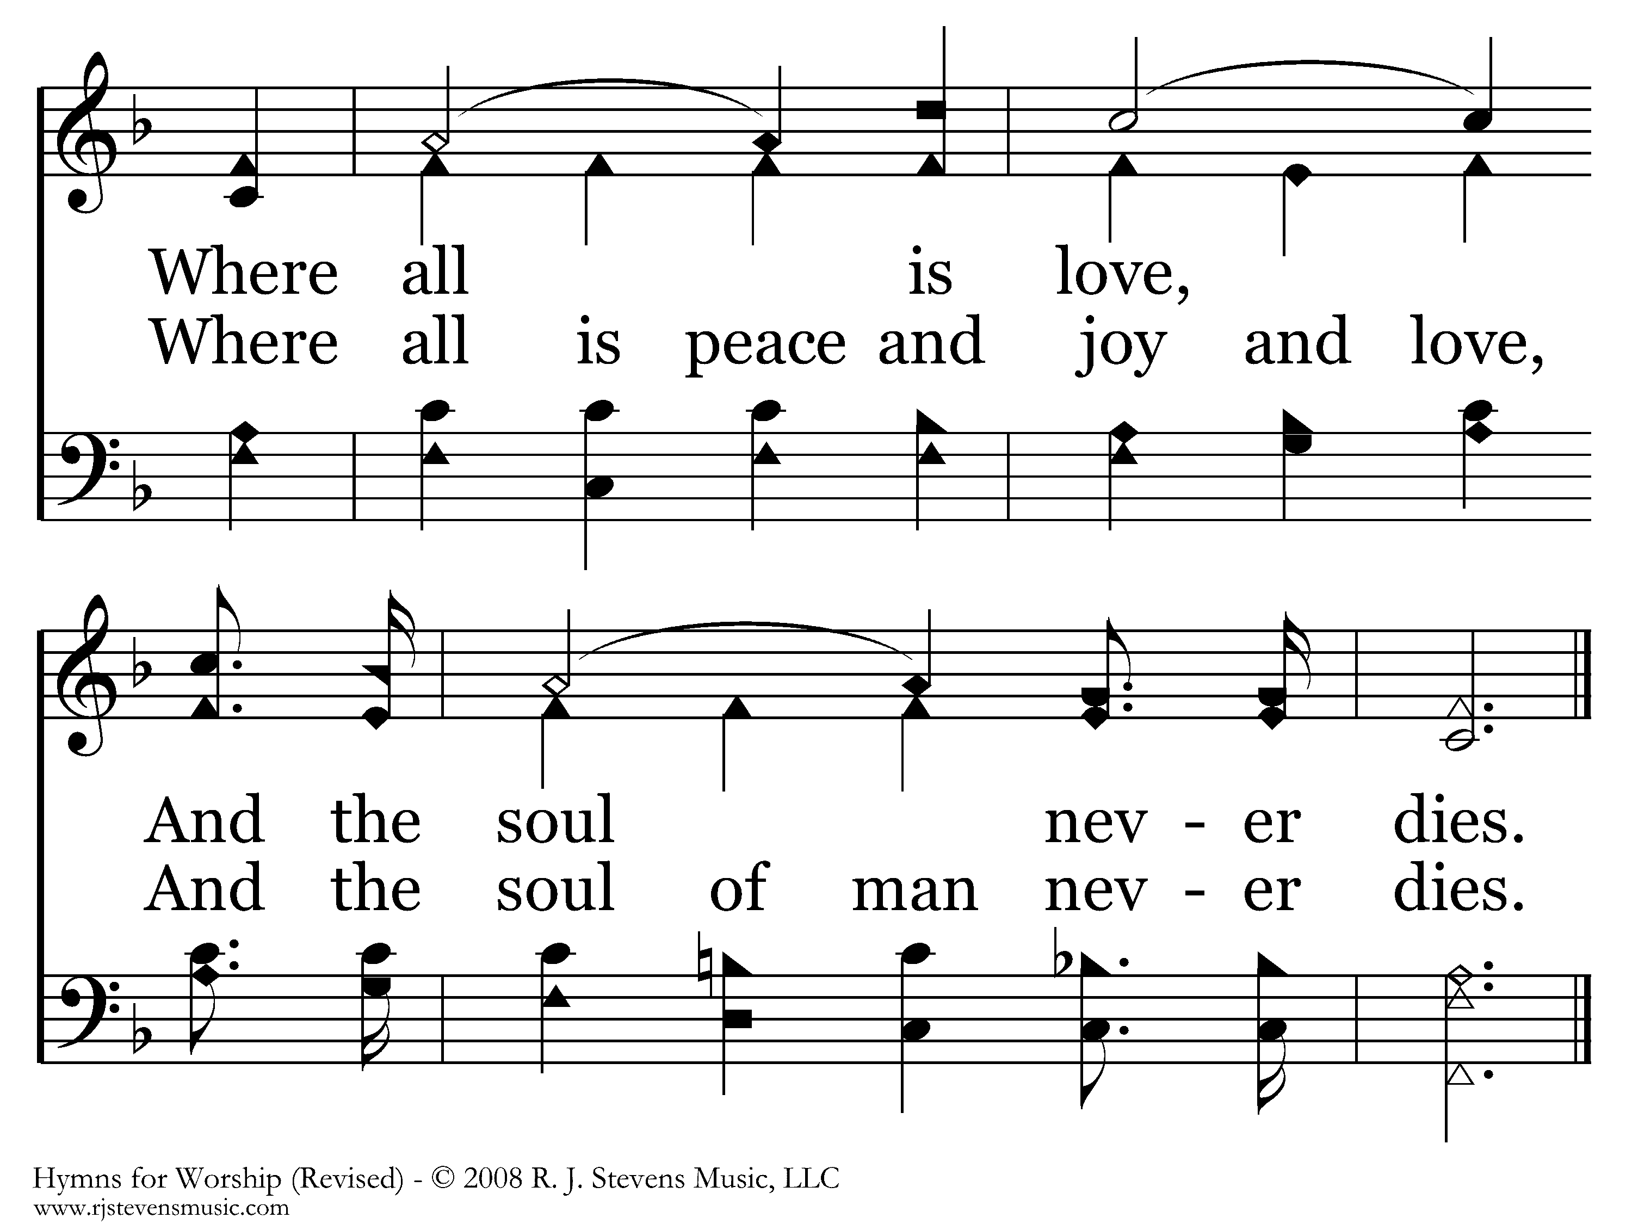
245 - Where The Soul Never Dies - C.2
End of Verse 1

Slide 6
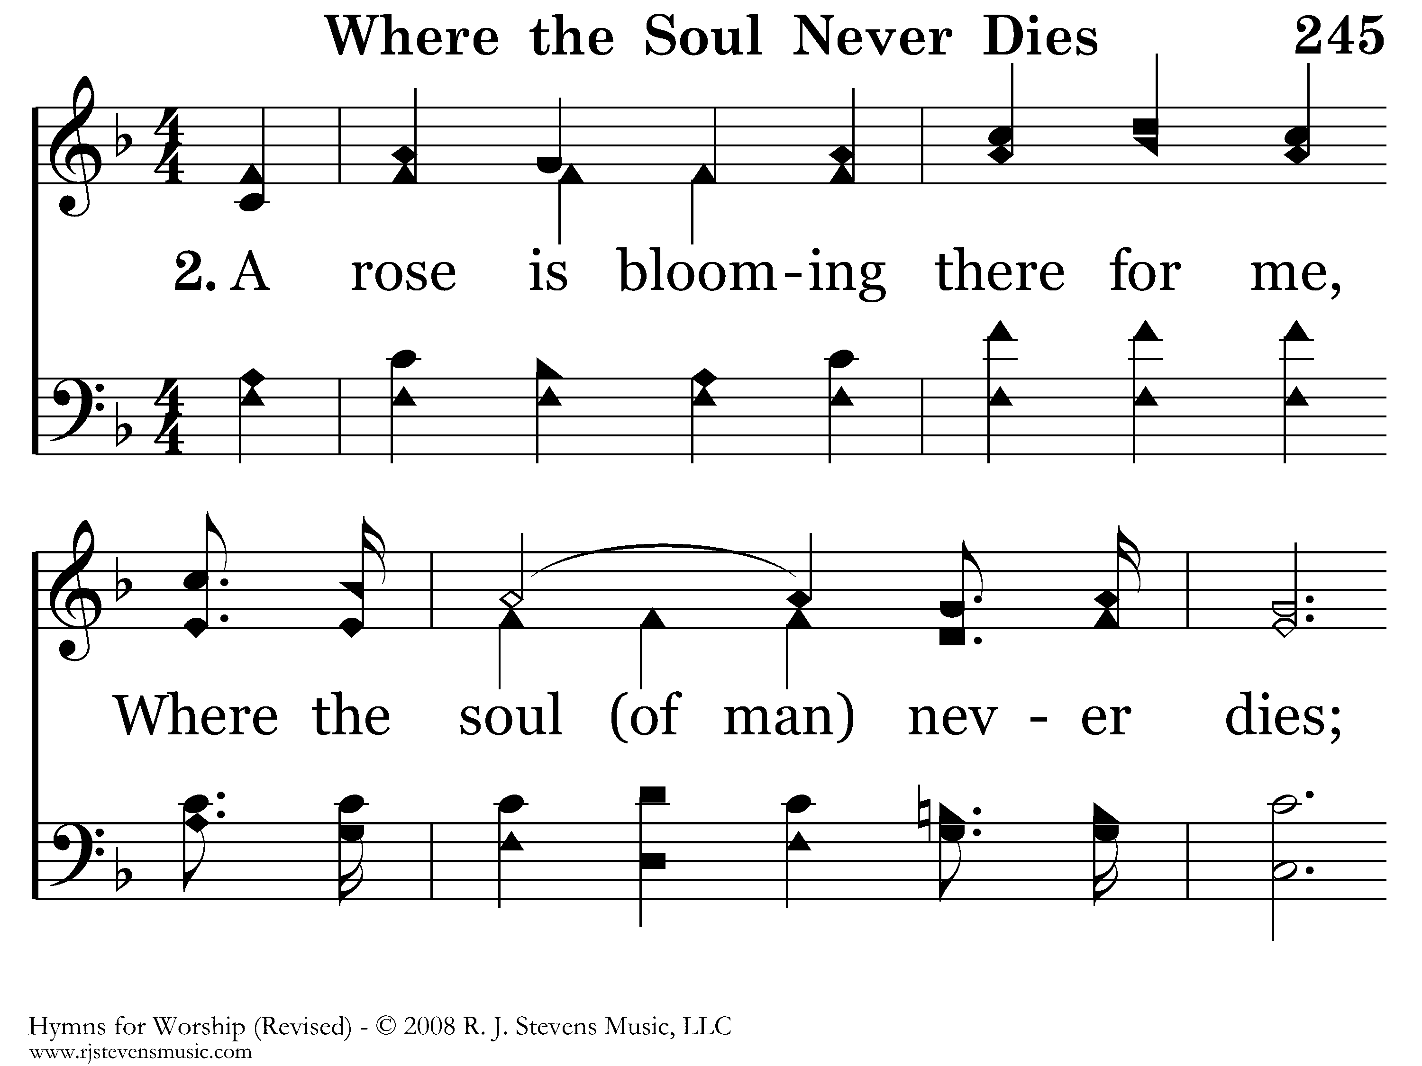
245 - Where The Soul Never Dies - 2.1

Slide 7
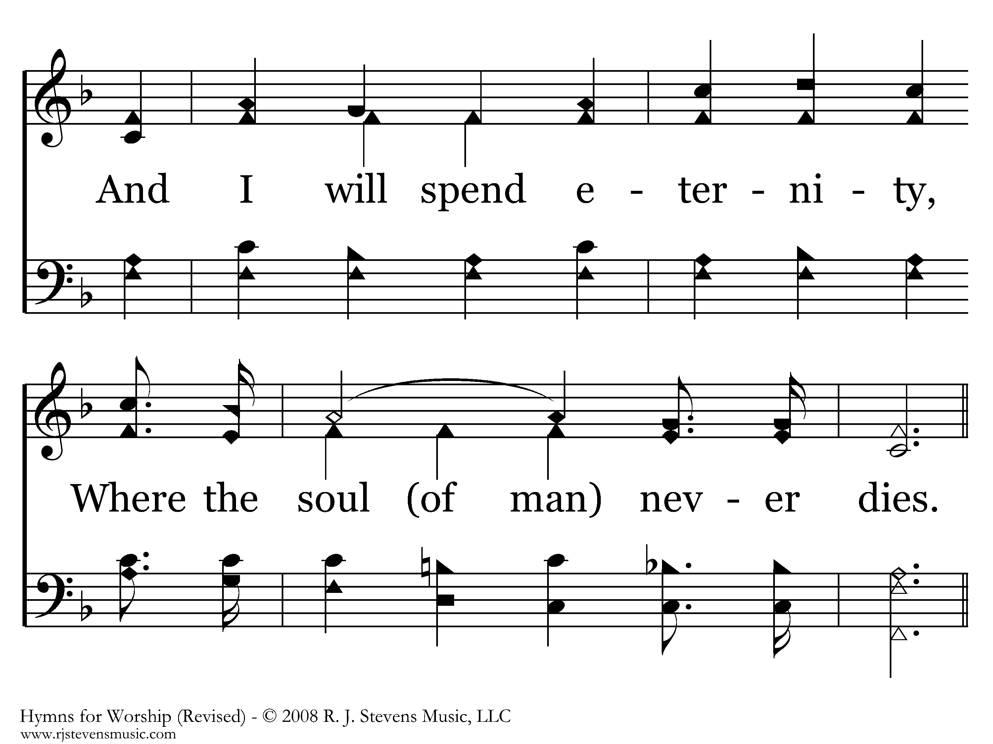
245 - Where The Soul Never Dies - 2.2

Slide 8
245 - Where The Soul Never Dies - C.1

Slide 9
245 - Where The Soul Never Dies - C.2
End of Verse 2

Slide 10
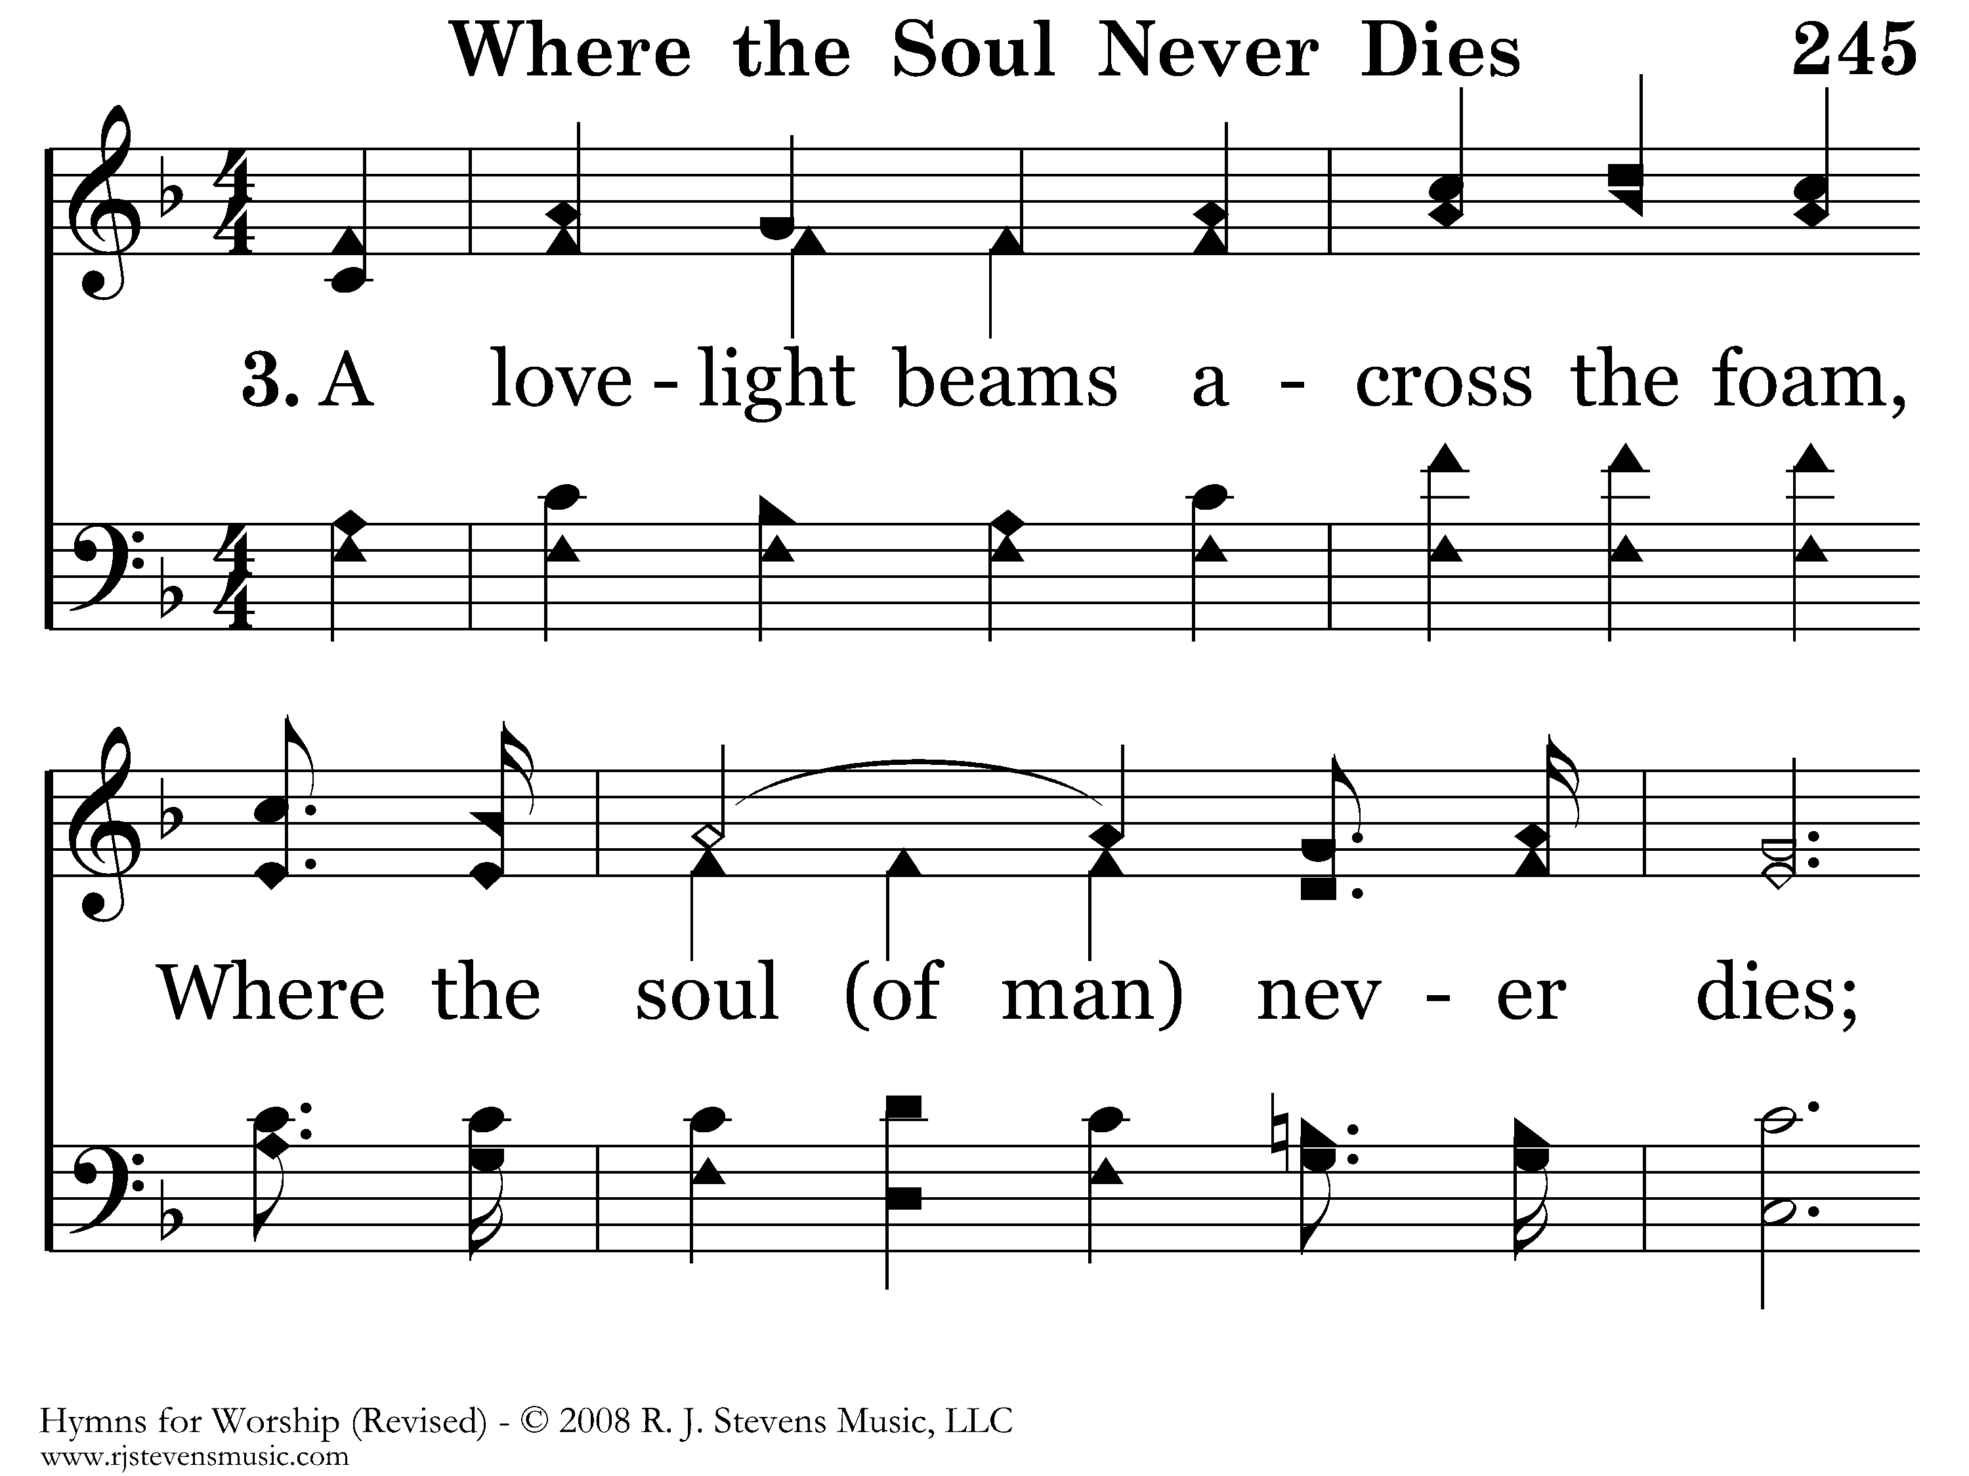
245 - Where The Soul Never Dies - 3.1

Slide 11
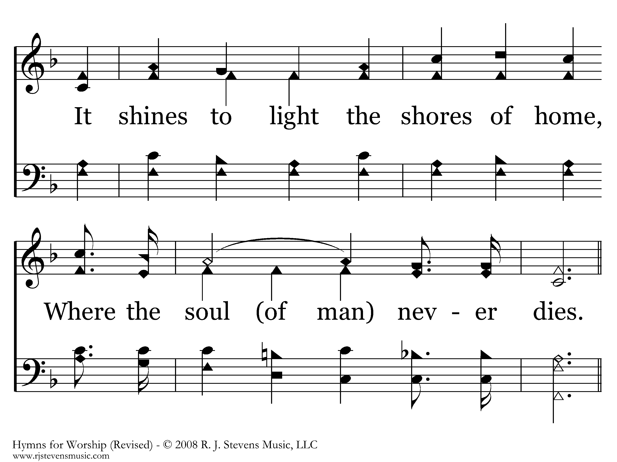
245 - Where The Soul Never Dies - 3.2

Slide 12
245 - Where The Soul Never Dies - C.1

Slide 13
245 - Where The Soul Never Dies - C.2
End of Verse 3

Slide 14
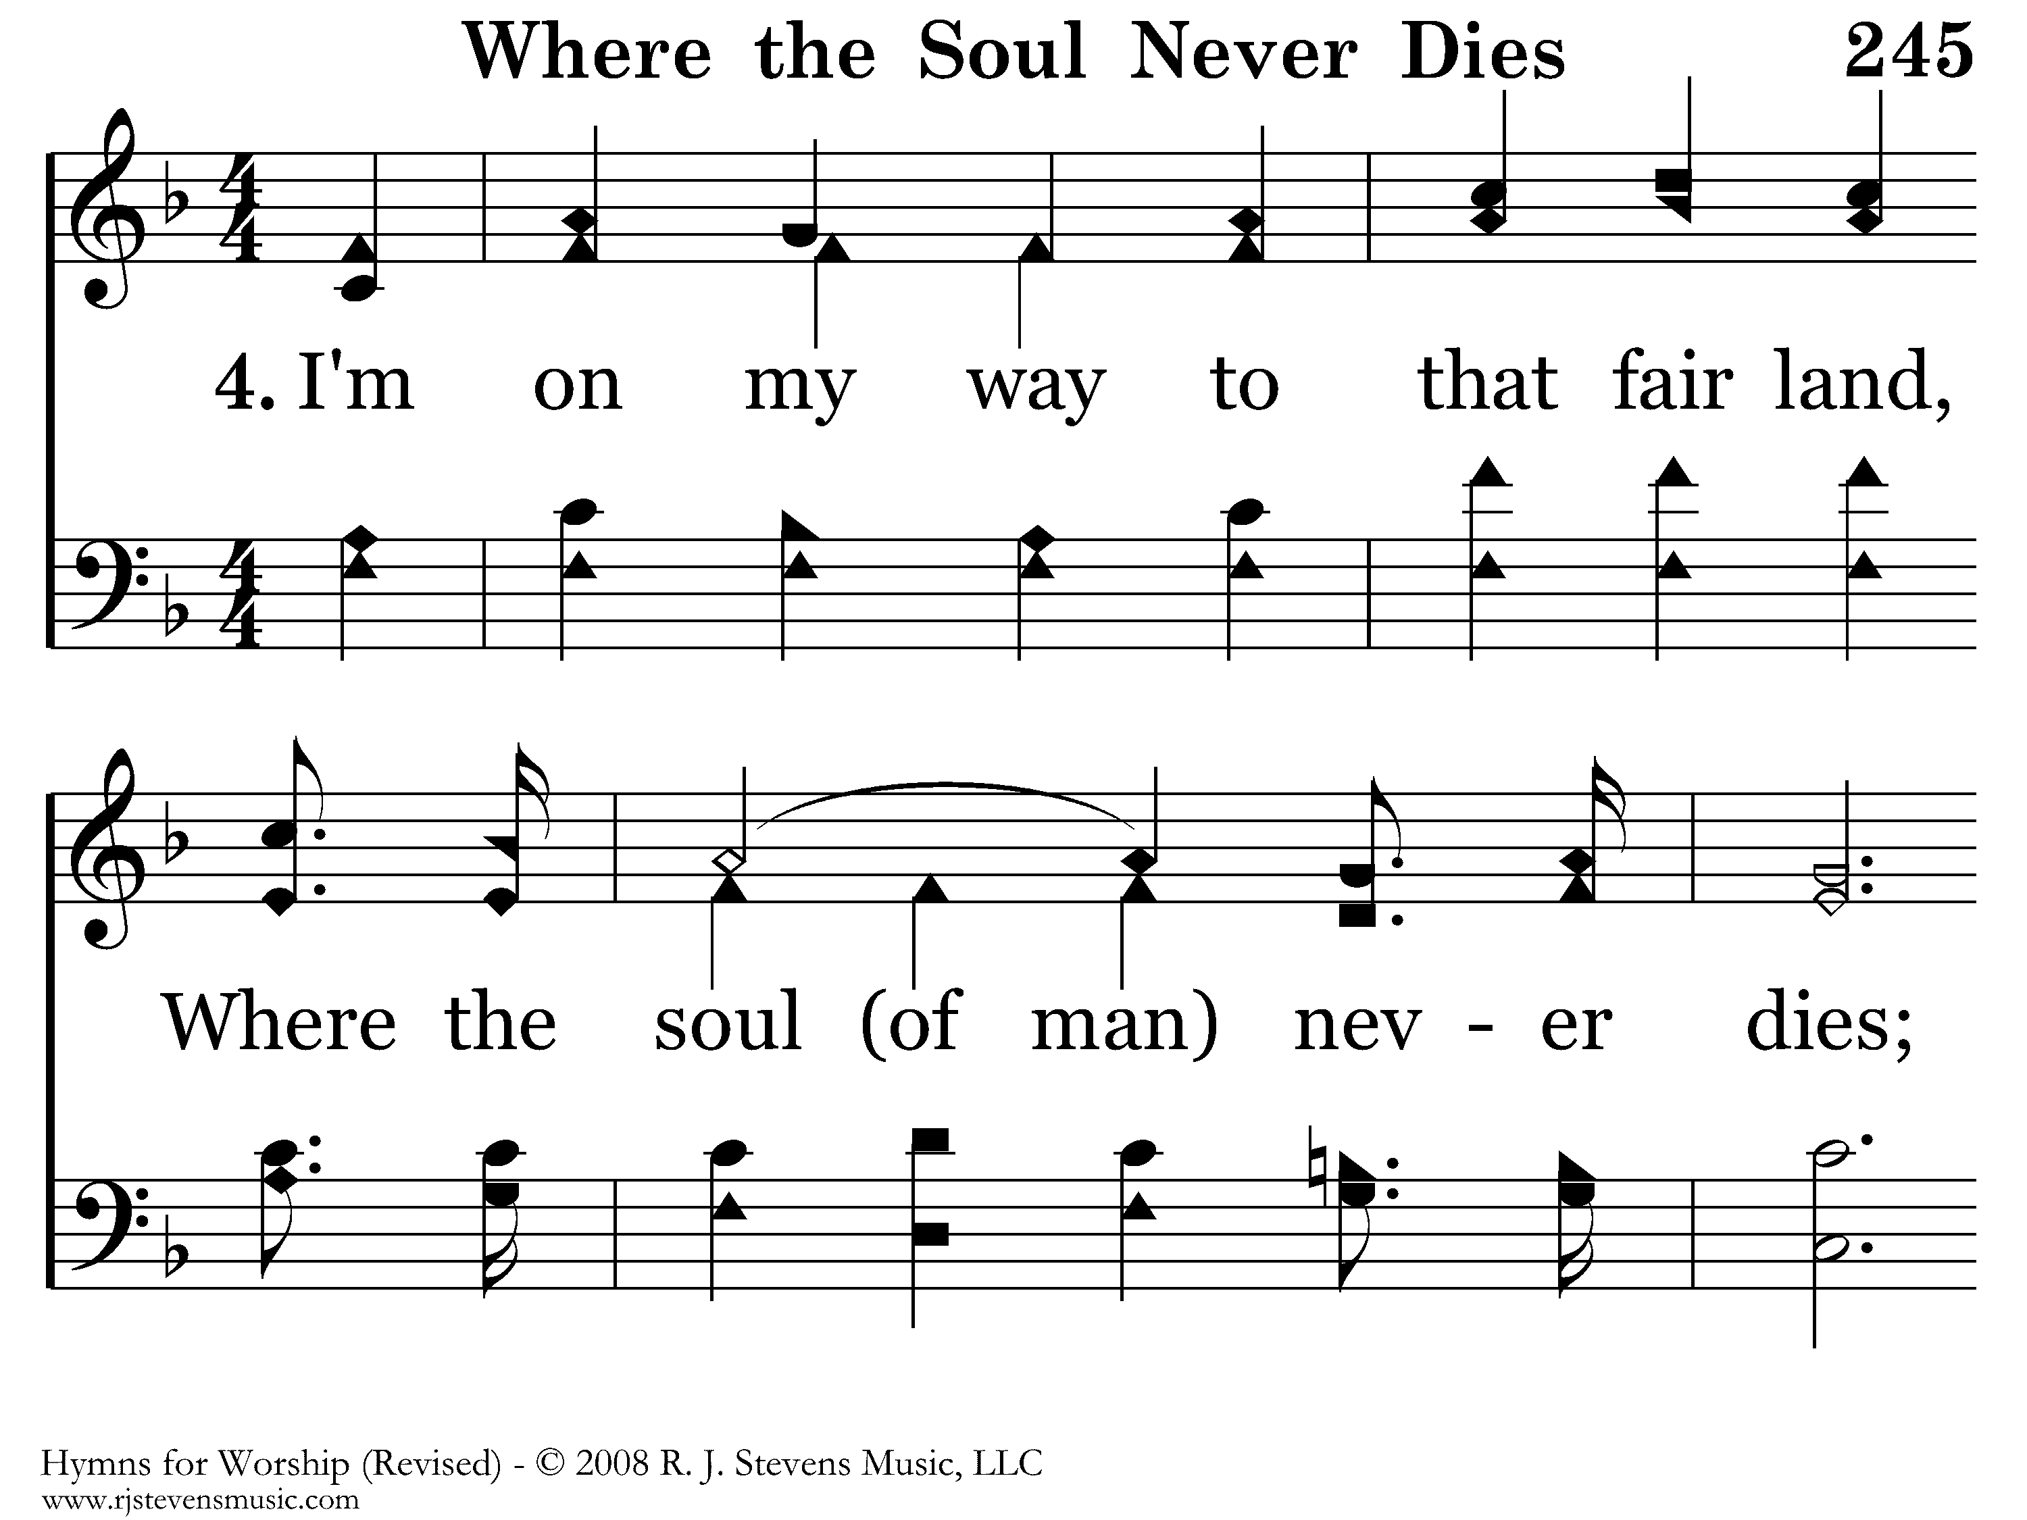
245 - Where The Soul Never Dies - 4.1

Slide 15
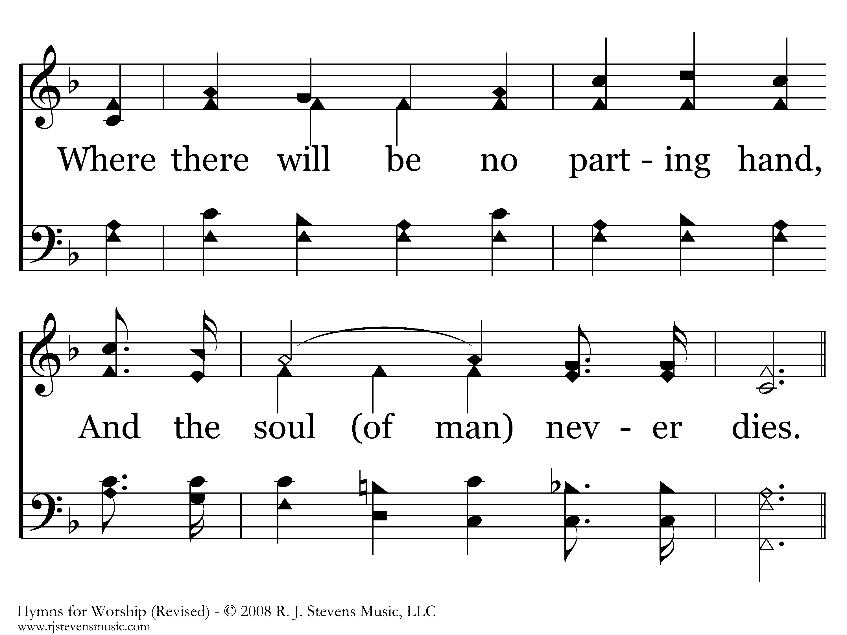
245 - Where The Soul Never Dies - 4.2

Slide 16
245 - Where The Soul Never Dies - C.1

Slide 17
245 - Where The Soul Never Dies - C.2
End of Song

Slide 18
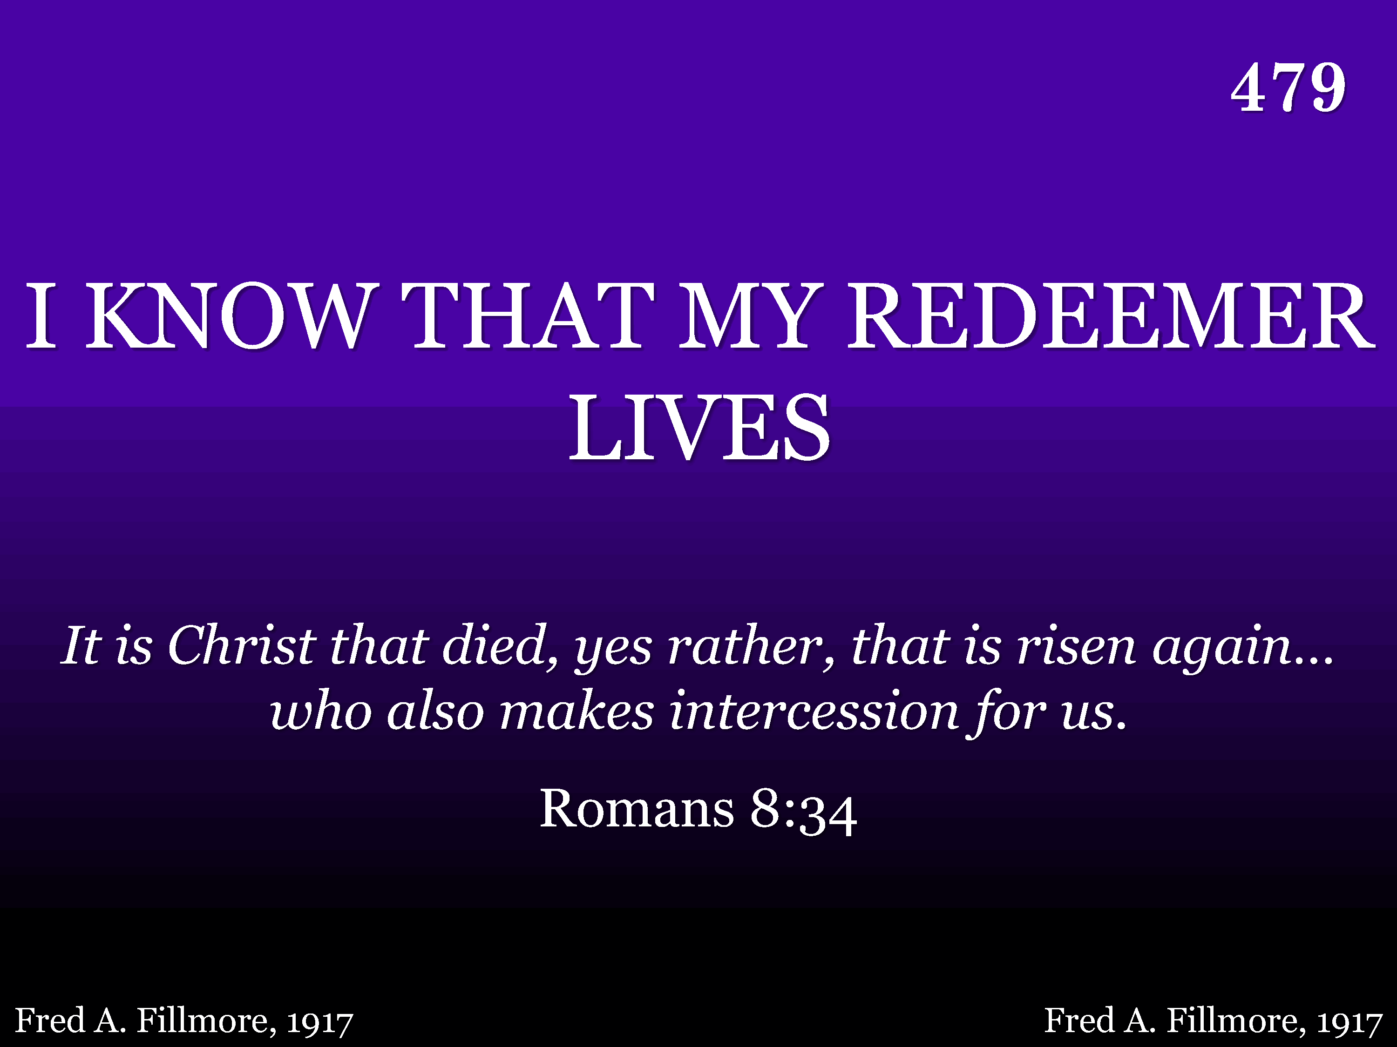
479 - I Know That My Redeemer Lives - Title

Slide 19
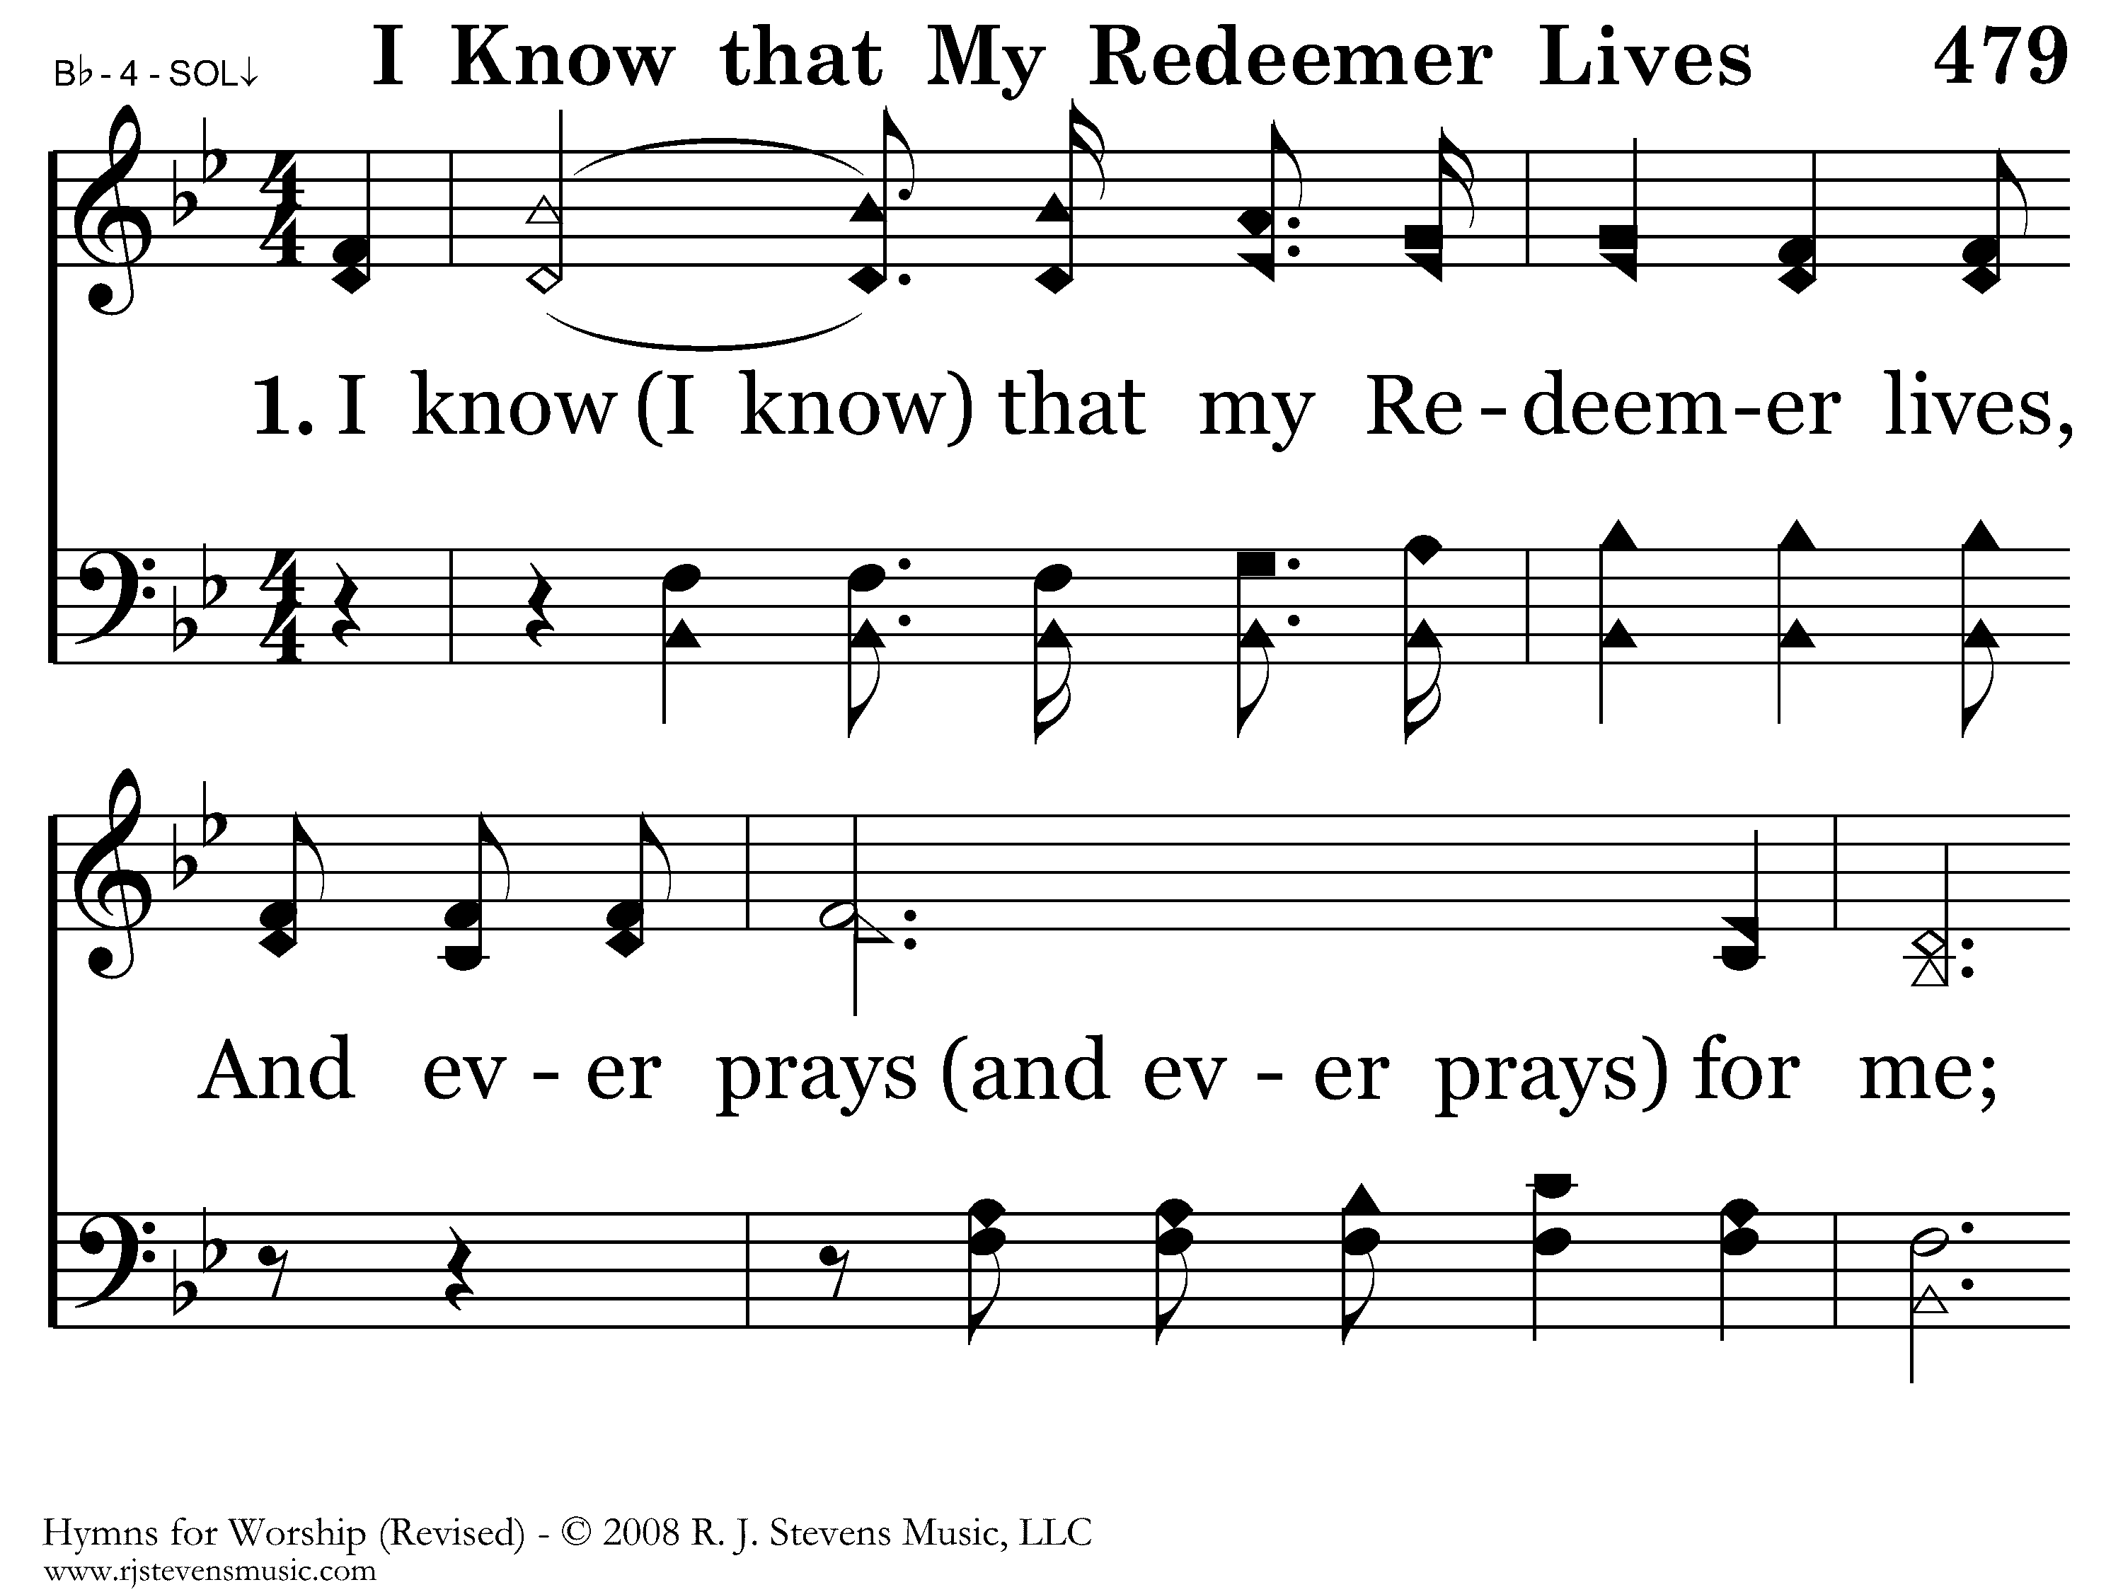
479 - I Know That My Redeemer Lives - 1.1

Slide 20
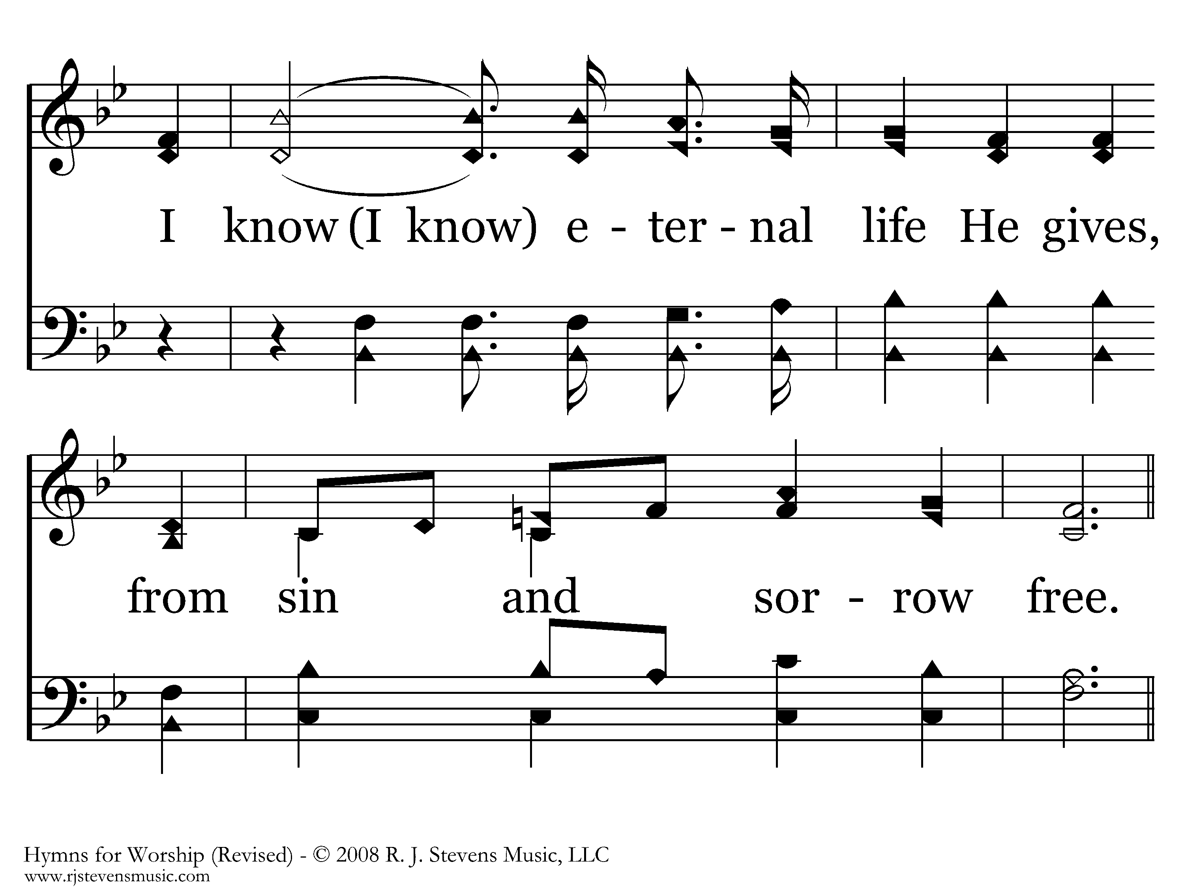
479 - I Know That My Redeemer Lives - 1.2

Slide 21
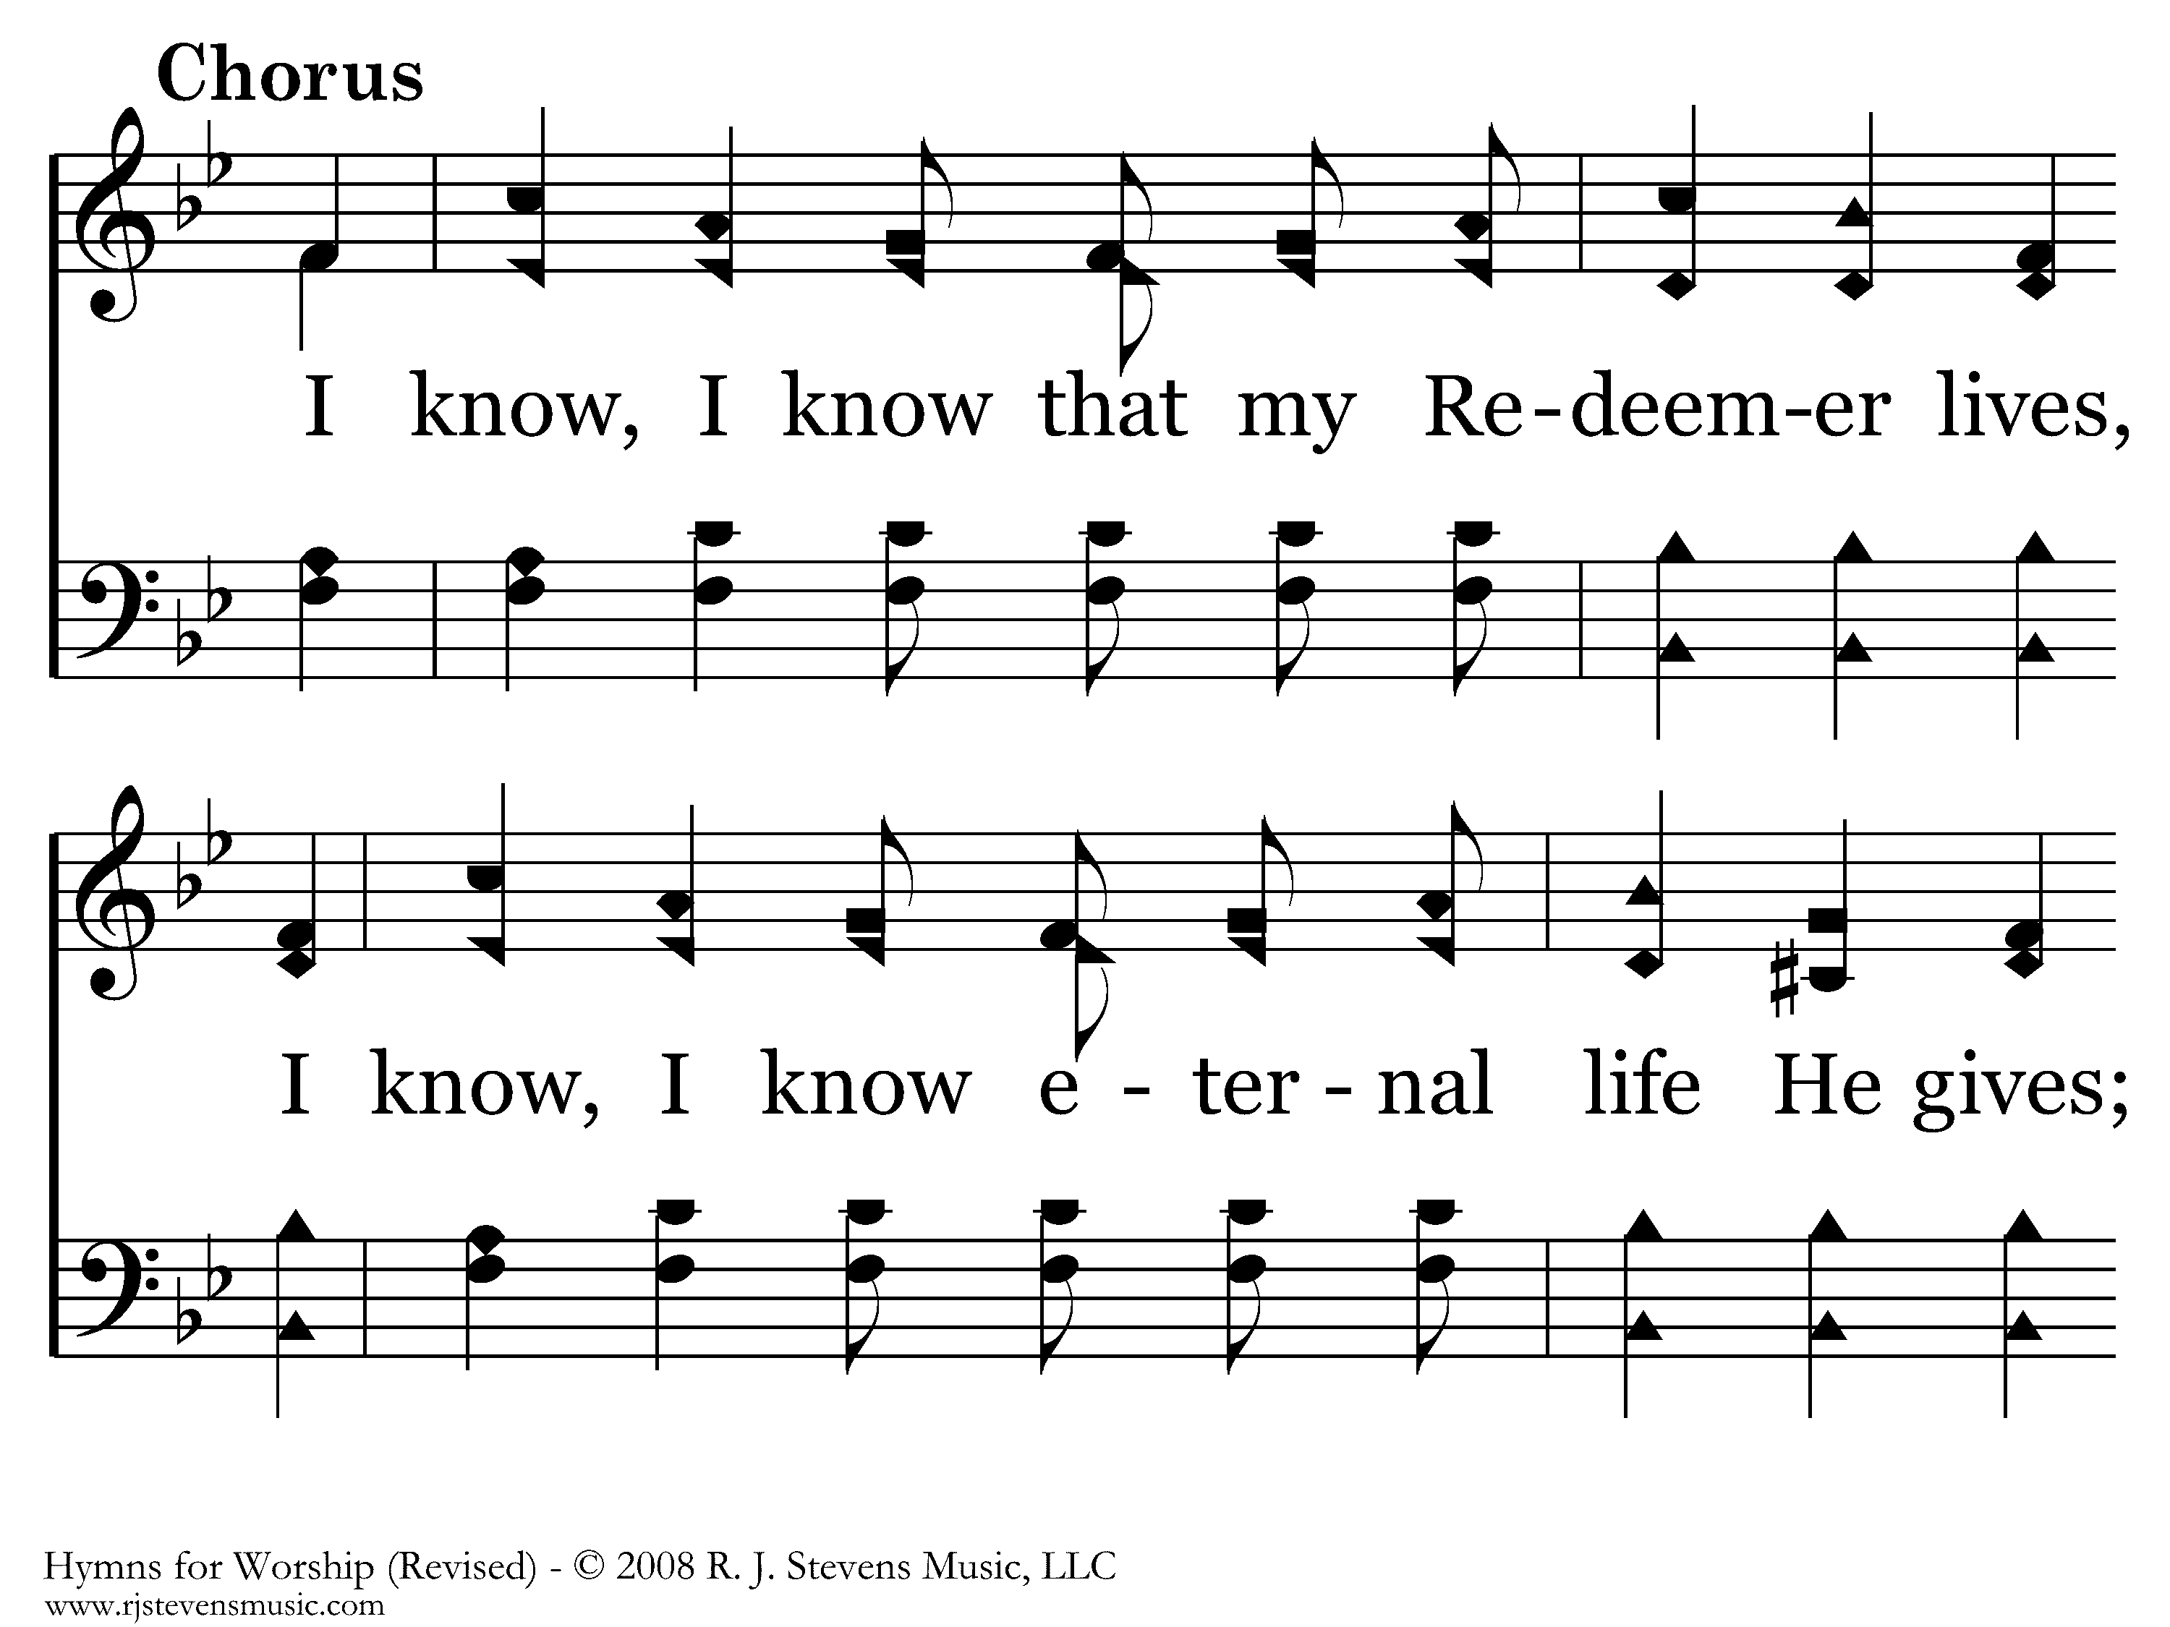
479 - I Know That My Redeemer Lives - C.1

Slide 22
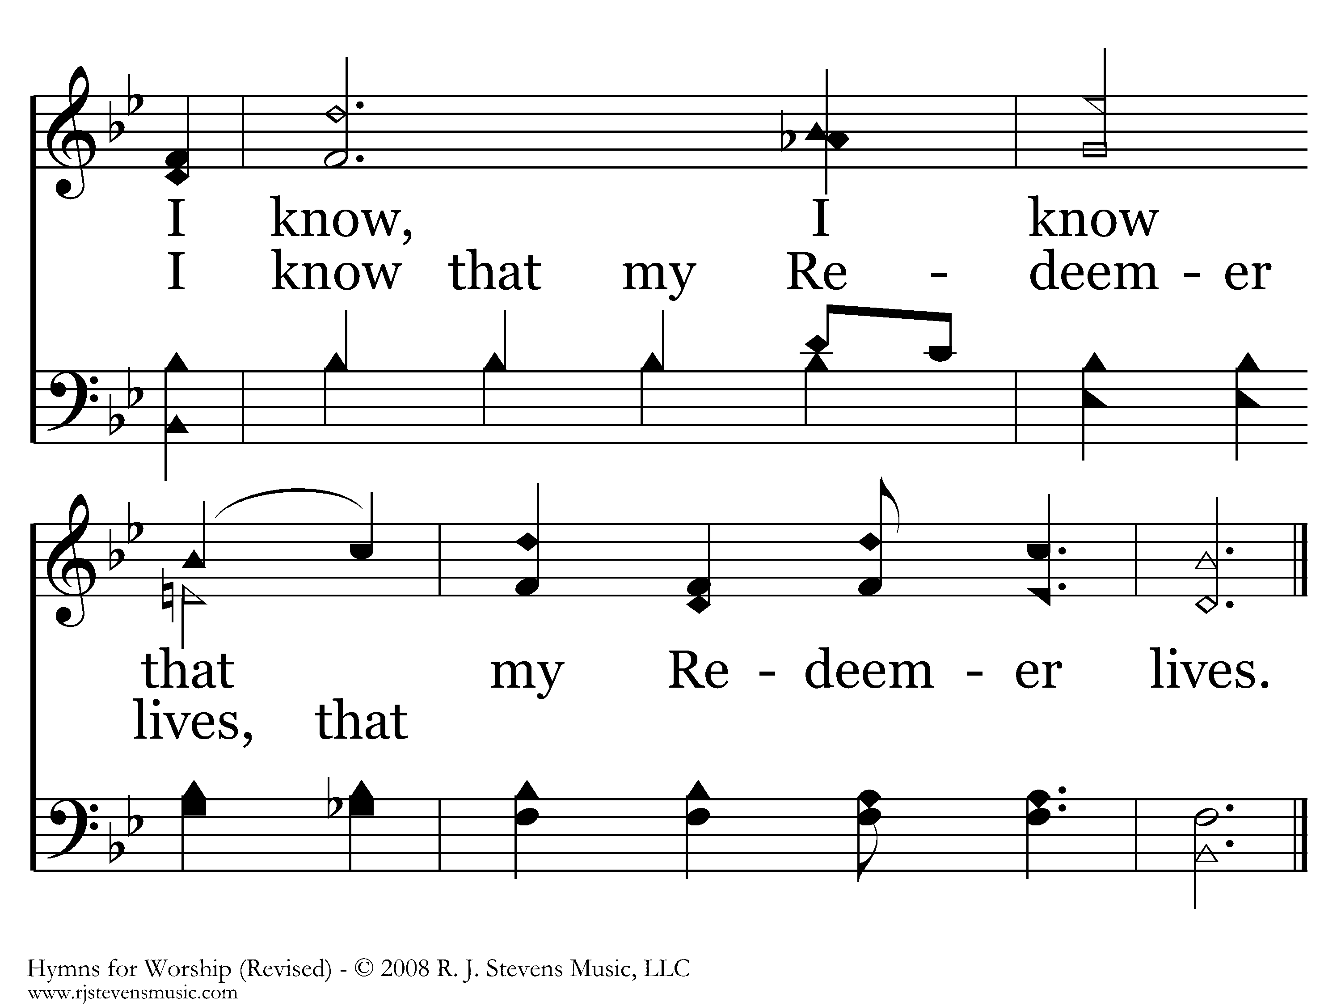
479 - I Know That My Redeemer Lives - C.2
End of Verse 1

Slide 23
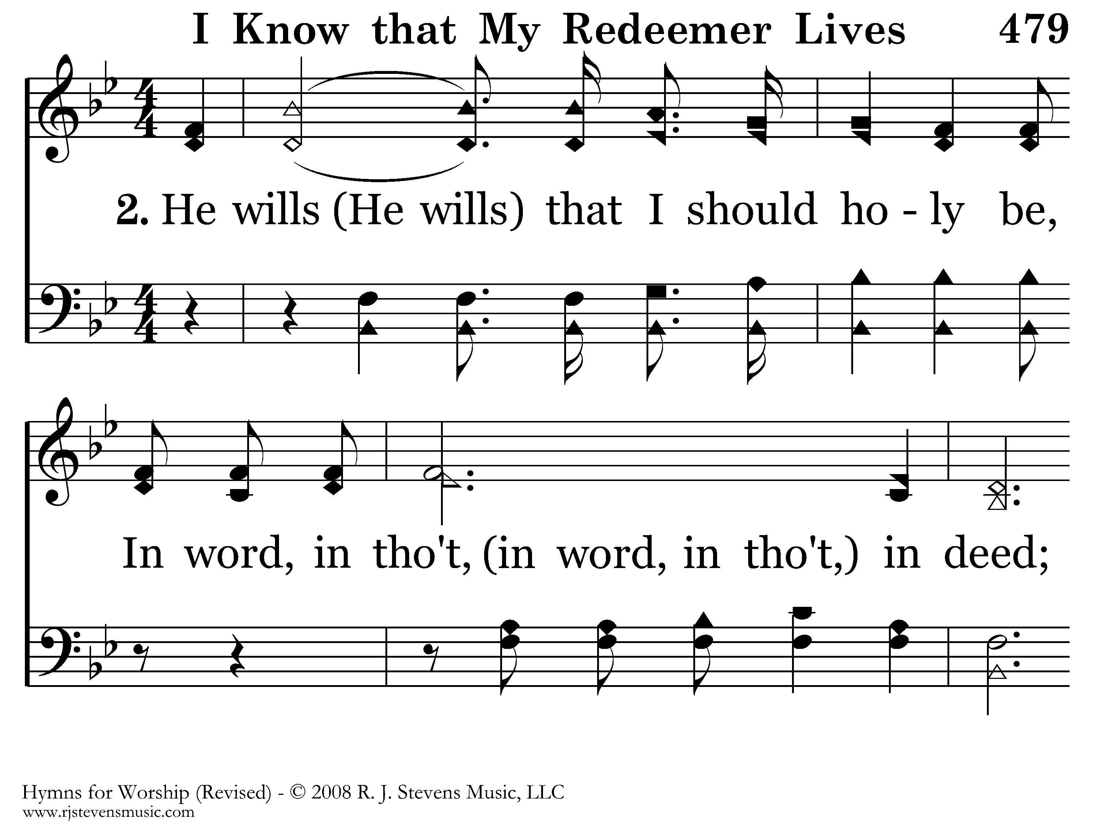
479 - I Know That My Redeemer Lives - 2.1

Slide 24
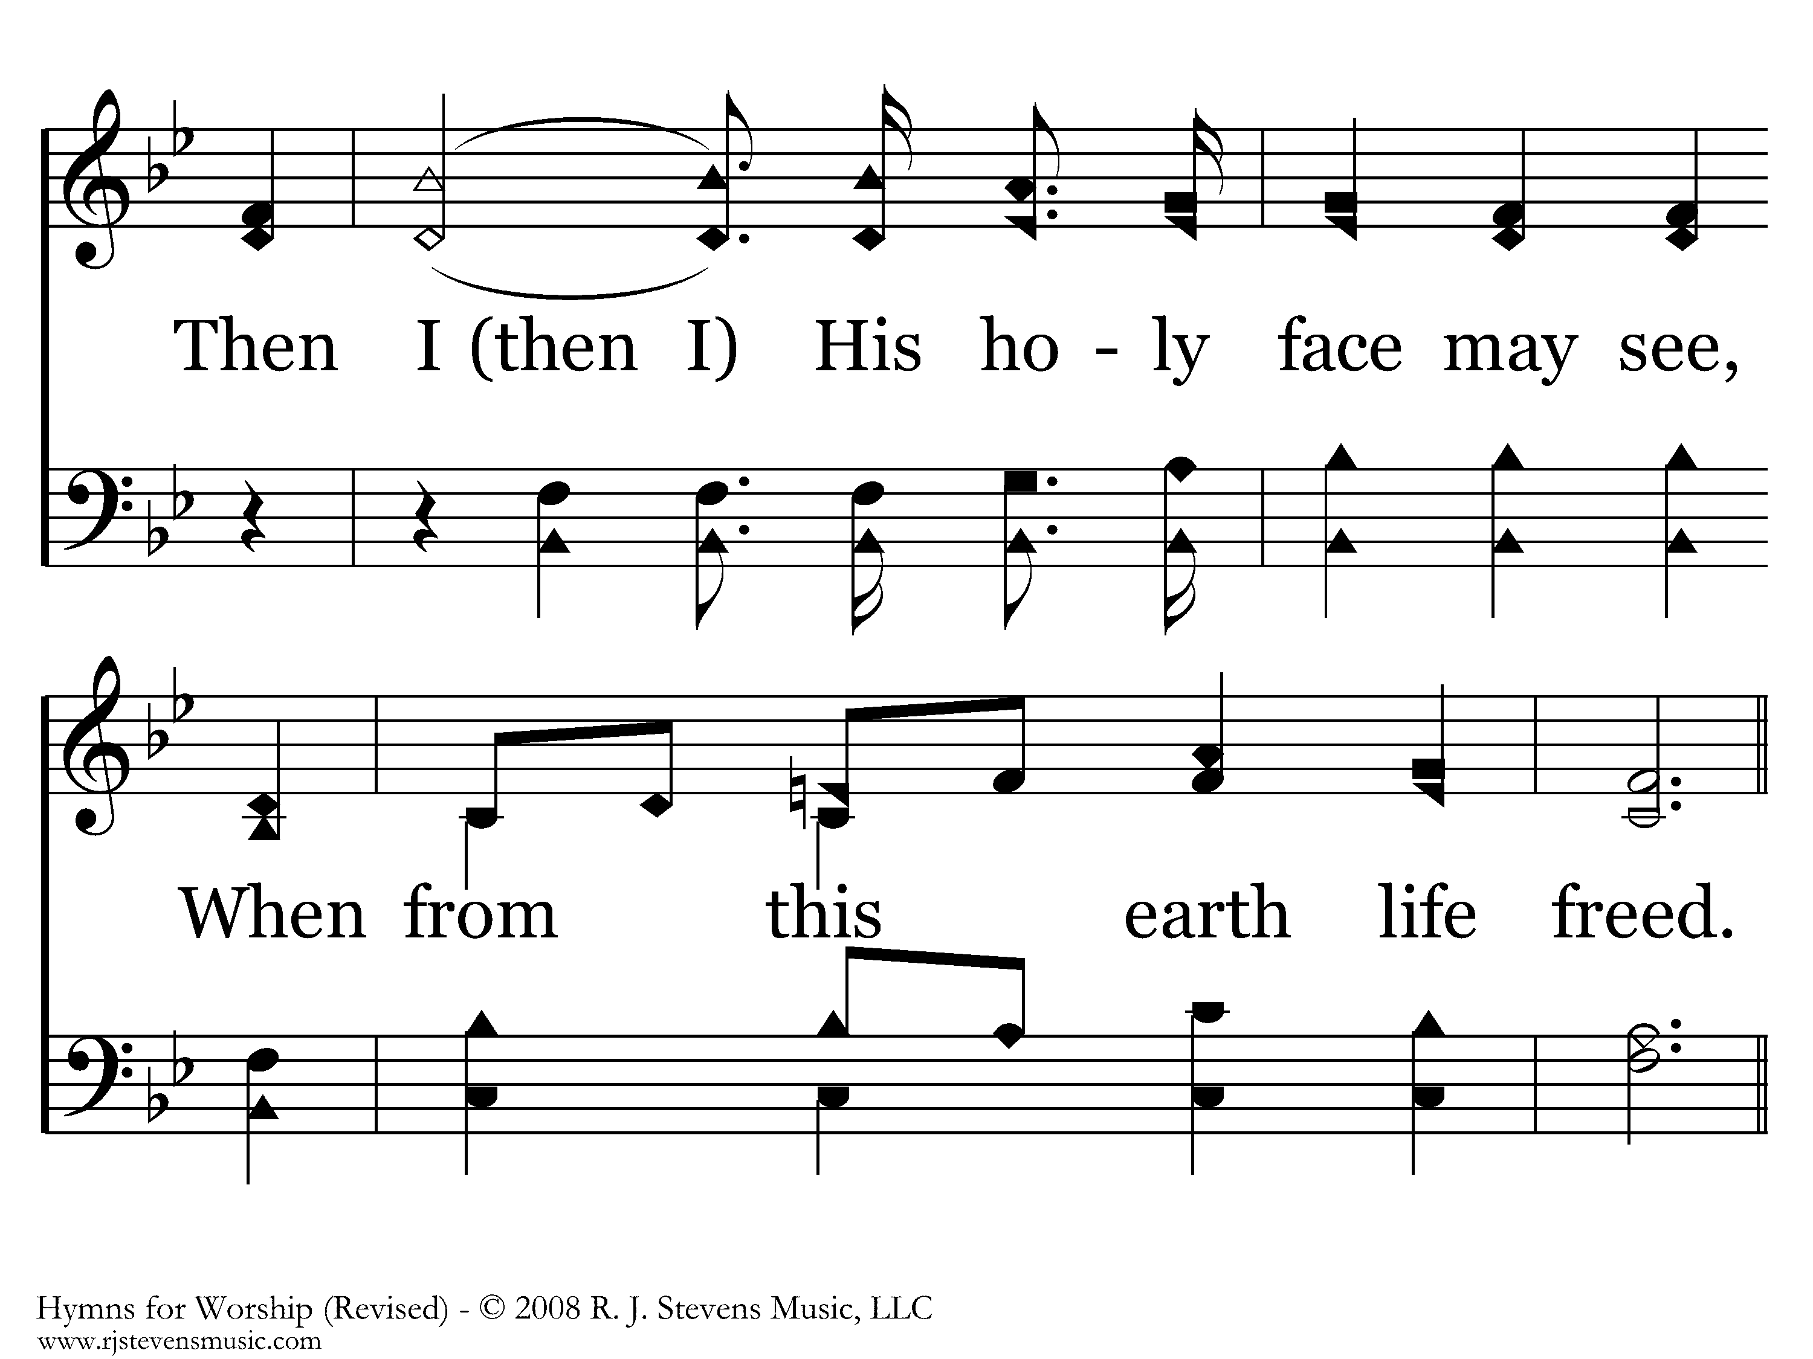
479 - I Know That My Redeemer Lives - 2.2

Slide 25
479 - I Know That My Redeemer Lives - C.1

Slide 26
479 - I Know That My Redeemer Lives - C.2
End of Verse 2

Slide 27
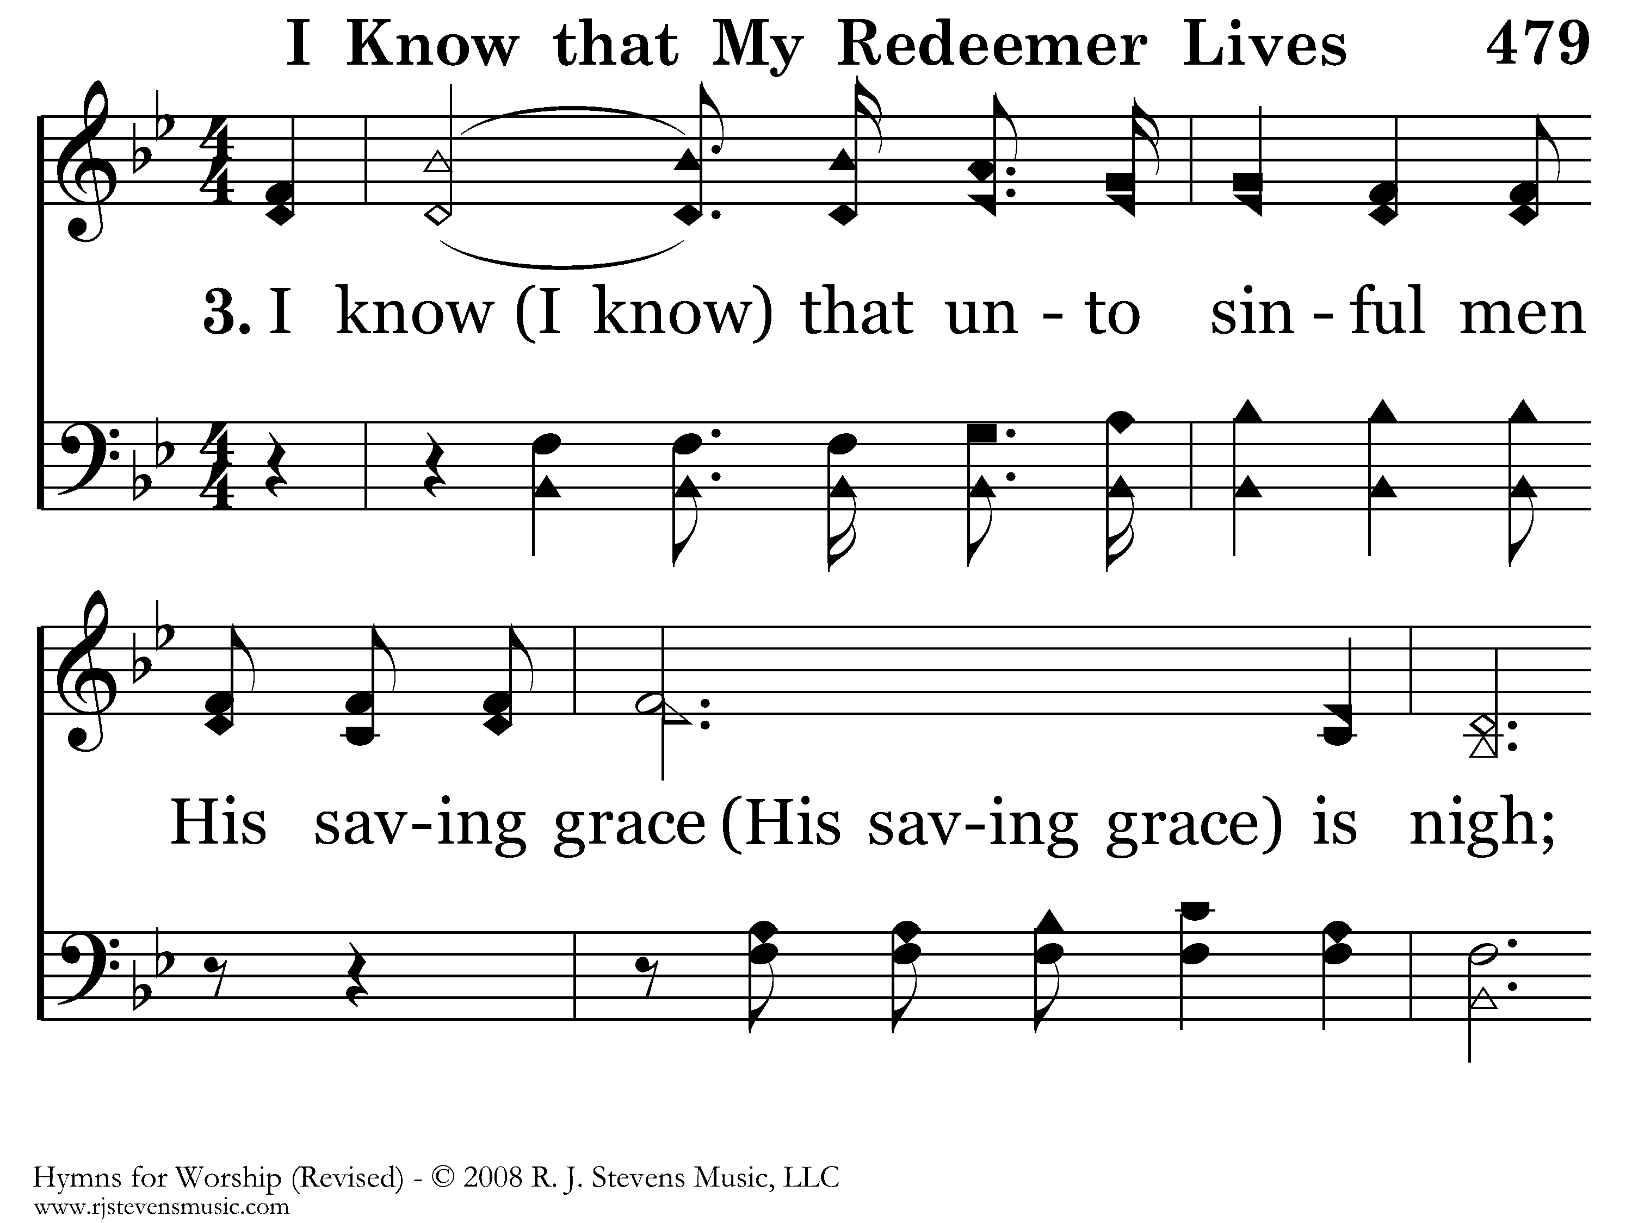
479 - I Know That My Redeemer Lives - 3.1

Slide 28
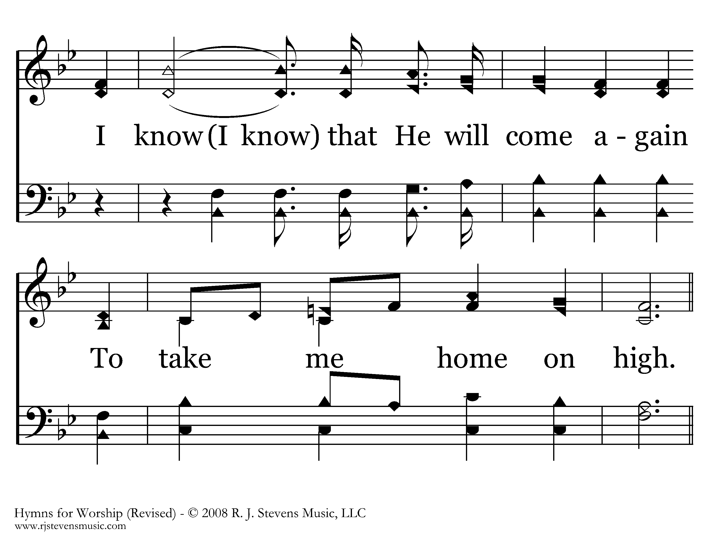
479 - I Know That My Redeemer Lives - 3.2

Slide 29
479 - I Know That My Redeemer Lives - C.1

Slide 30
479 - I Know That My Redeemer Lives - C.2
End of Verse 3

Slide 31
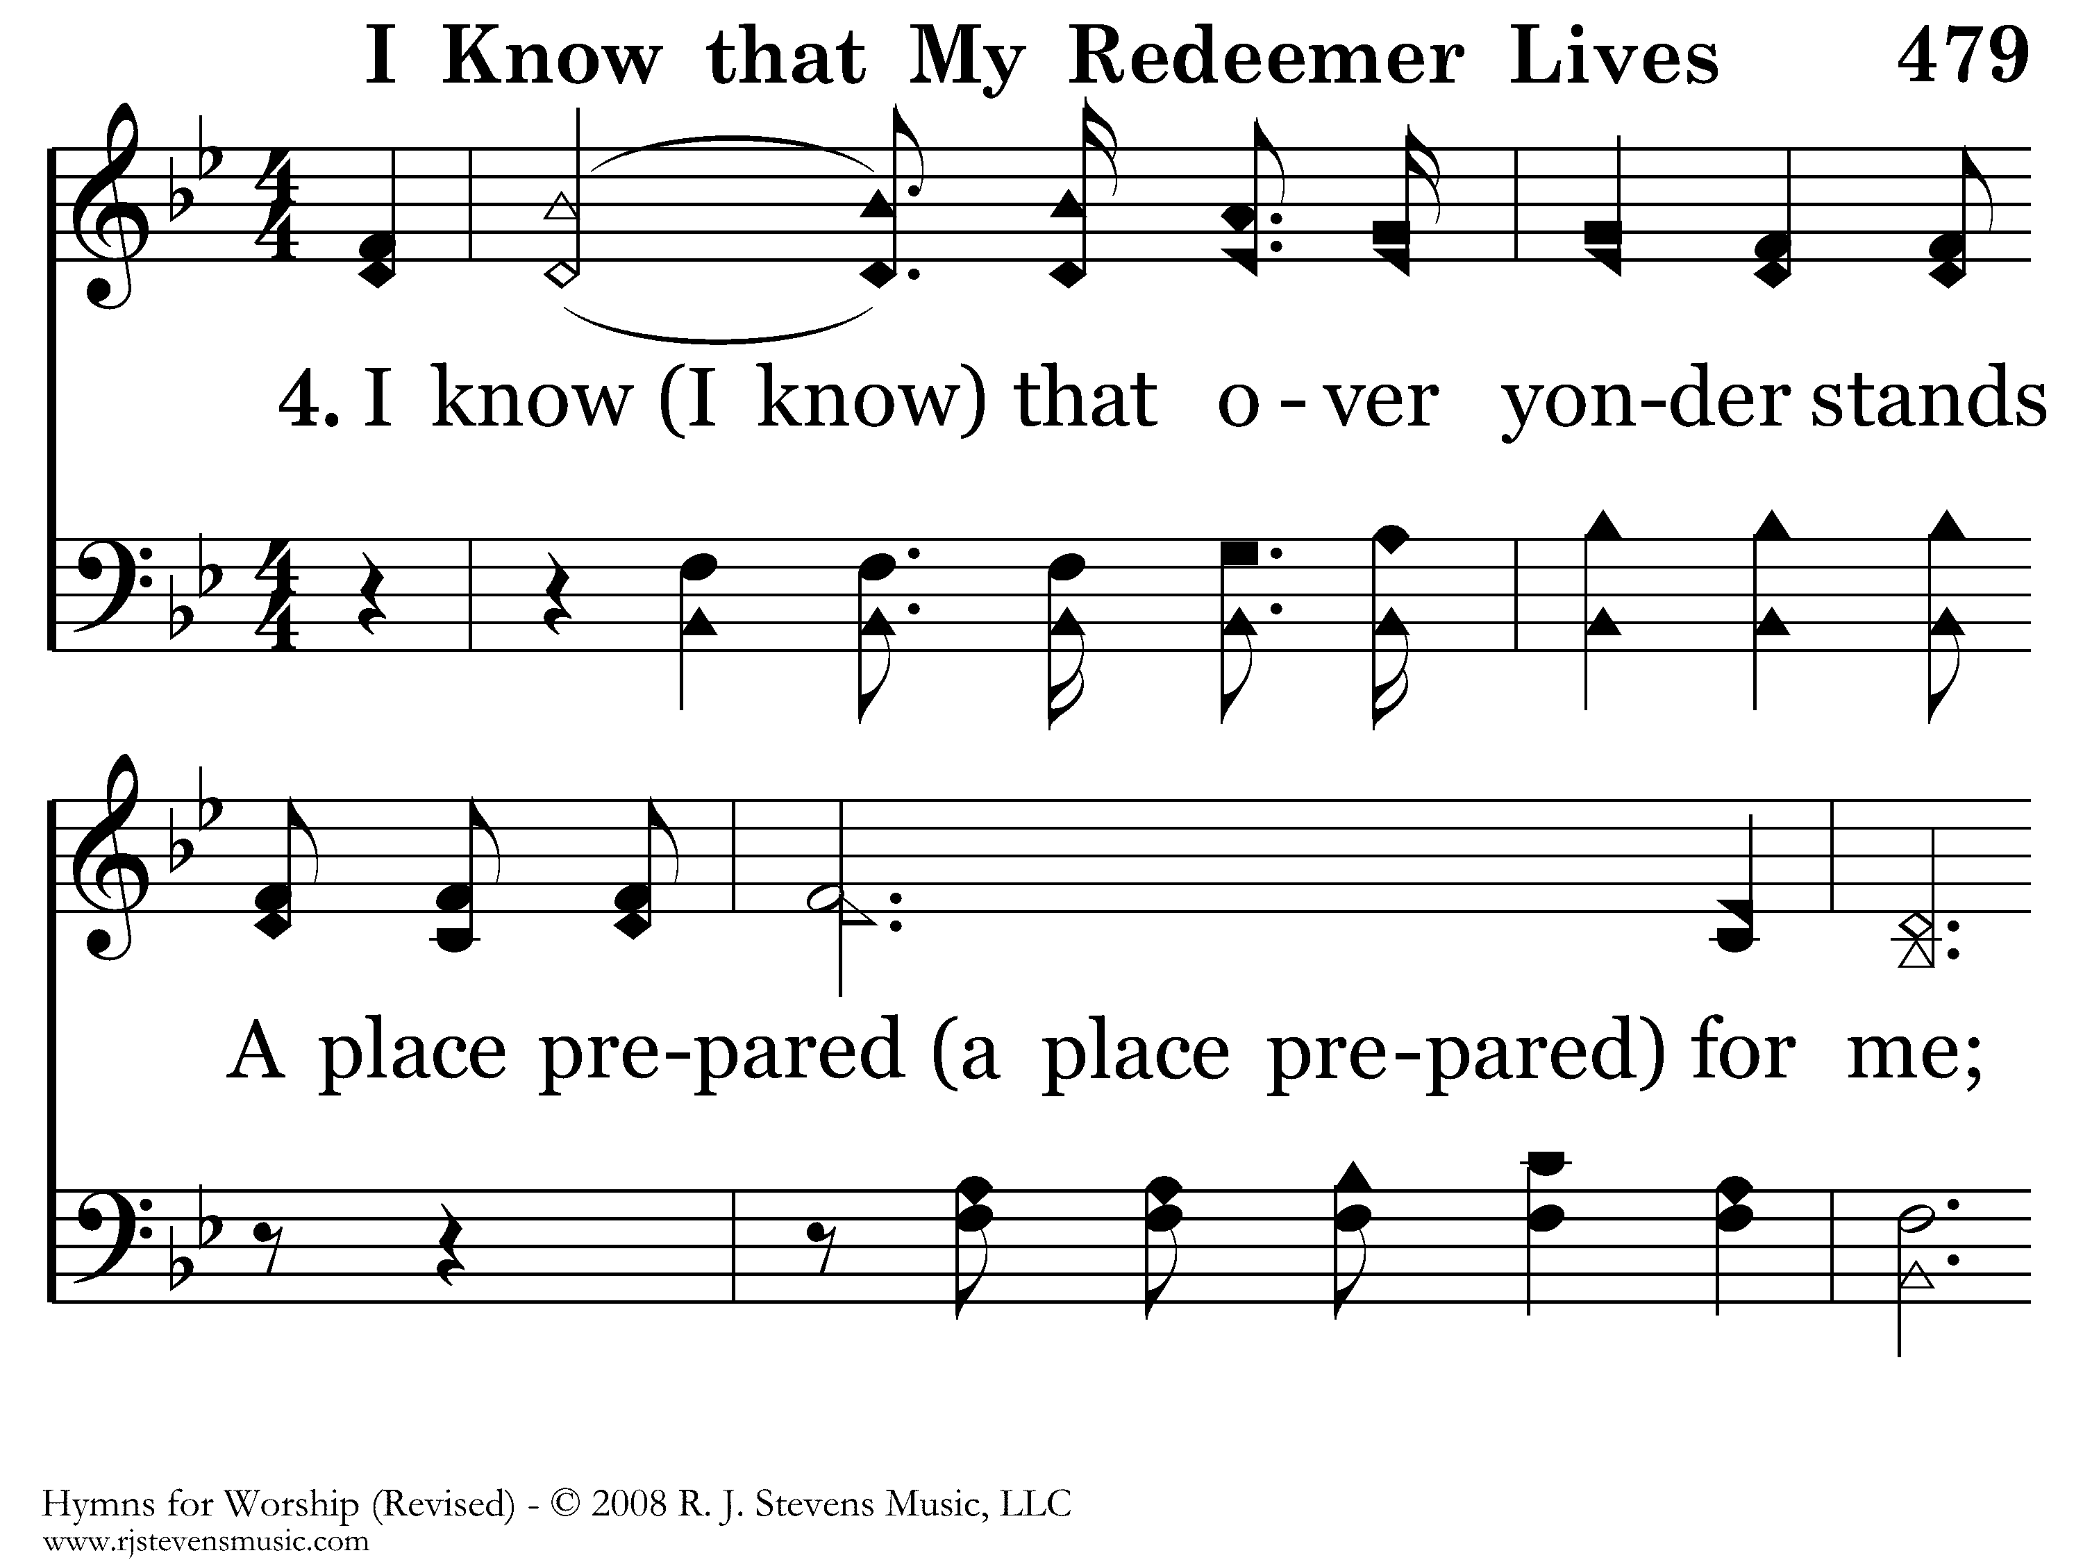
479 - I Know That My Redeemer Lives - 4.1

Slide 32

479 - I Know That My Redeemer Lives - 4.2

Slide 33
479 - I Know That My Redeemer Lives - C.1

Slide 34
479 - I Know That My Redeemer Lives - C.2
End of Song

Slide 35
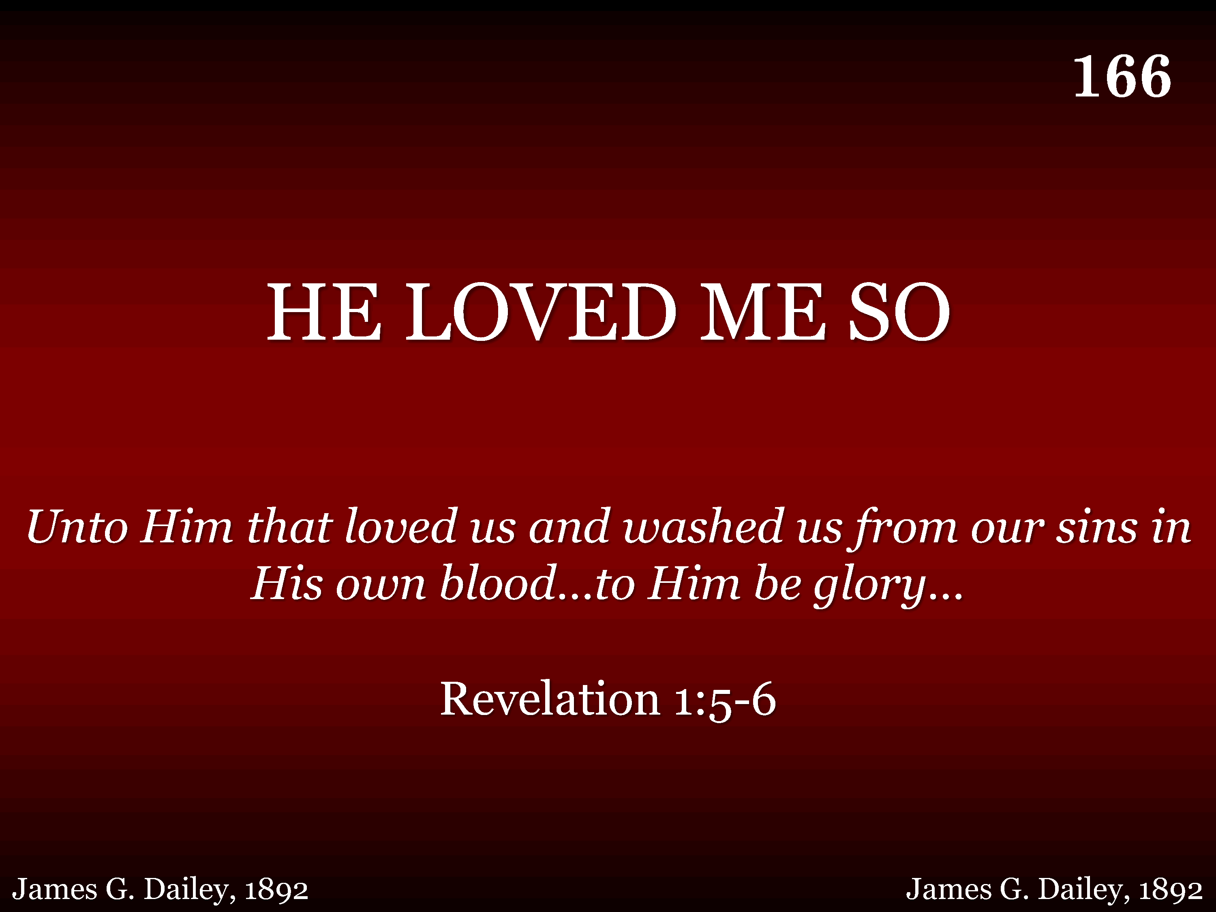
166 - He Loved Me So - Title

Slide 36
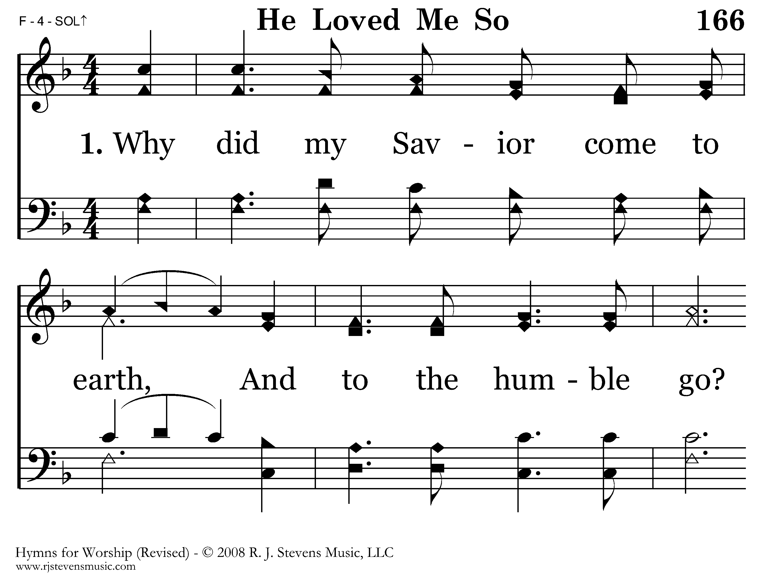
166 - He Loved Me So - 1.1

Slide 37
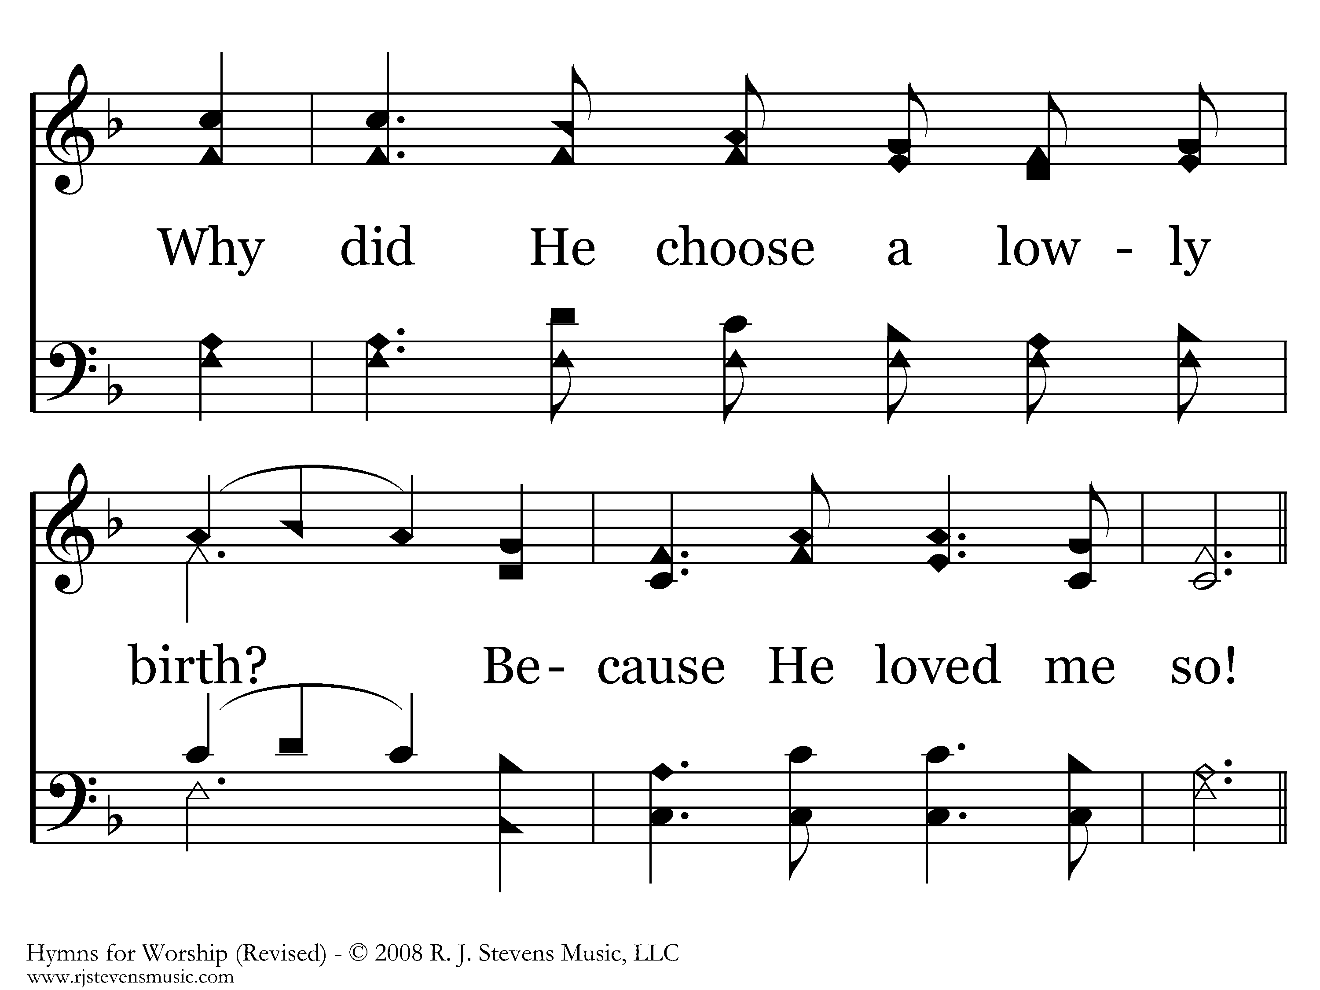
166 - He Loved Me So - 1.2

Slide 38
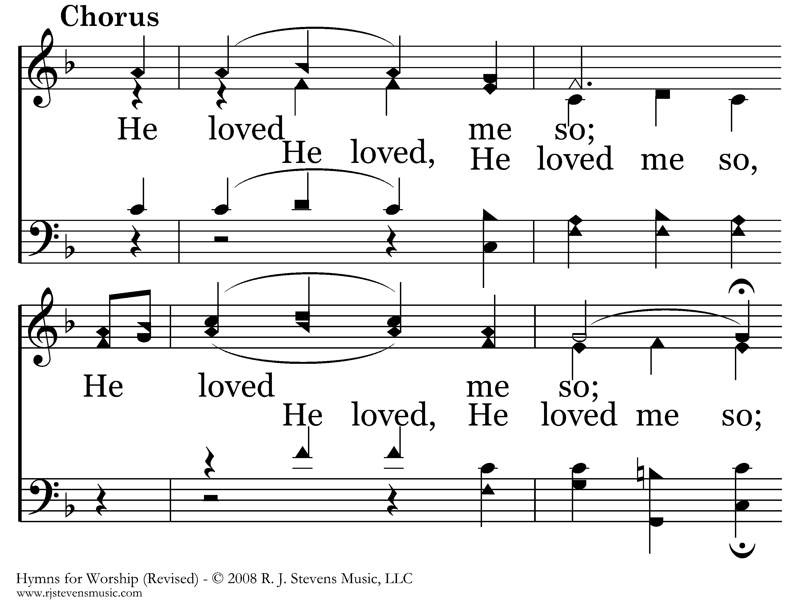
166 - He Loved Me So - C.1

Slide 39
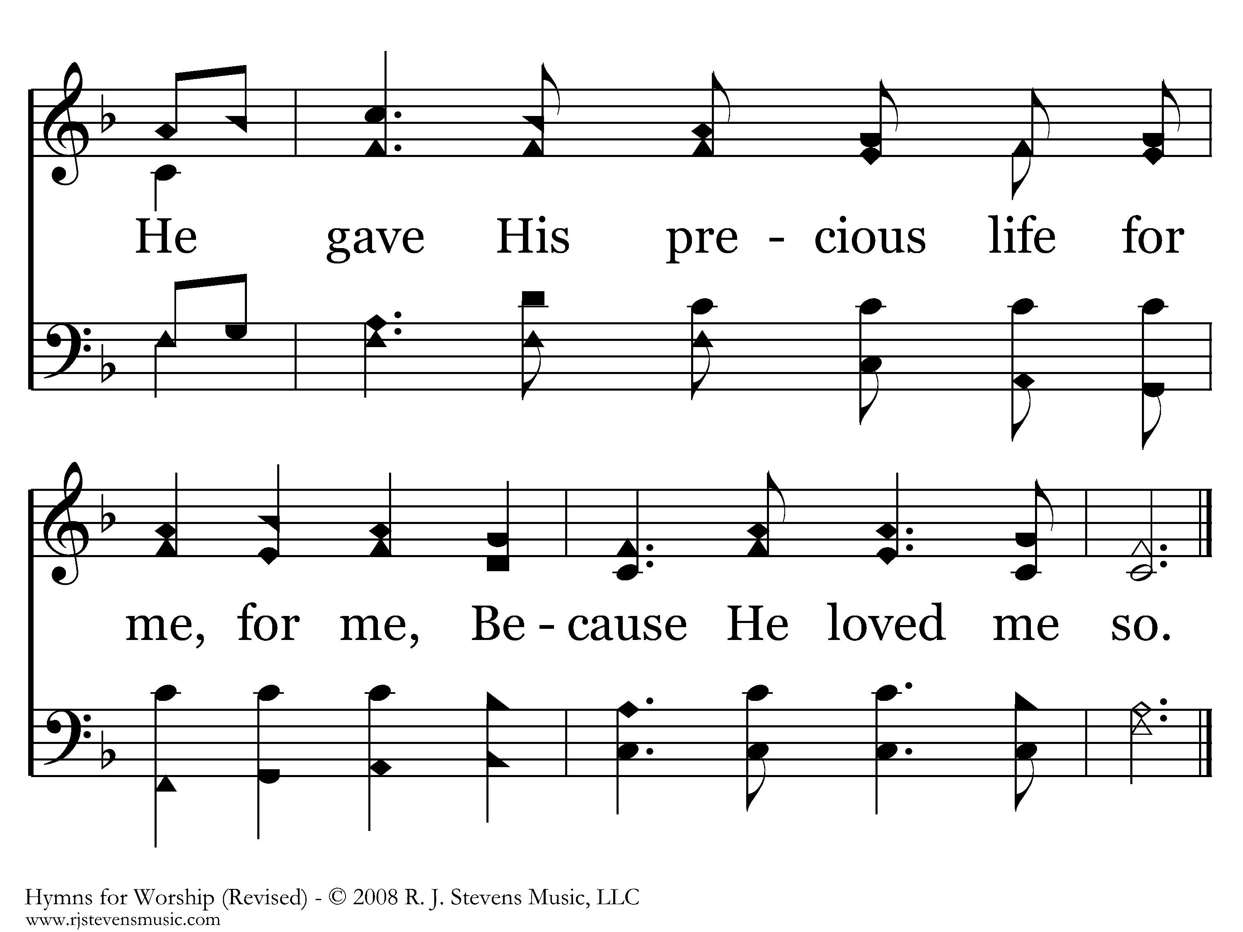
166 - He Loved Me So - C.2
End of Verse 1

Slide 40
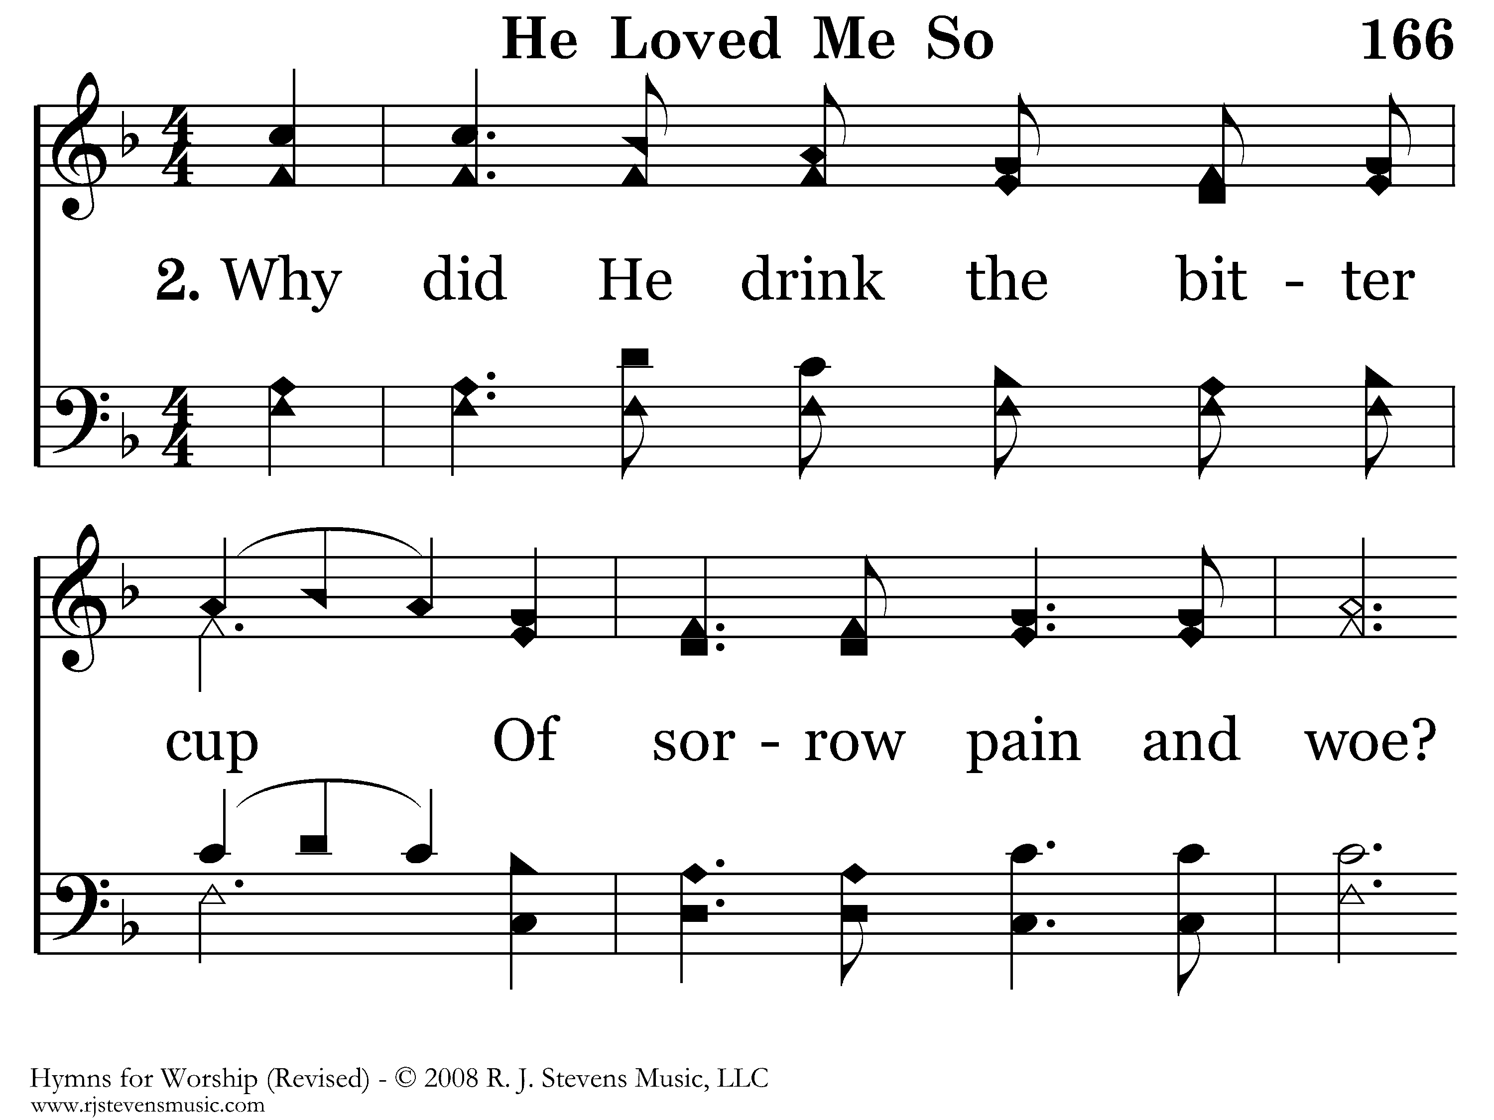
166 - He Loved Me So - 2.1

Slide 41
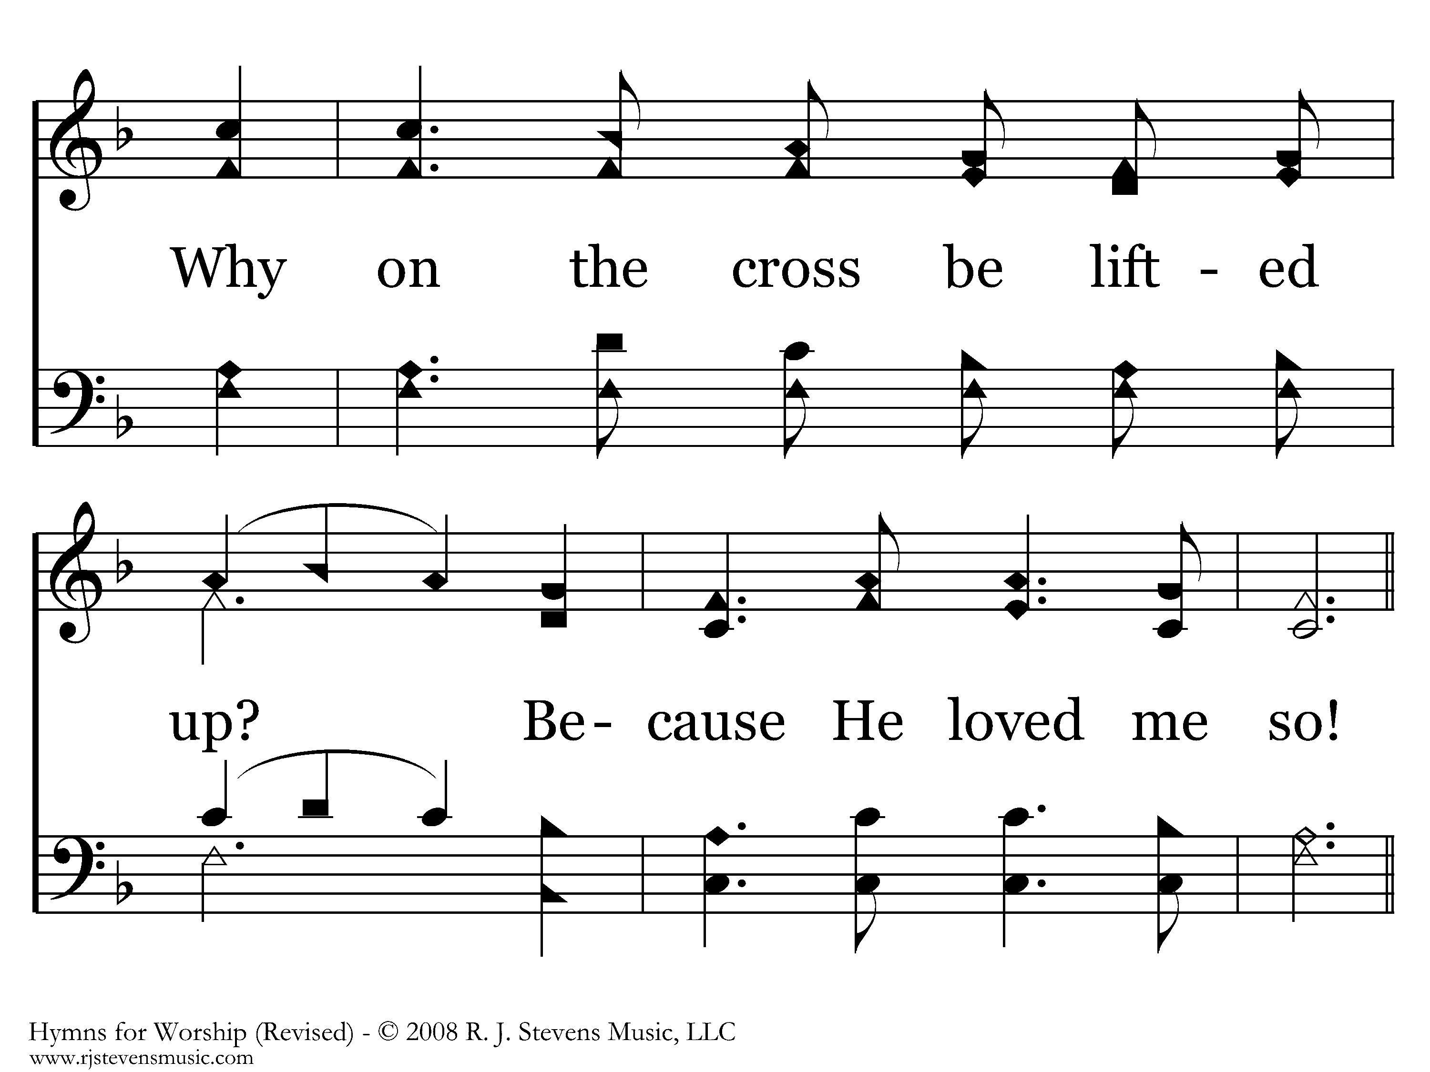
166 - He Loved Me So - 2.2

Slide 42
166 - He Loved Me So - C.1

Slide 43
166 - He Loved Me So - C.2
End of Verse 2

Slide 44
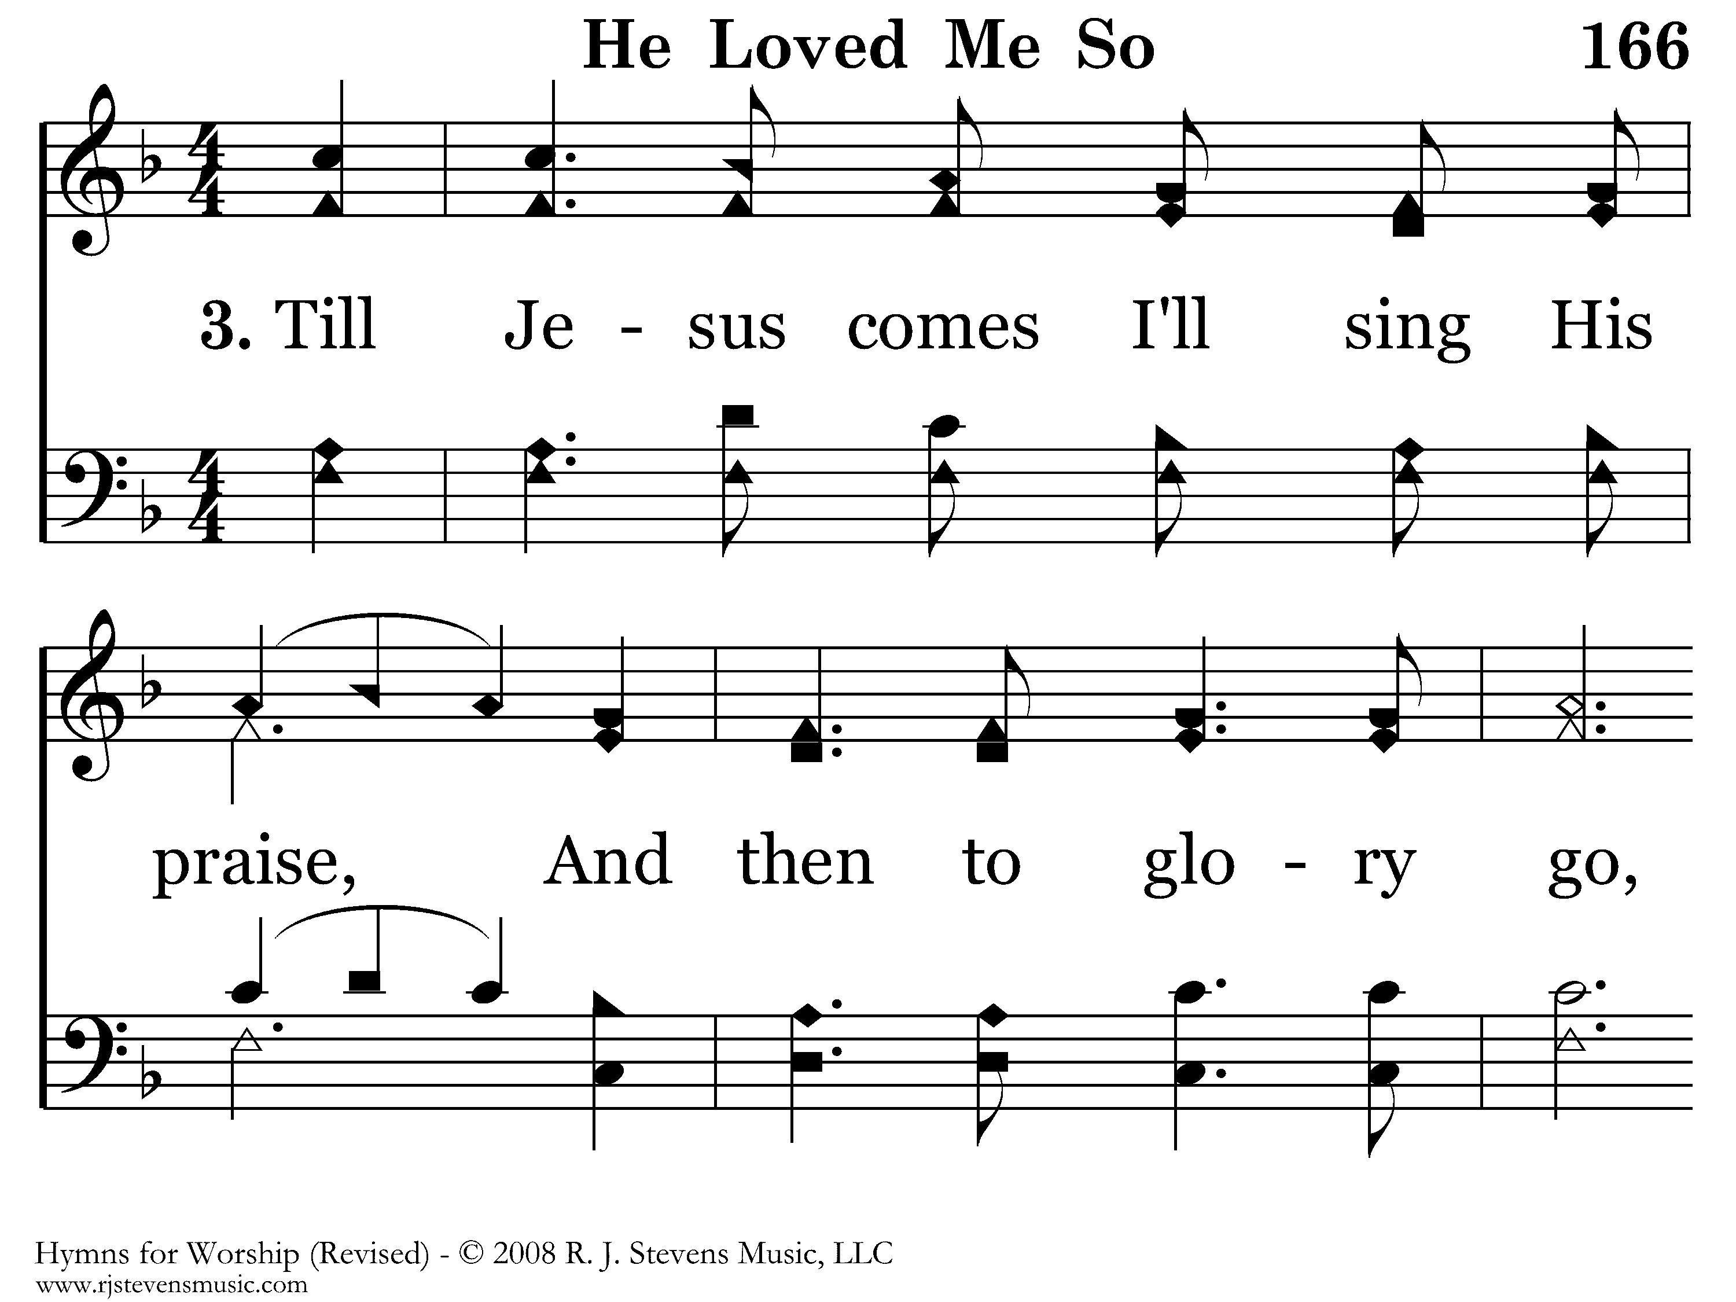
166 - He Loved Me So - 3.1

Slide 45
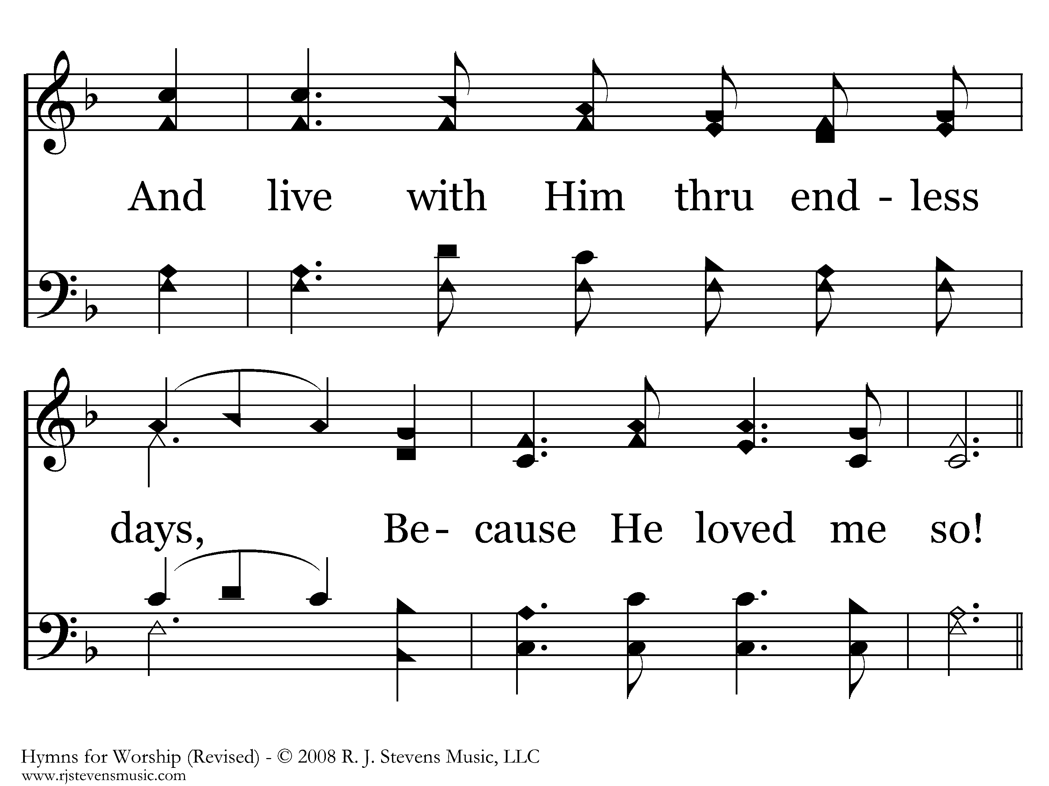
166 - He Loved Me So - 3.2

Slide 46
166 - He Loved Me So - C.1

Slide 47
166 - He Loved Me So - C.2
End of Song

Slide 48
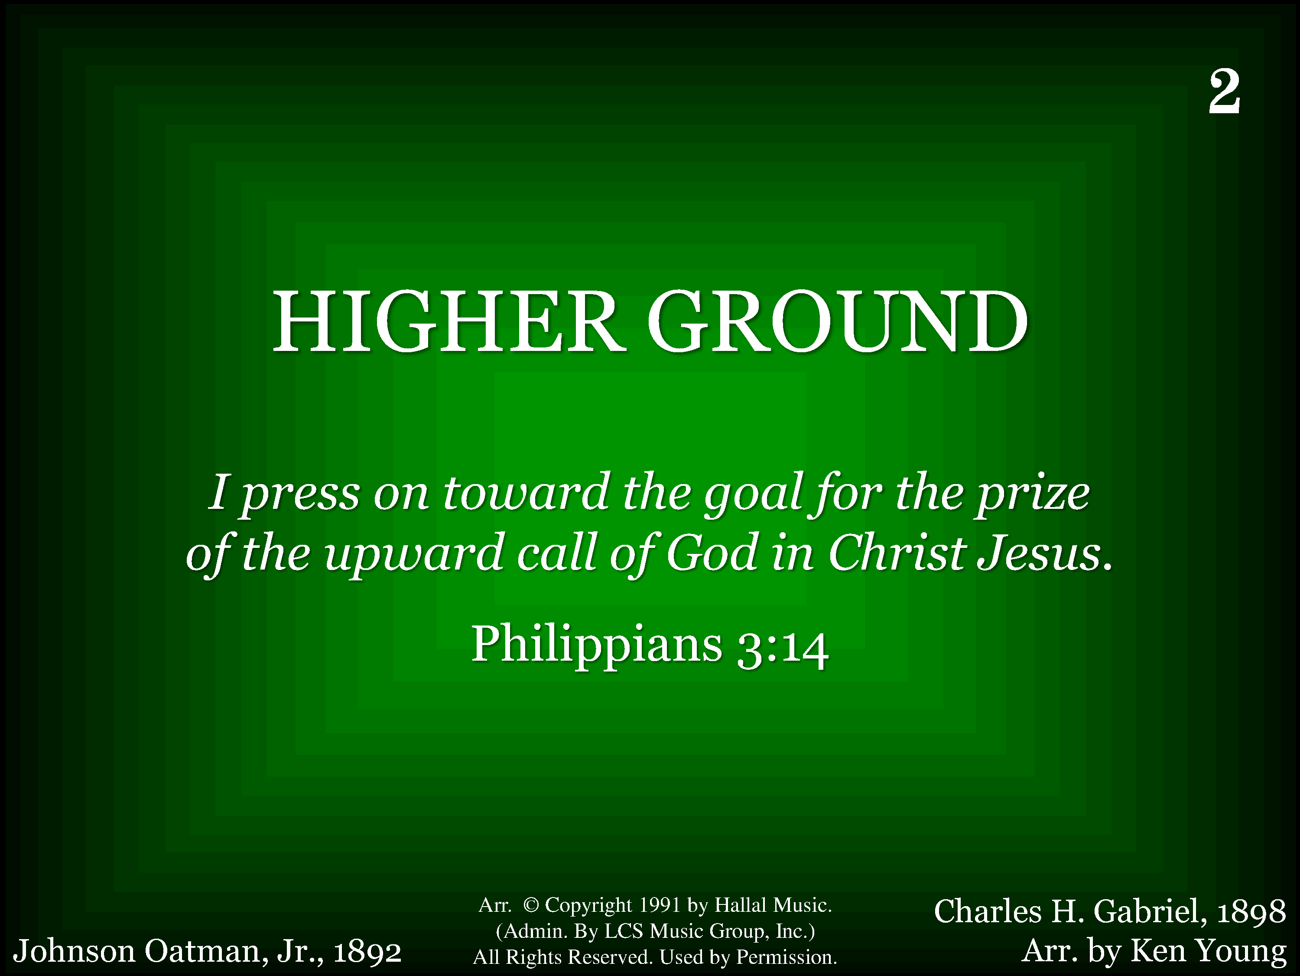
1002 - Higher Ground - Title

Slide 49
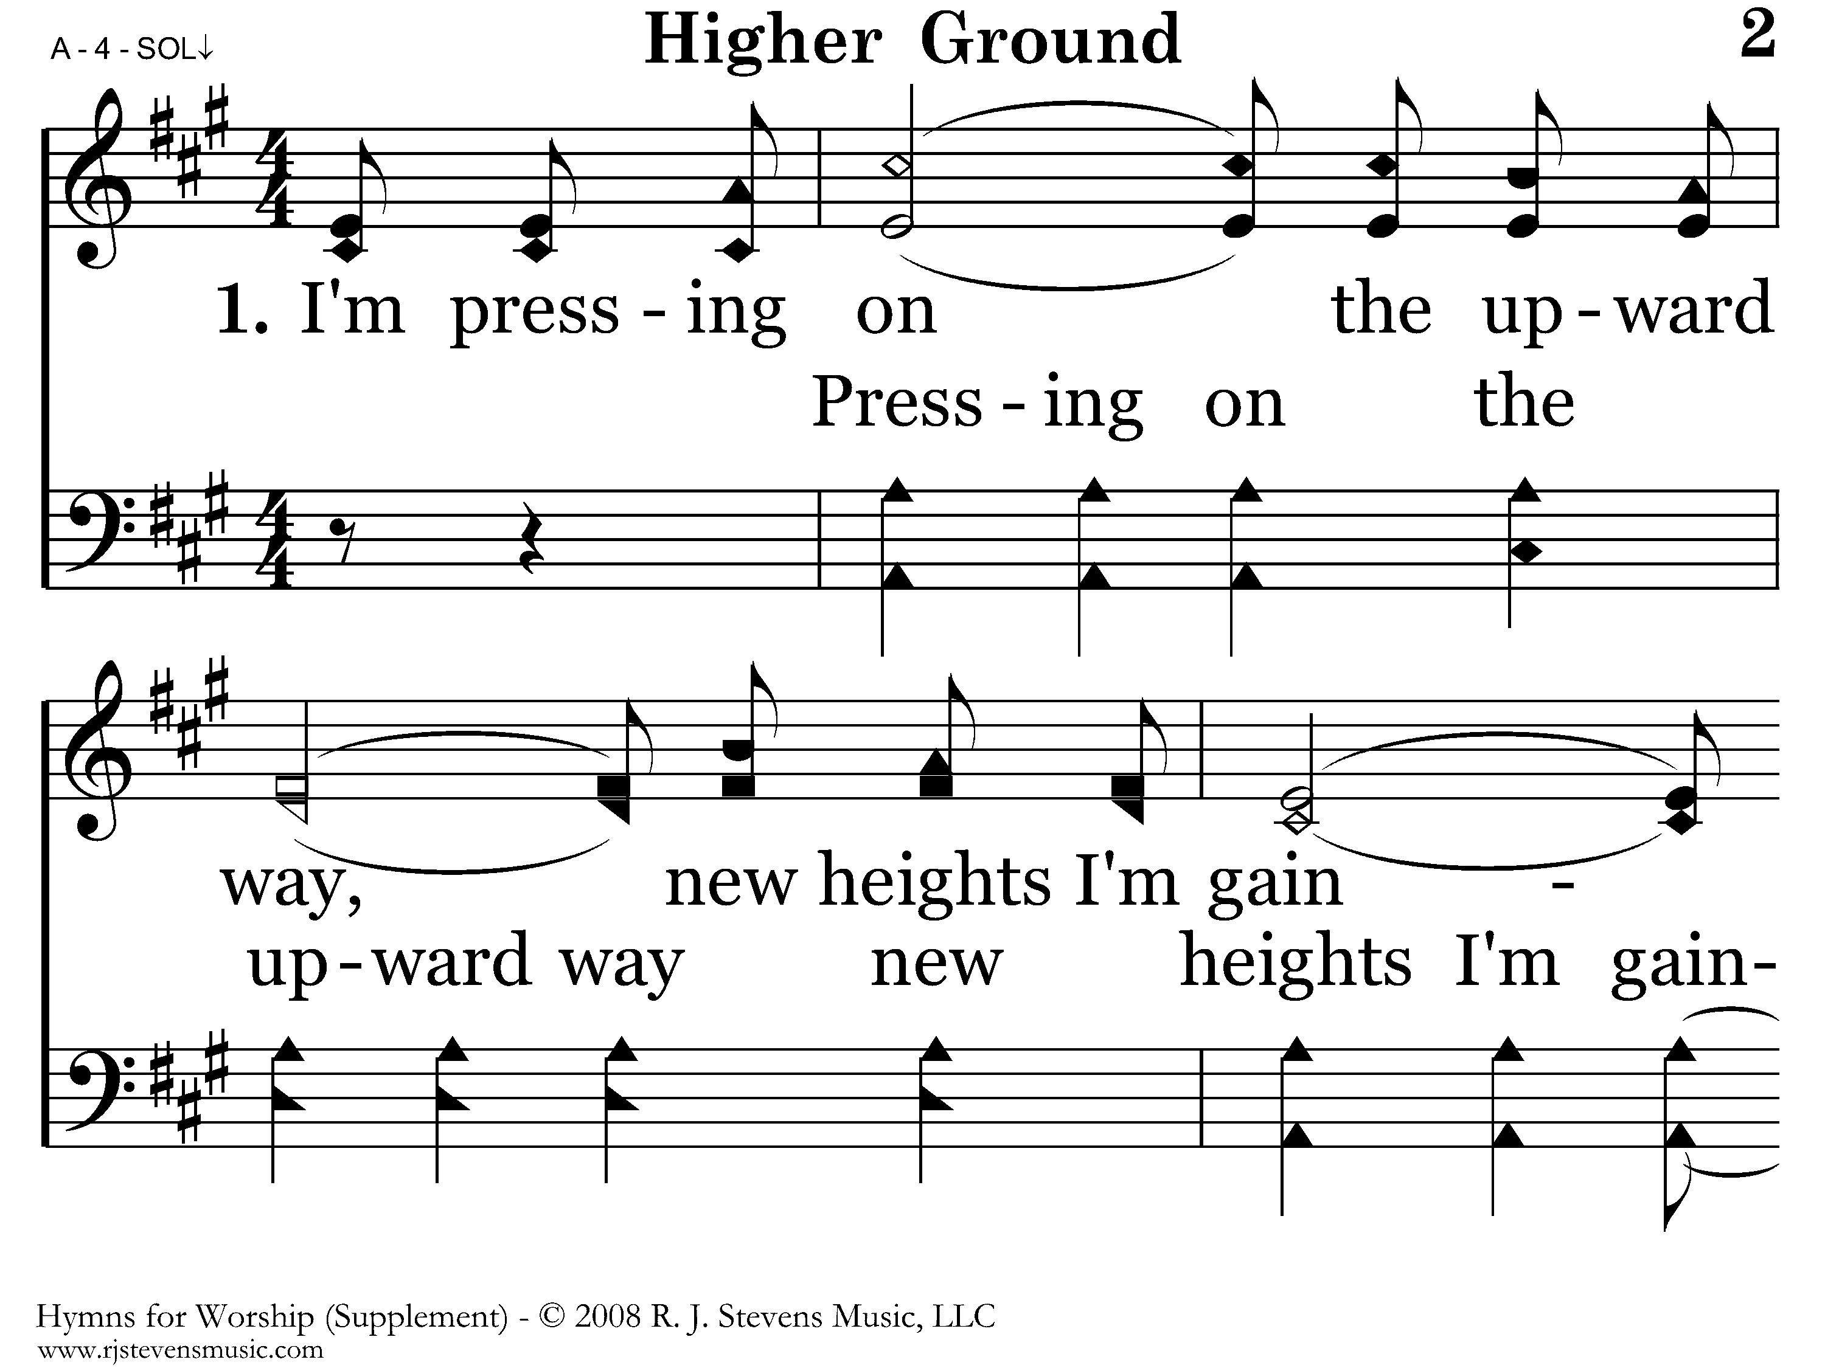
1002 - Higher Ground - 1.1

Slide 50
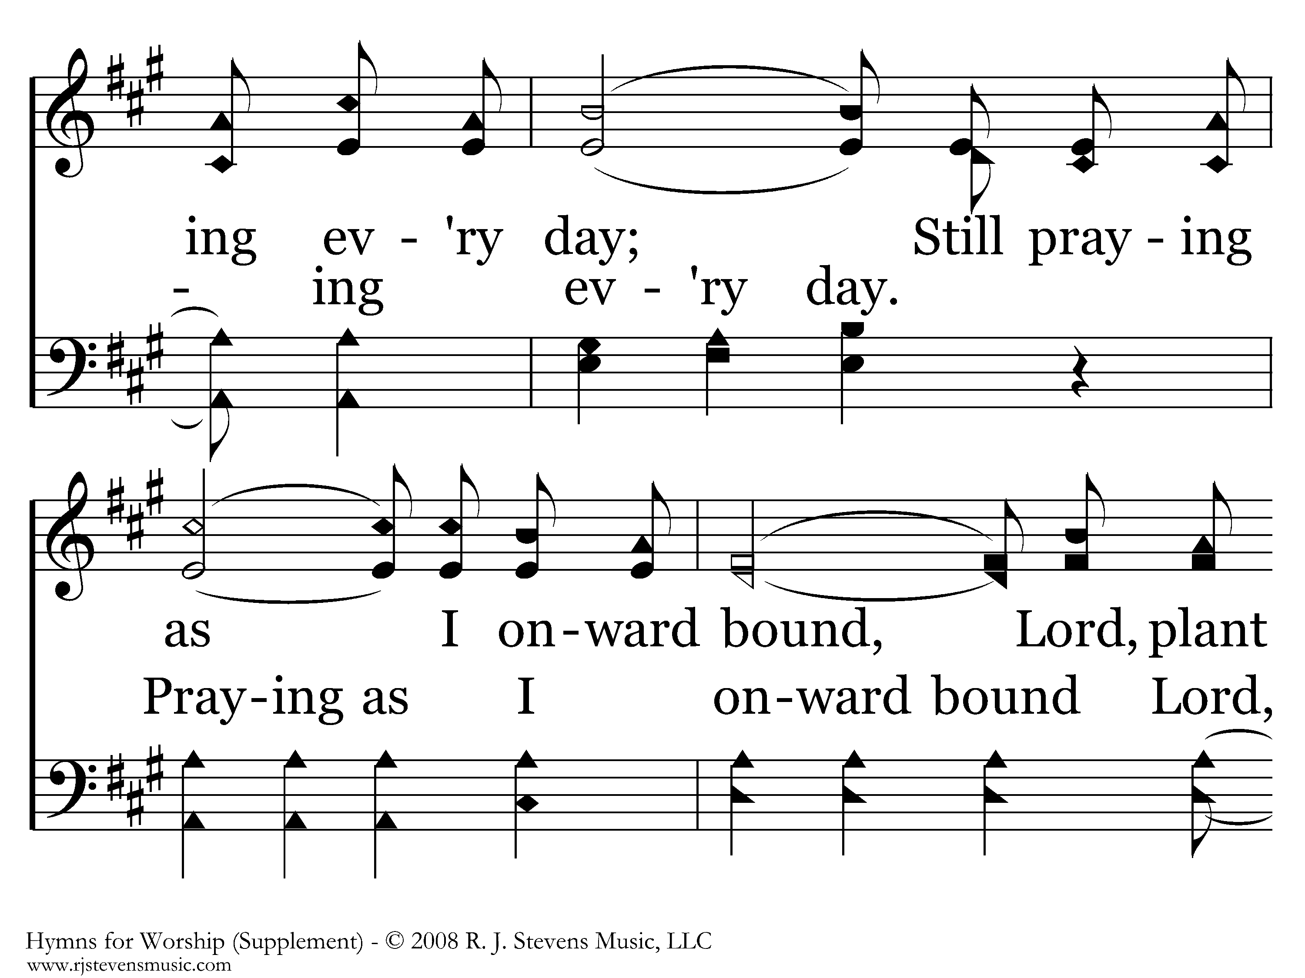
1002 - Higher Ground - 1.2

Slide 51
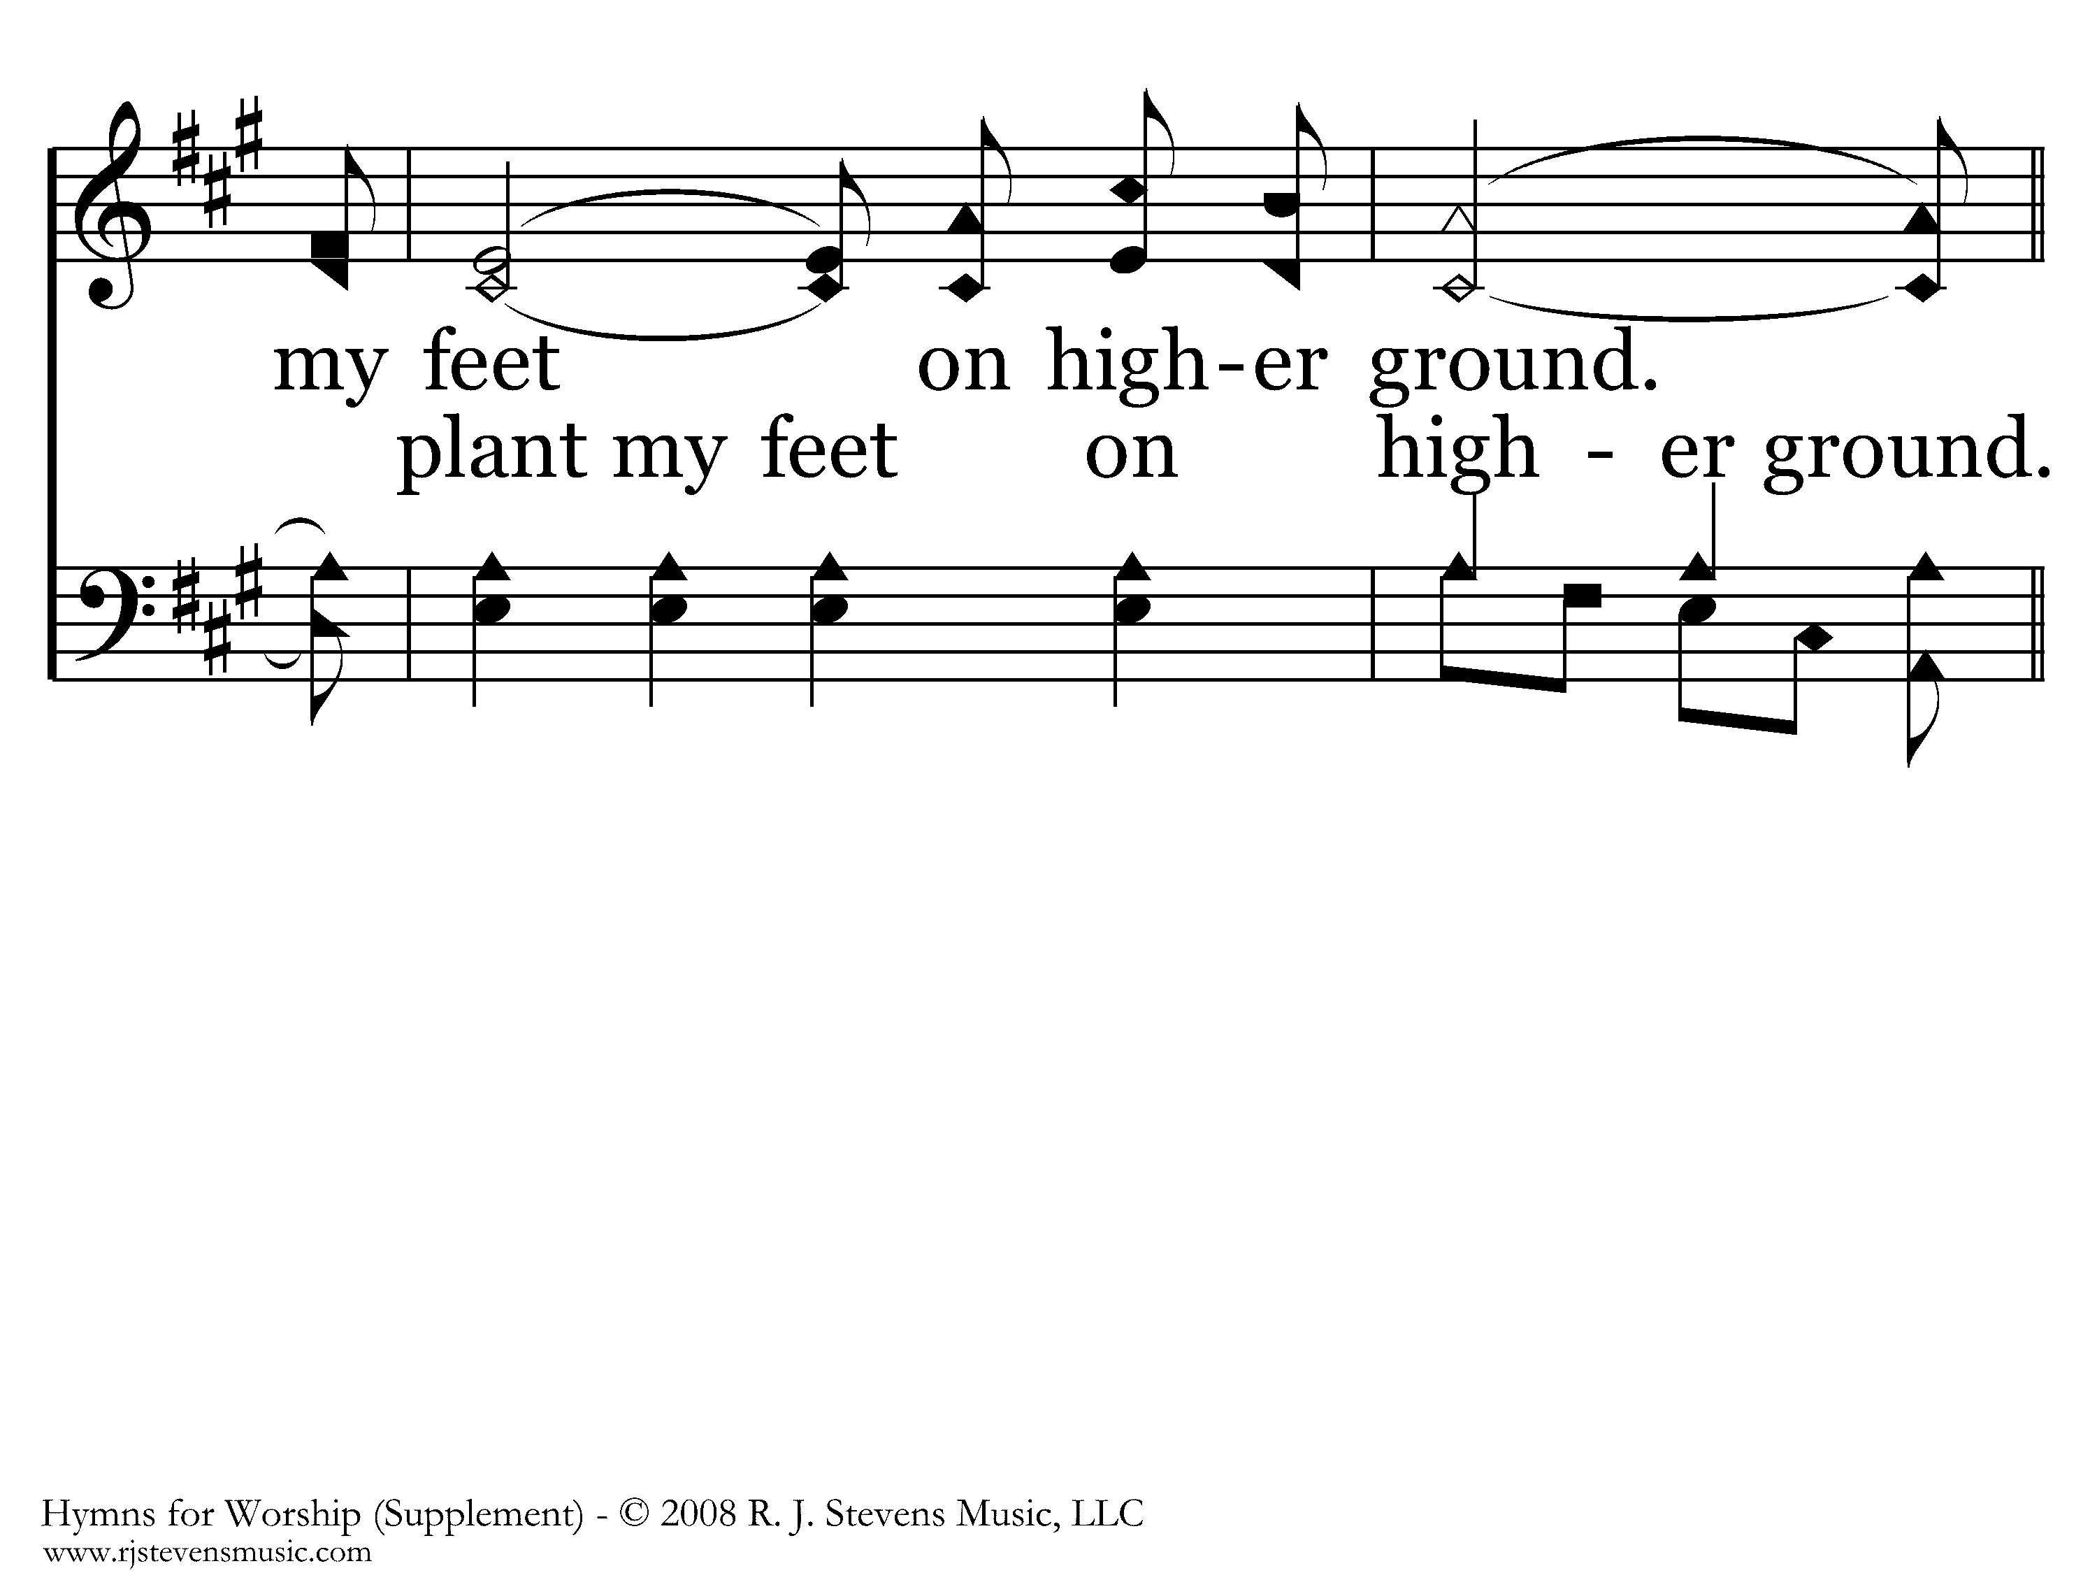
1002 - Higher Ground - 1.3

Slide 52
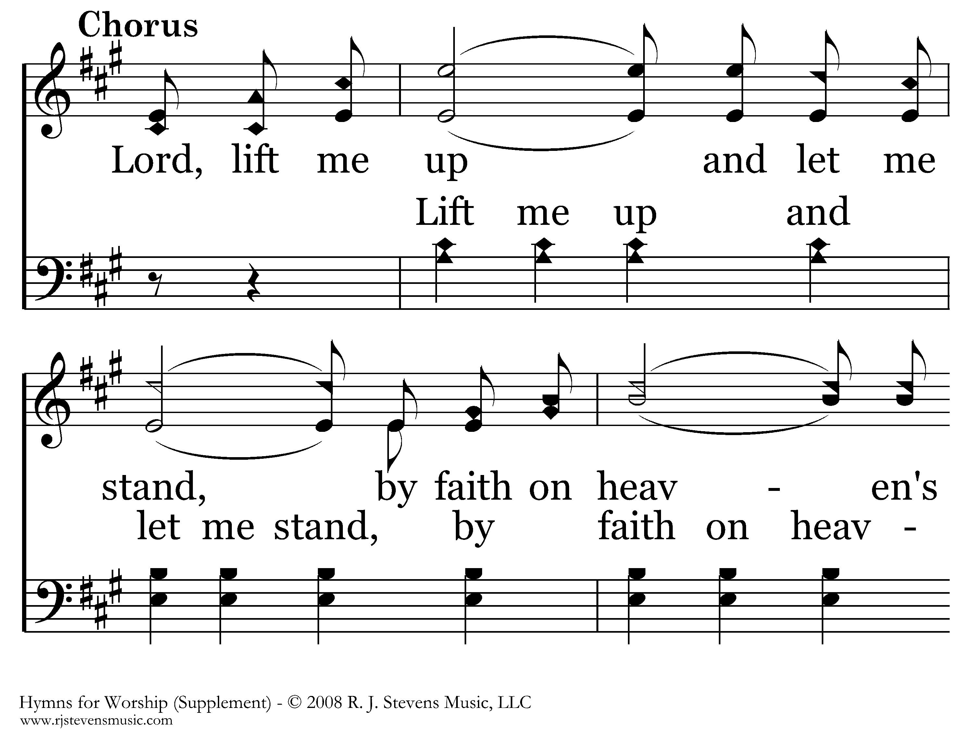
1002 - Higher Ground - C.1

Slide 53
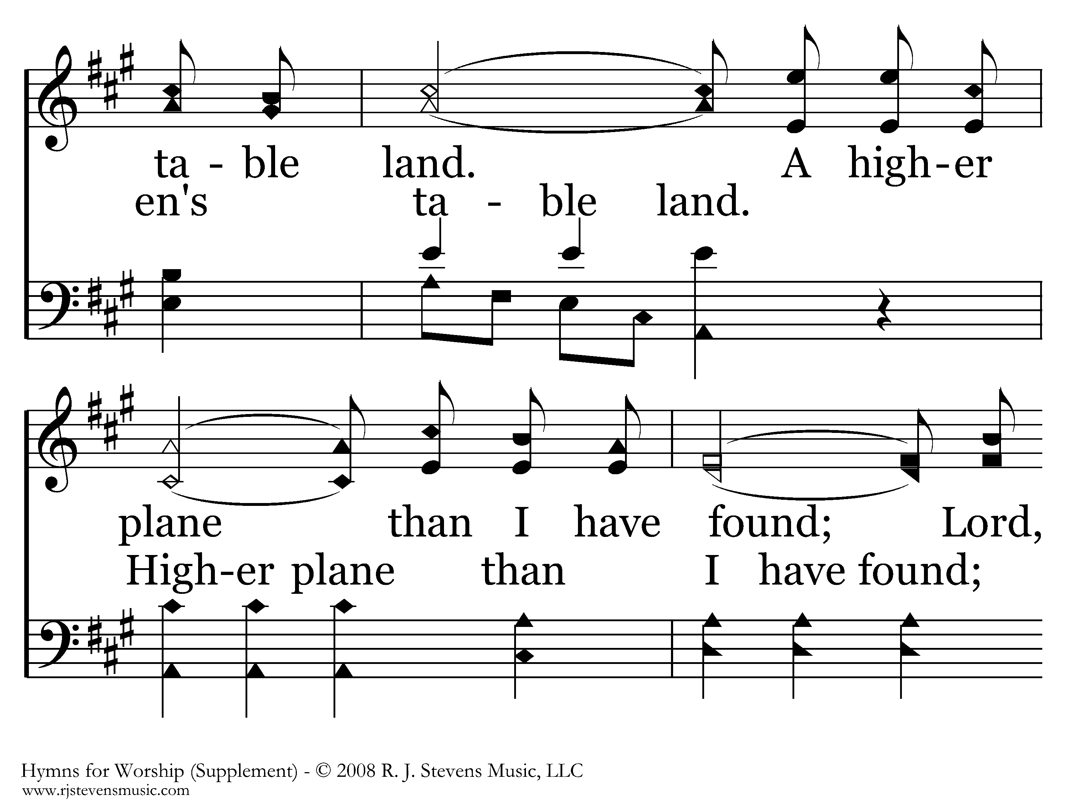
1002 - Higher Ground - C.2

Slide 54
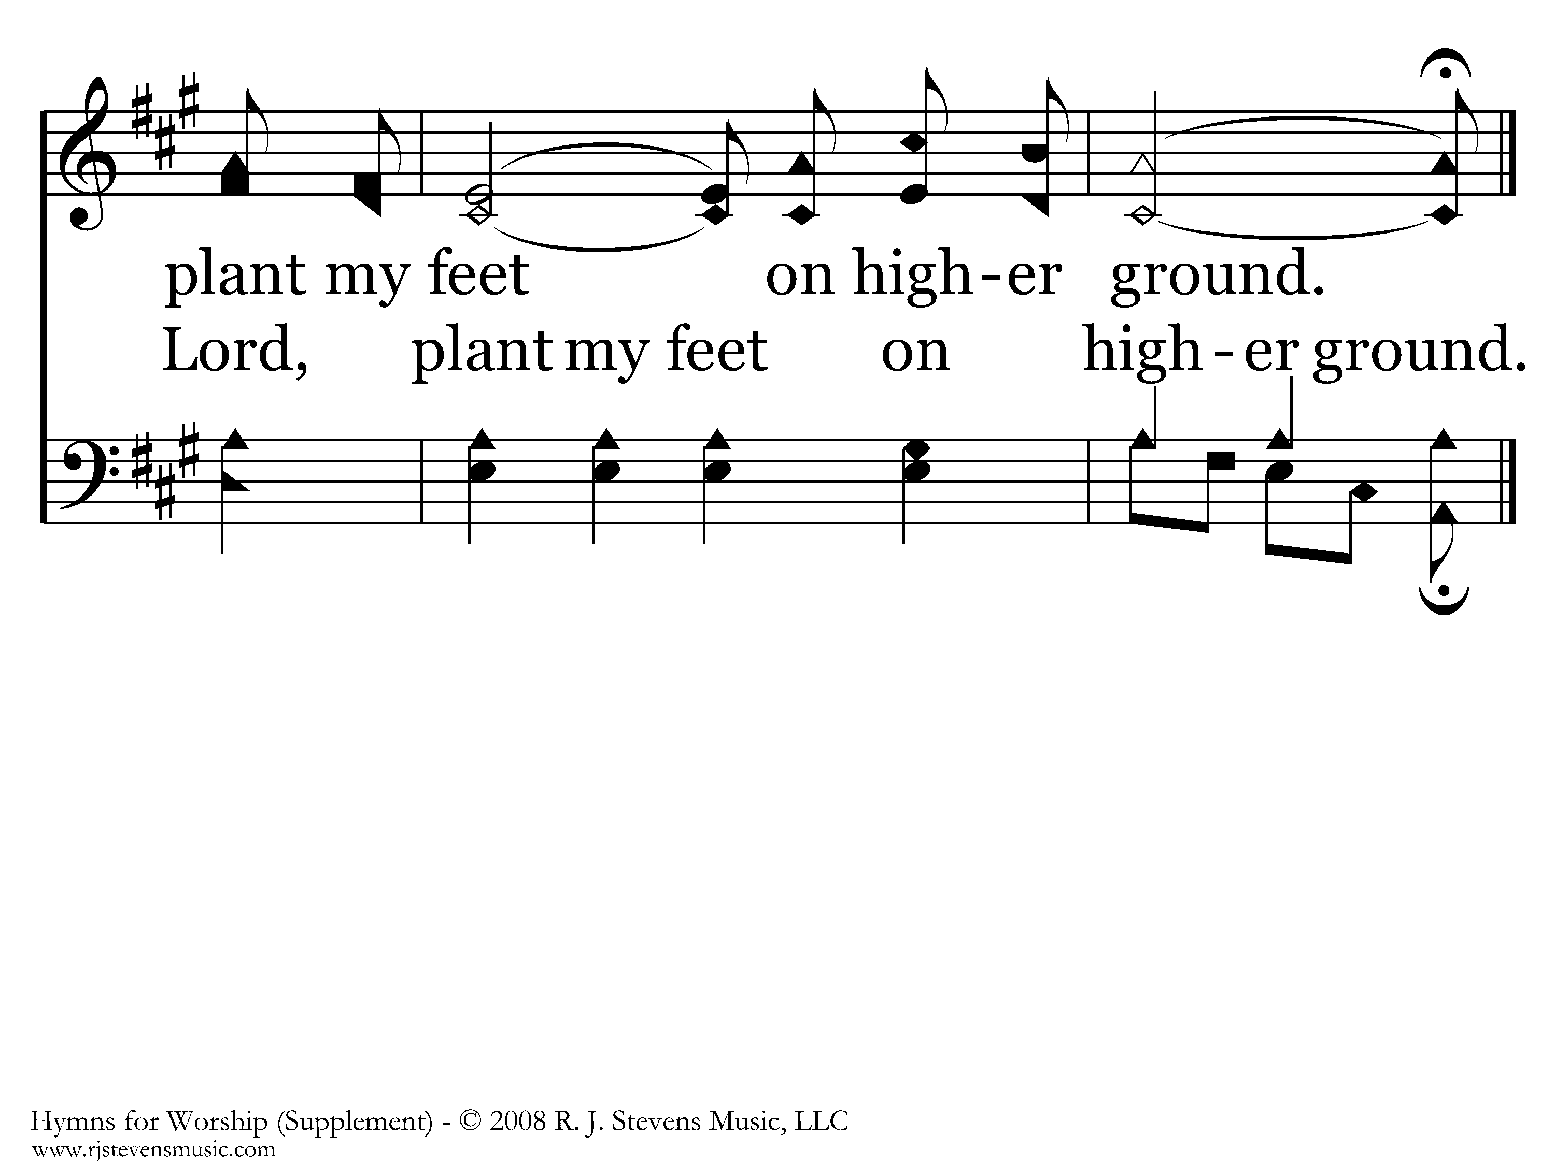
1002 - Higher Ground - C.3
End of Verse 1

Slide 55
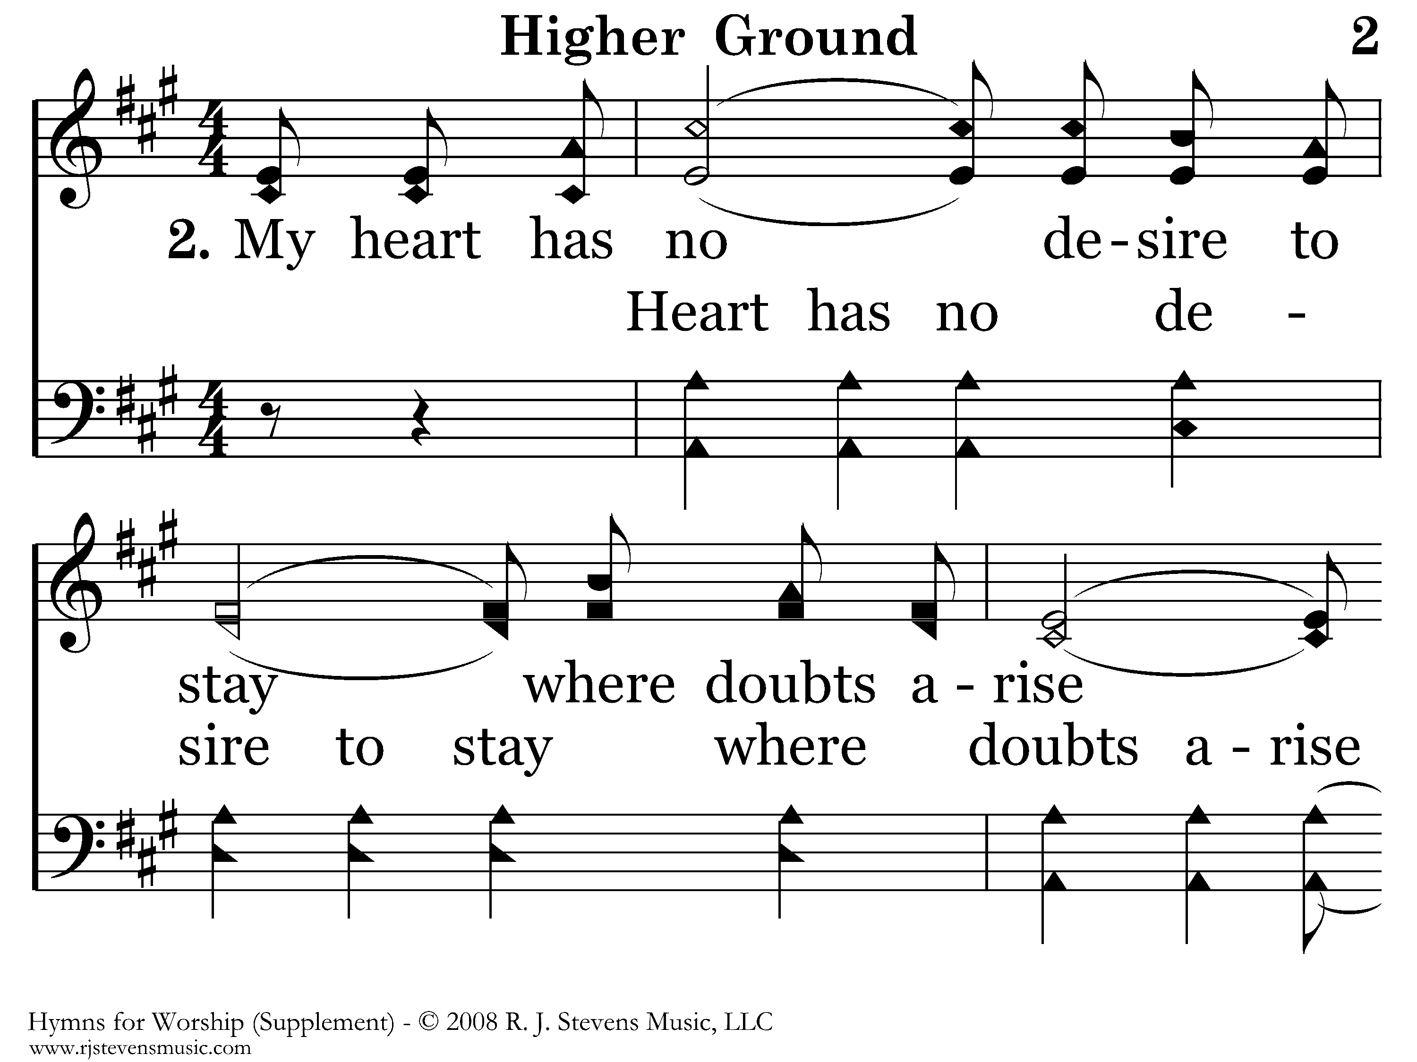
1002 - Higher Ground - 2.1

Slide 56
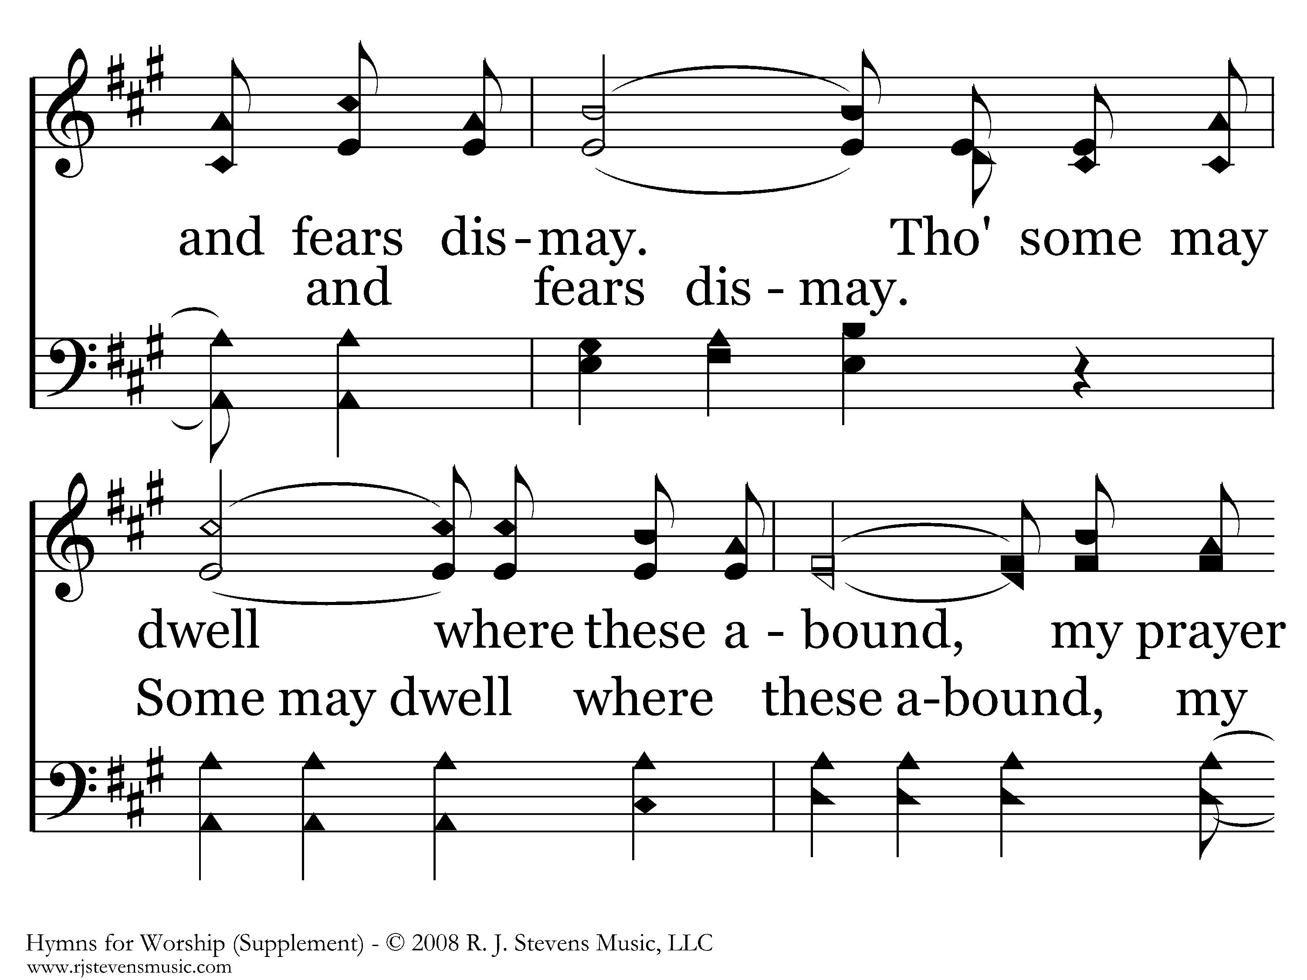
1002 - Higher Ground - 2.2

Slide 57
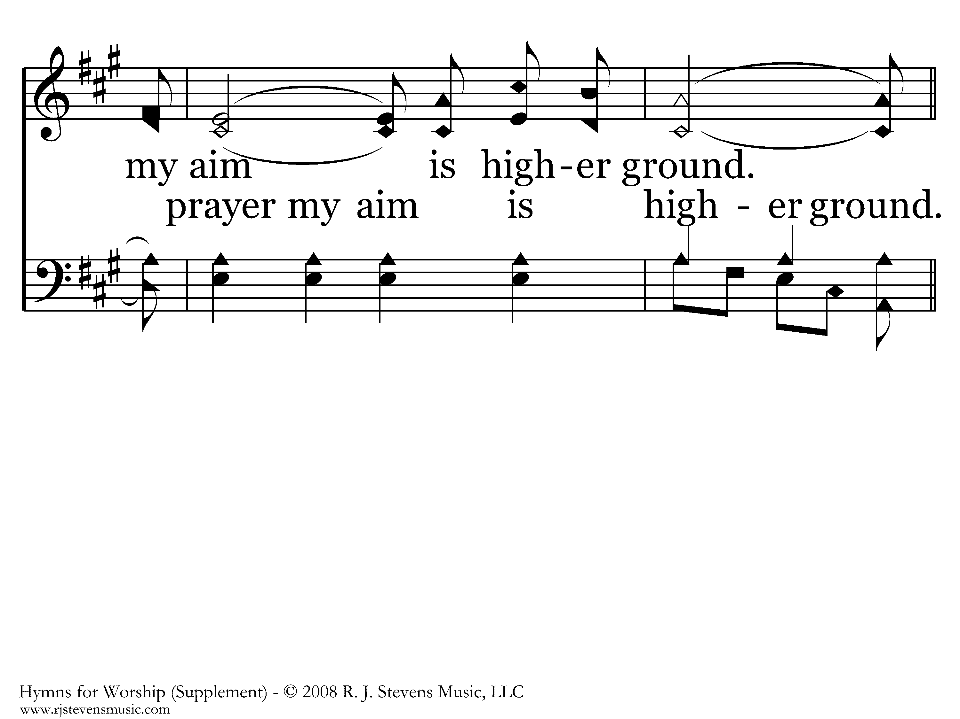
1002 - Higher Ground - 2.3

Slide 58
1002 - Higher Ground - C.1

Slide 59
1002 - Higher Ground - C.2

Slide 60
1002 - Higher Ground - C.3
End of Verse 2

Slide 61
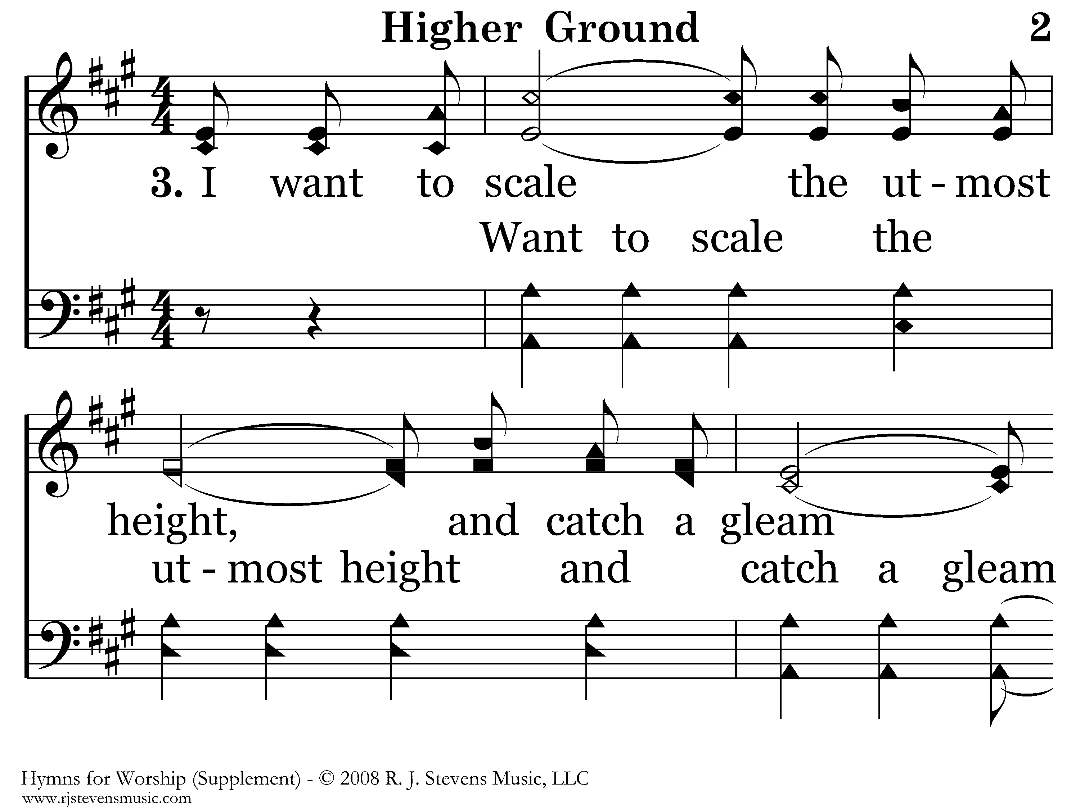
1002 - Higher Ground - 3.1

Slide 62
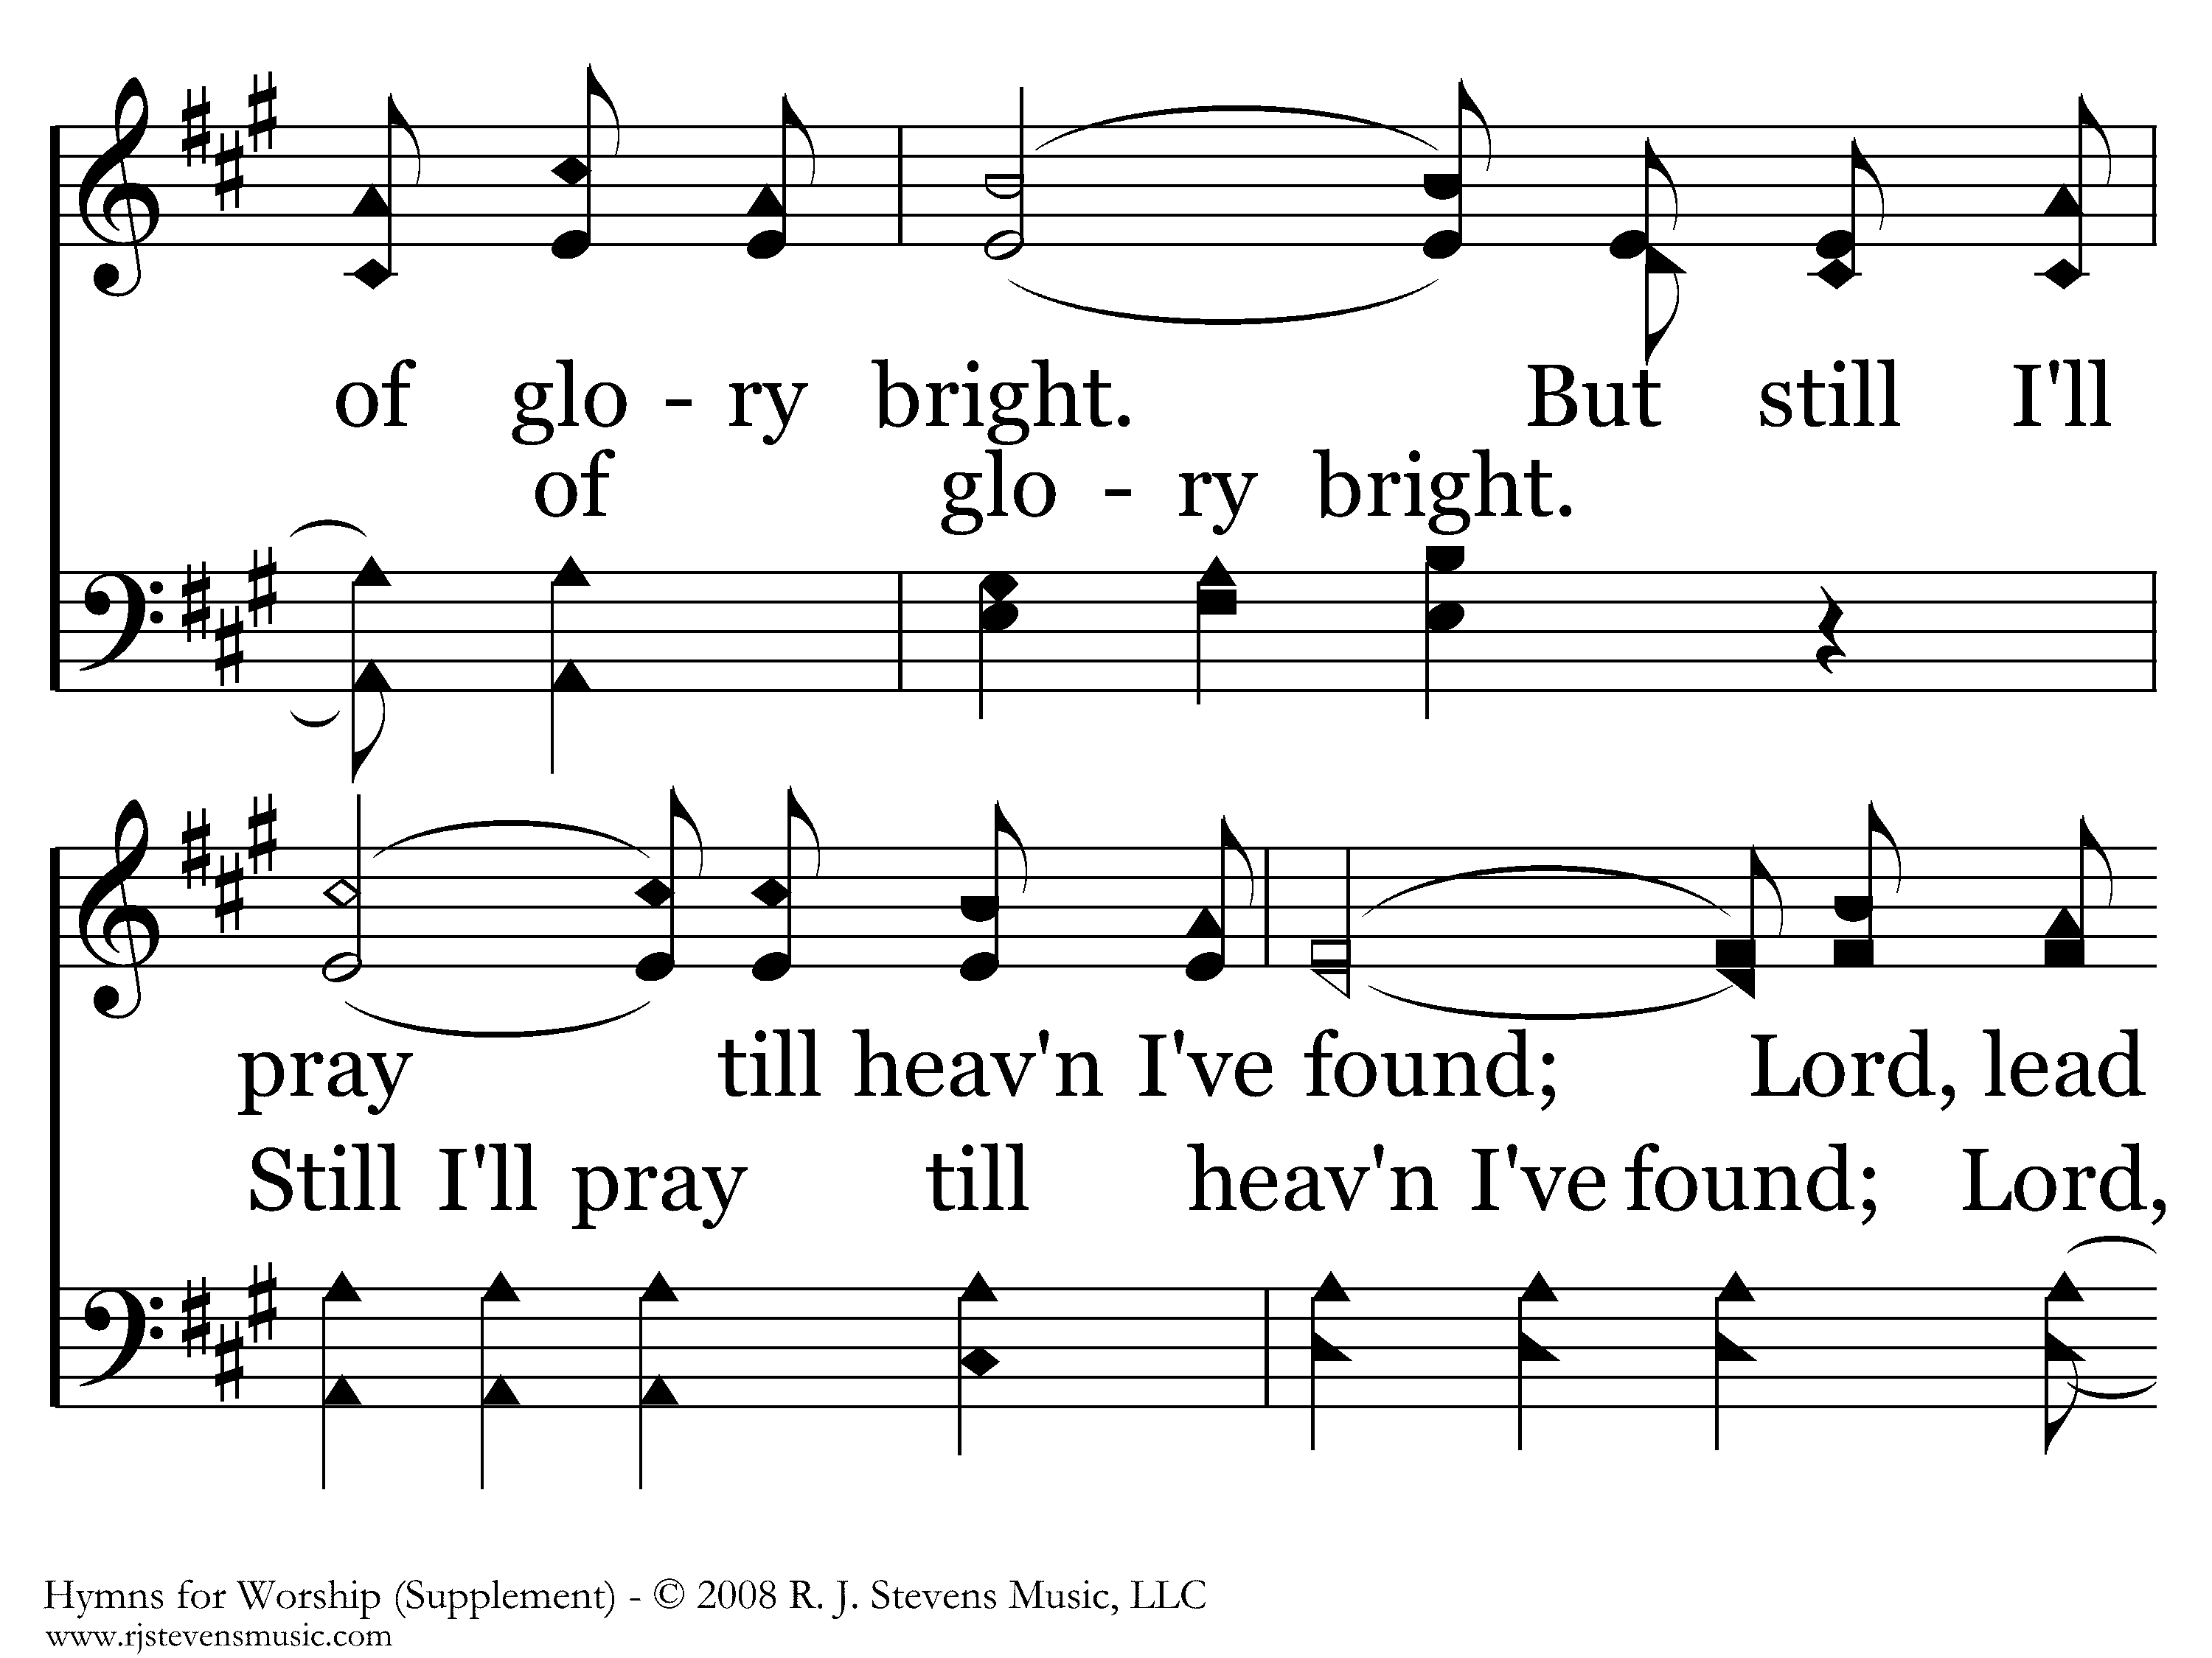
1002 - Higher Ground - 3.2

Slide 63
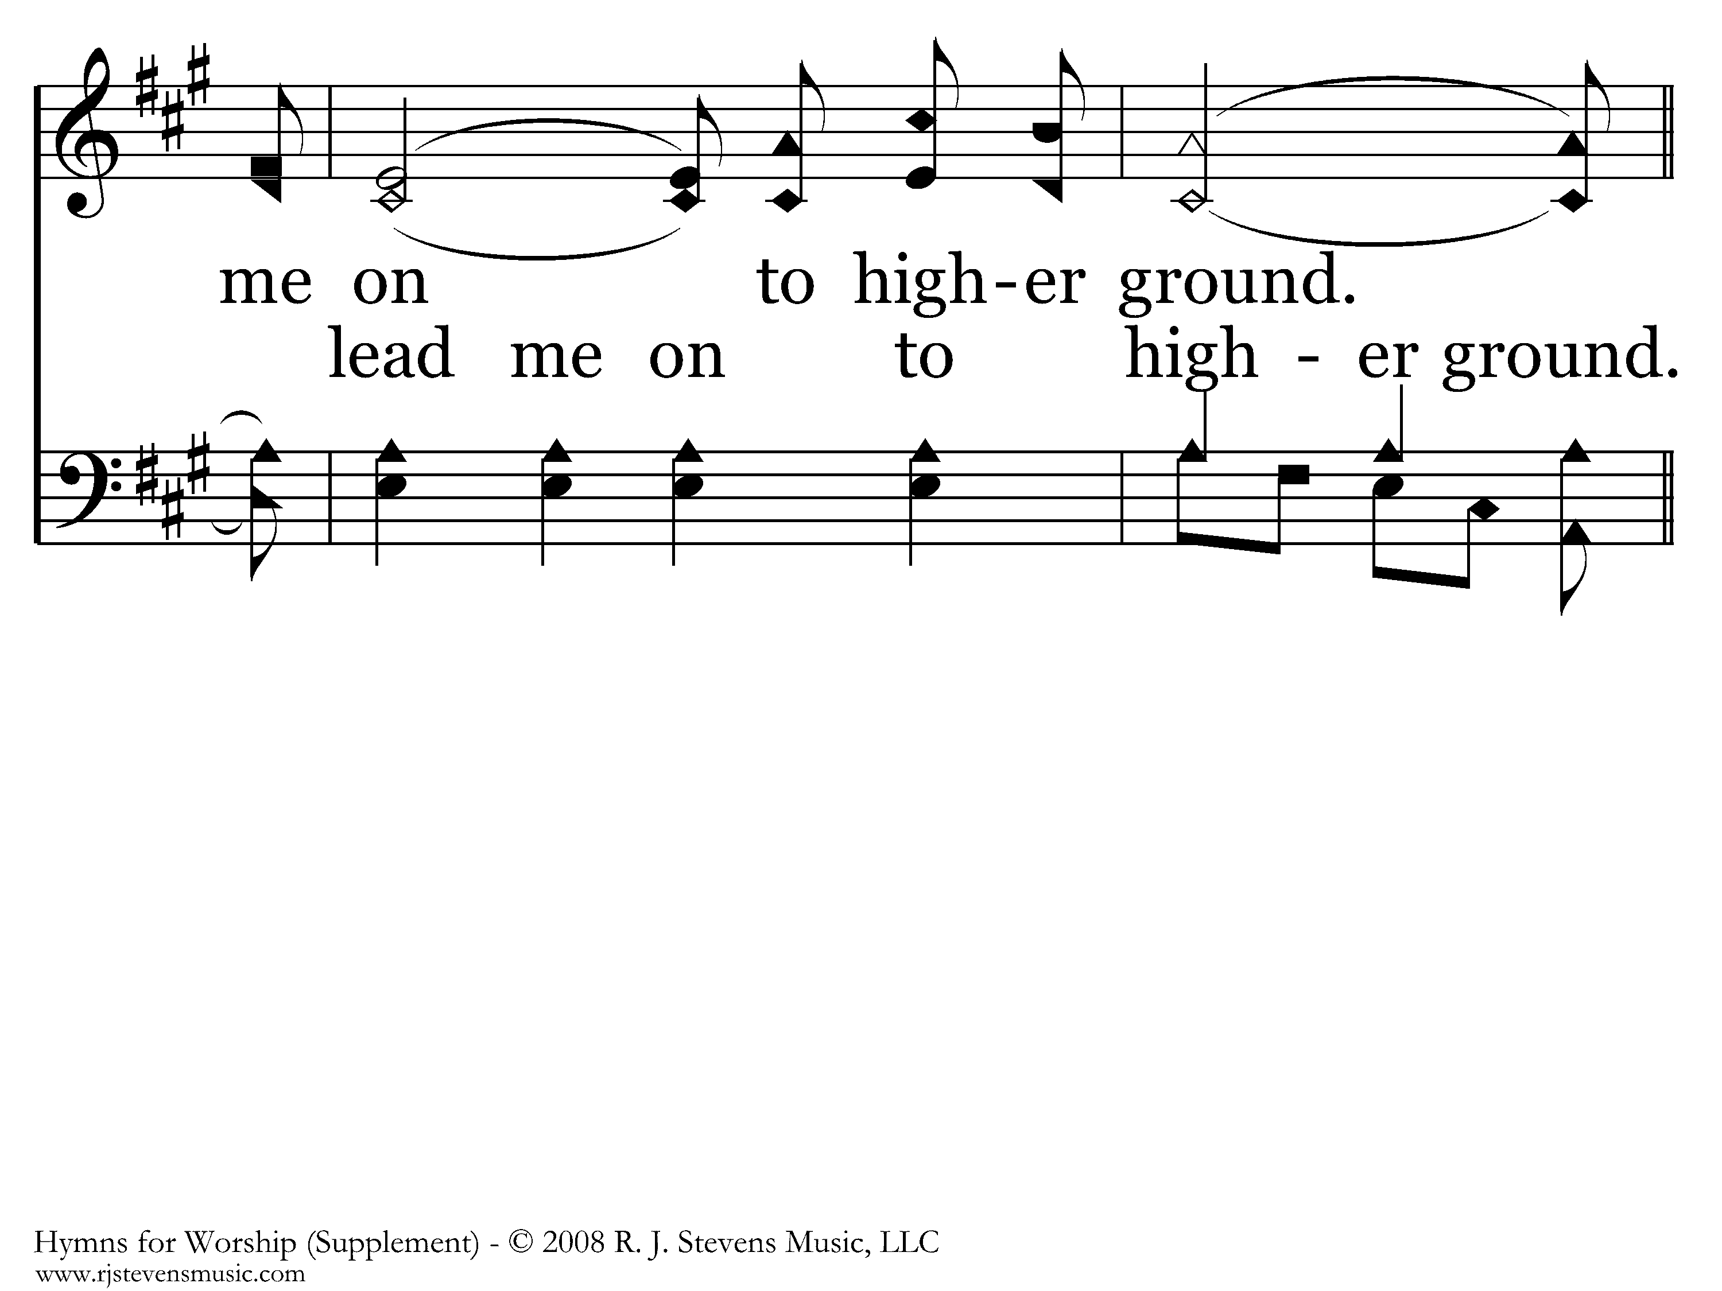
1002 - Higher Ground - 3.3

Slide 64
1002 - Higher Ground - C.1

Slide 65
1002 - Higher Ground - C.2

Slide 66
1002 - Higher Ground - C.3
End of Song

Slide 67
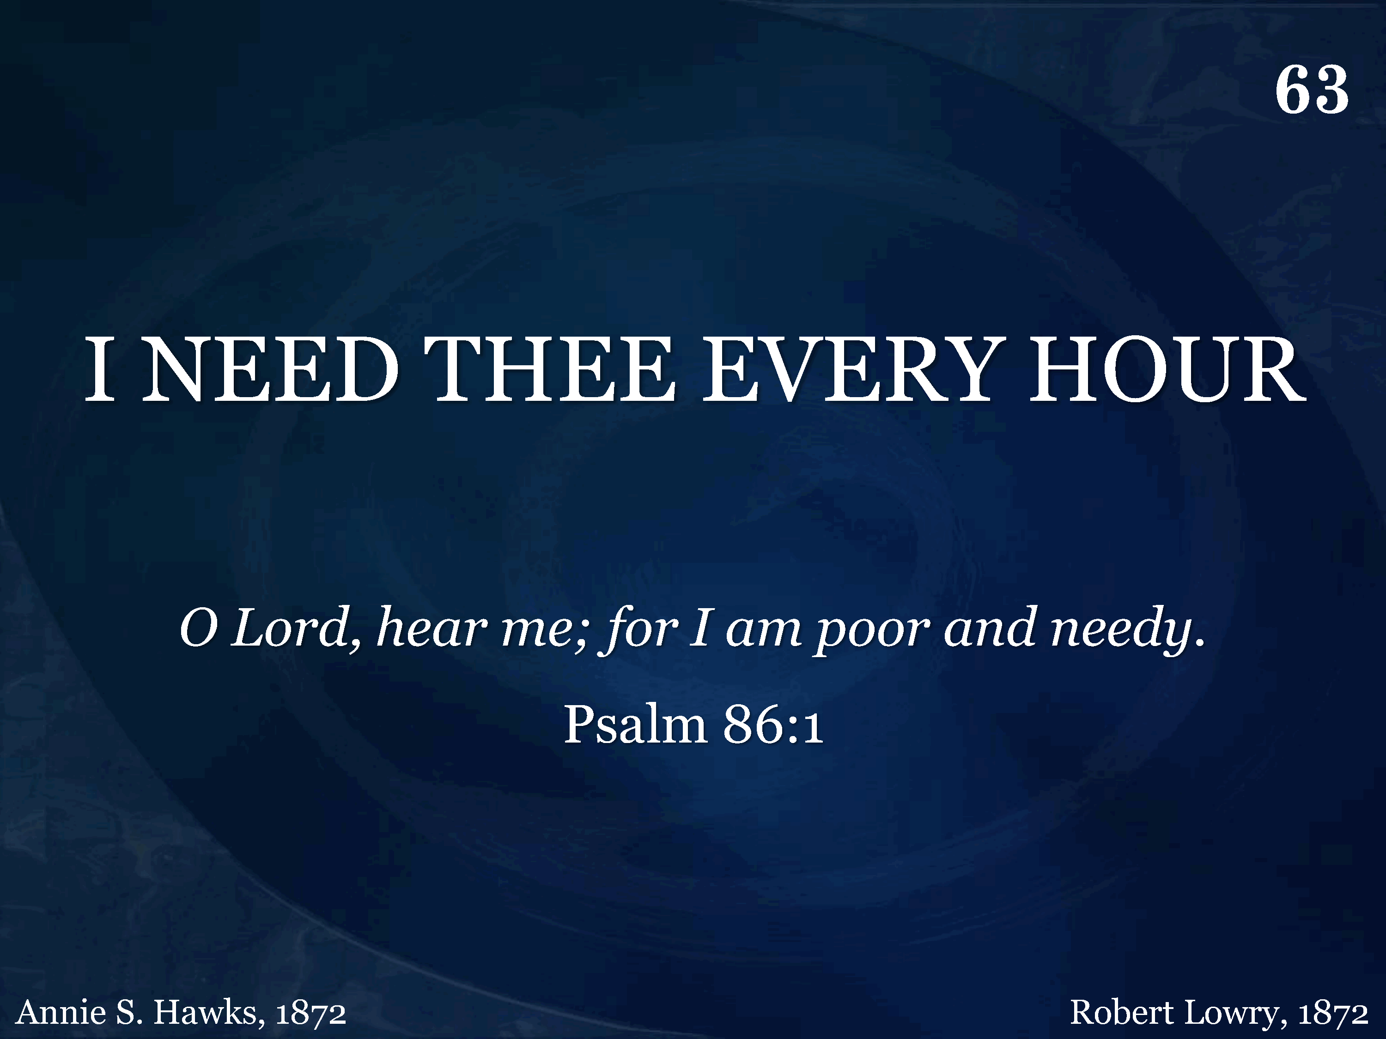
063 - I Need Thee Every Hour - Title

Slide 68
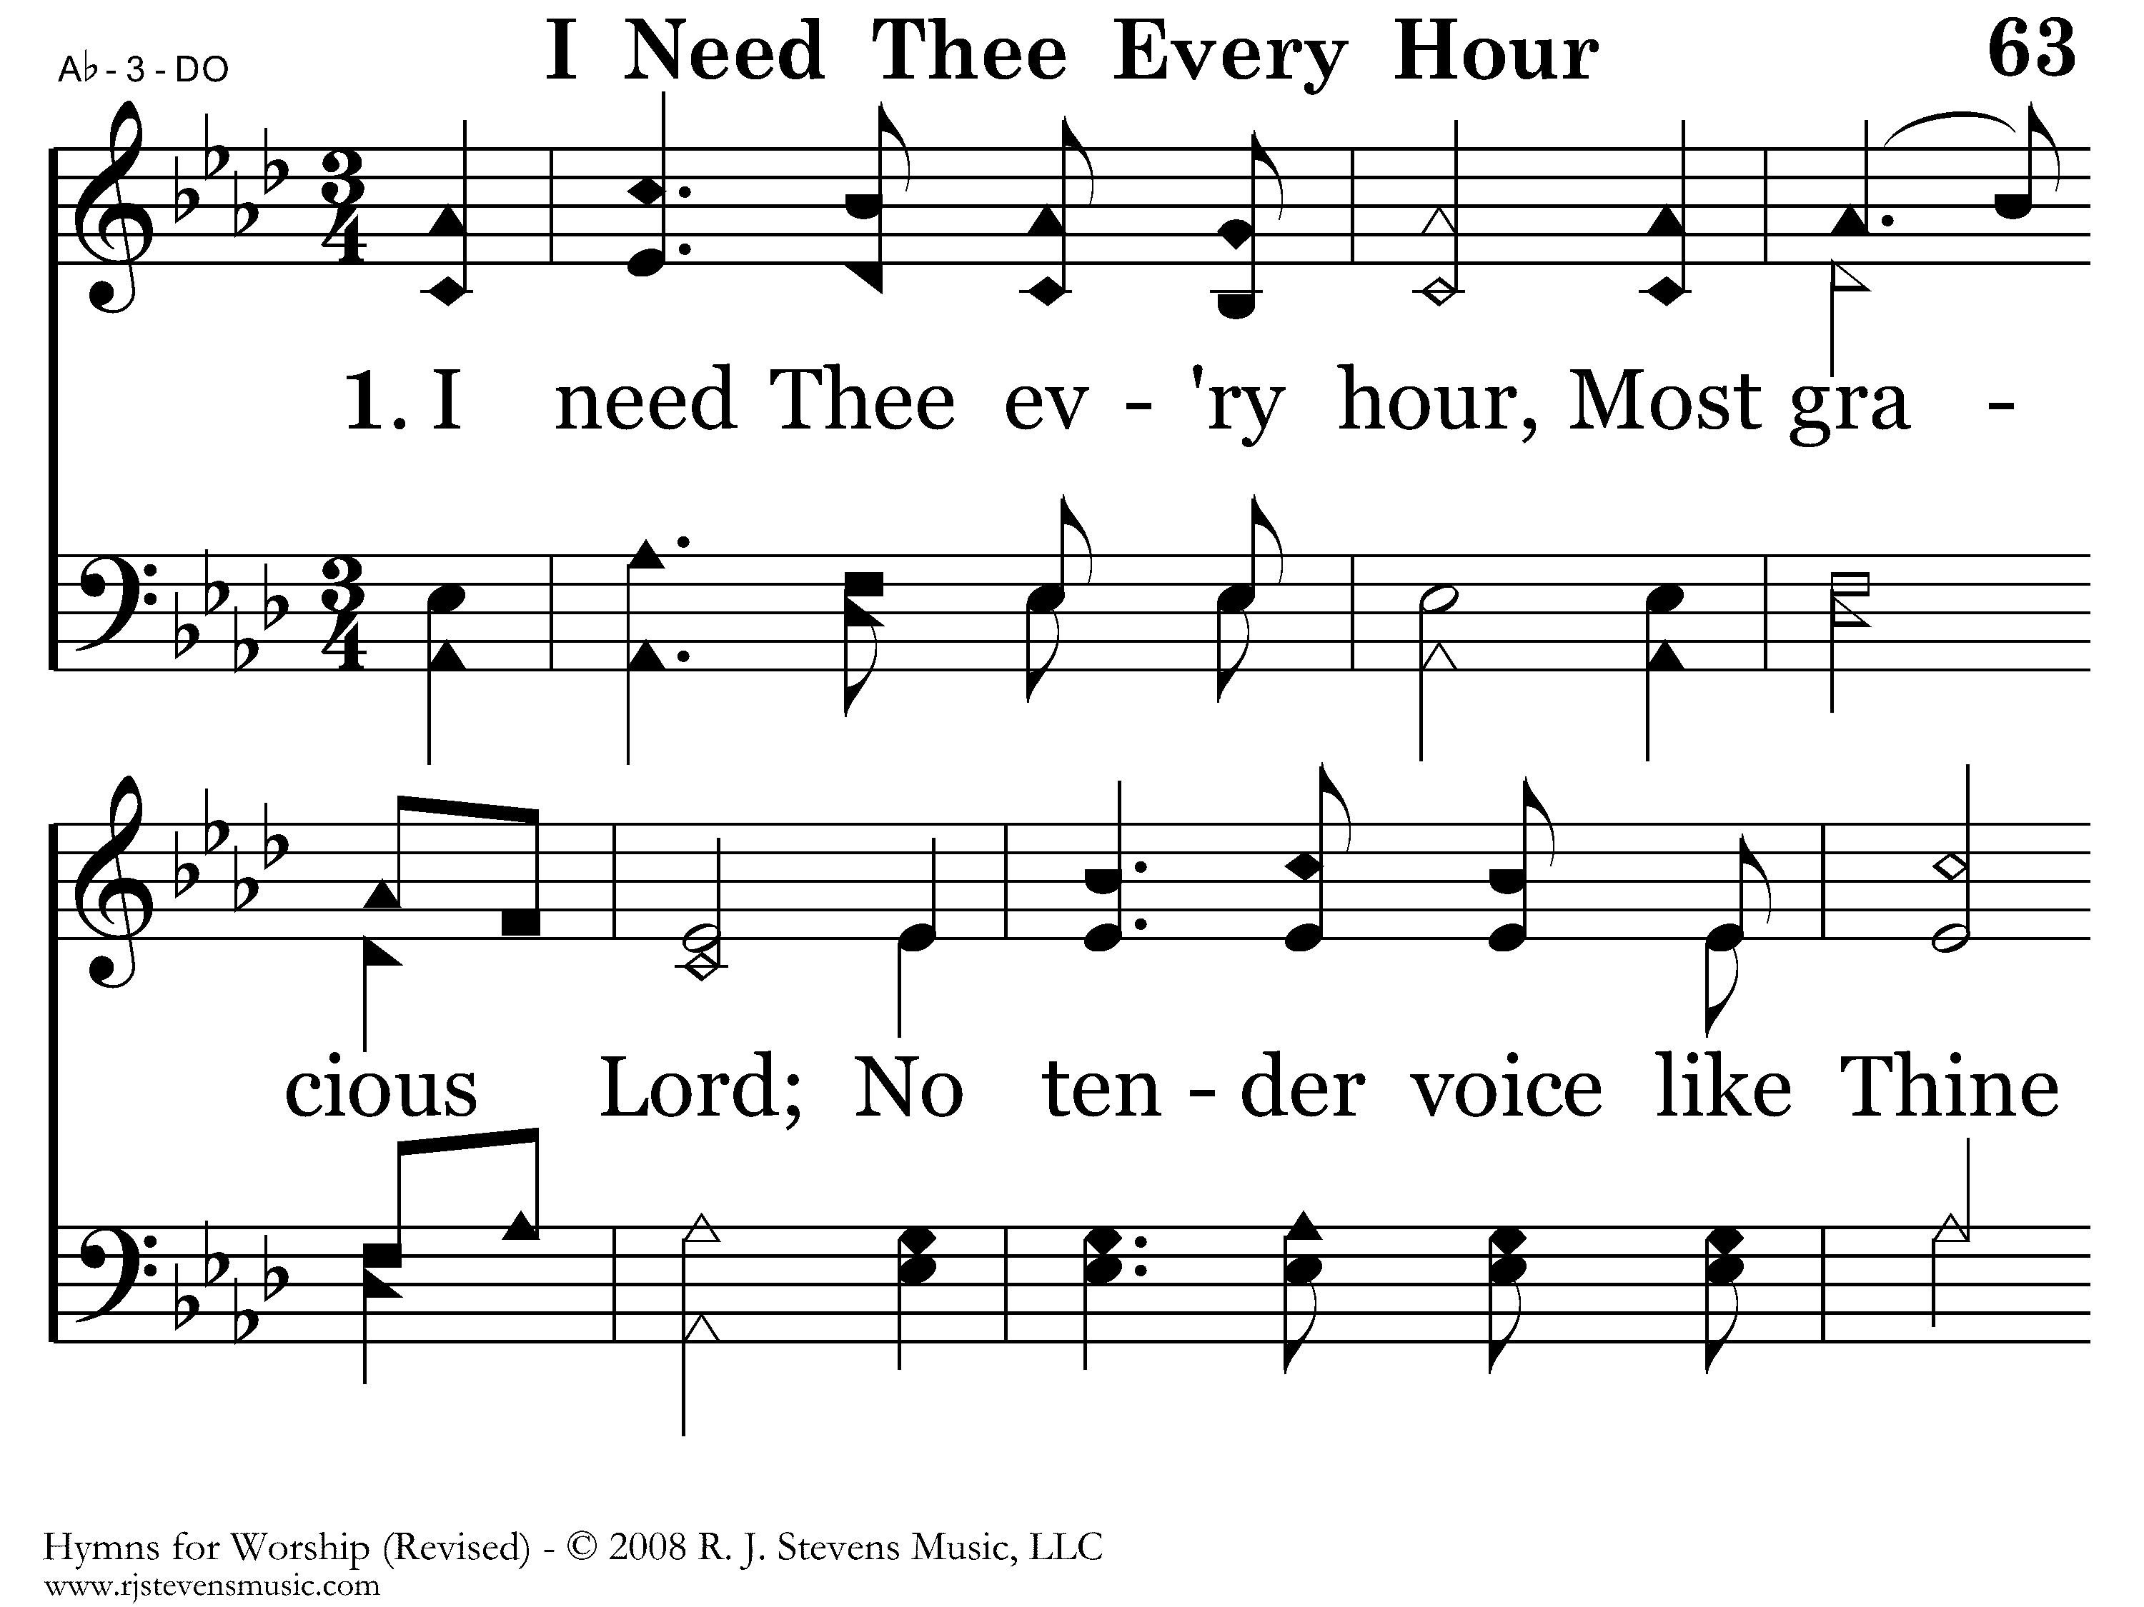
063 - I Need Thee Every Hour - 1.1

Slide 69
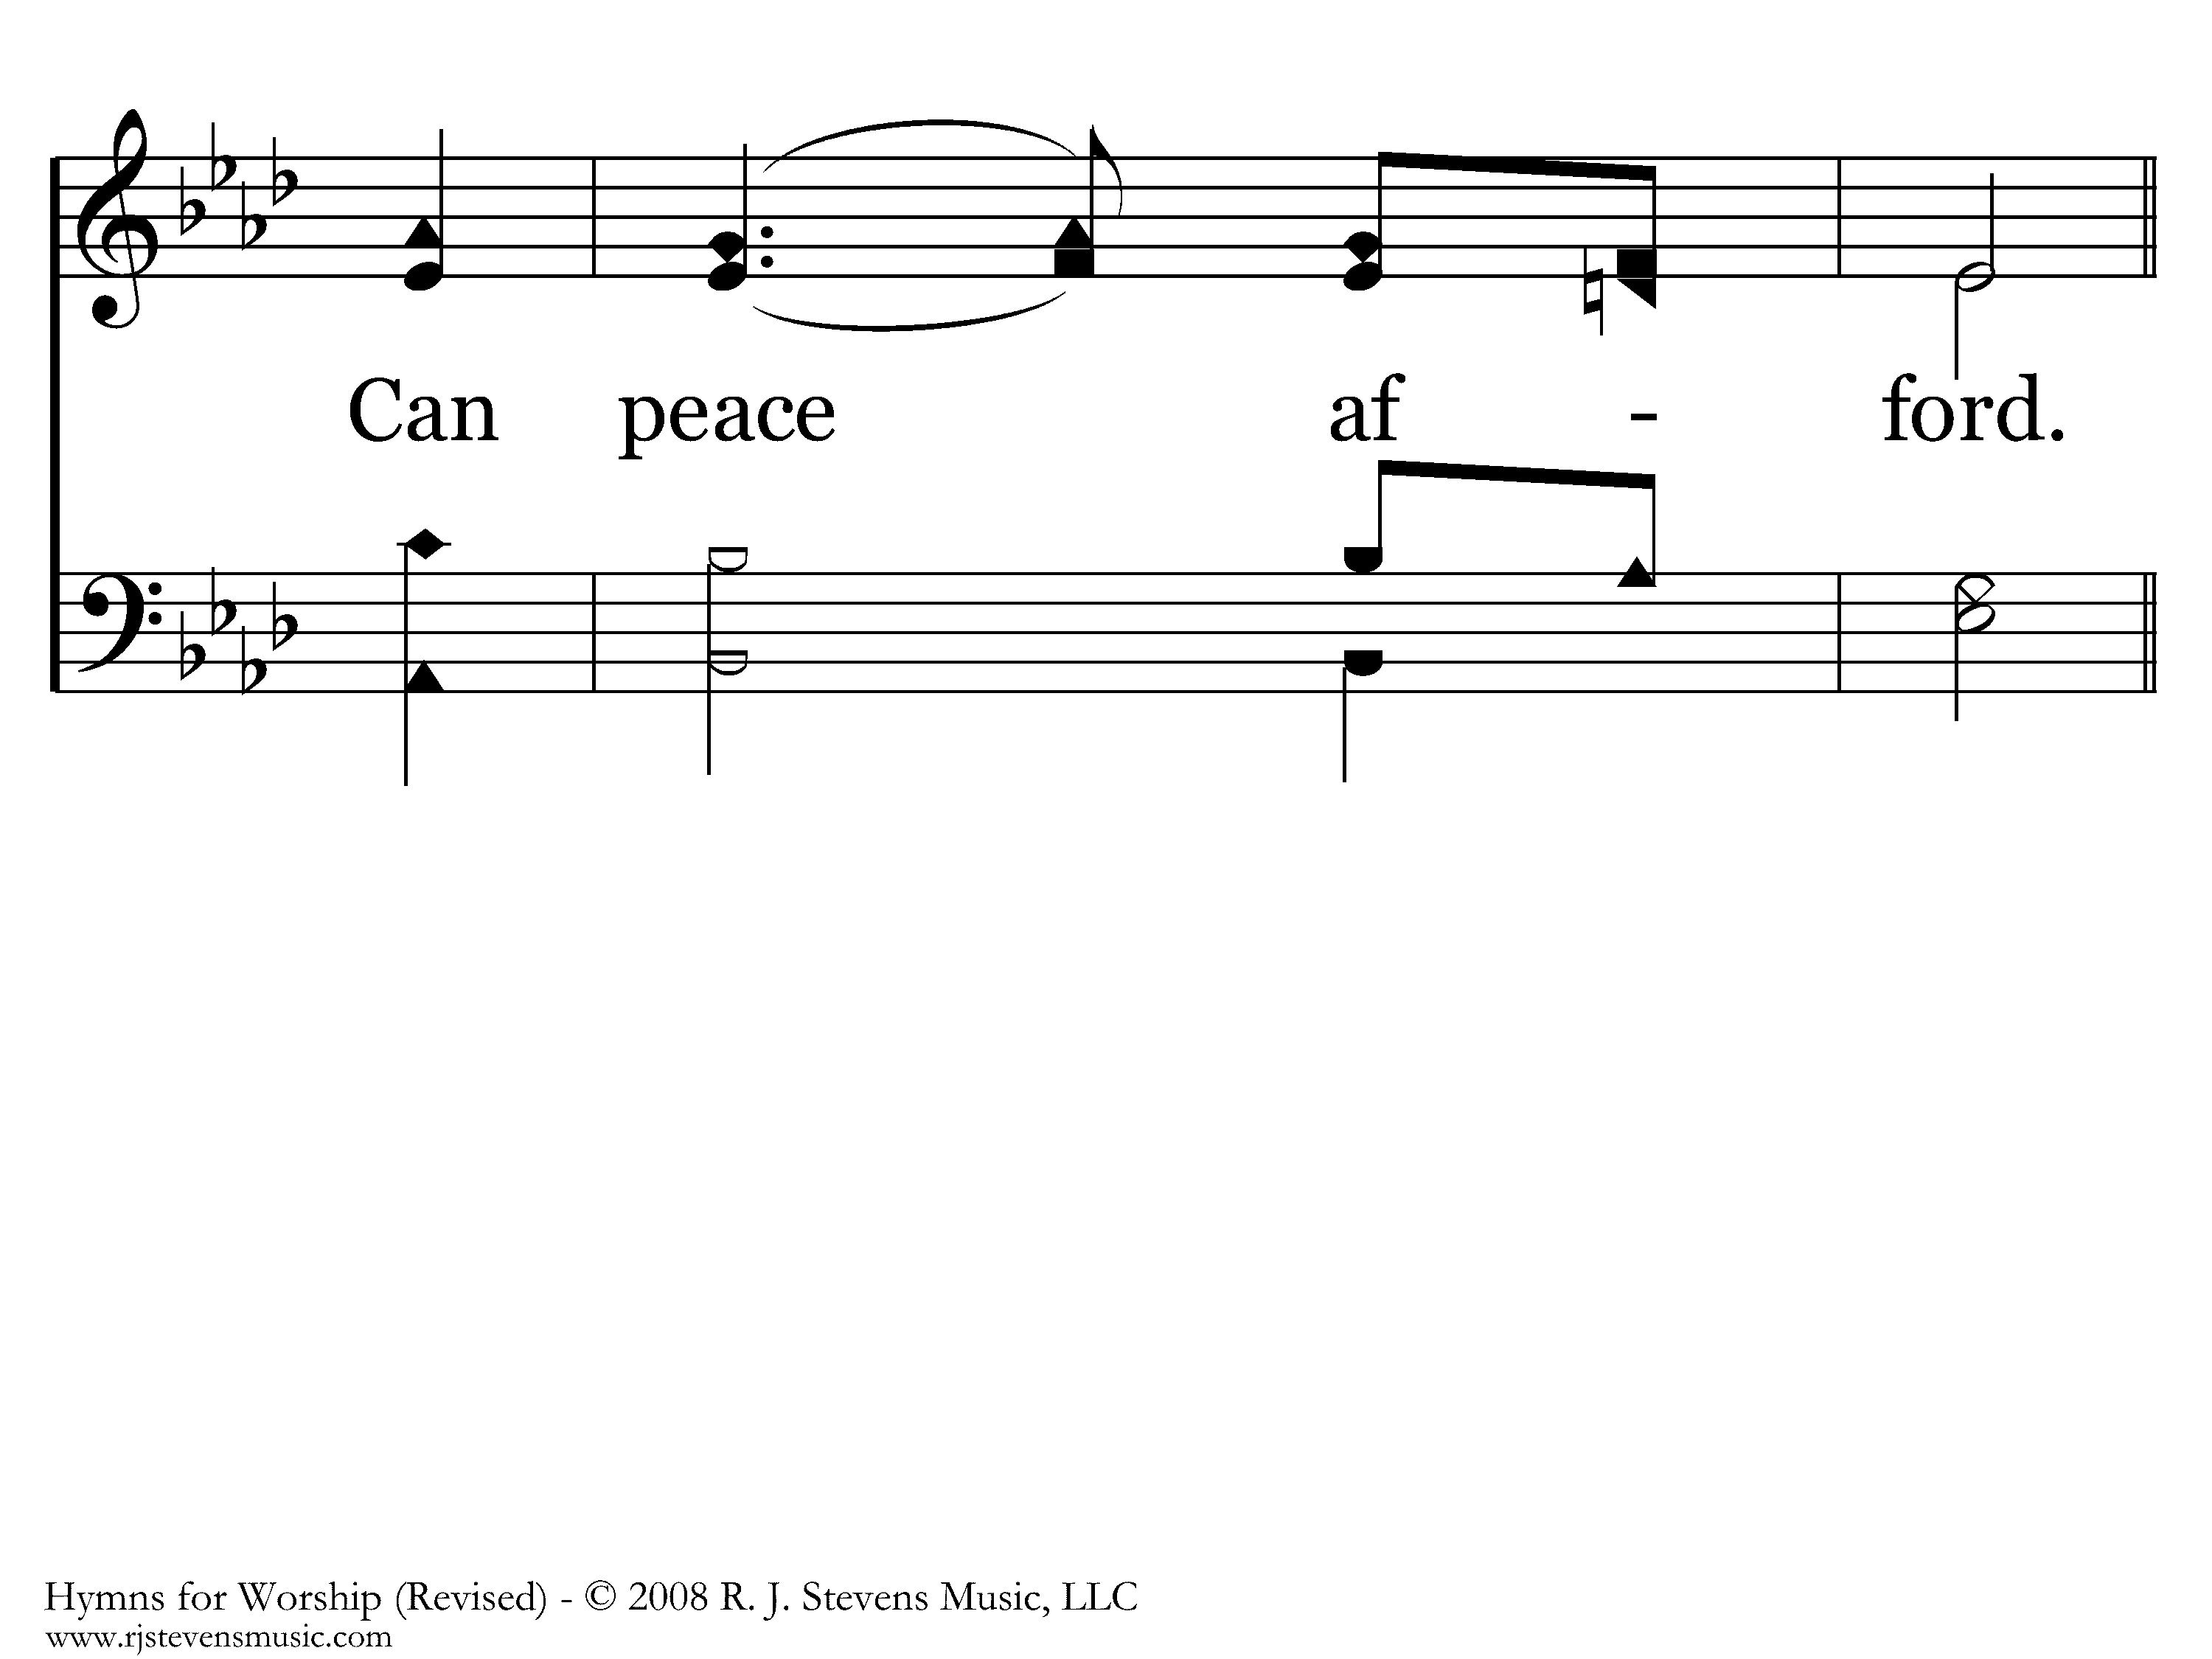
063 - I Need Thee Every Hour - 1.2

Slide 70
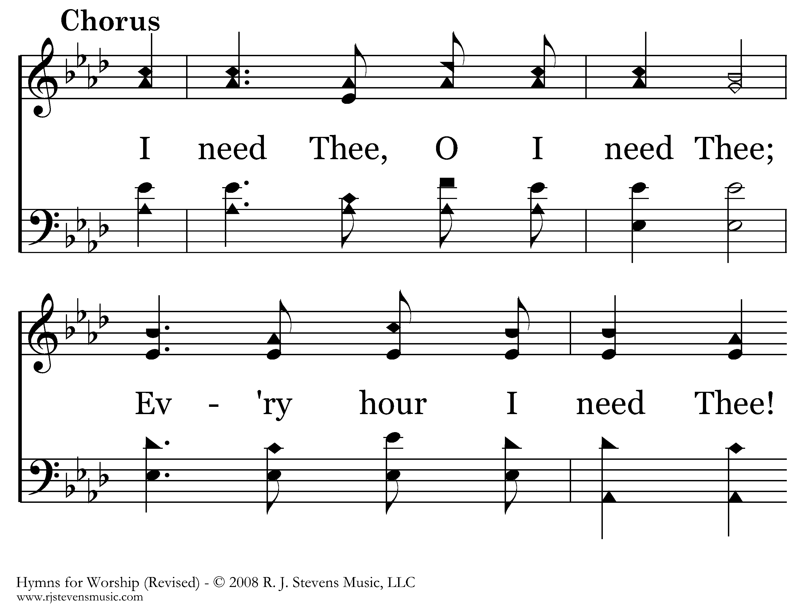
063 - I Need Thee Every Hour - C.1

Slide 71
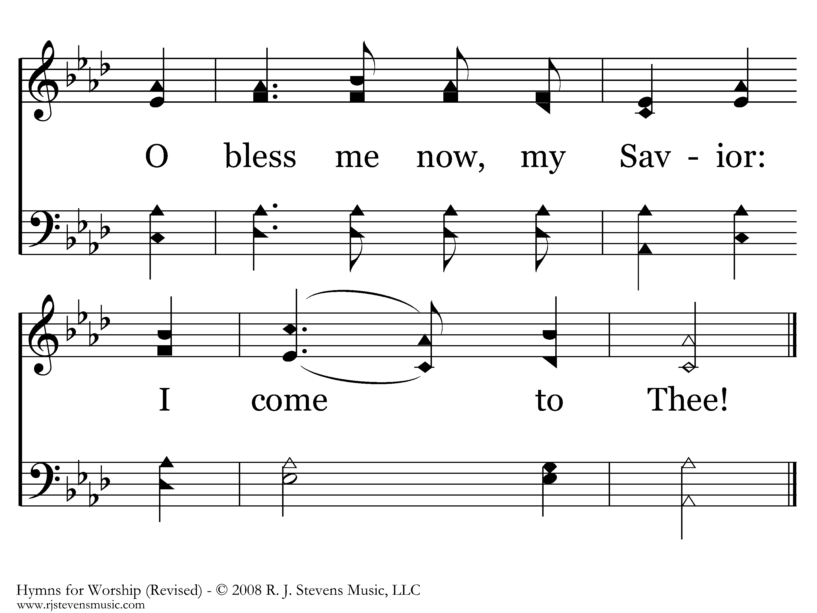
063 - I Need Thee Every Hour - C.2
End of Verse 1

Slide 72
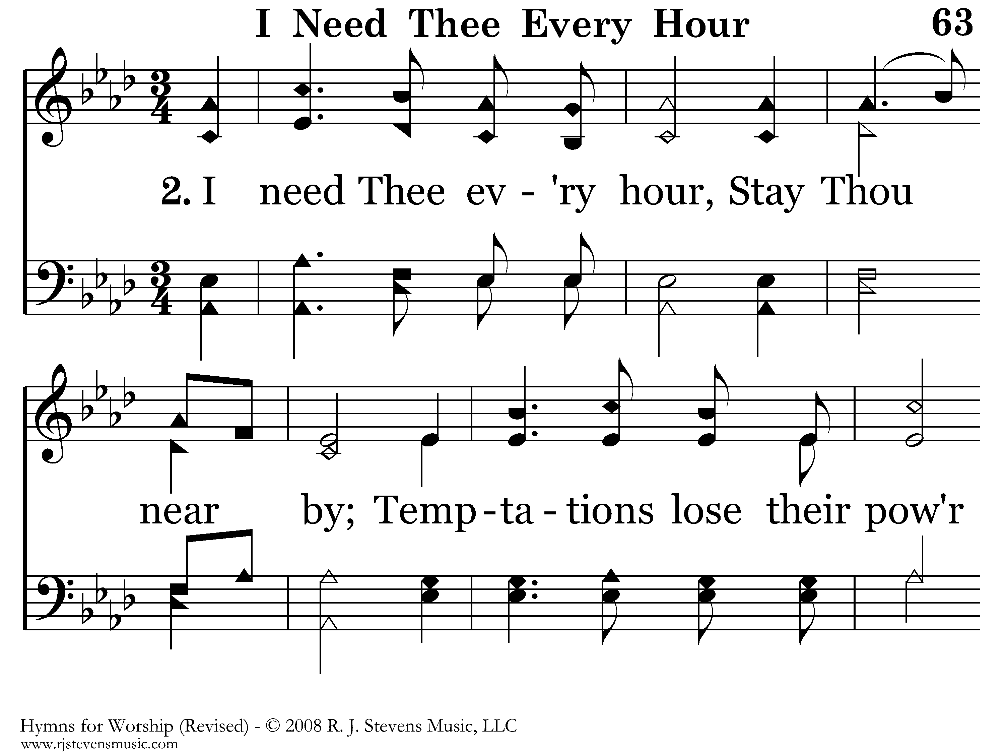
063 - I Need Thee Every Hour - 2.1

Slide 73
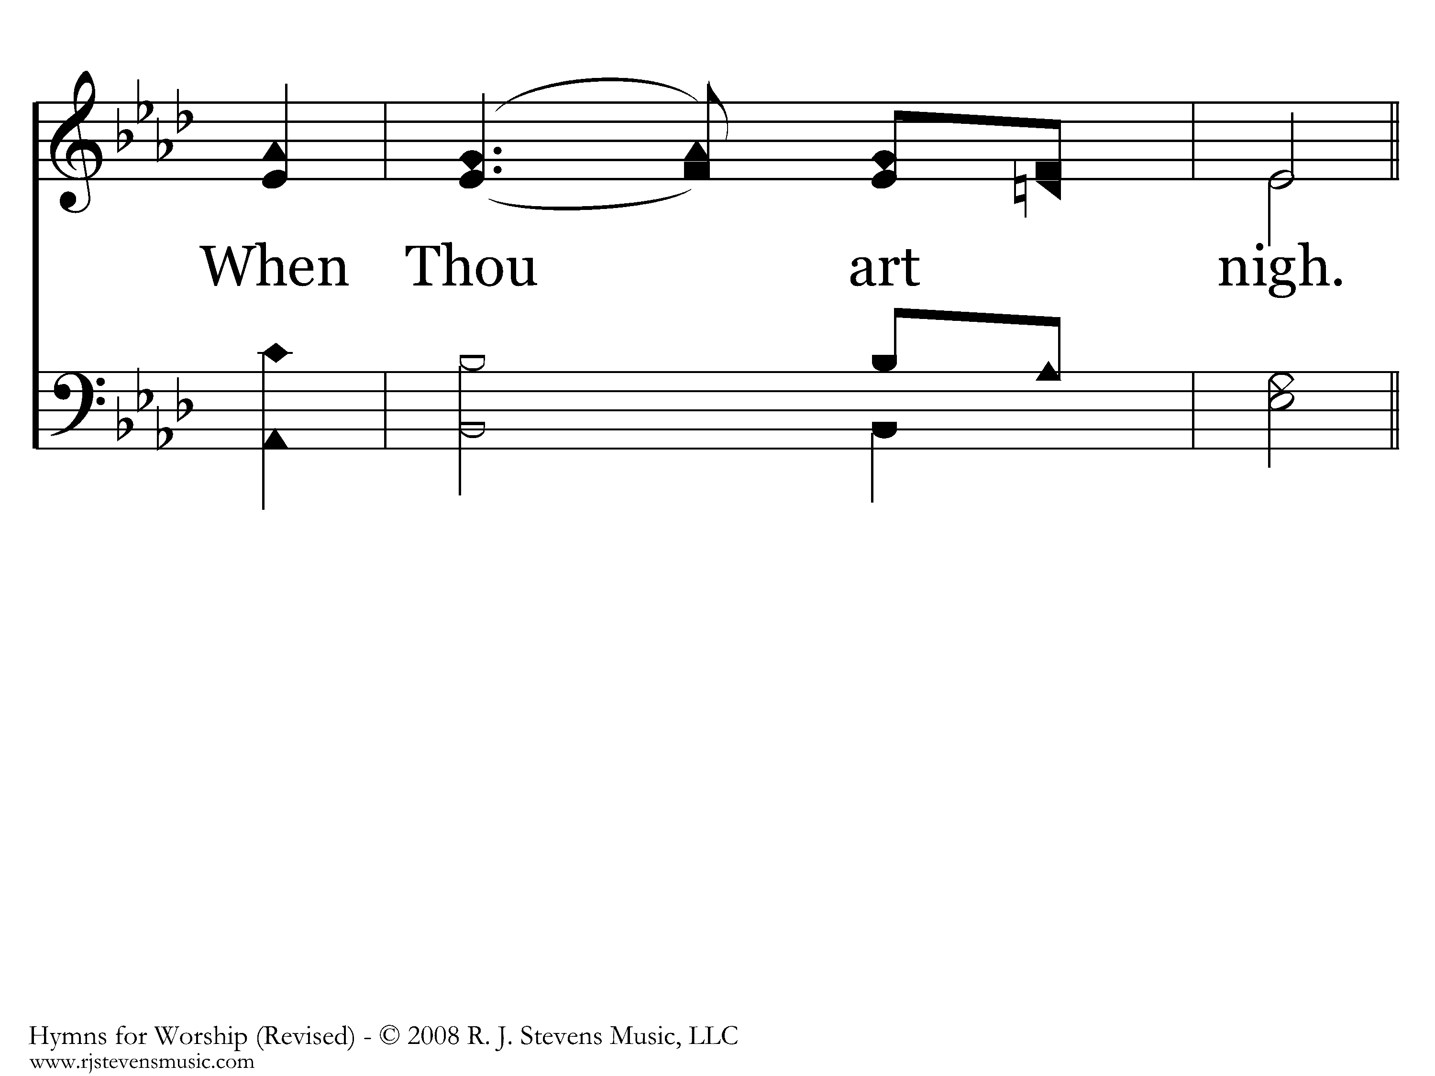
063 - I Need Thee Every Hour - 2.2

Slide 74
063 - I Need Thee Every Hour - C.1

Slide 75
063 - I Need Thee Every Hour - C.2
End of Verse 2

Slide 76

063 - I Need Thee Every Hour - 3.1

Slide 77

063 - I Need Thee Every Hour - 3.2

Slide 78
063 - I Need Thee Every Hour - C.1

Slide 79
063 - I Need Thee Every Hour - C.2
End of Verse 3

Slide 80

063 - I Need Thee Every Hour - 4.1

Slide 81

063 - I Need Thee Every Hour - 4.2

Slide 82
063 - I Need Thee Every Hour - C.1

Slide 83
063 - I Need Thee Every Hour - C.2

Slide 84

063 - I Need Thee Every Hour - D.1
End of Song

