Slide 2
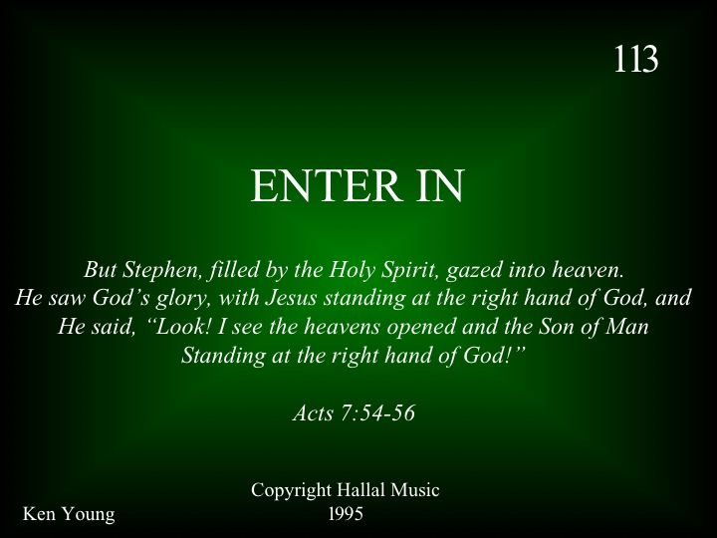

Slide 3
CCLI# 2043526

Slide 11
End of Verse 1

Slide 20
End of Song

Slide 22
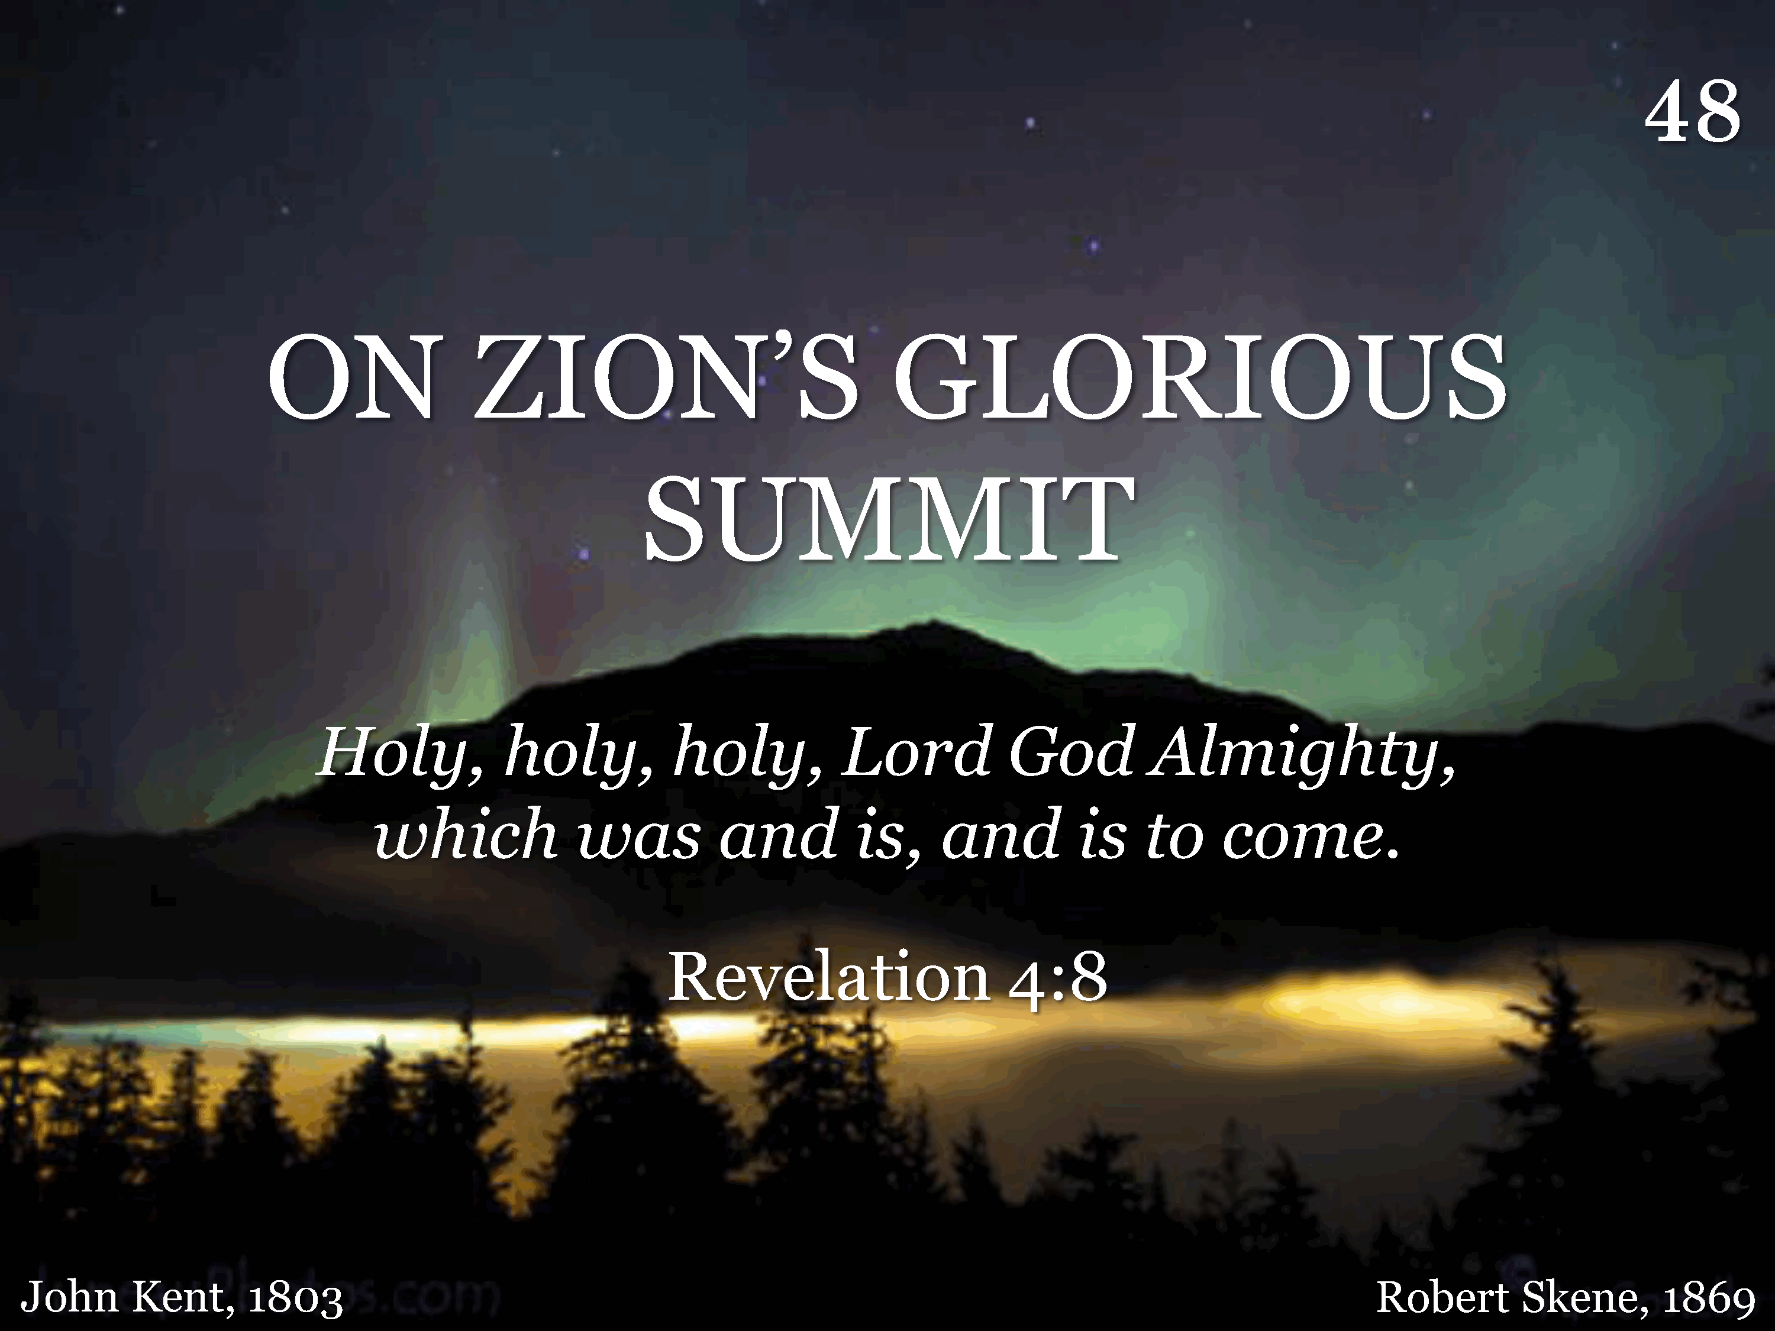
048 - On Zion's Glorious Summit - Title

Slide 23
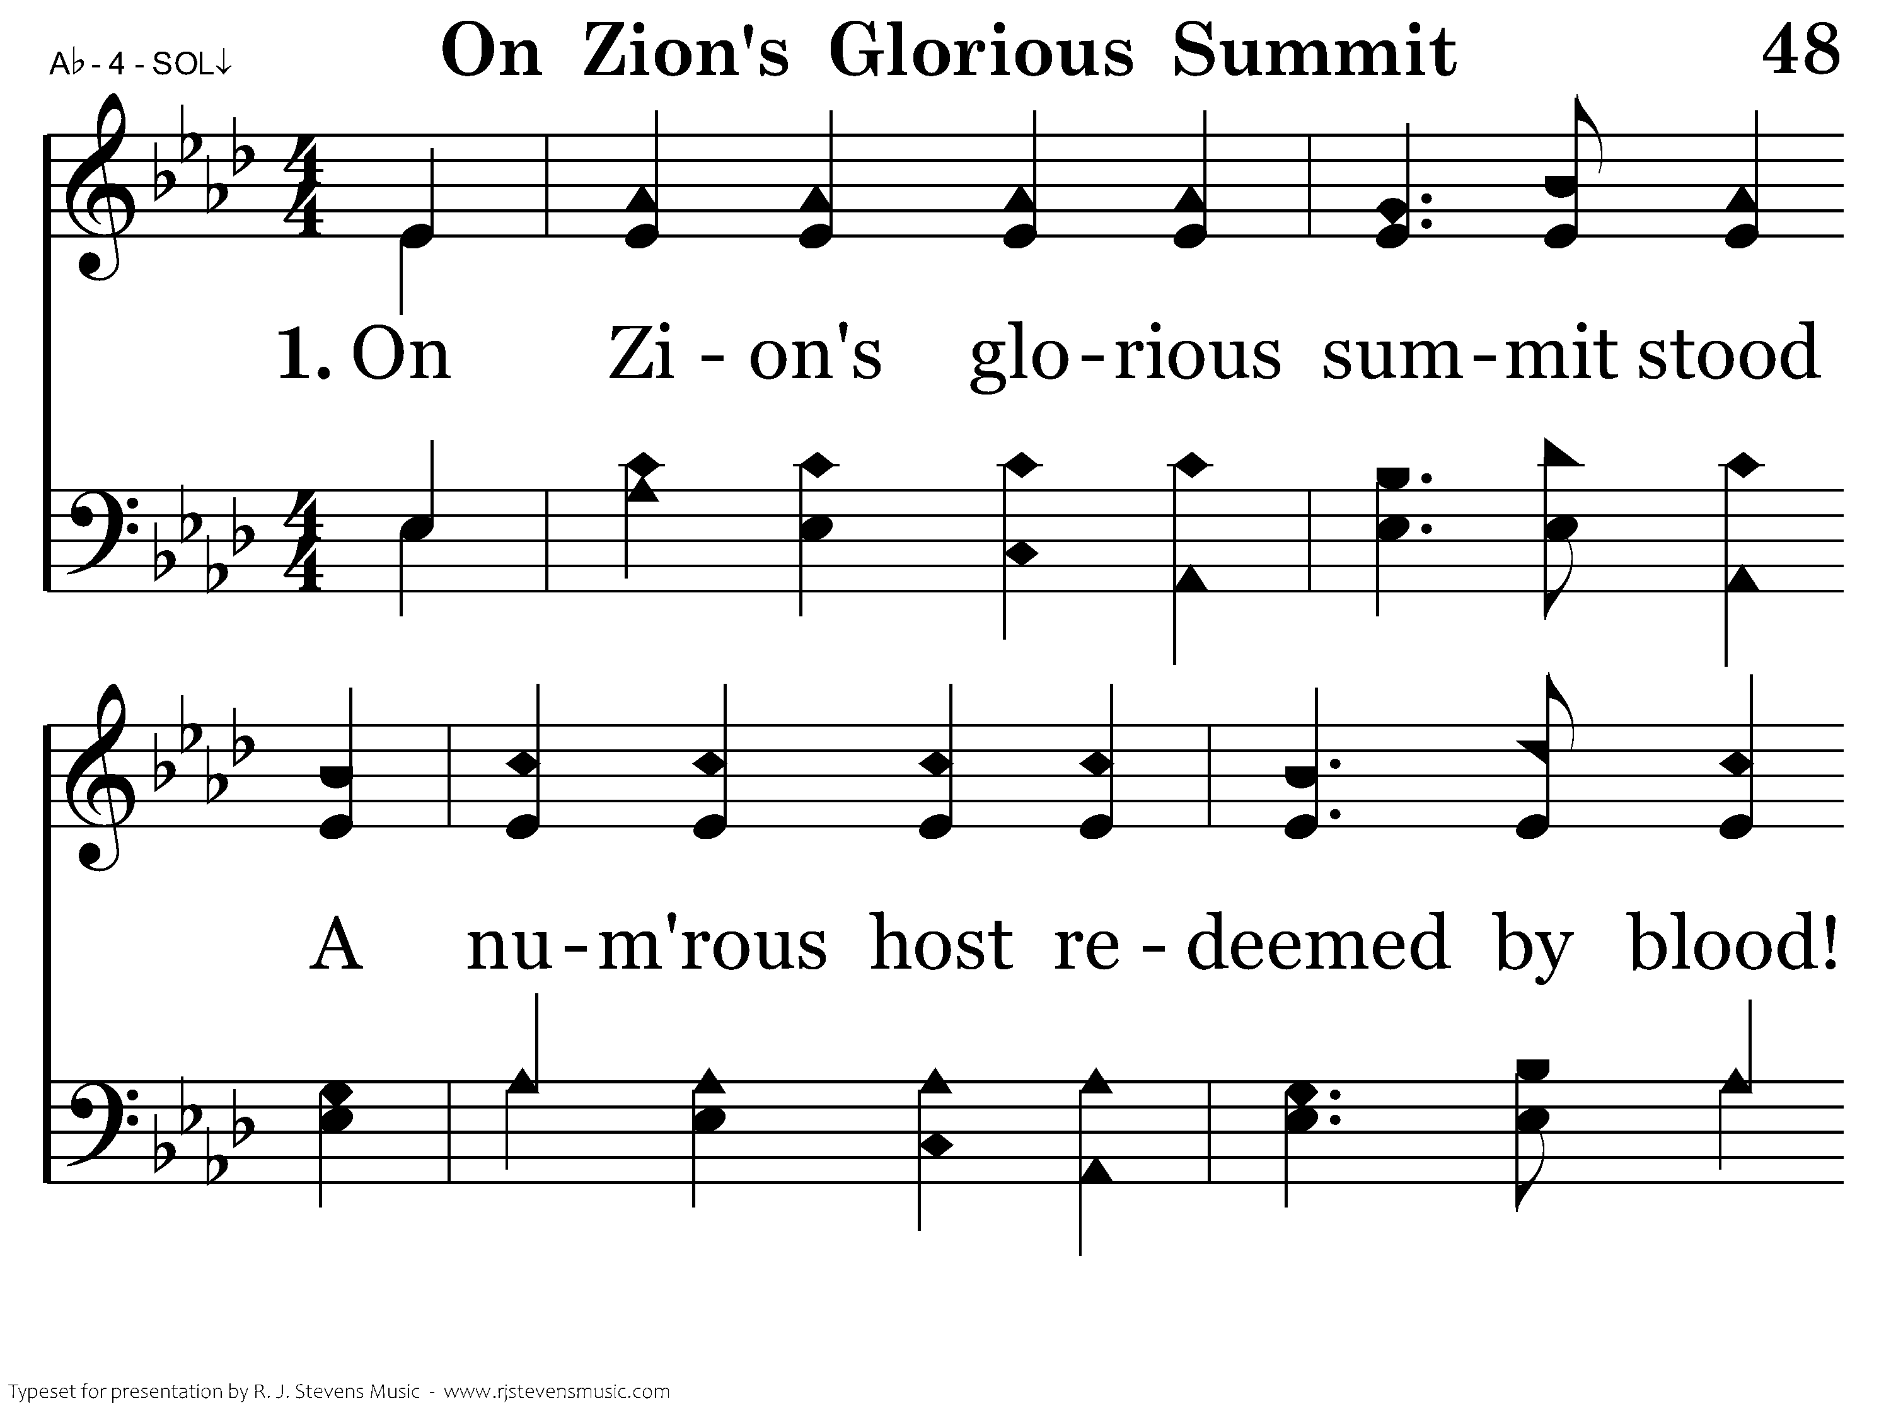
048 - On Zion's Glorious Summit - 1.1

Slide 24
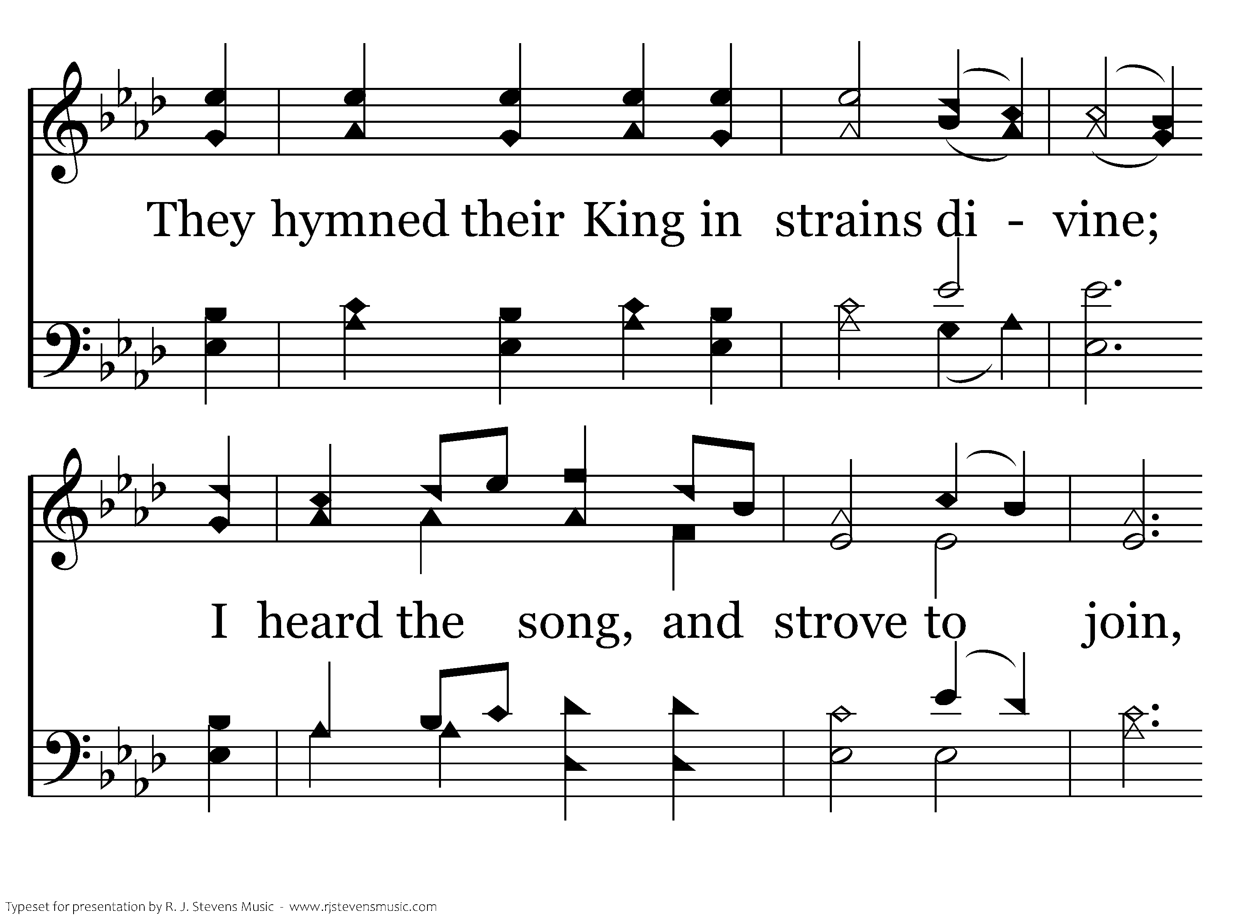
048 - On Zion's Glorious Summit - 1.2

Slide 25
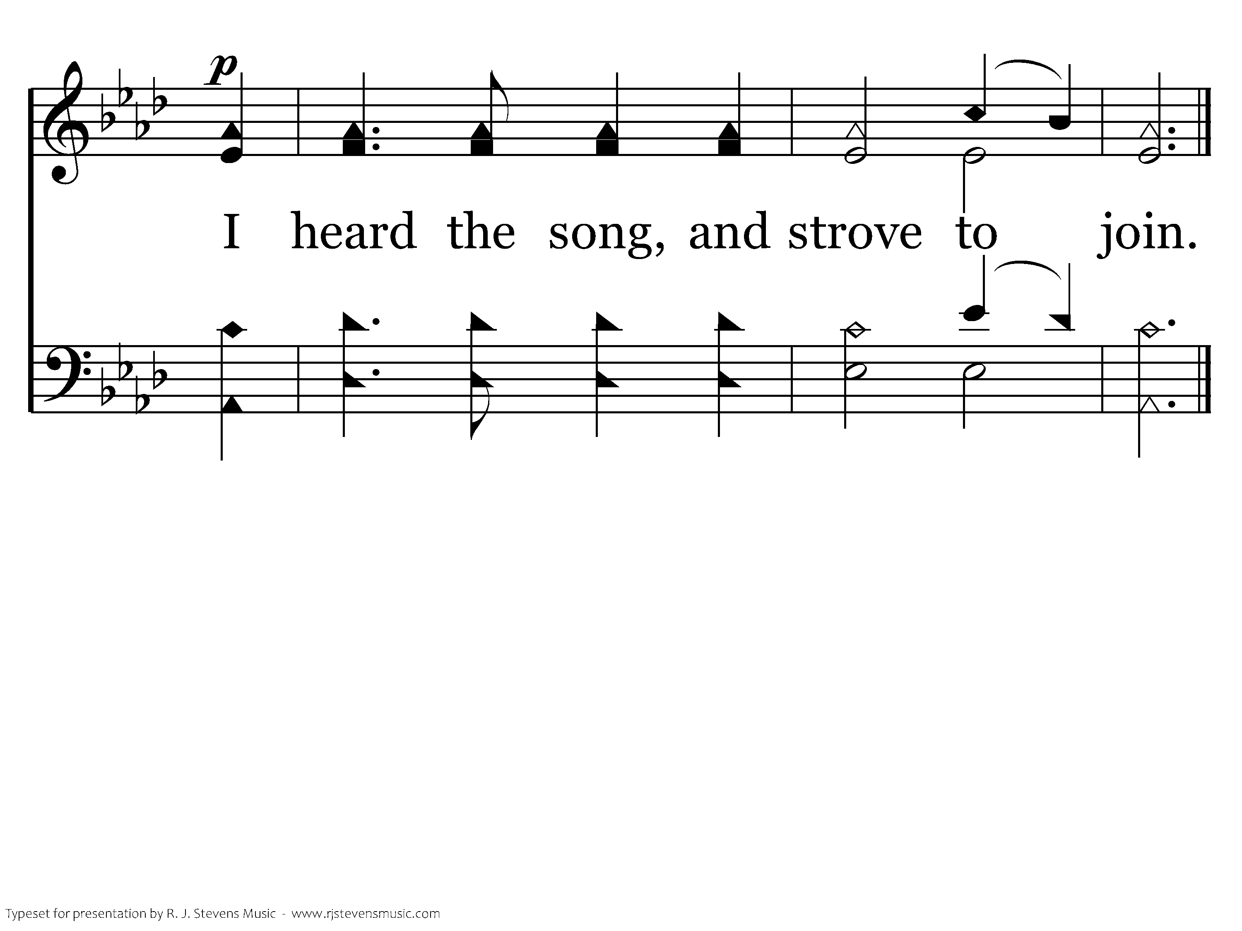
048 - On Zion's Glorious Summit - 1.3
End of Verse 1

Slide 26
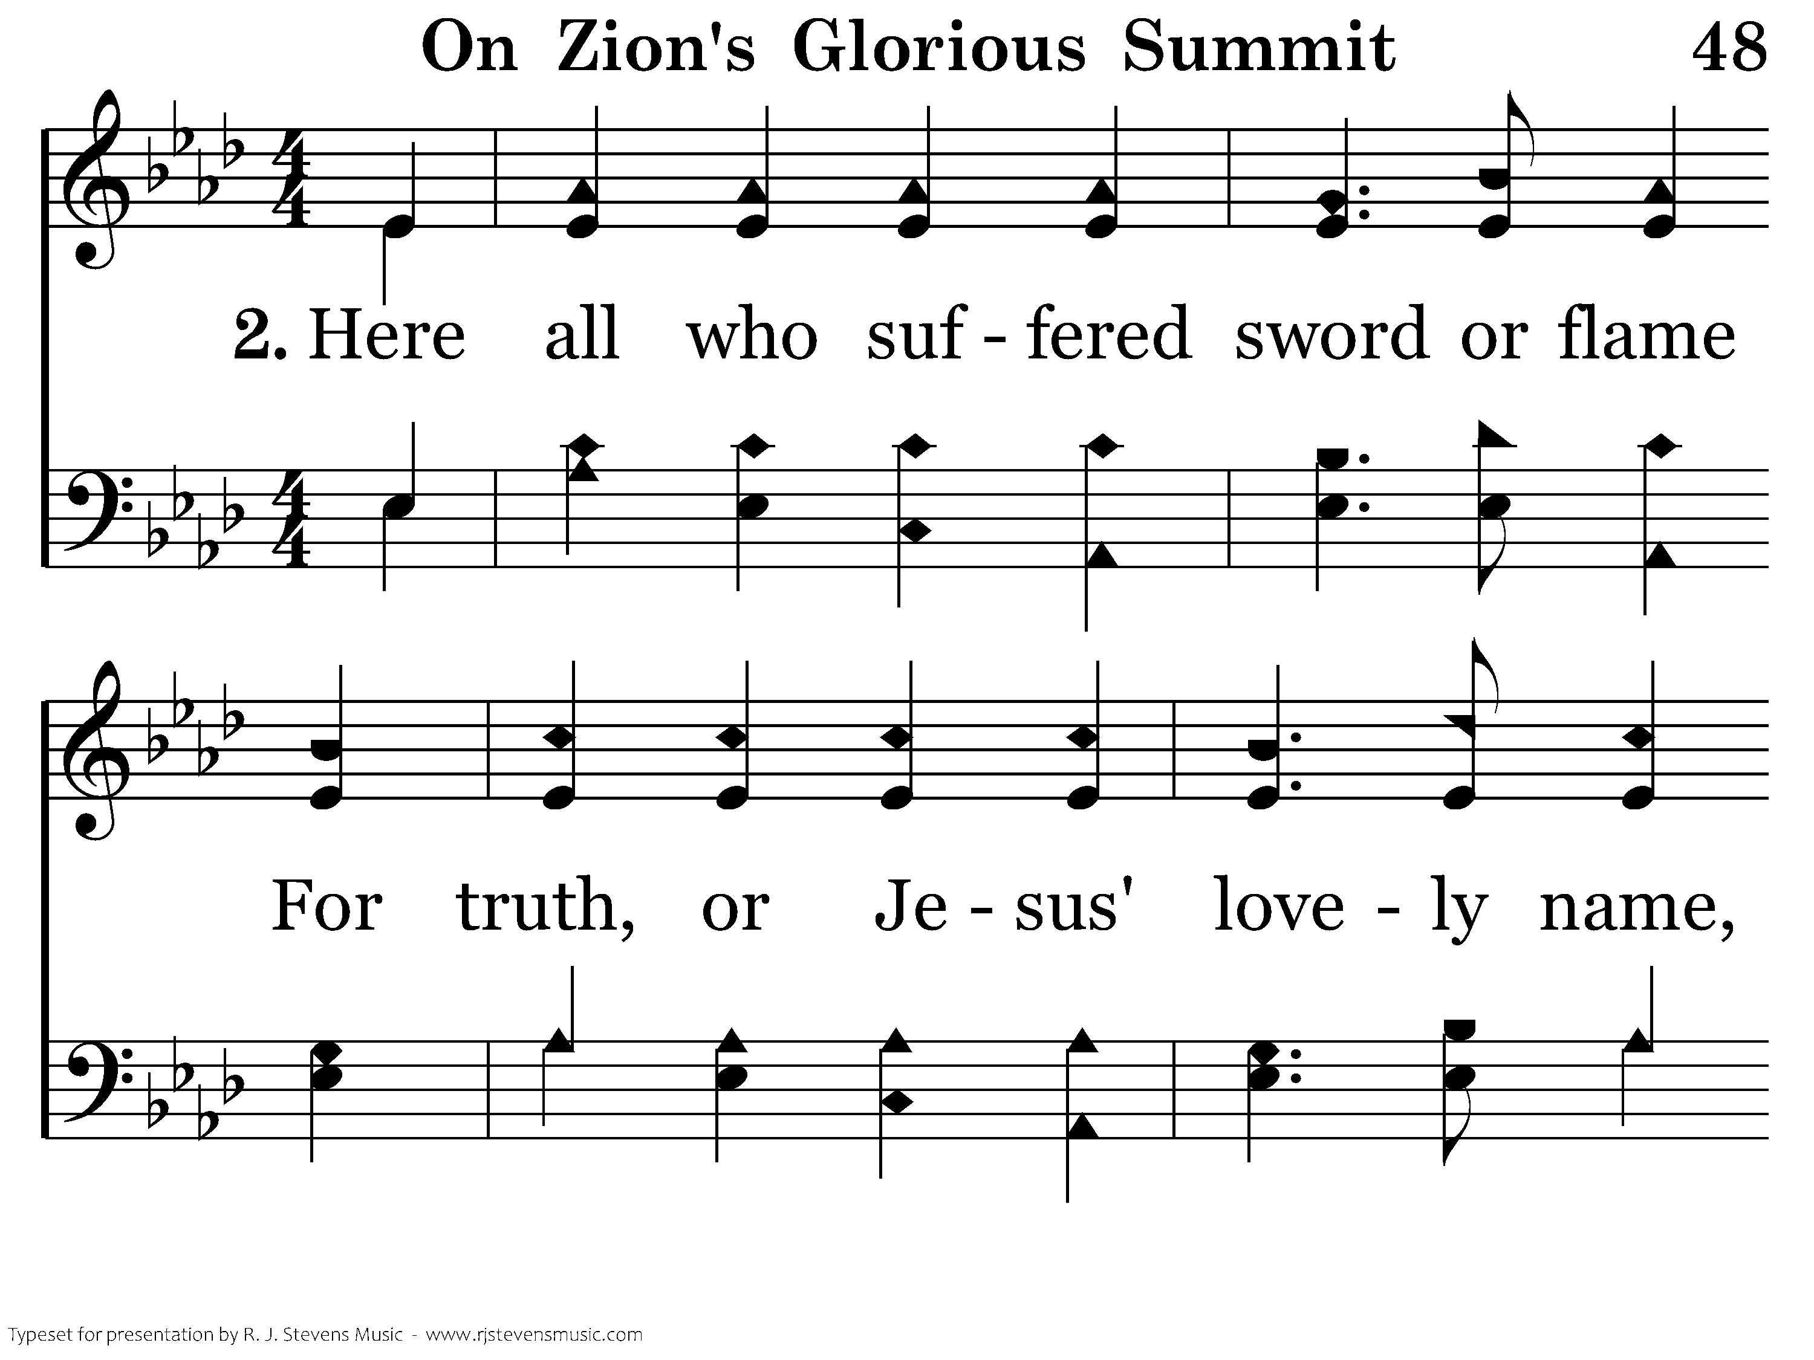
048 - On Zion's Glorious Summit - 2.1

Slide 27
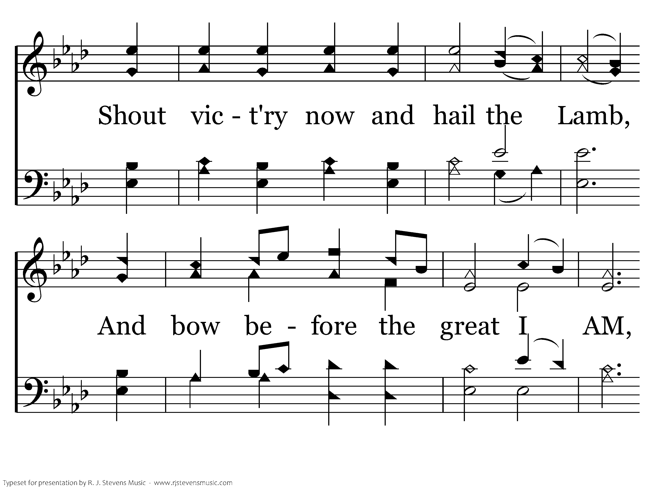
048 - On Zion's Glorious Summit - 2.2

Slide 28
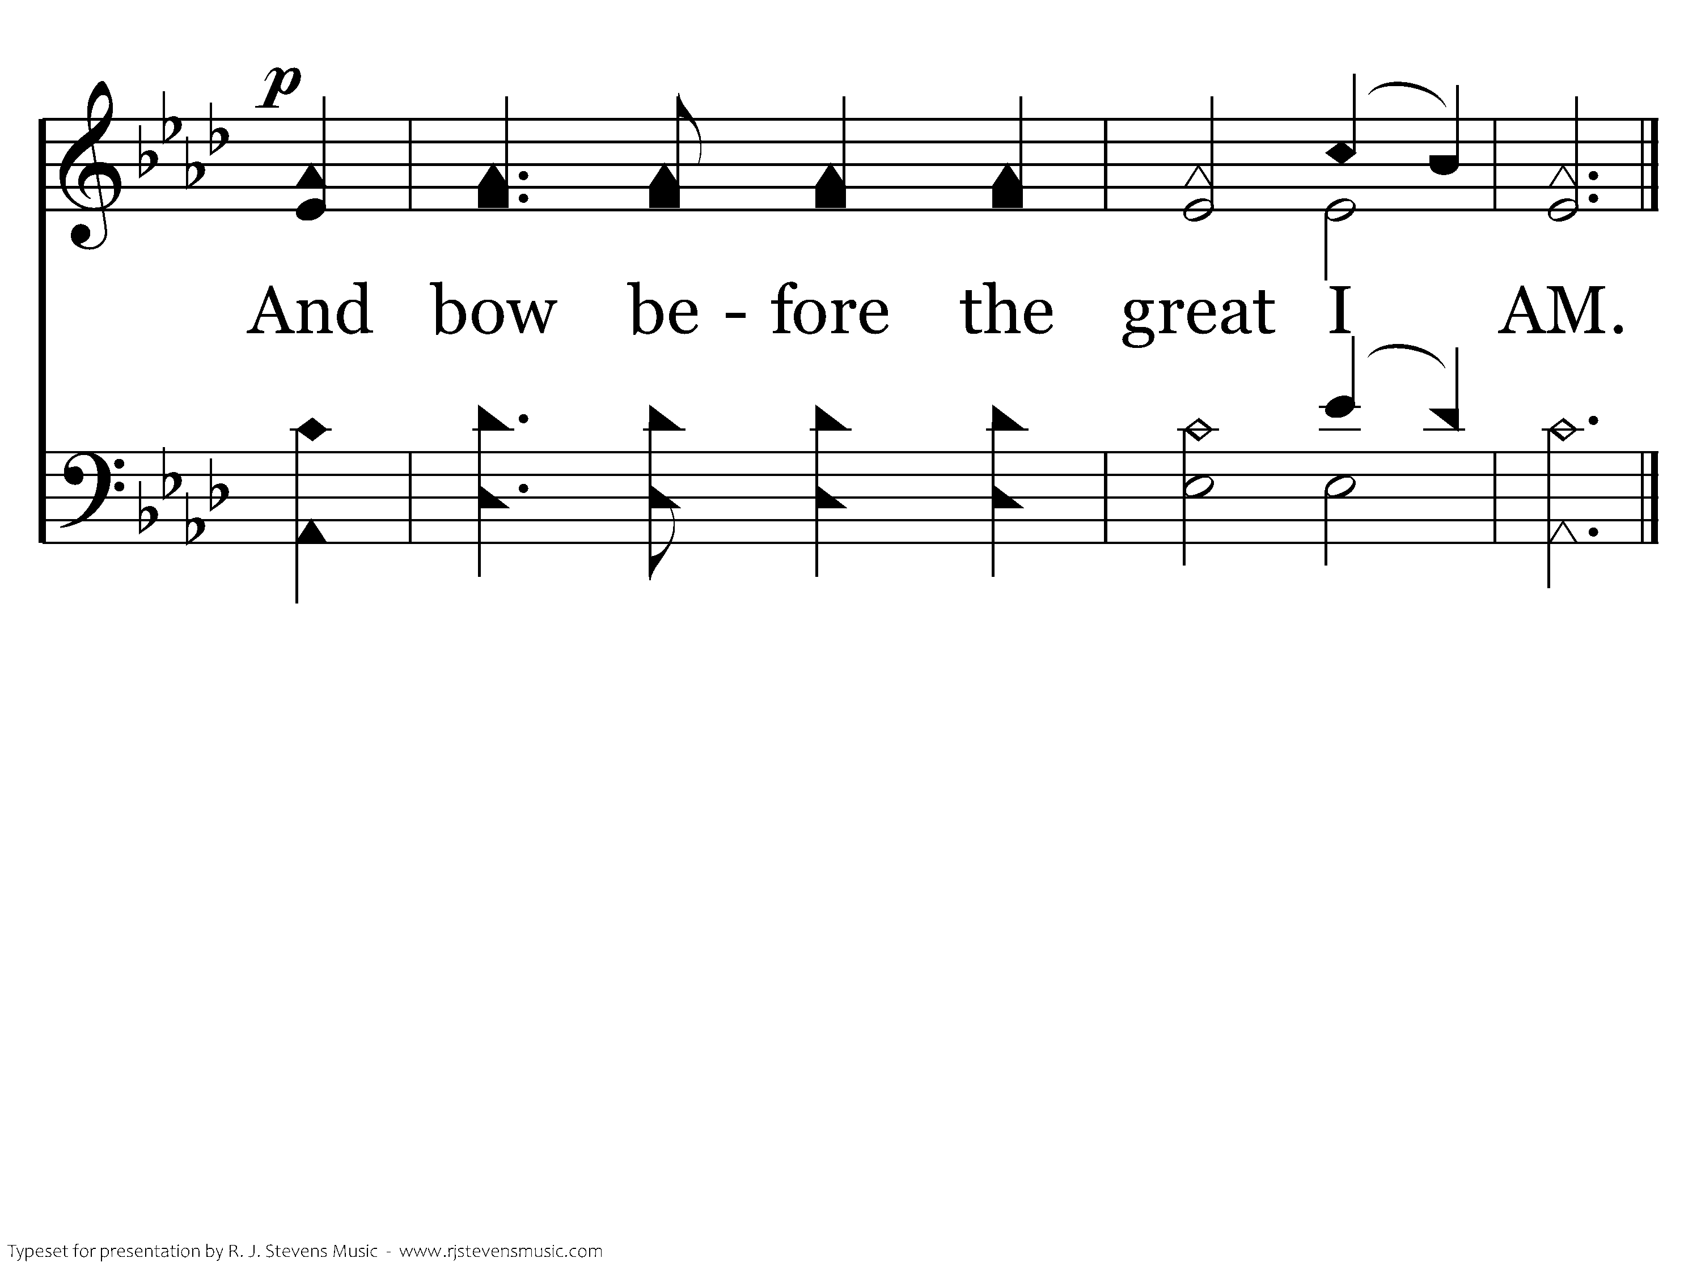
048 - On Zion's Glorious Summit - 2.3
End of Verse 2

Slide 29
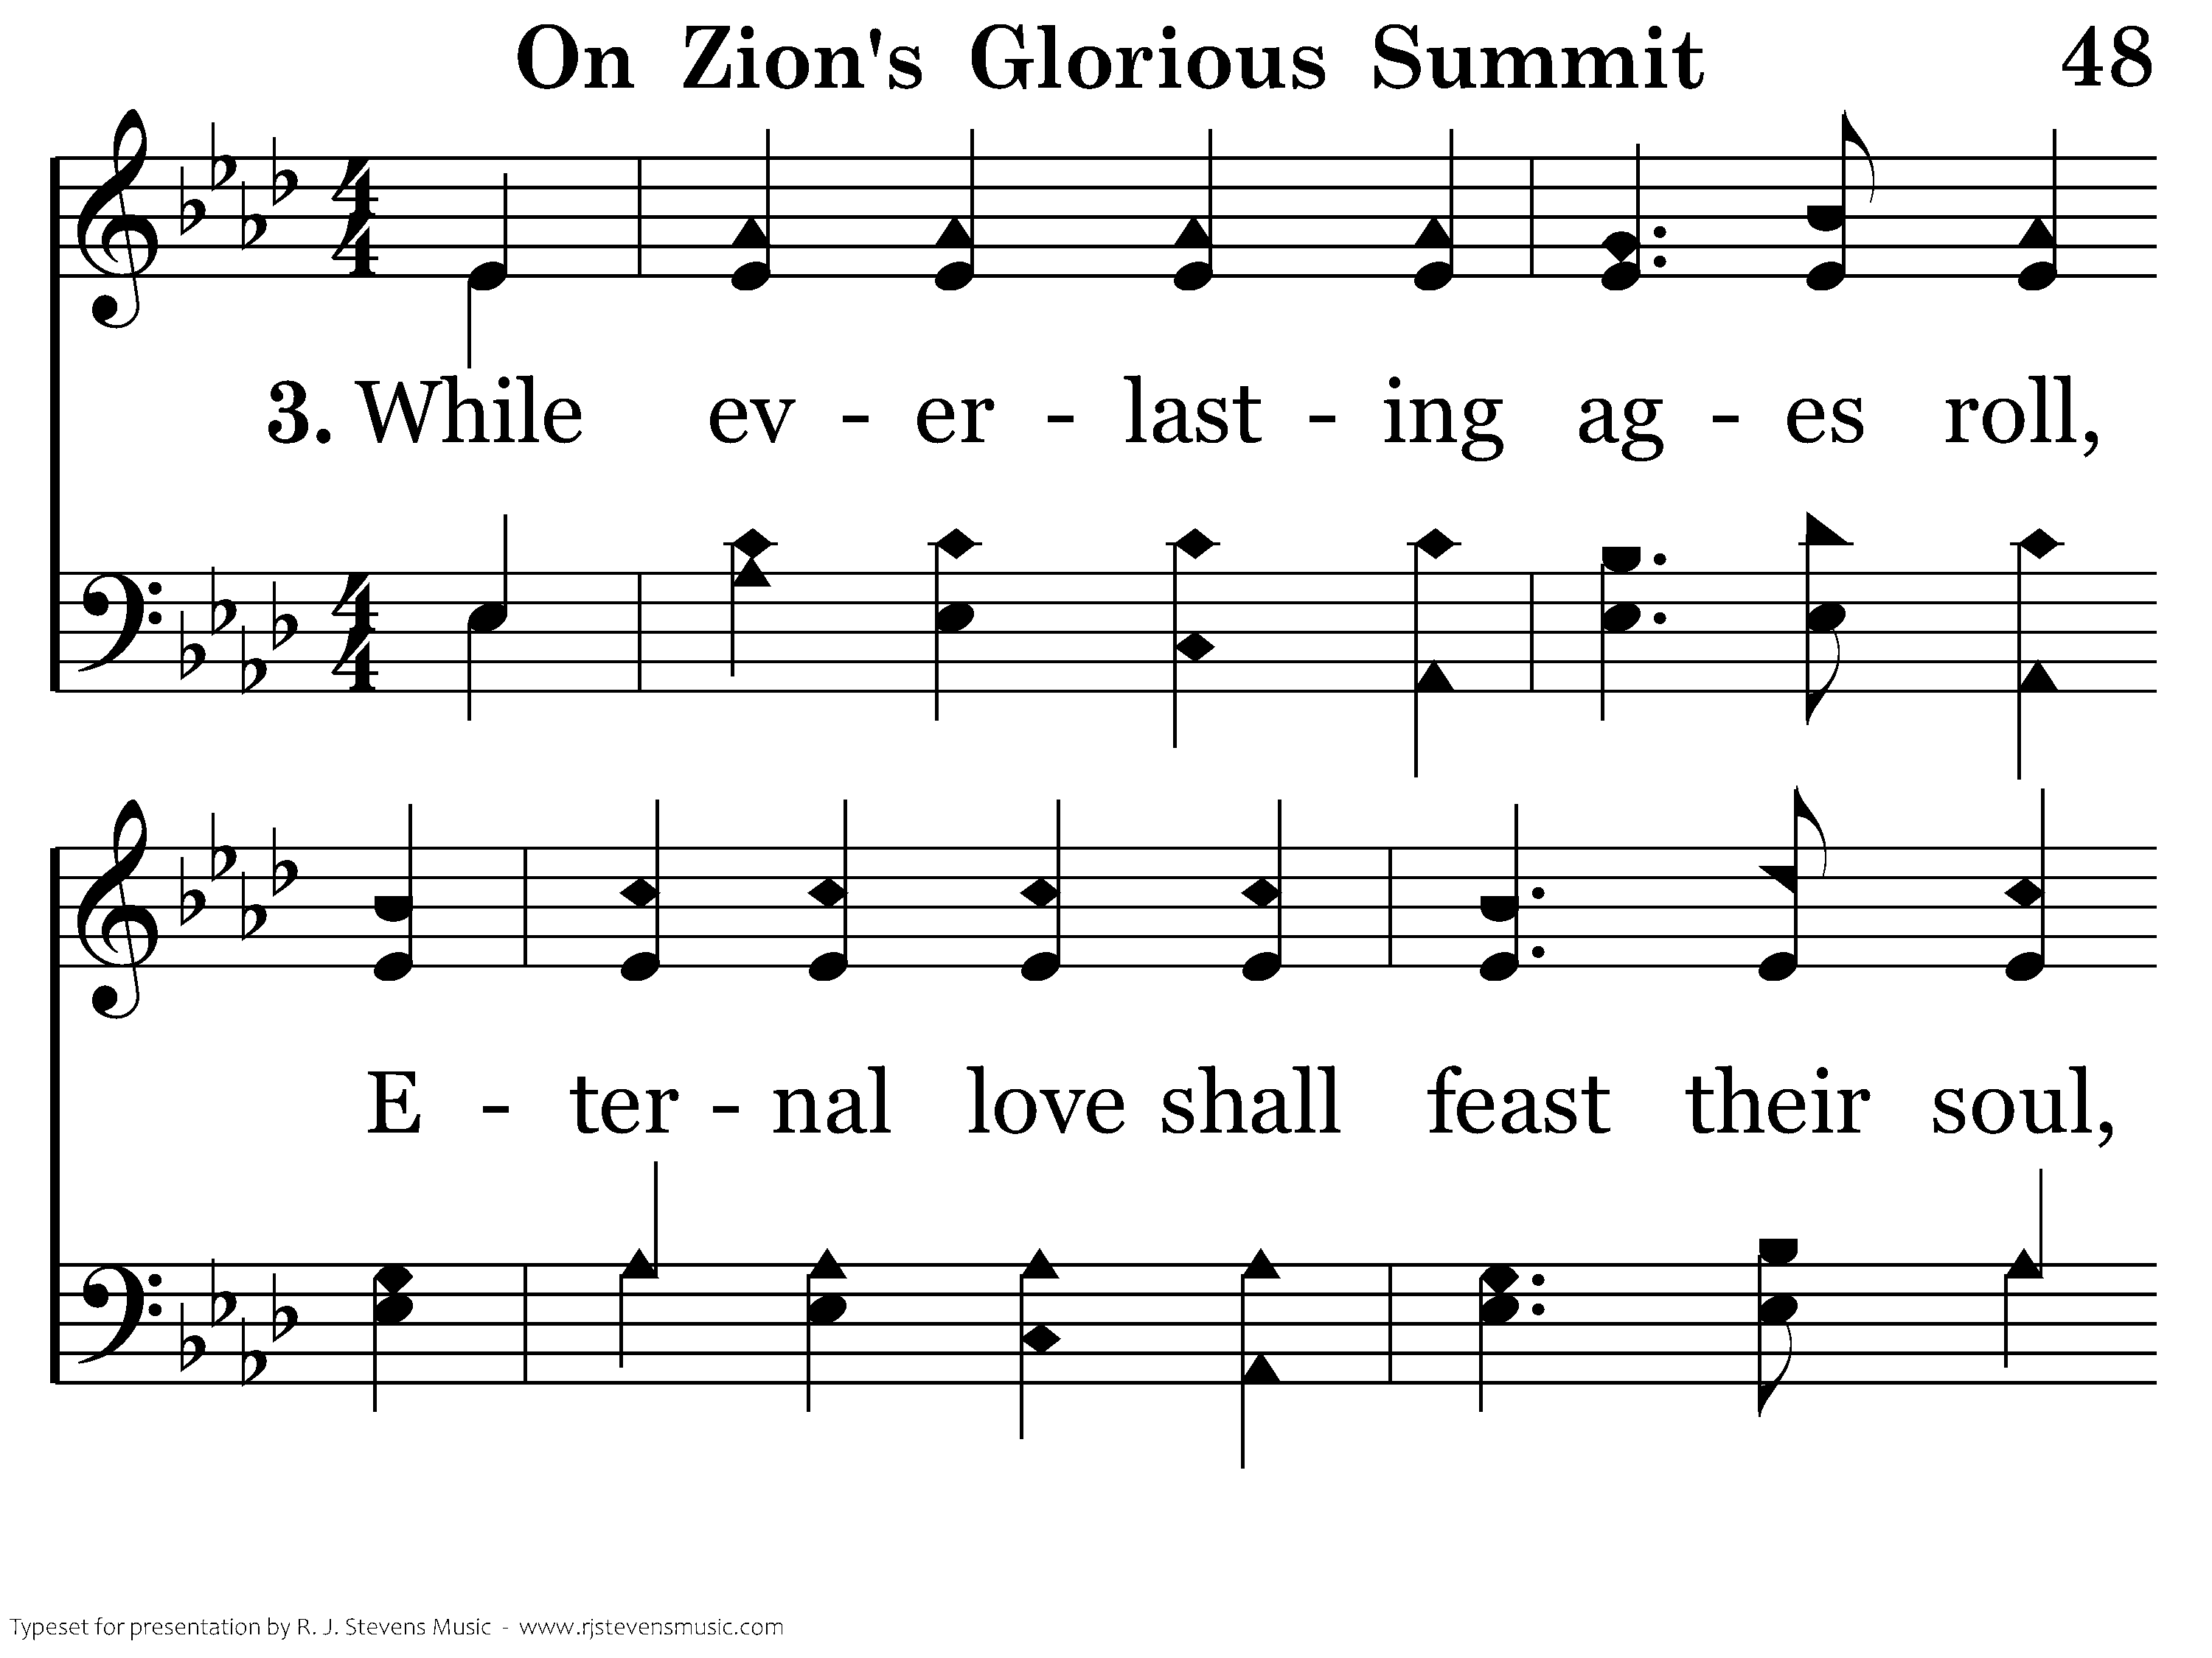
048 - On Zion's Glorious Summit - 3.1

Slide 30
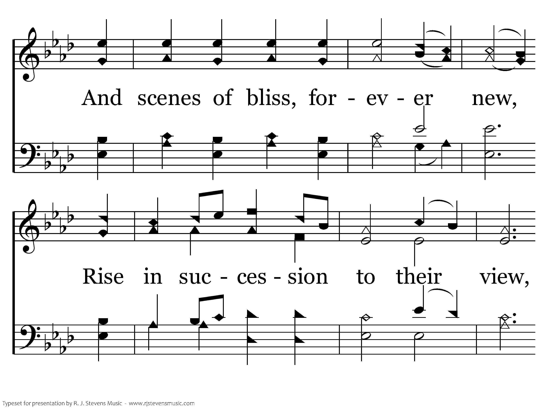
048 - On Zion's Glorious Summit - 3.2

Slide 31
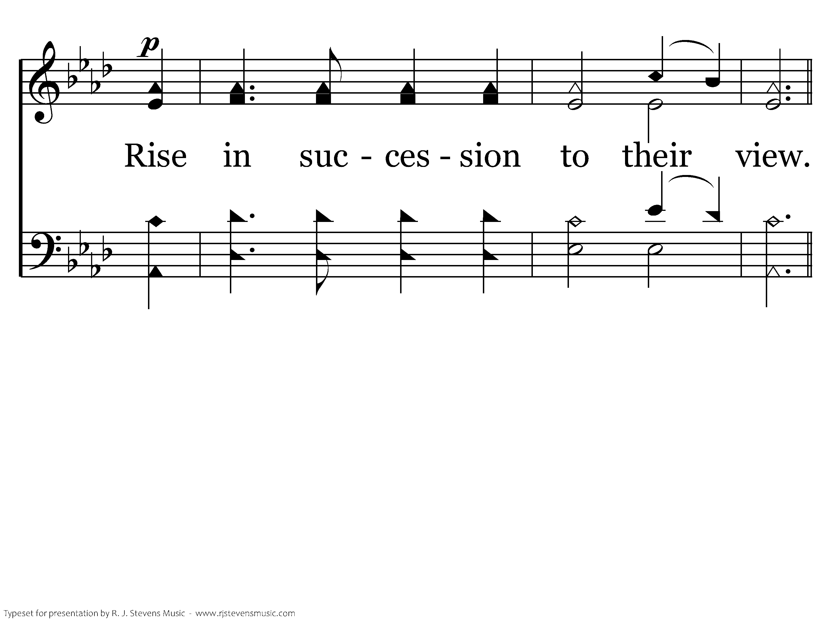
048 - On Zion's Glorious Summit - 3.3

Slide 32
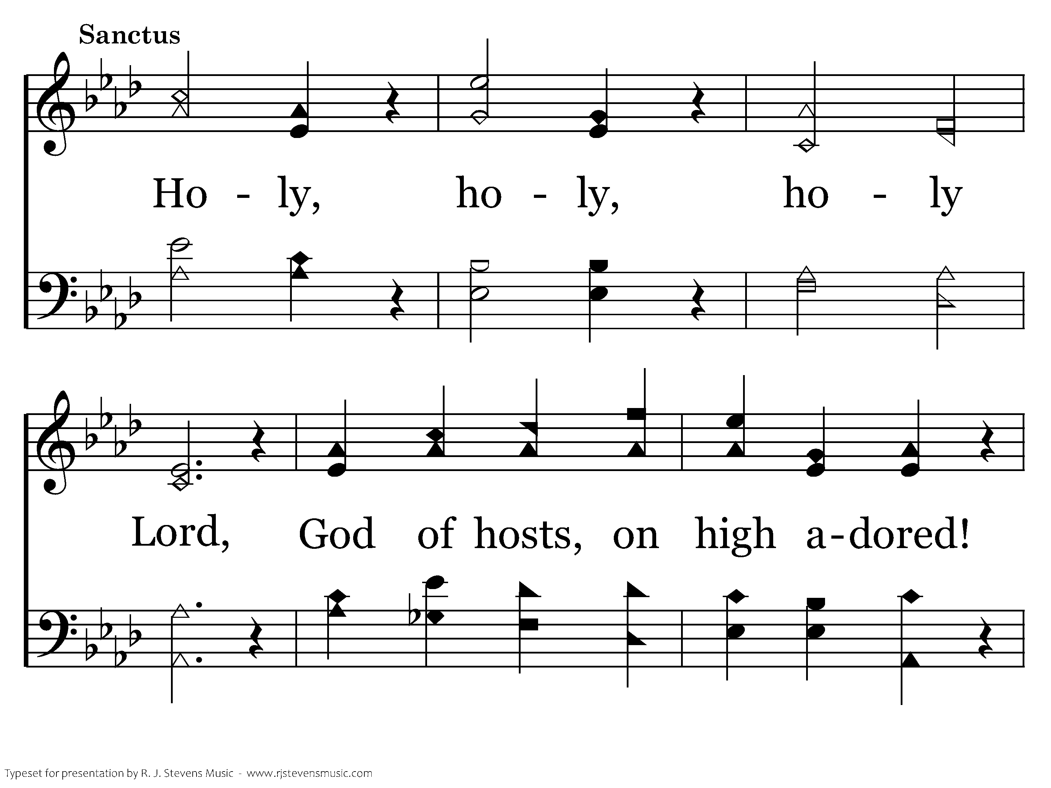
048 - On Zion's Glorious Summit - S.1

Slide 33
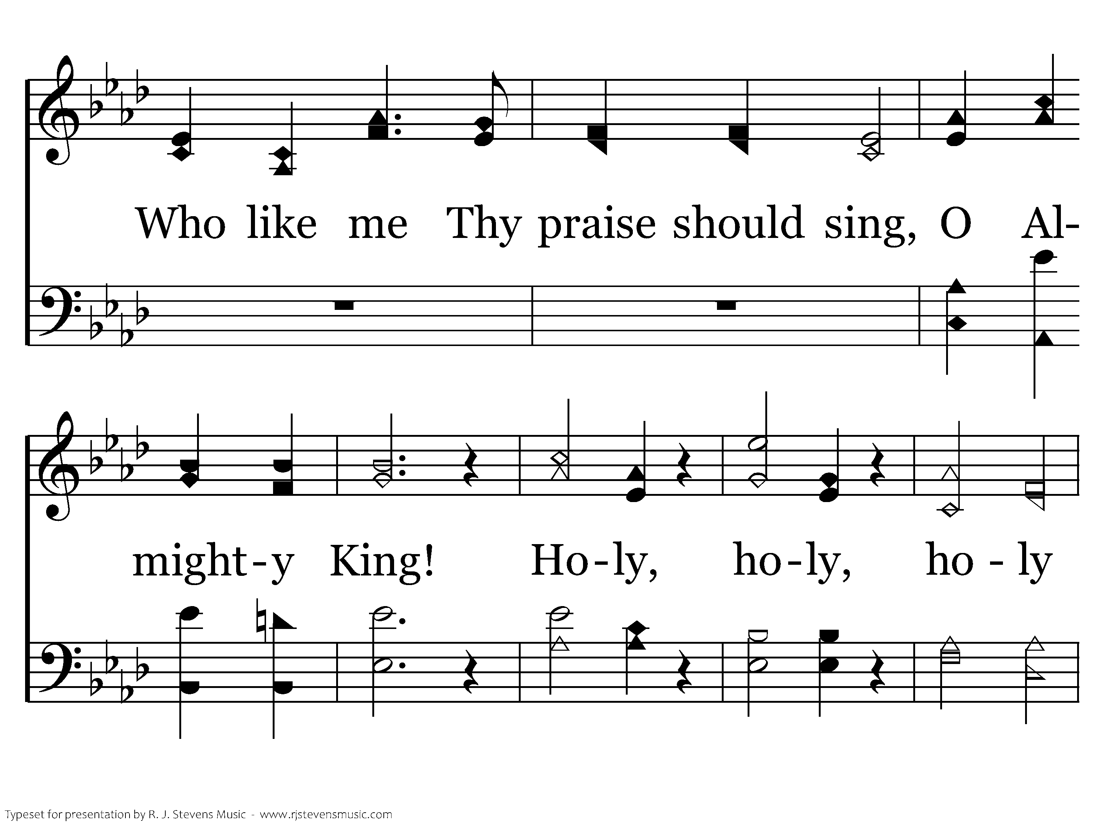
048 - On Zion's Glorious Summit - S.2

Slide 34
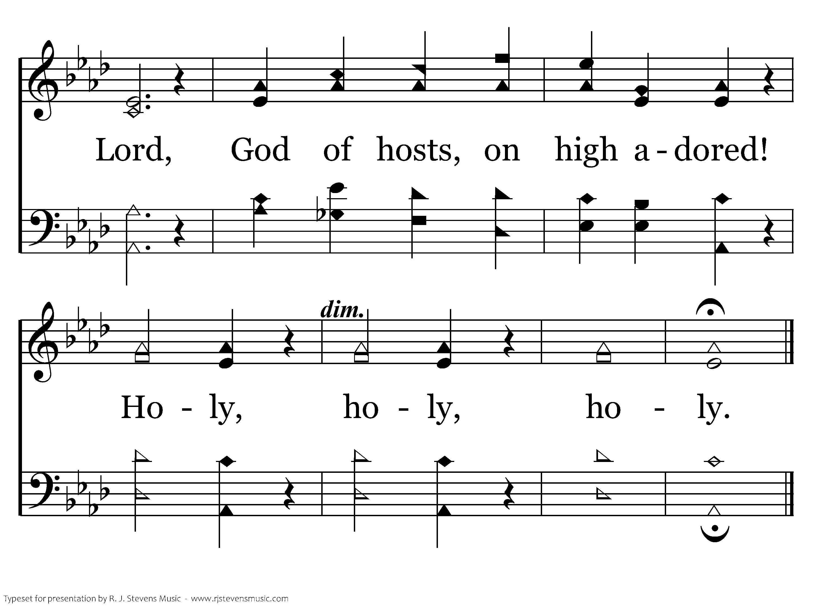
048 - On Zion's Glorious Summit - S.3
End of Song

Slide 36
I planted,
Apollos watered, but GOD…
1 Corinthians 3:6

Slide 37
Then Paul dwelt two whole years in his own rented house, and received all who came to him, preaching the kingdom of God and teaching the things which concern the Lord Jesus Christ with all confidence, no one forbidding him.
Acts 28: 30-31
Why this ending?

Slide 38
What are you recording for your ending to Acts?
How do you feel about that?

Slide 39
Go and make disciples of all the nations, baptizing them in the name of the Father and of the Son and of the Holy Spirit, teaching them to observe all that I have commanded you; and lo, I am with you always, even to the end of the age.
Matthew 28:19-20

Slide 40
And Jesus said to him, “Today salvation has come to this house, because he also is a son of Abraham; for the Son of Man has come to seek and to save that which was lost.”
Luke 19:9-10

Slide 41
11 For it has been declared to me concerning you, my brethren, by those of Chloe's household, that there are contentions among you. 12 Now I say this, that each of you says, “I am of Paul,” or “I am of Apollos,” or “I am of Cephas,” or “I am of Christ.”
1 Corinthians 1:11-12

Slide 42
5 Who then is Paul, and who is Apollos, but ministers (servants) through whom you believed, as the Lord gave to each one?
6 I planted, Apollos watered, but God gave the increase. 7 So then neither he who plants is anything, nor he who waters, but God who gives the increase.
1 Corinthians 3:5-7

Slide 43
Now these things, brethren, I have figuratively transferred to myself and Apollos for your sakes, that you may learn in us not to think beyond what is written, that none of you may be puffed up on behalf of one against the other.
1 Corinthians 4:6

Slide 44
5 Who then is Paul, and who is Apollos, but ministers (servants) through whom you believed, as the Lord gave to each one?
6 I planted, Apollos watered, but God gave the increase. 7 So then neither he who plants is anything, nor he who waters, but God who gives the increase.
1 Corinthians 3:5-7

Slide 45
What you CAN do
Find the courage to mention Jesus
Live like Jesus before men
Pray to God for open doors

Slide 46
I planted,
Apollos watered, but GOD…
1 Corinthians 3:6

Slide 48

20368 - BEFORE THE THRONE OF GOD ABOVE - Title

Slide 49
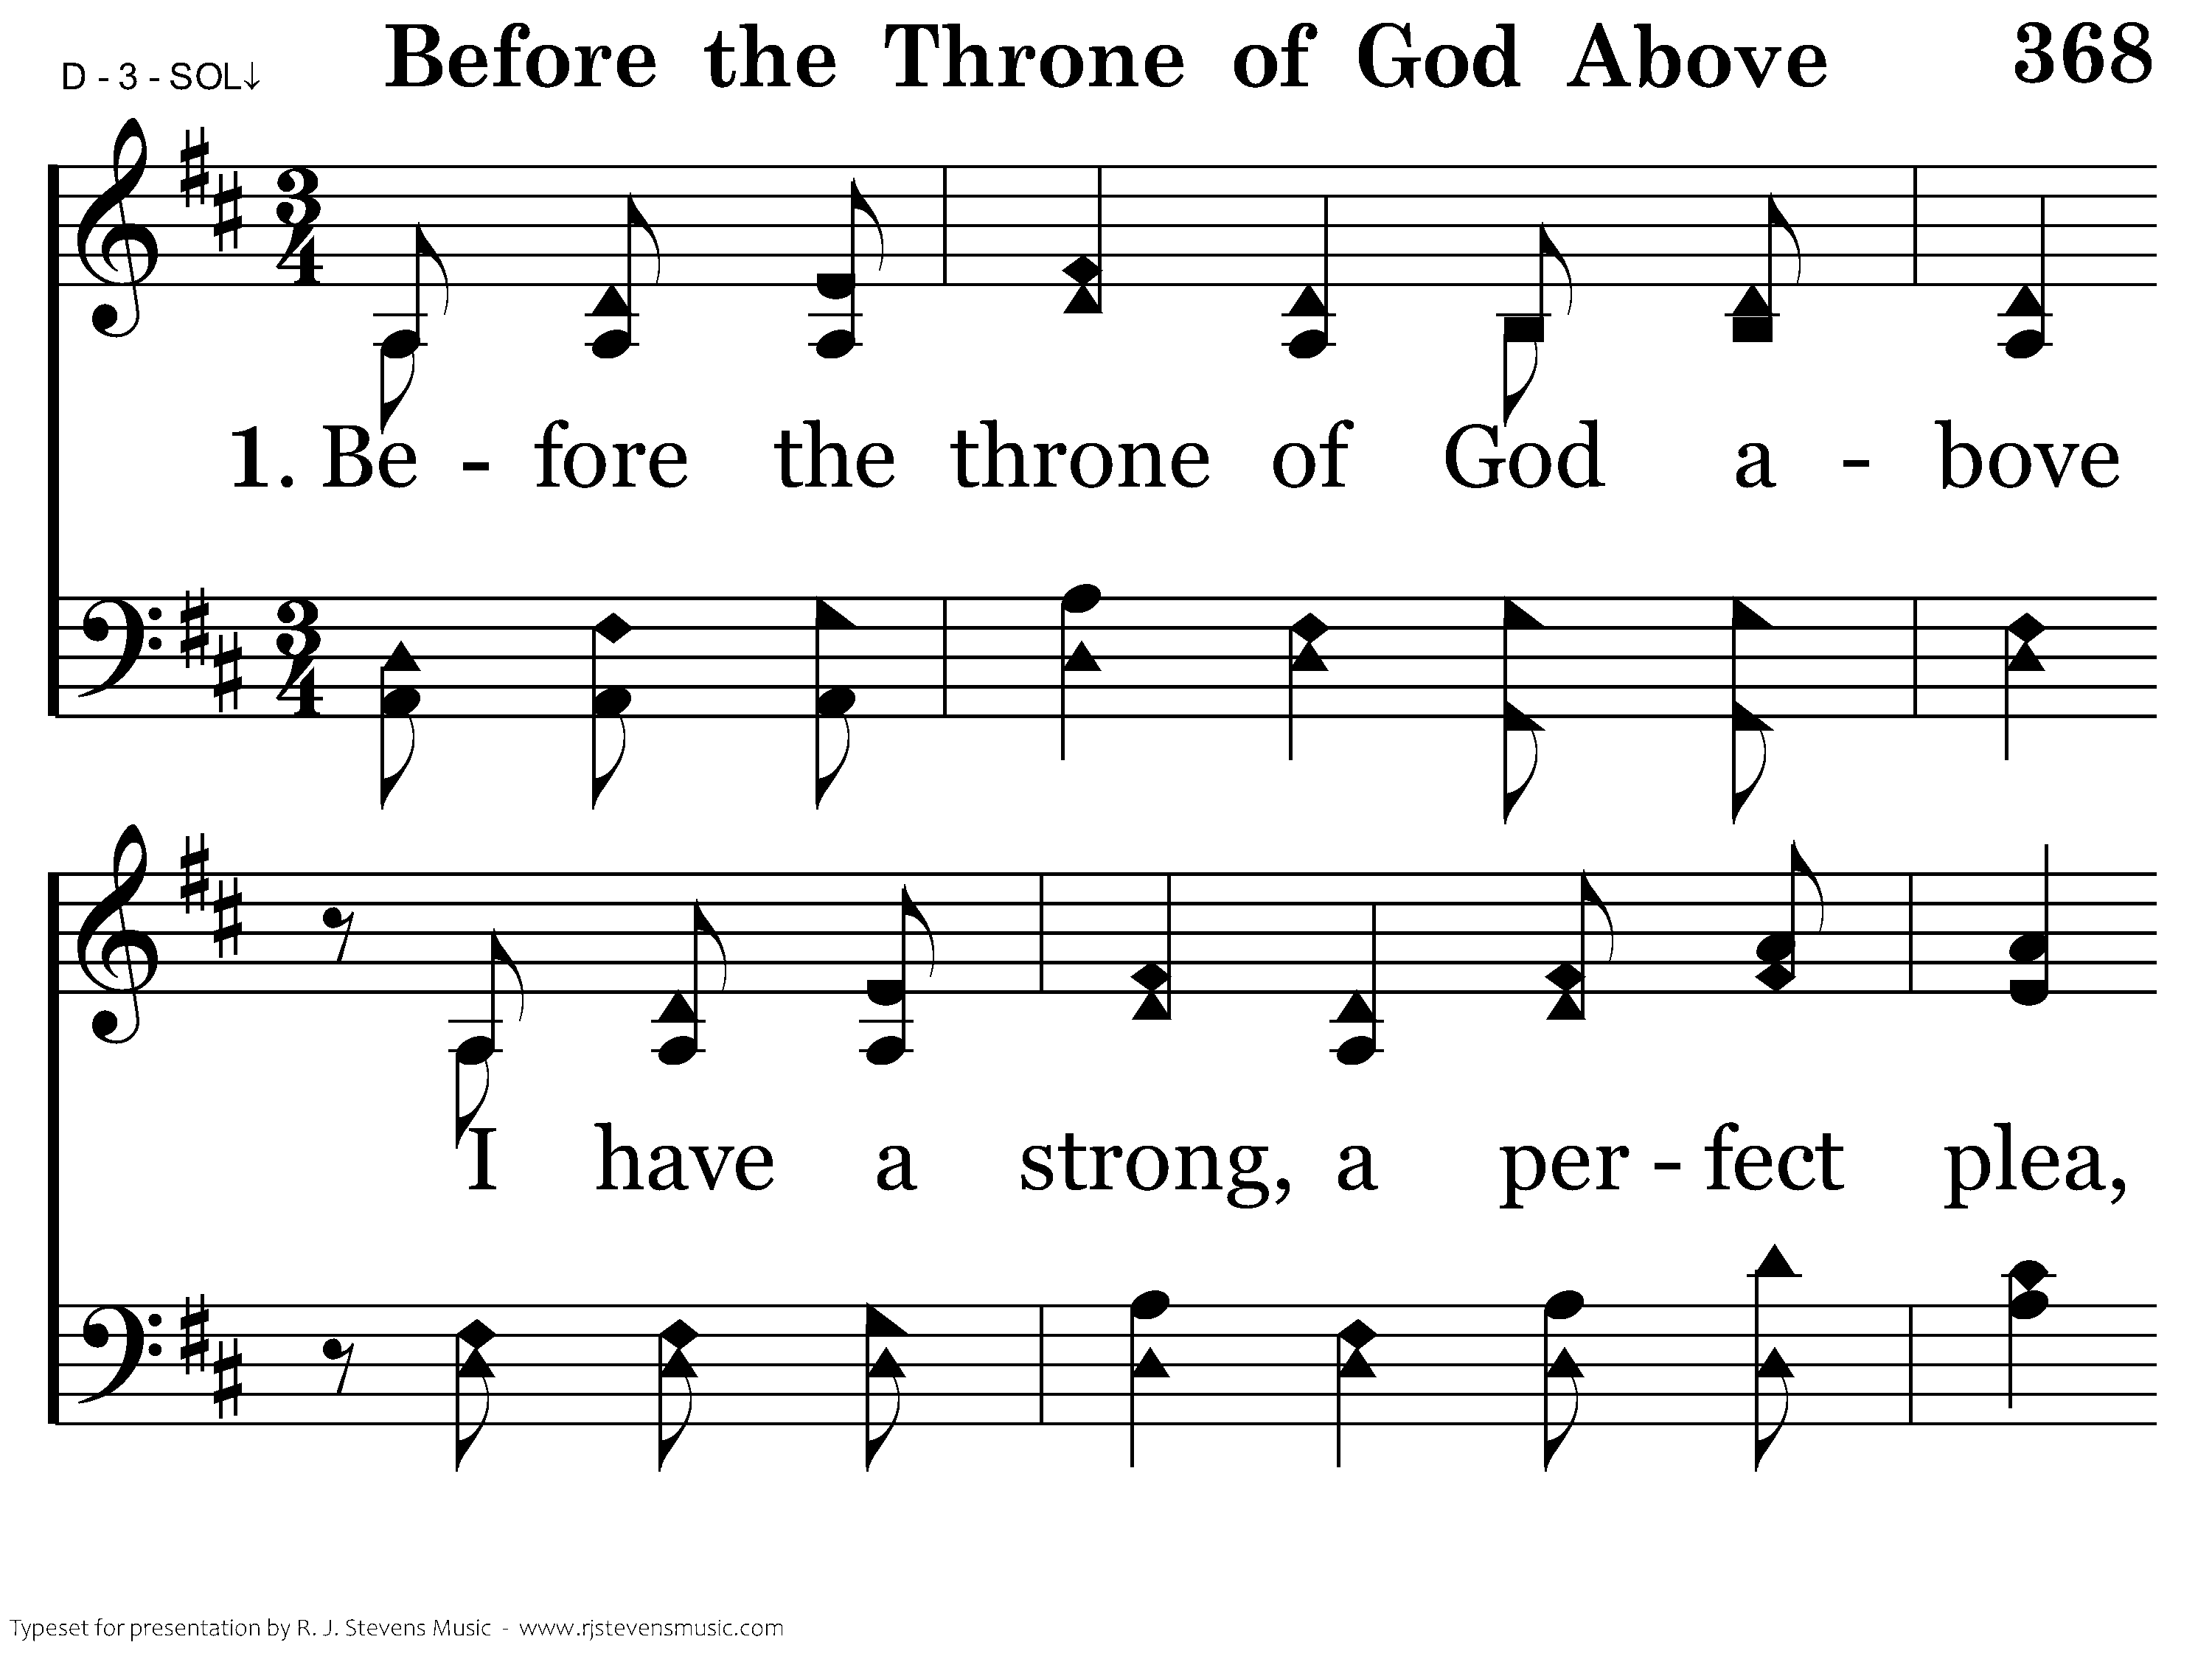
20368 - BEFORE THE THRONE OF GOD ABOVE - 1.1

Slide 50
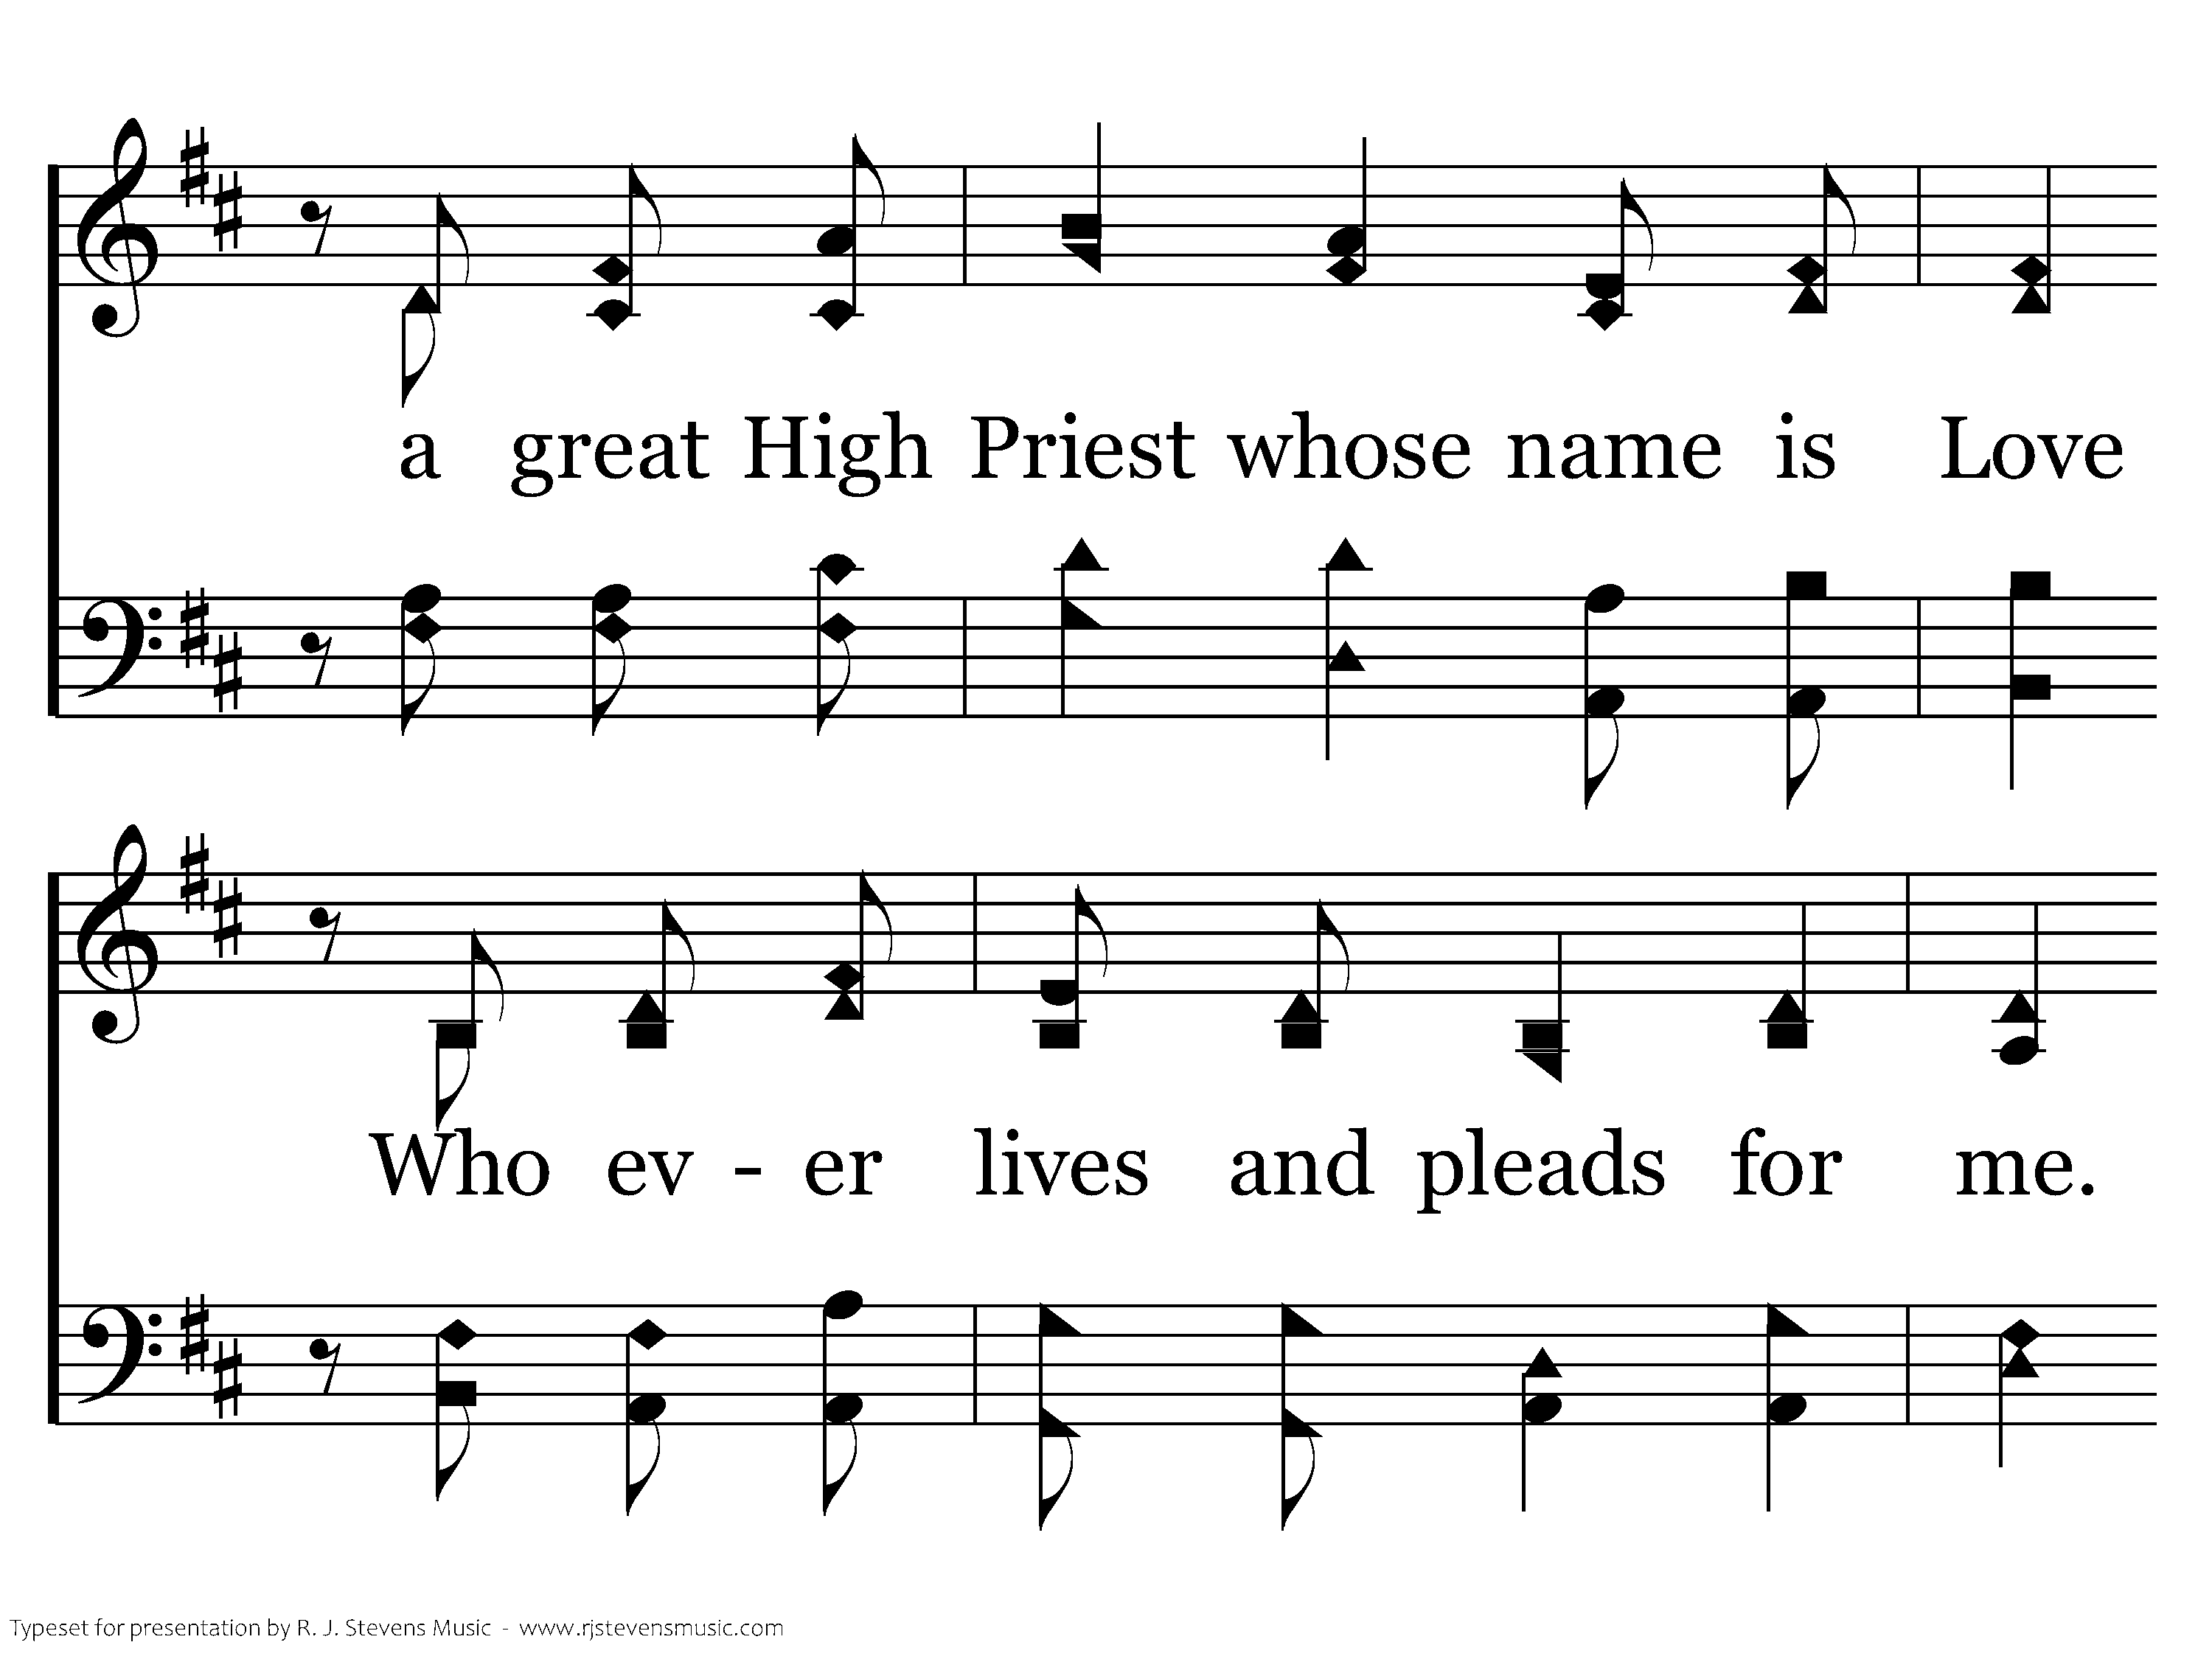
20368 - BEFORE THE THRONE OF GOD ABOVE - 1.2

Slide 51
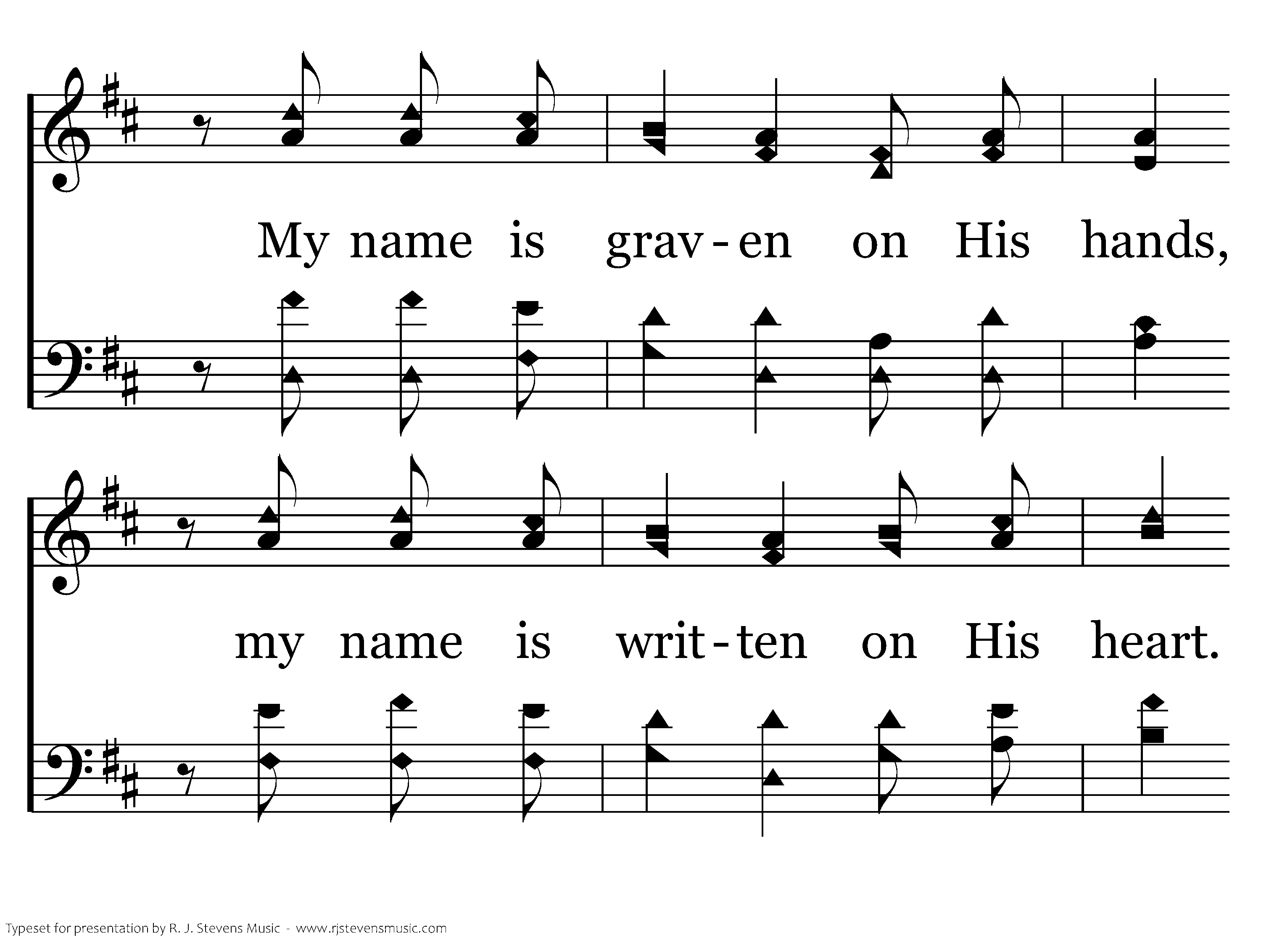
20368 - BEFORE THE THRONE OF GOD ABOVE - 1.3

Slide 52
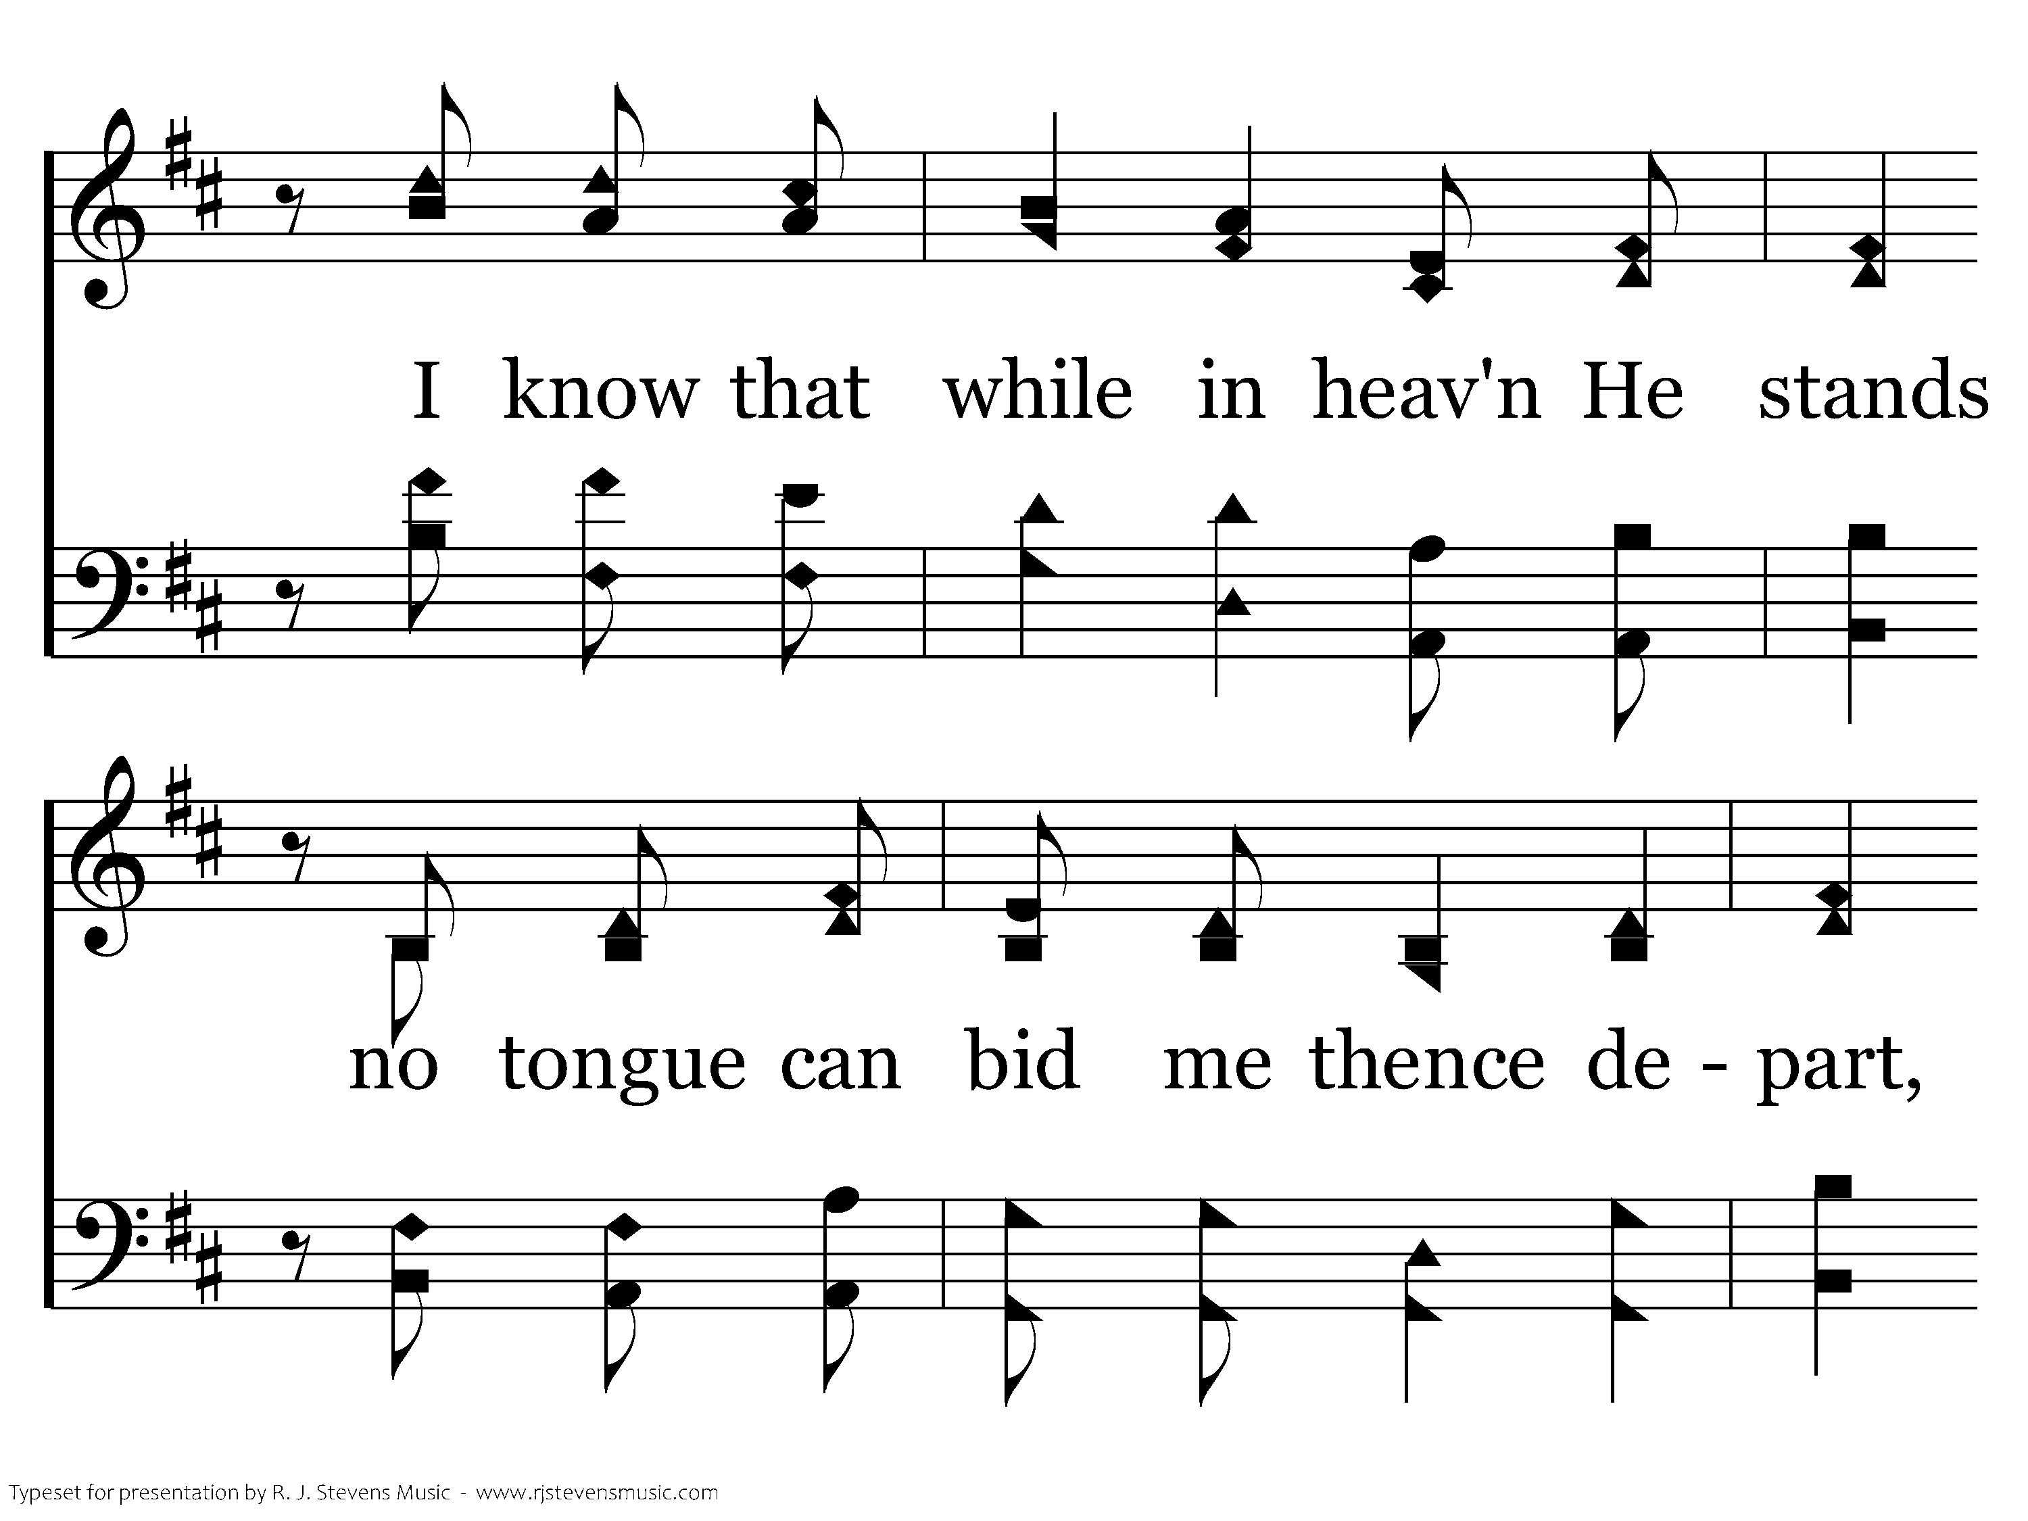
20368 - BEFORE THE THRONE OF GOD ABOVE - 1.4

Slide 53
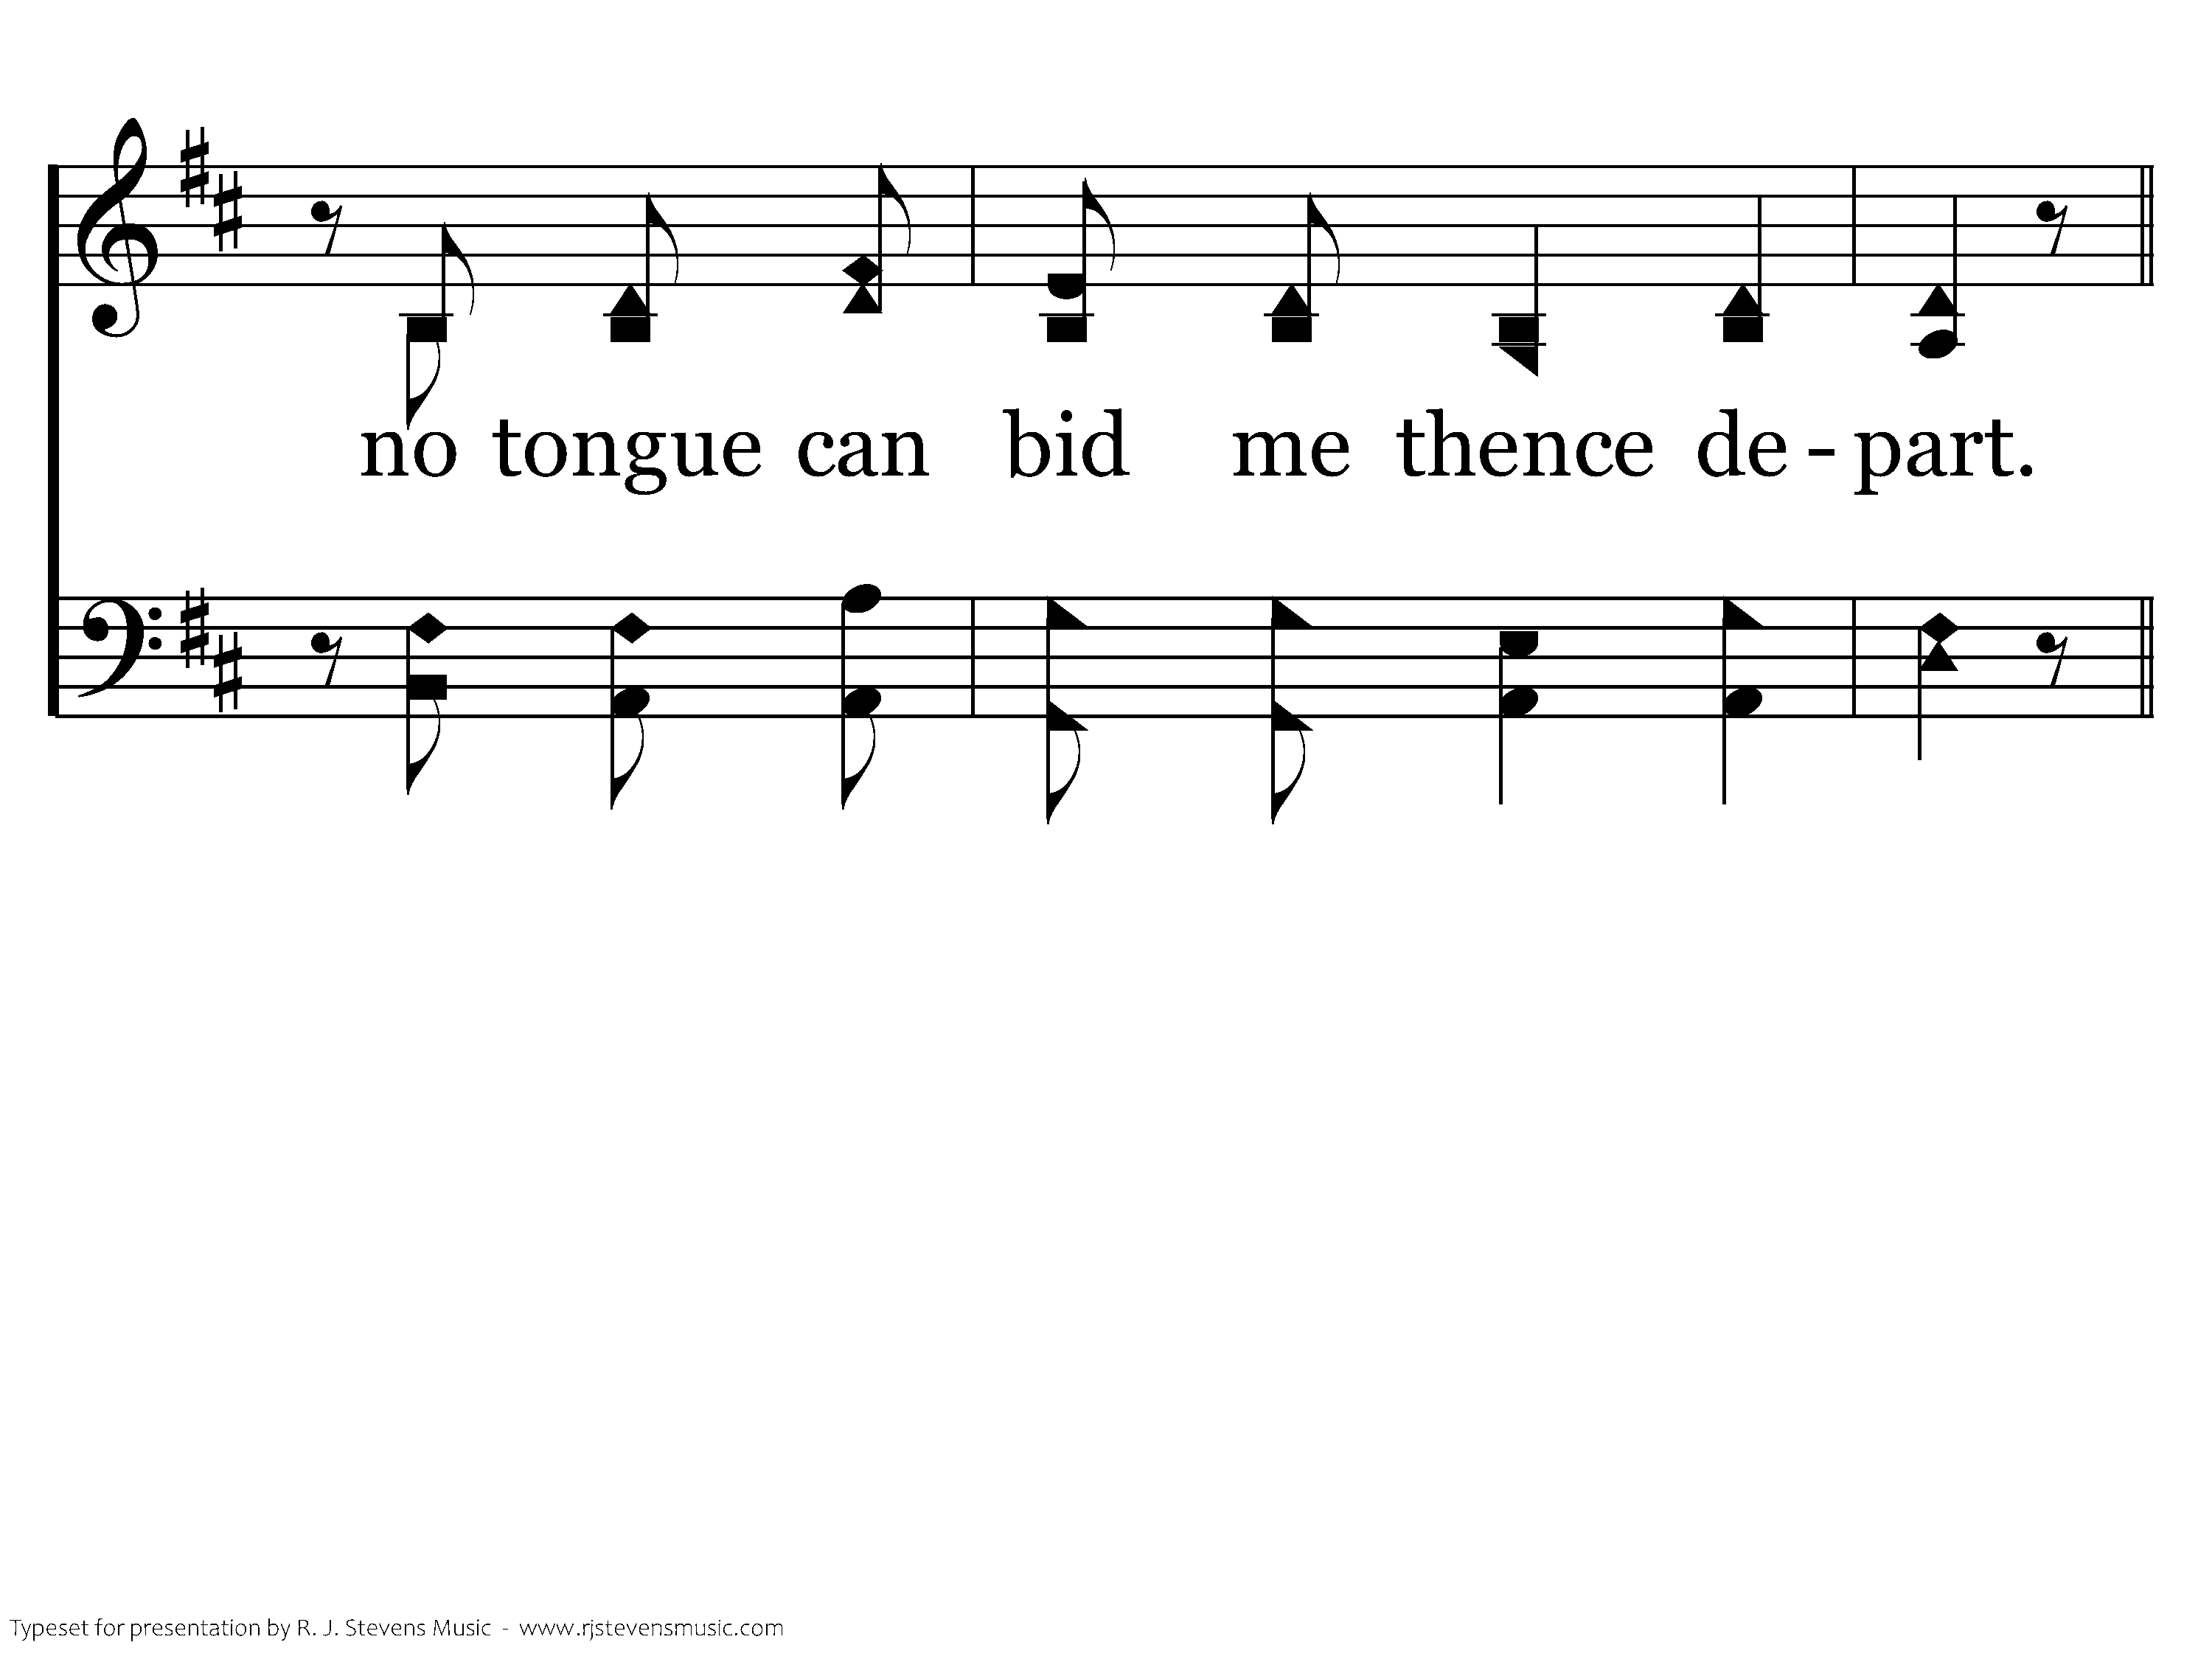
20368 - BEFORE THE THRONE OF GOD ABOVE - 1.5
End of Verse 1

Slide 54
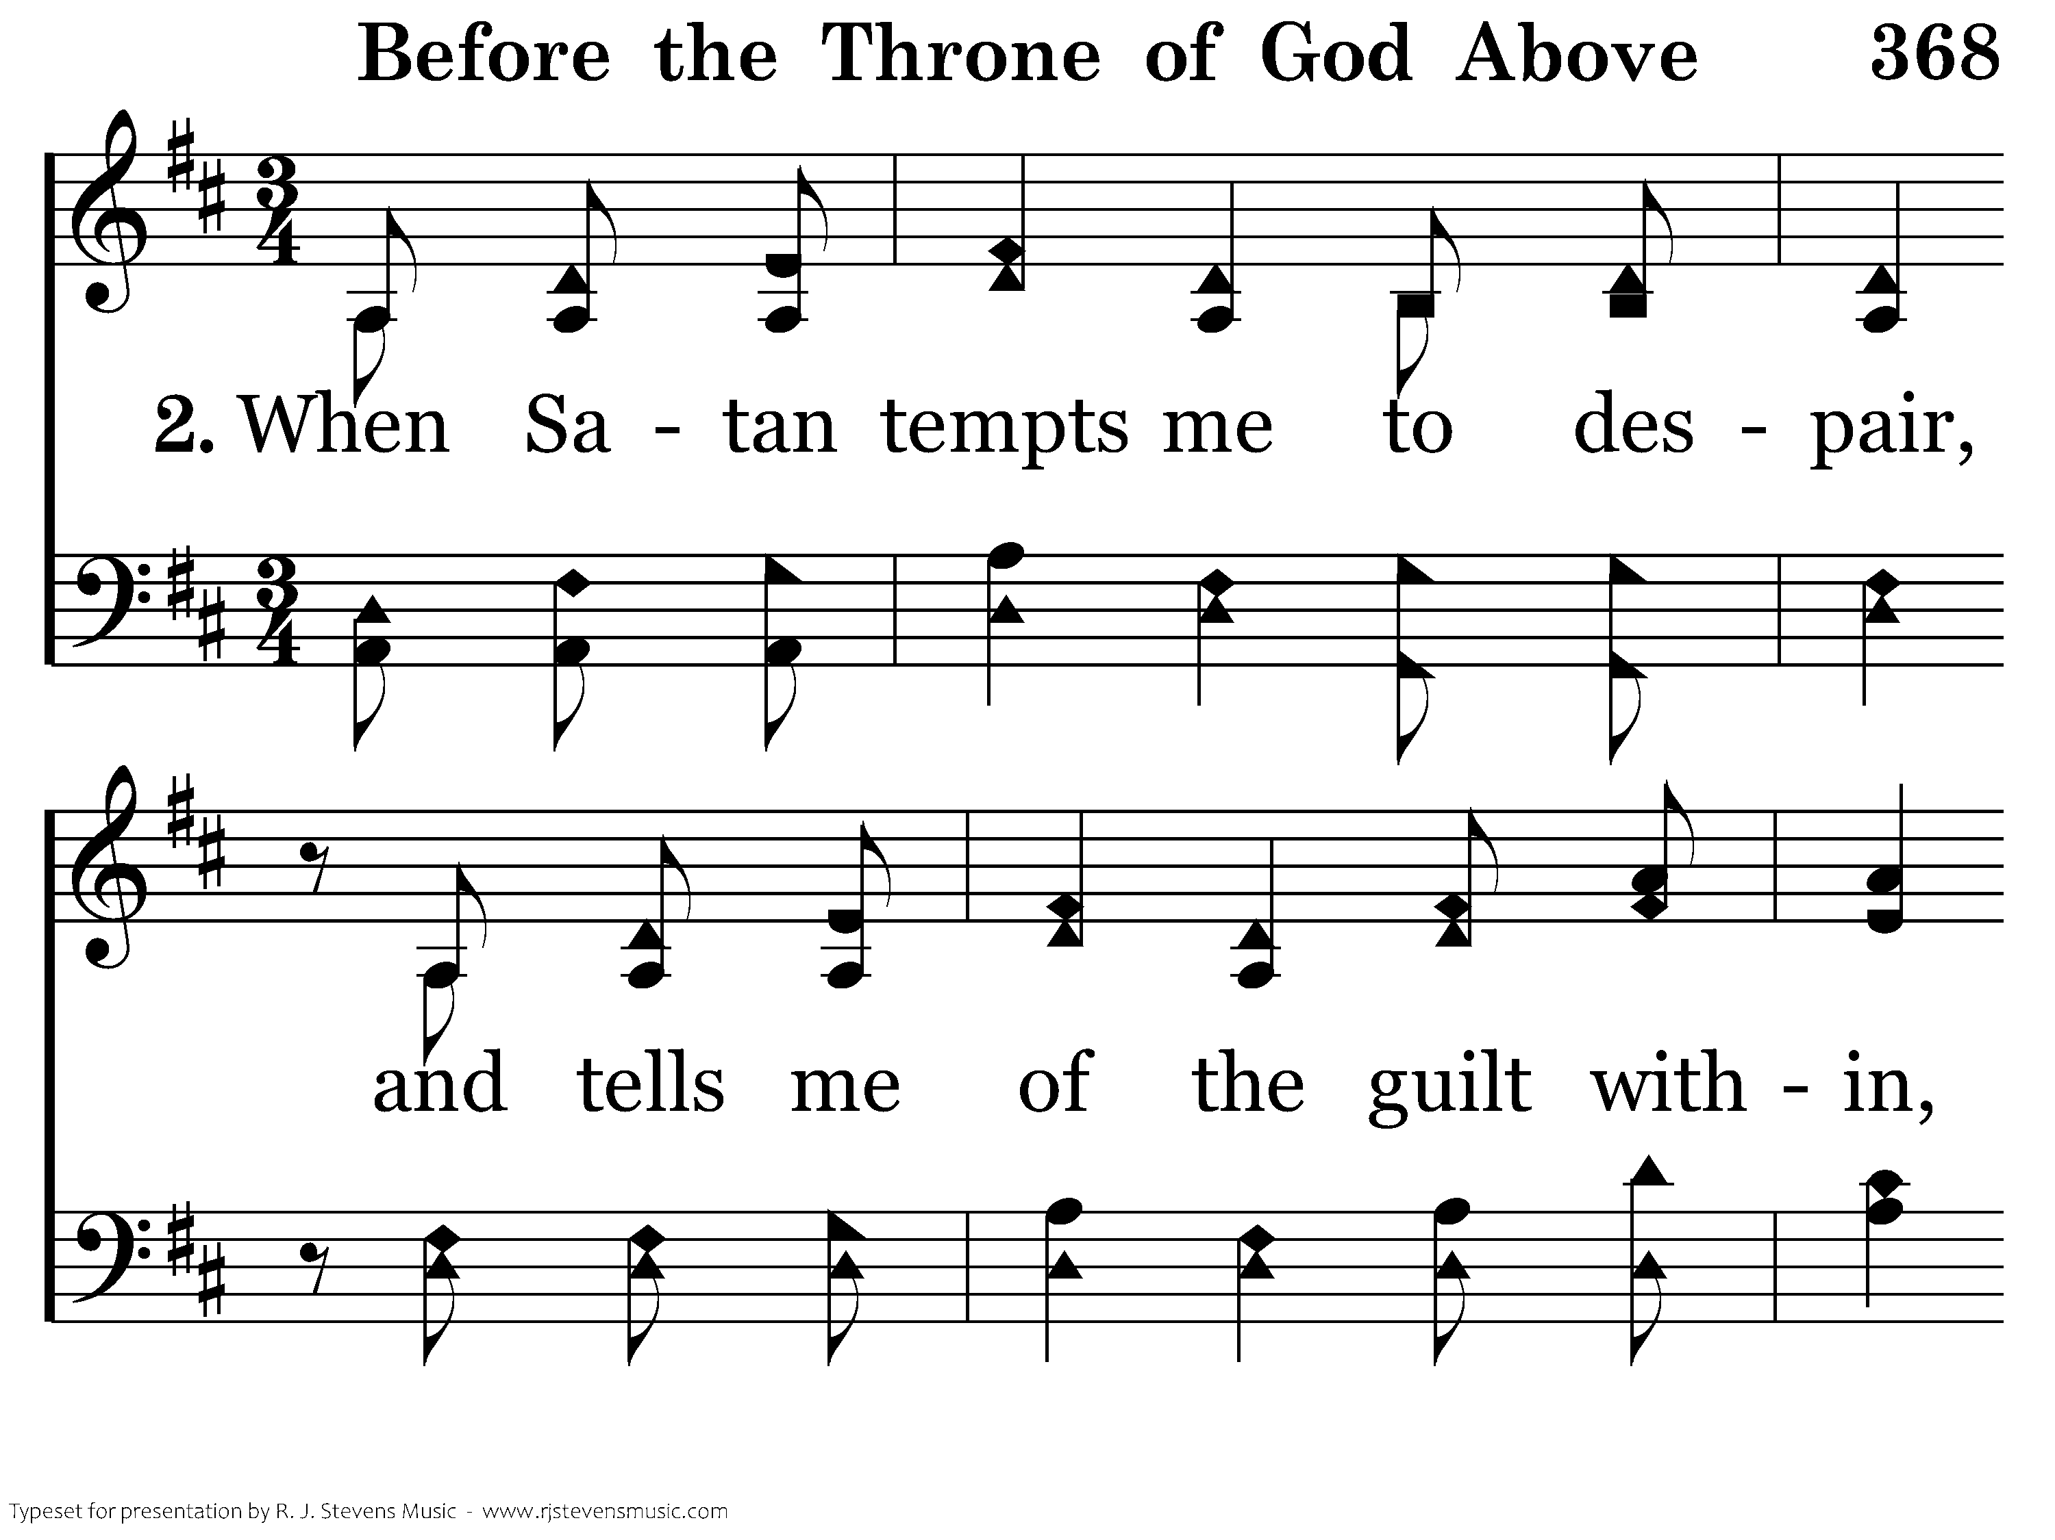
20368 - BEFORE THE THRONE OF GOD ABOVE - 2.1

Slide 55
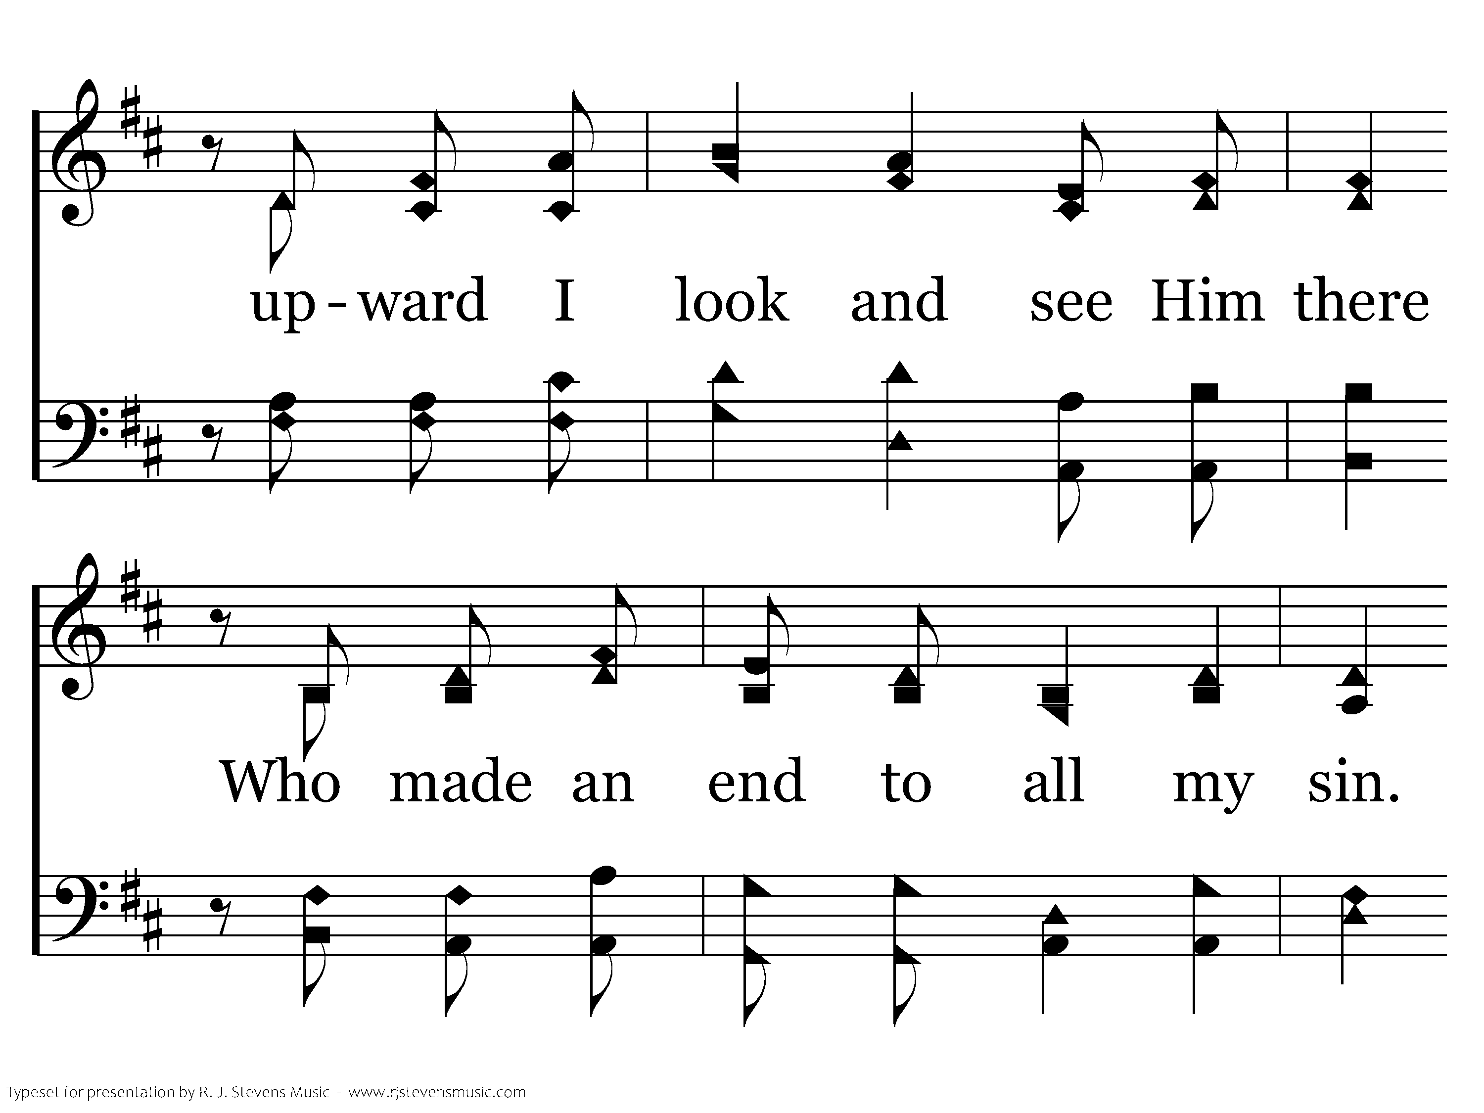
20368 - BEFORE THE THRONE OF GOD ABOVE - 2.2

Slide 56
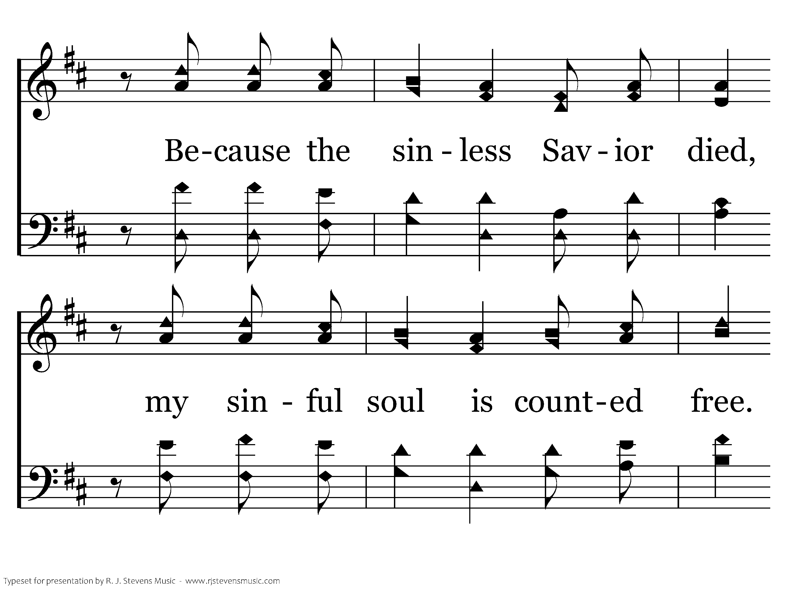
20368 - BEFORE THE THRONE OF GOD ABOVE - 2.3

Slide 57
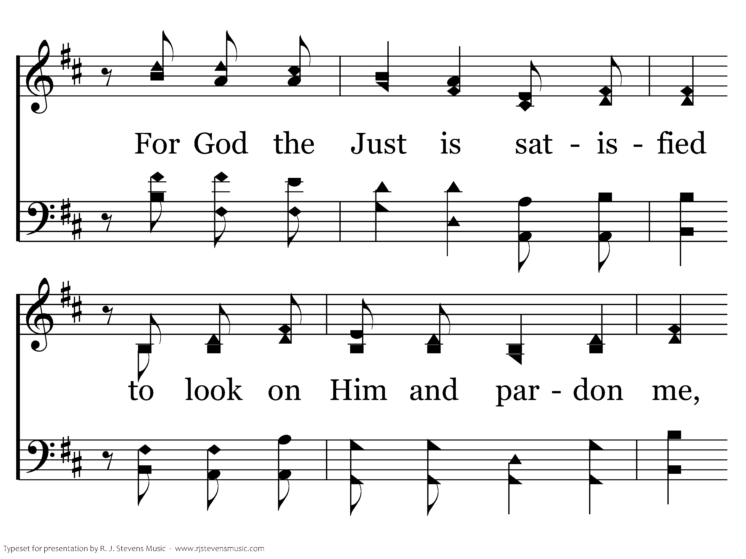
20368 - BEFORE THE THRONE OF GOD ABOVE - 2.4

Slide 58
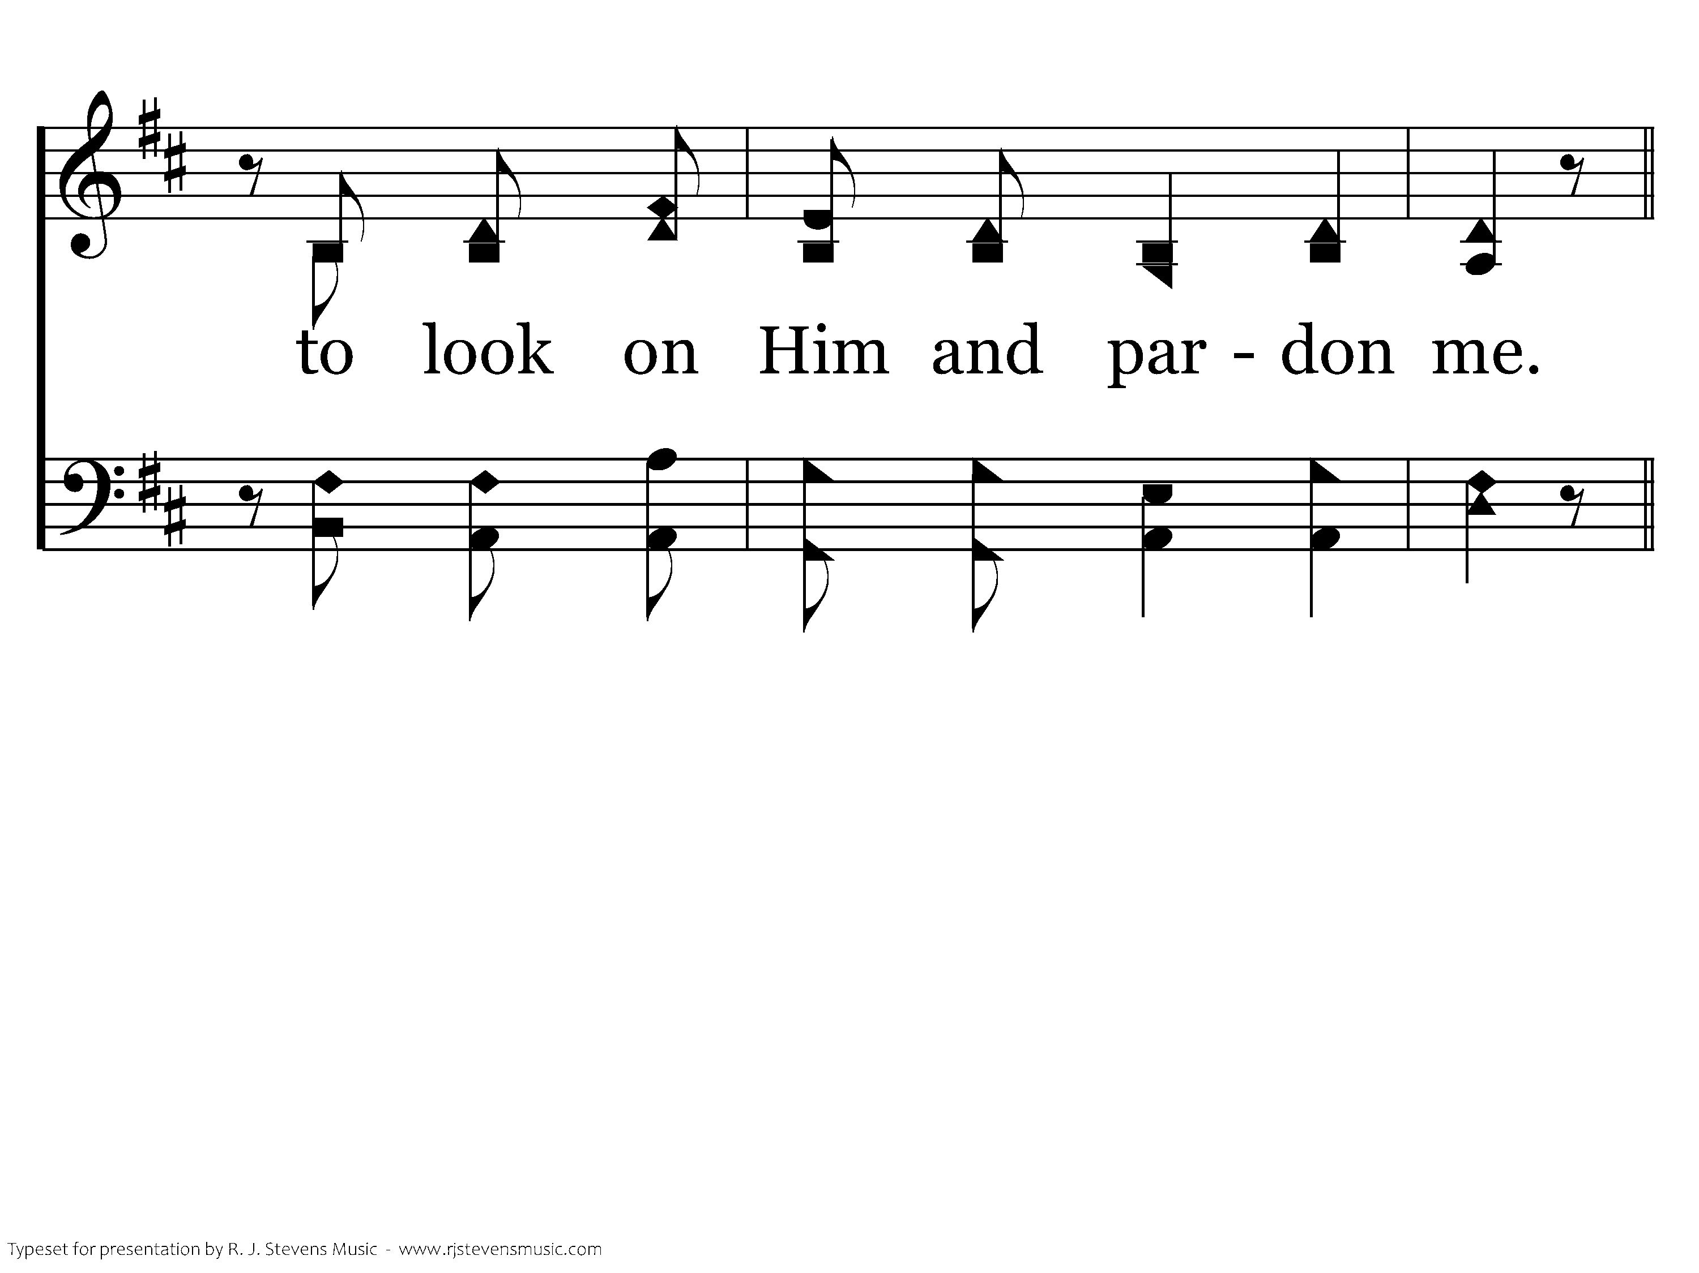
20368 - BEFORE THE THRONE OF GOD ABOVE - 2.5
End of Verse 2

Slide 59
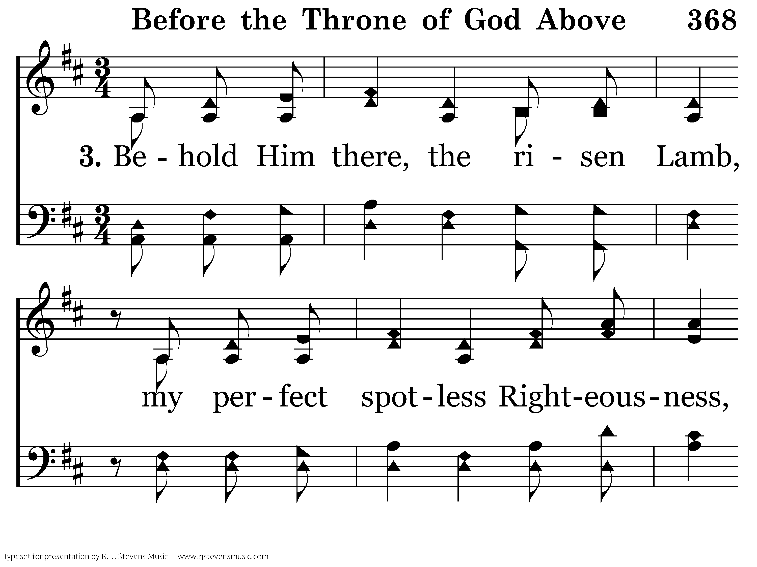
20368 - BEFORE THE THRONE OF GOD ABOVE - 3.1

Slide 60
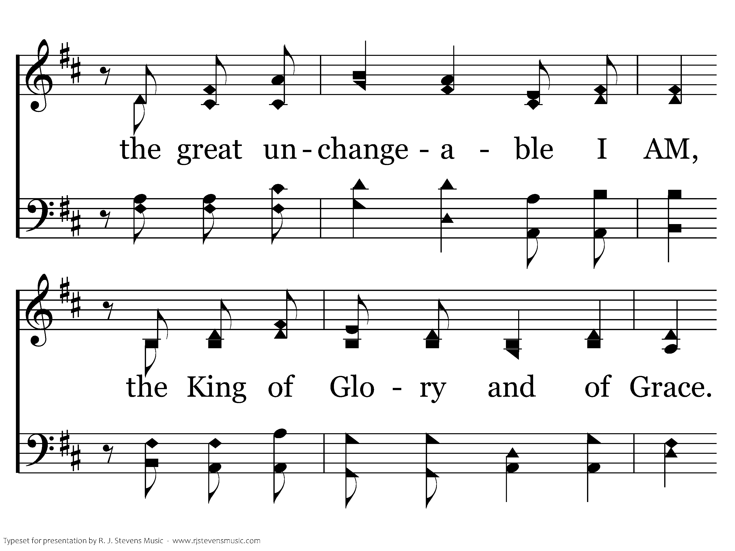
20368 - BEFORE THE THRONE OF GOD ABOVE - 3.2

Slide 61
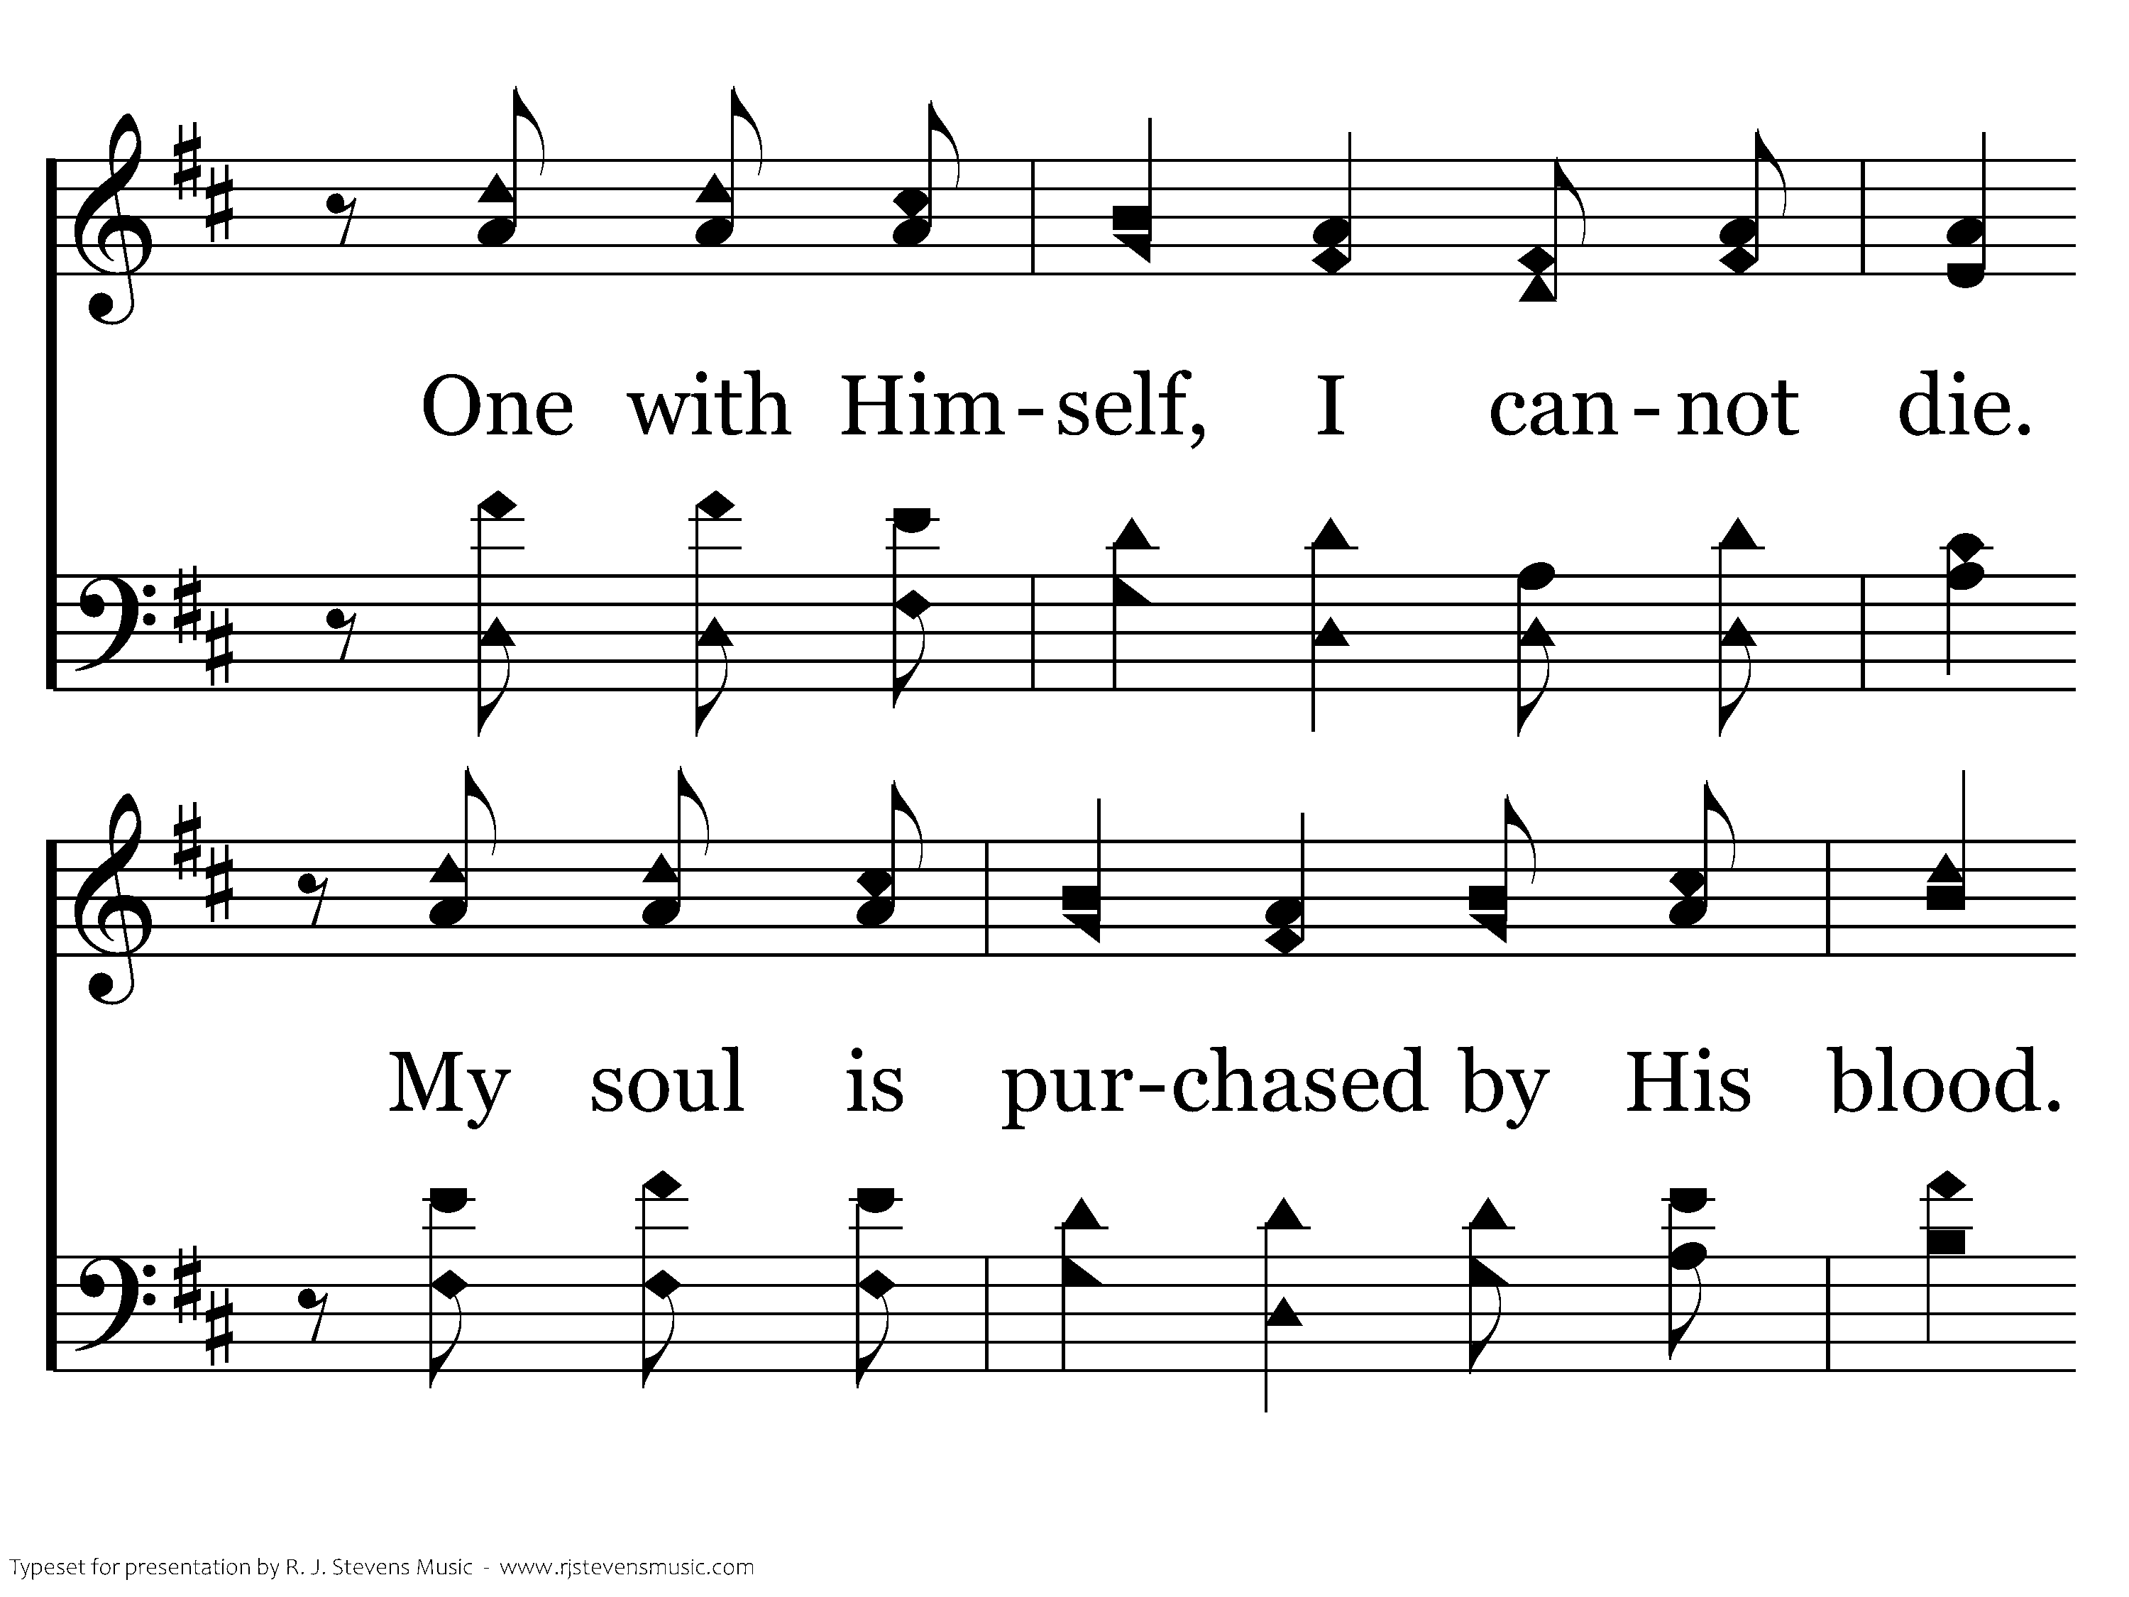
20368 - BEFORE THE THRONE OF GOD ABOVE - 3.3

Slide 62
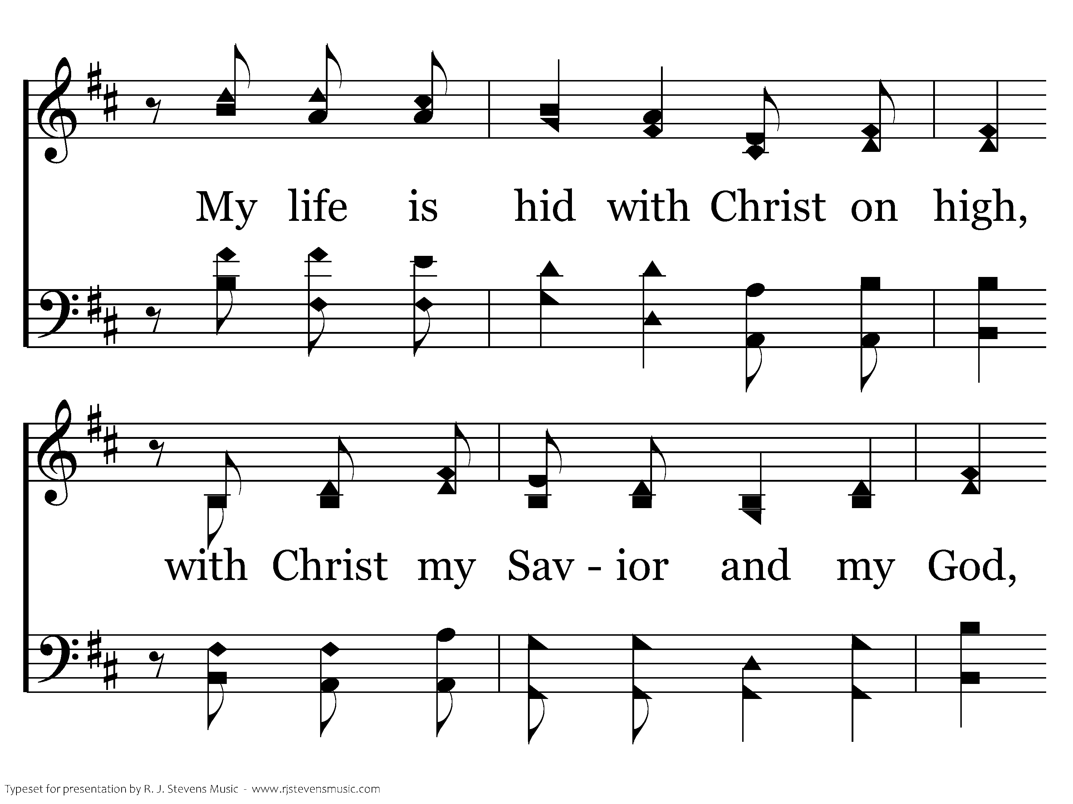
20368 - BEFORE THE THRONE OF GOD ABOVE - 3.4

Slide 63
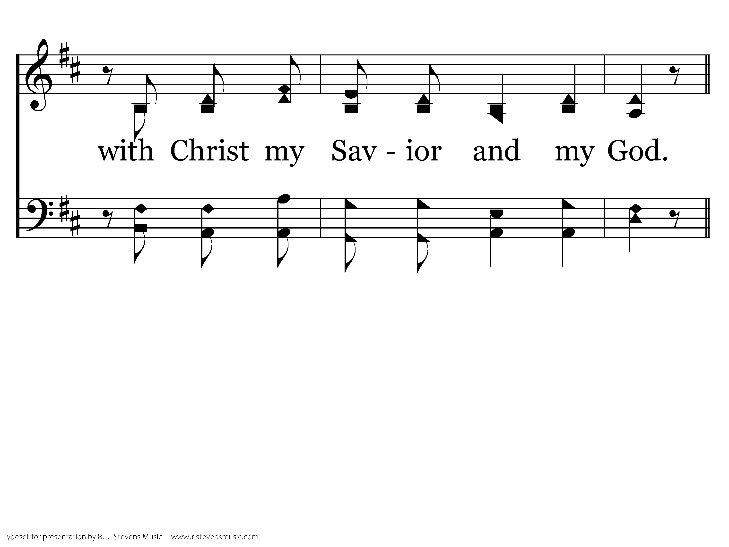
20368 - BEFORE THE THRONE OF GOD ABOVE - 3.5
End of Verse 3

Slide 64
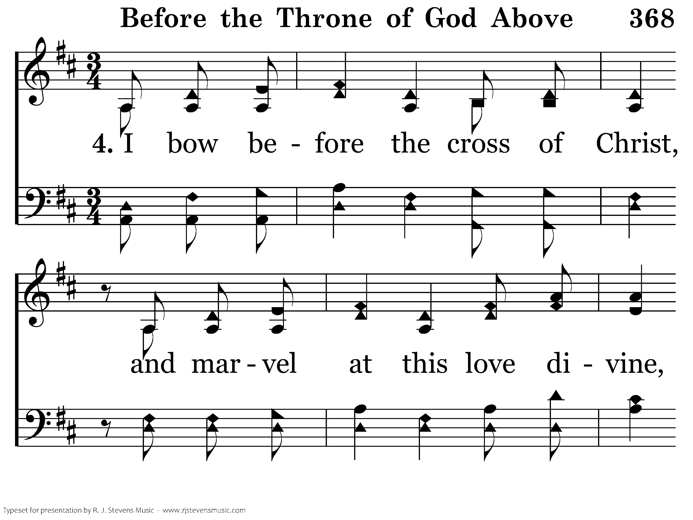
20368 - BEFORE THE THRONE OF GOD ABOVE - 4.1

Slide 65
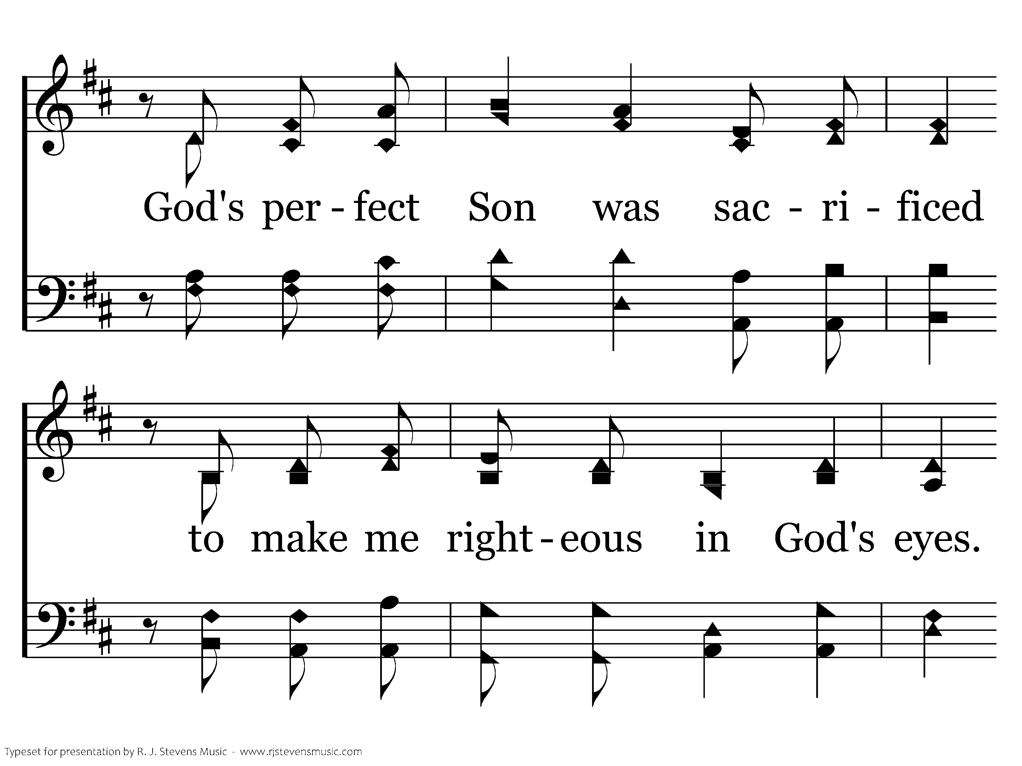
20368 - BEFORE THE THRONE OF GOD ABOVE - 4.2

Slide 66
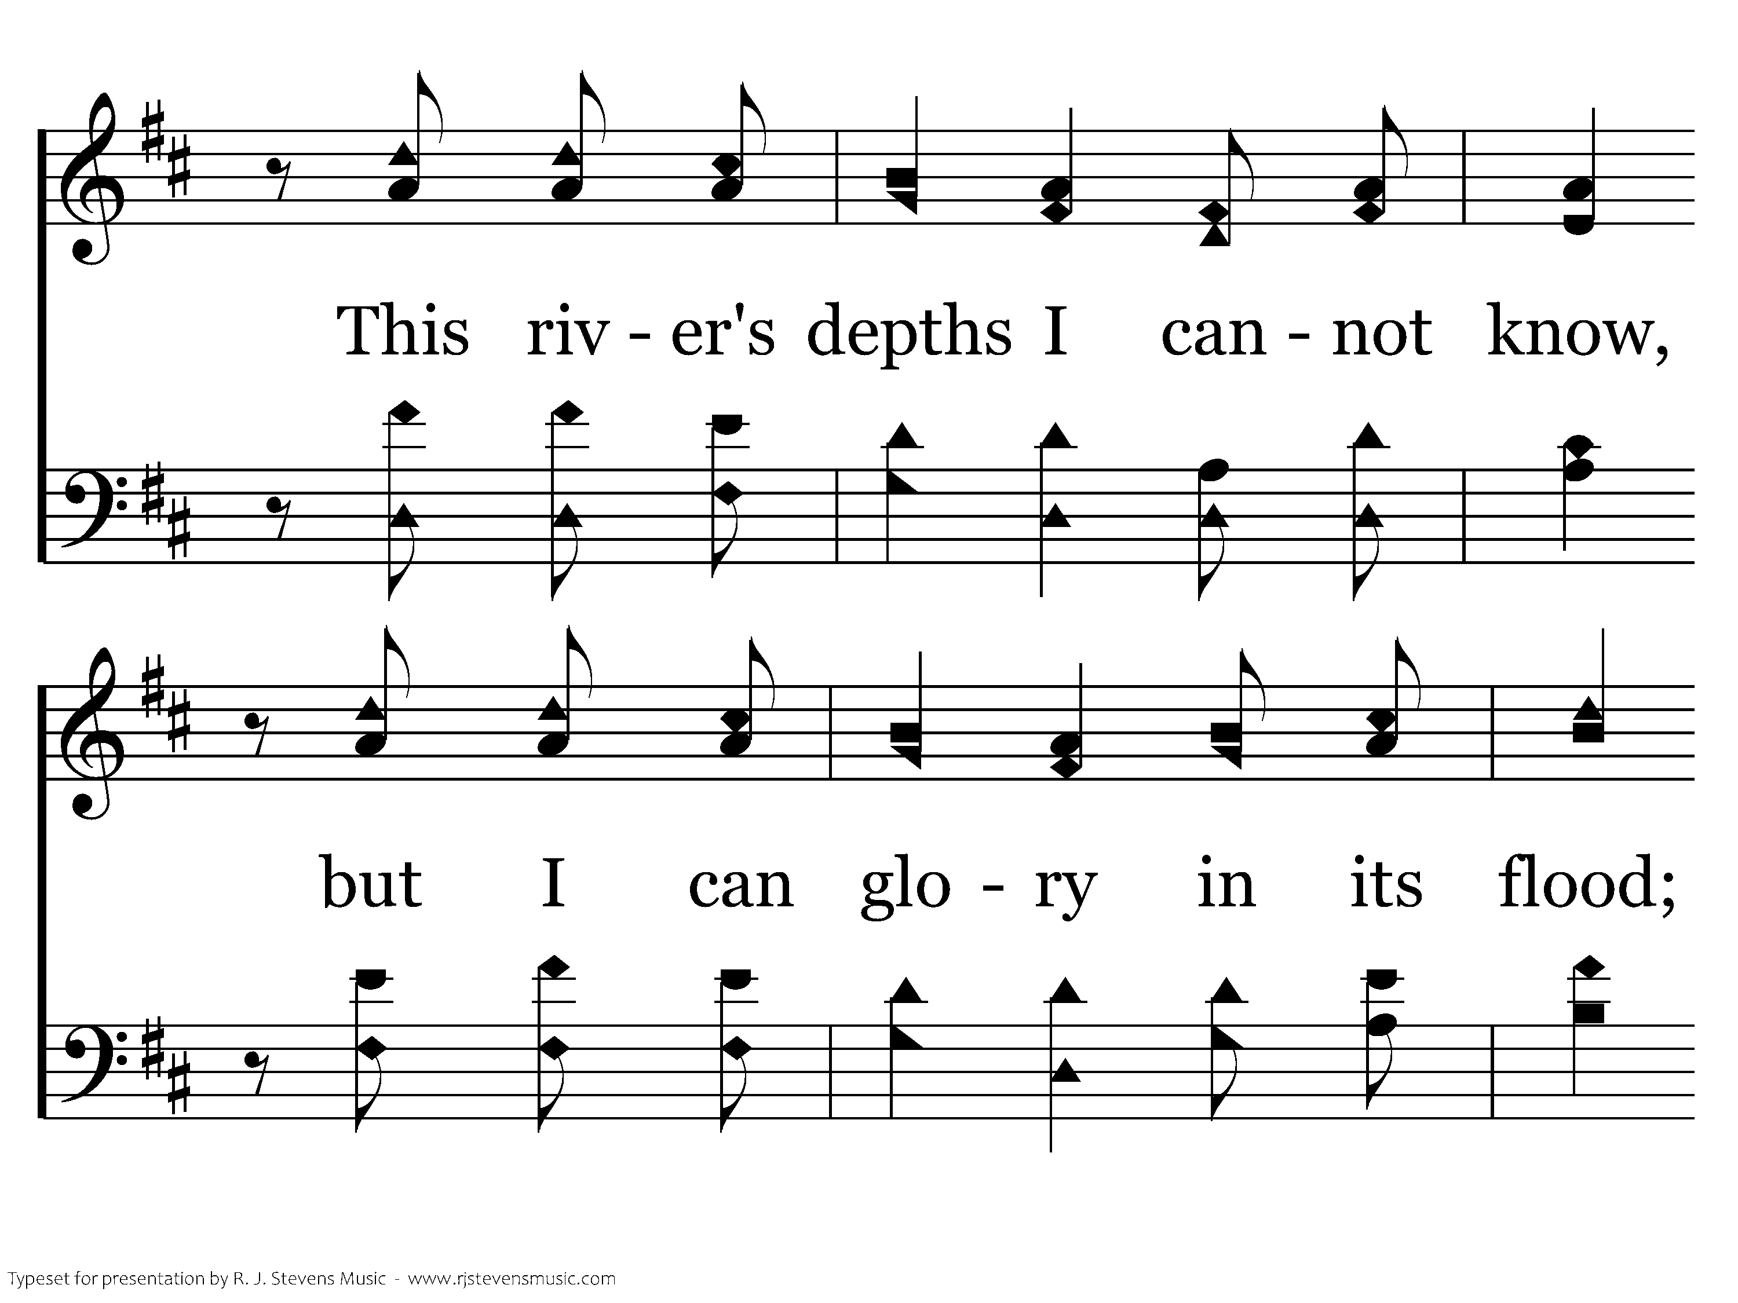
20368 - BEFORE THE THRONE OF GOD ABOVE - 4.3

Slide 67
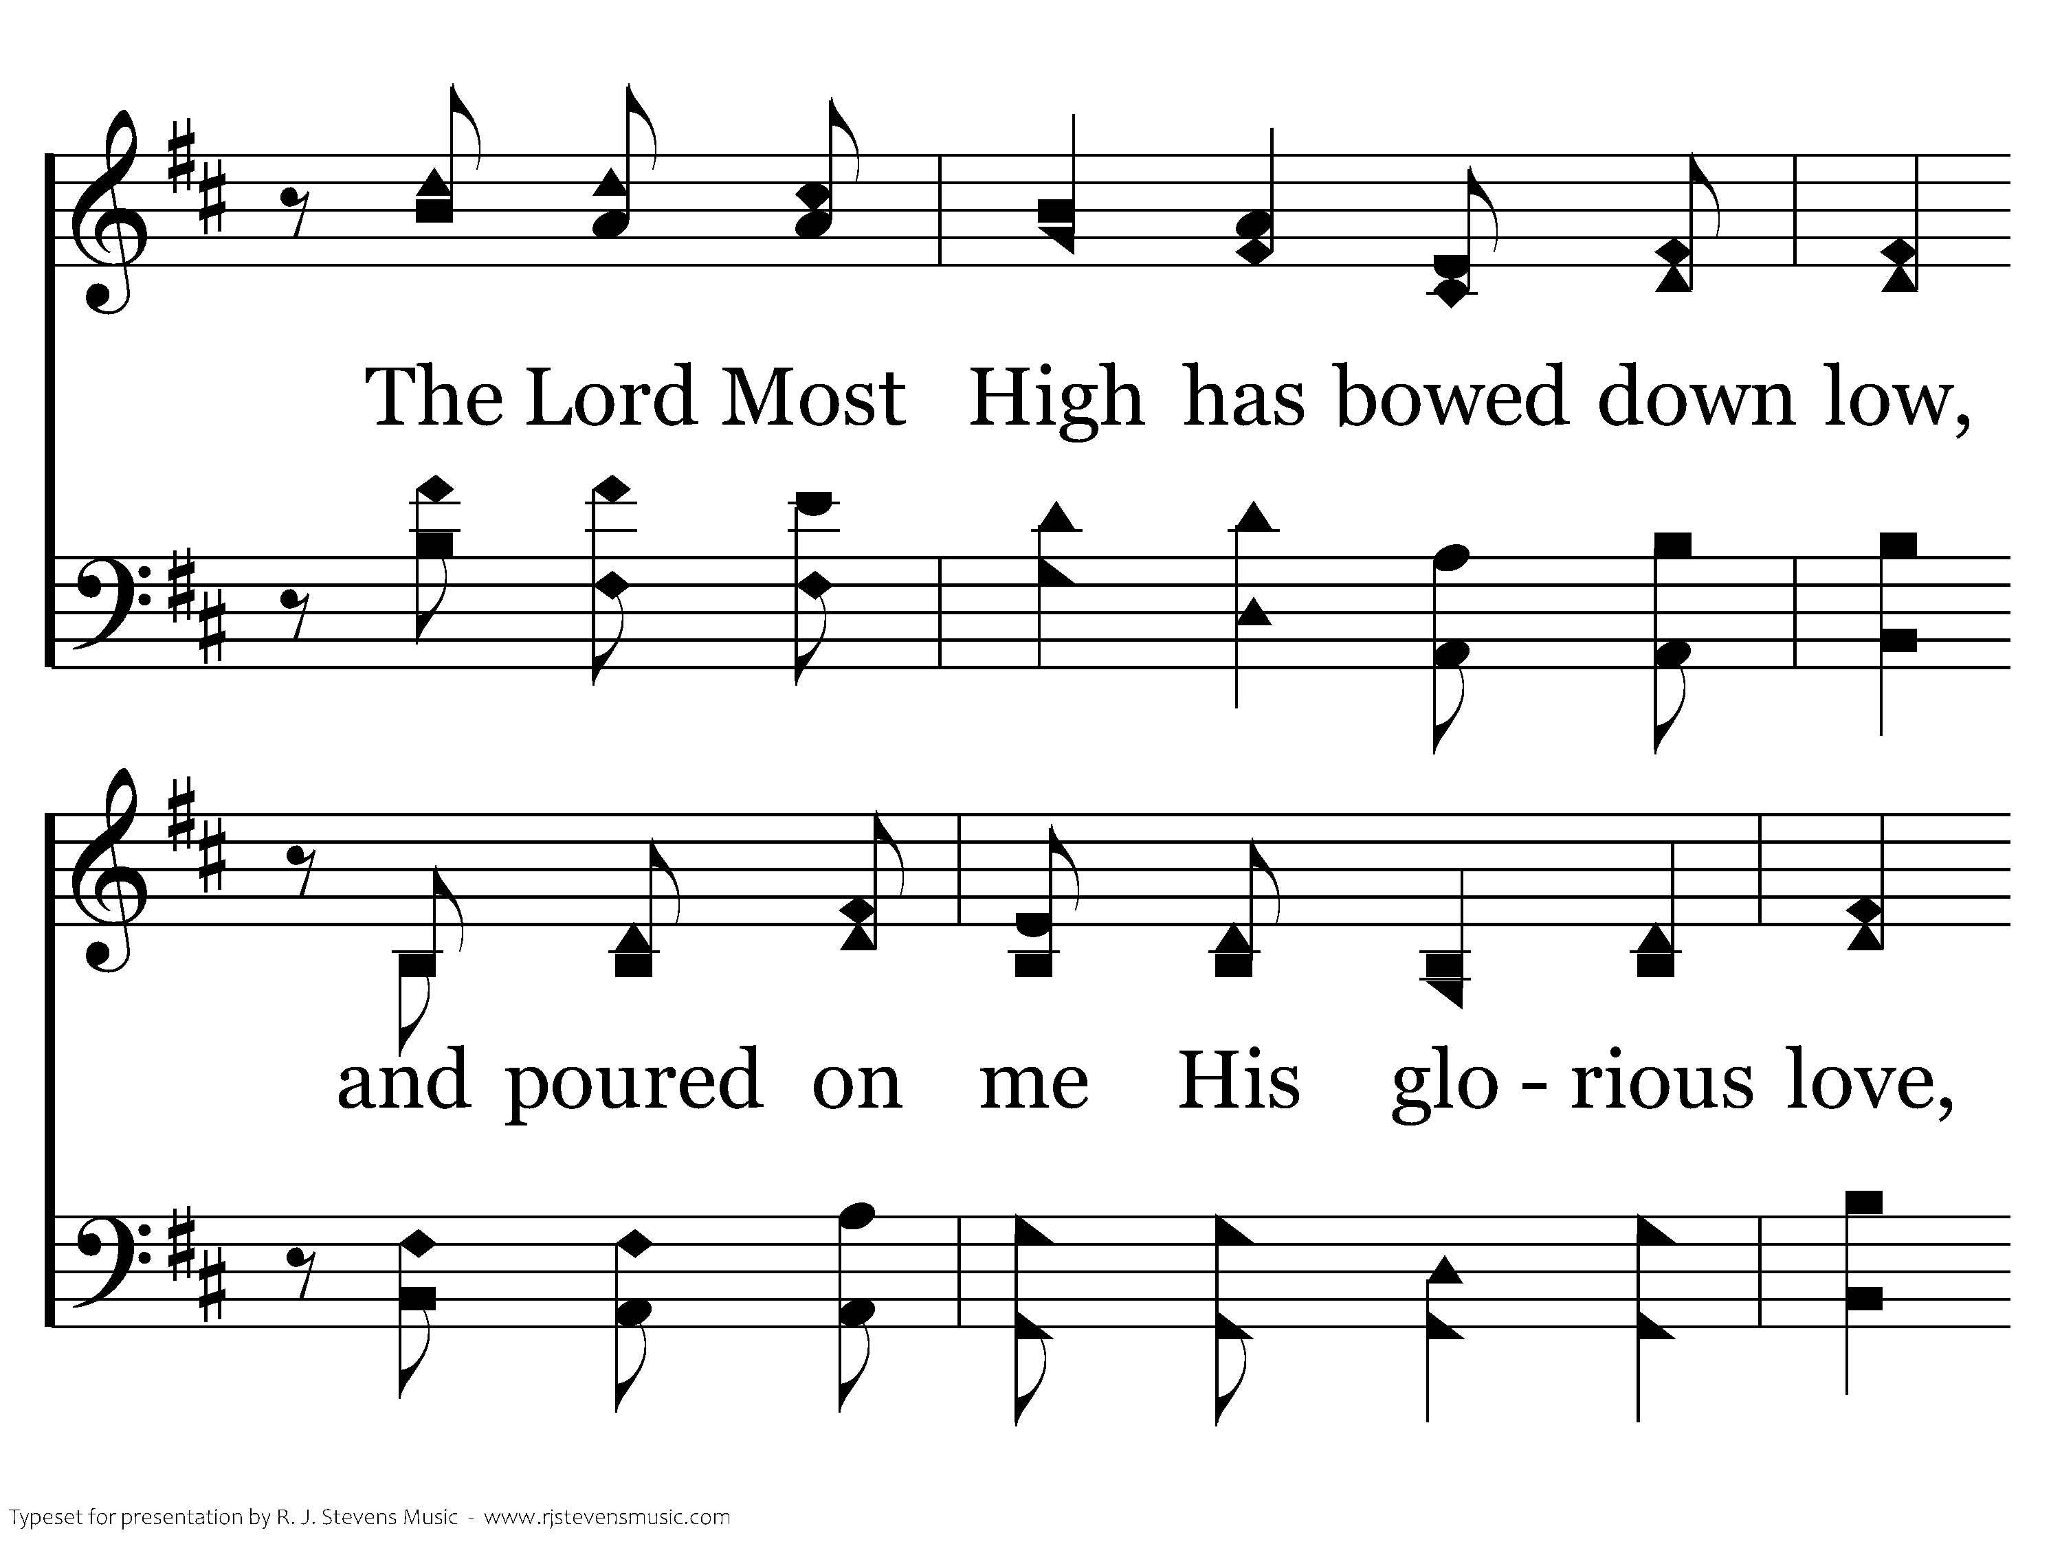
20368 - BEFORE THE THRONE OF GOD ABOVE - 4.4

Slide 68
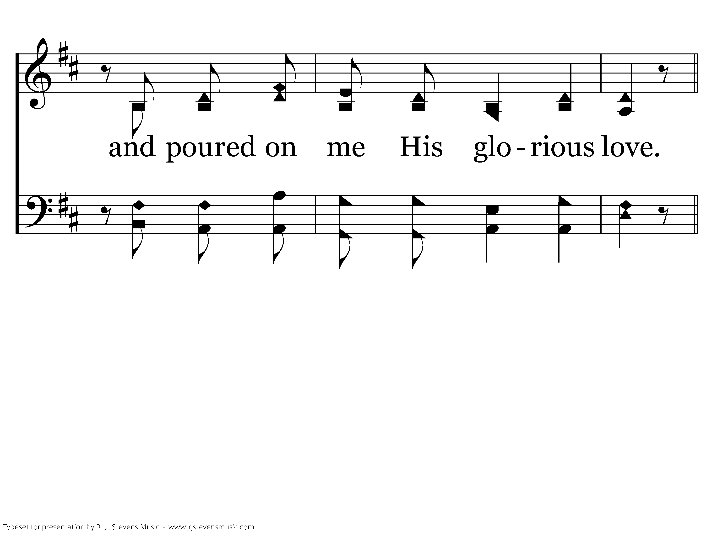
20368 - BEFORE THE THRONE OF GOD ABOVE - 4.5
End of Song

